Slide 1


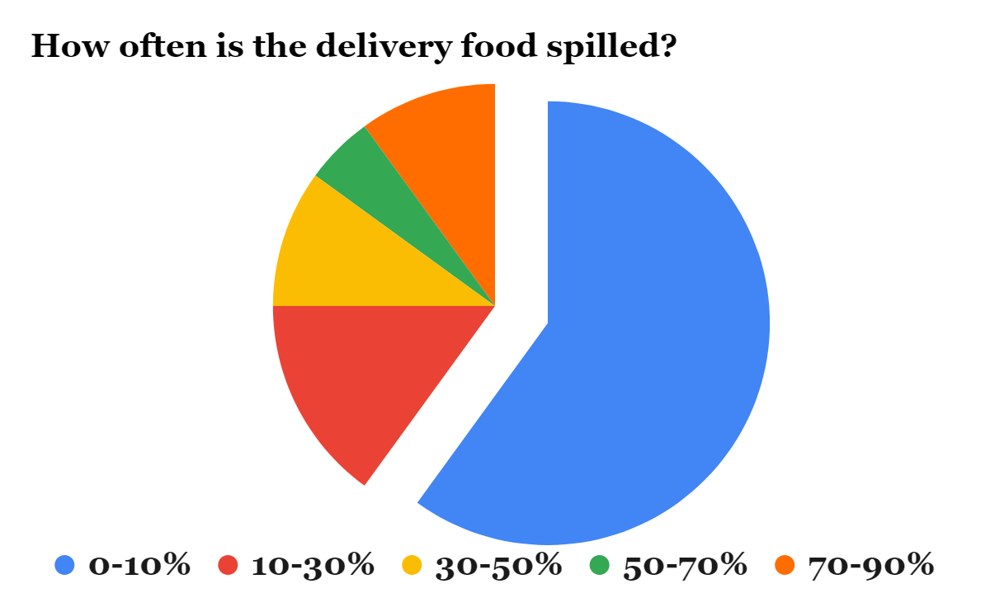
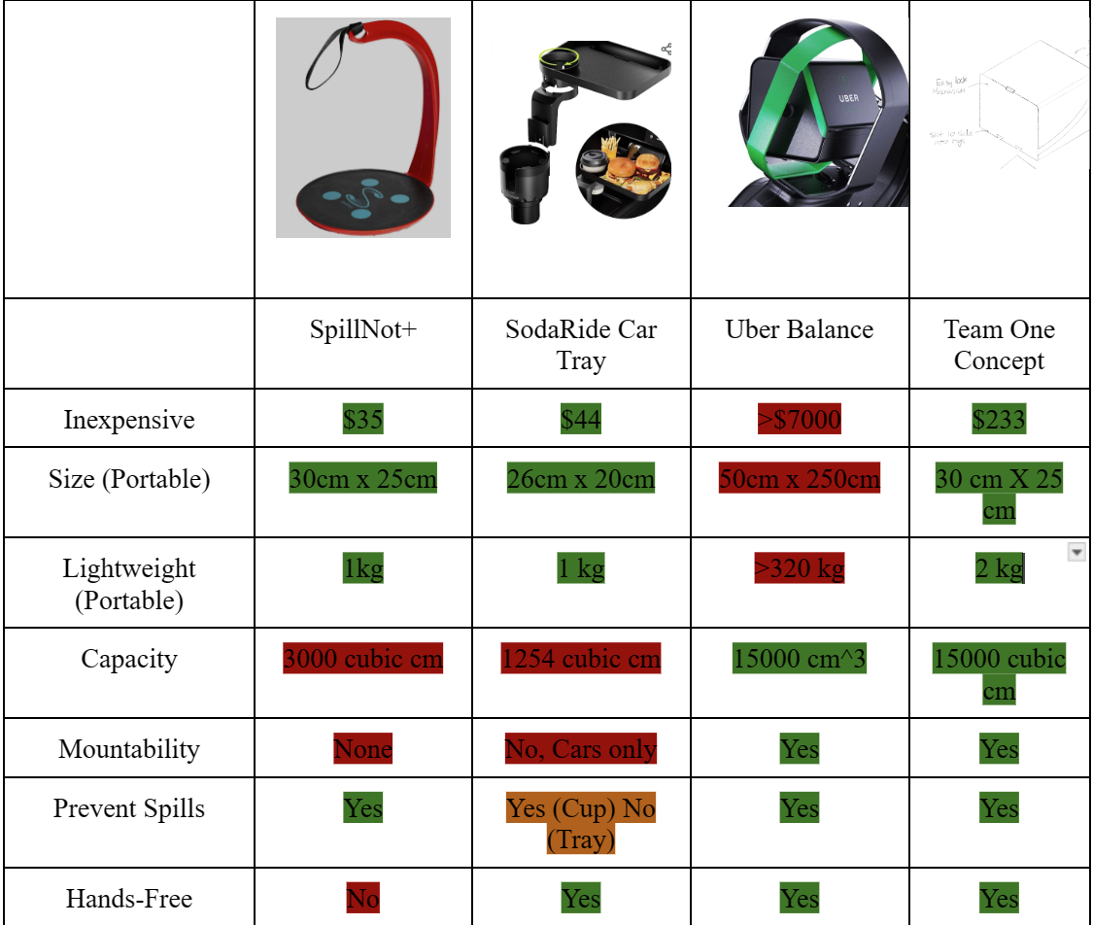
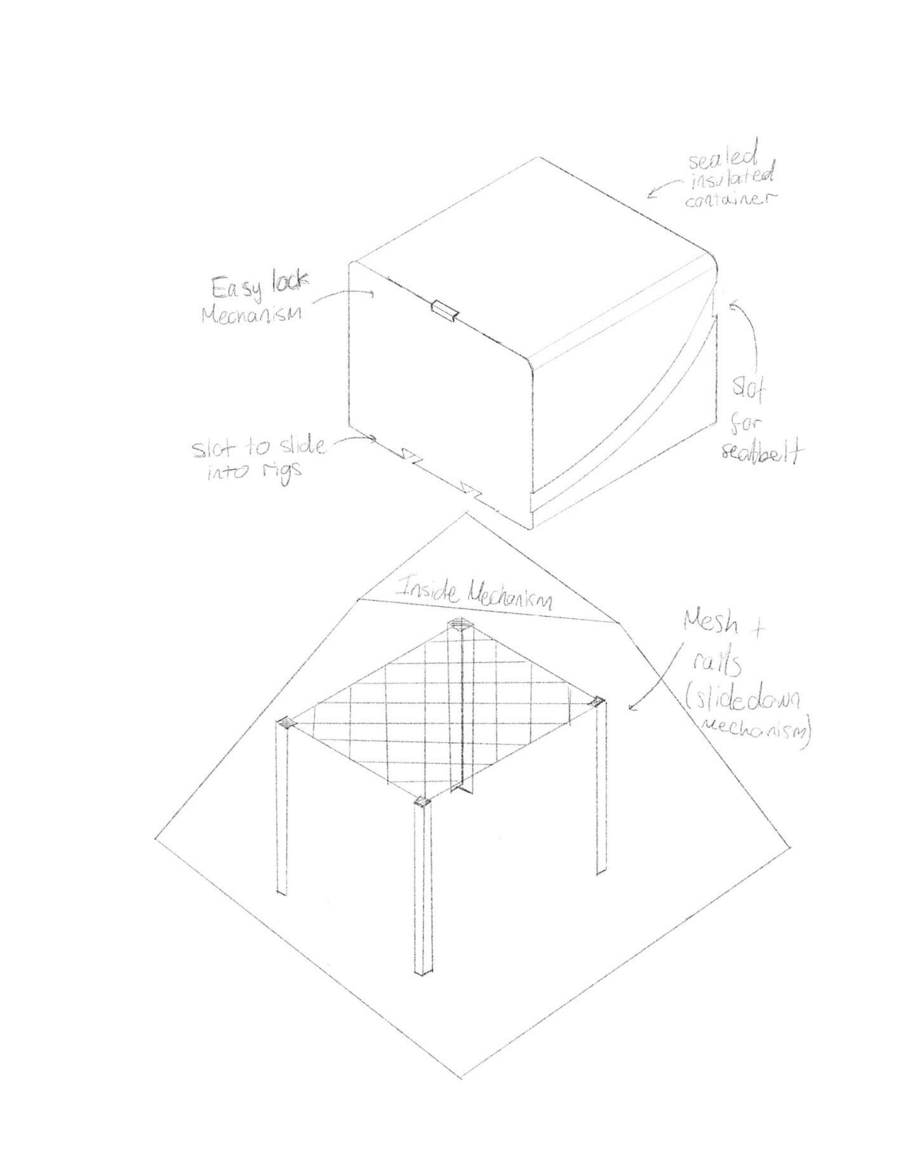
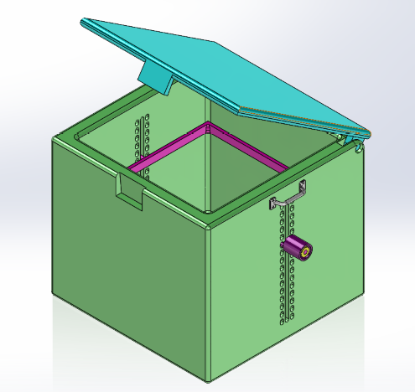
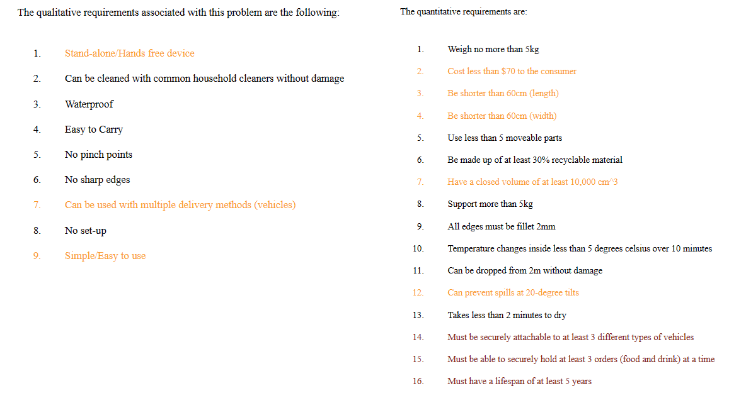
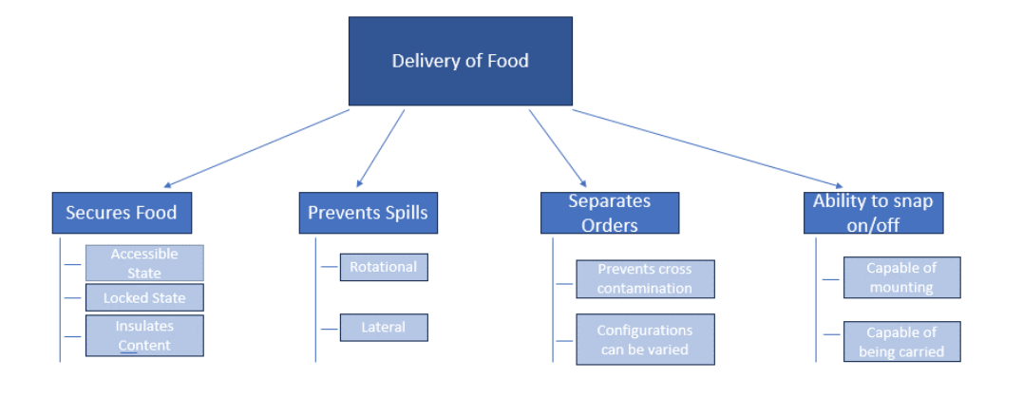
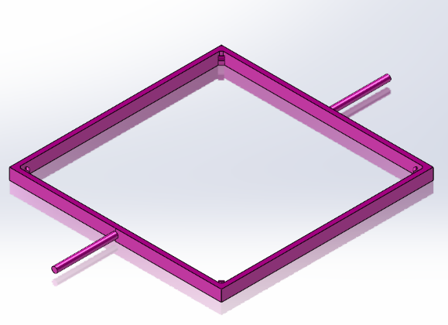
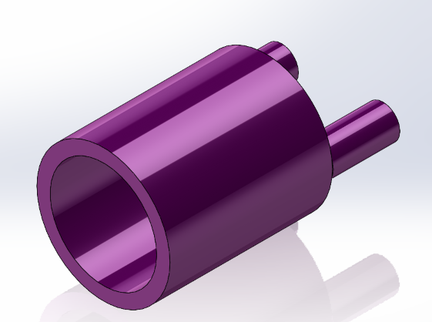
Delivery Carriage System
Team One
Problem Statement
Delivery Services suffer from frequent spills of both food and beverages leading to a negative impact to their service quality.
Contributors: Nicolas Aldaba, Christopher Baron, Enzo Aguirre, Danah Alam
Lab Coordinator: Jacey Birkenmeyer
ME 263
Primary Concept Description
Comparison to Benchmarks
The primary concept is a large volume box. This has a lid and grooves on the outside to fit in different types of vehicles. The inner section features a retractable mesh that secures food by holding the bags down through pressure.
Functional Decomposition
Engineering Requirements
The product focuses on securing food, preventing spills, separating orders, and ability to snap on/off. The device had to be able to be accessible state, a locked state and insulate content within the device. The device is to prevent spills, so it has horizontal and lateral restriction to keep food from spilling at all times. For separating orders, the focus was to prevent cross contamination and have different configurations within the device. For the ability to snap on/off, the device had to be capable of being mounted to different vehicles and with the capability to be carried.
The design features a locking mechanism to make sure that food is kept safe.
The container is also made hollow for insulation purposes.
The mesh system is supported by the bracket (left) and the knob and peg system (right).

