Slide 1
F1 Race Strategy Platform
From telemetry to race strategy, data-driven automation for F1 performance
Enzo BERREUR, Leo WEISS, Elea NIZAM

Slide 2
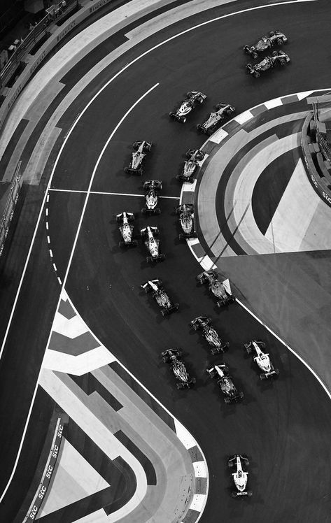

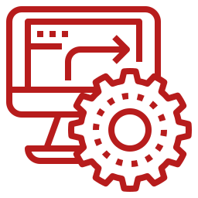
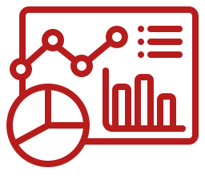
F1 Smart race strategy platform
From data overload to decision clarity — in real time
Real-Time
Insight
Automation
Observability
Live anomaly detection & pit-stop scoring
Airflow DAGs handle analytics workflows
Prometheus & Grafana monitor every system metric
Storage Layer
Notes:
In Formula 1, every millisecond counts. But behind the speed we see on track, engineers face a huge challenge — too much data, too little time. During a race, they have to decide instantly when to pit, how to manage tires, and whether a car is pushing too hard — all from thousands of telemetry points per second.
That’s where our project comes in. We built the F1 Smart Race Strategy Platform — an IoT system that turns raw telemetry into real-time insights. It detects anomalies, predicts performance drops, and even recommends the perfect pit-stop window.
Everything is automated — from data ingestion to analytics and monitoring — using Airflow, Prometheus, and Grafana, all running in a scalable Docker/Kubernetes setup.
In short, we help F1 engineers go from data overload to decision clarity — faster than ever.

Slide 3


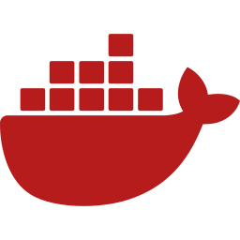

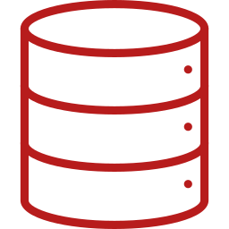


Architecture overview
Workflow Automation
Task Queue / Broker
Apache (Airflow)
Analytics Results (SQL Writes)
Redis
F1 Car Sensors
Real-time dataflow
(HTTP JSON)
Stream Processor
(Python)
Analytics Results (SQL Writes)
Storage Layer
Real–time Data generator
Real–time Data analytics
PostgreSQL database for telemetry and analytics results
Prometheus
Grafana
System and Application Monitoring
API /v1/query
Metrics Collection and Visualisation
Real-time dataflow
(HTTP JSON)
Storage Layer
Notes:
“This slide gives a complete overview of our system’s architecture.
We structured the platform around four main layers: Data Ingestion, Processing, Storage, and Monitoring/Visualization.
On the left, the F1 car sensors generates realistic telemetry — car speed, RPM, tire wear, temperatures — which is sent in real-time to the Stream Processor.
The Stream Processor applies business logic: it calculates pit-stop scores, detects anomalies, and forwards results to PostgreSQL for persistence.
Both the F1 car sensors and the Stream Processor expose Prometheus metrics so that system health and performance can be continuously monitored.
Above that, Apache Airflow orchestrates batch analytics workflows — it aggregates historical data and generates performance summaries.
Finally, Grafana provides dashboards for real-time and post-race insights, allowing the team to monitor both system-level and race-level metrics.
All services are containerized and managed with Docker, making the system fully portable and ready for deployment in Kubernetes.
->Now that we’ve seen the global architecture, let’s zoom into the core data flow — how telemetry is processed and analyzed inside the system.

Slide 4
Data flow and processing logic
F1 Car Sensors
HTTP POST (telemetry JSON)
Redis
(Buffer/Broker)
Ingestion
Telemetry streaming from car sensors (speed, temp, wear)
Decouples producers and consumers to avoid message loss.
/metric
Buffering
Redis smooths bursts and prevents data loss
Stream Processor
(Python)
/metric
Processing
Python Stream Processor detects anomalies and computes pit-stop scores
Processes incoming data, detects anomalies.
Prometheus
(Monitoring)
Write Processed Data
Monitoring
Prometheus tracks system performance
PostgreSQL (Storage)
Stores raw and processed telemetry for analytics and historical reporting
Once processed, data is persisted in PostgreSQL and orchestrated by Airflow.
Notes:
Here’s how our data flows through the system in real time.
It starts with the F1 car sensors, which continuously send telemetry — things like speed, tire wear, brake temperature, or engine health — through HTTP requests.
This data first goes into Redis, which acts as a buffer and broker. Redis smooths out bursts and decouples ingestion from computation, ensuring we never lose messages even under heavy load.
Next, the data moves to our Stream Processor, built in Python. This component performs the heavy lifting — it analyses telemetry in real time, detects anomalies, and computes pit-stop recommendations using rolling windows.
During this process, the Stream Processor also exposes Prometheus metrics — so every service performance indicator, like message throughput or latency, is continuously collected.
This gives the operations team live visibility through Grafana dashboards.
Finally, the processed telemetry is stored in PostgreSQL, where it’s ready for batch analytics and reporting.
And at that point — Airflow takes over, orchestrating post-race data aggregation and performance summaries.

Slide 5
Workflow Automation (Apache Airflow)
PostgreSQL (Storage)
Automating batch analytics and post-race reporting through DAG orchestration.
Airflow DAG
Ingestion
Each Grand Prix triggers an Airflow DAG — a pipeline that runs automatically after the race
Transformation
Automation
Airflow orchestrates analytics workflows
Aggregation
Reporting
Batch Processing
Executes periodic jobs after each race
Notification
Reporting
Outputs summarized results and strategy insights
Redis -> Broker
This ensures reproducible, dependency-aware, and scalable analytics runs
Airflow Web UI
Notes:
Once the telemetry data is securely stored, Apache Airflow takes over to orchestrate all the post-race analytics.
After each simulated race, a DAG — or Directed Acyclic Graph — is automatically triggered. It begins by ingesting raw telemetry from PostgreSQL, then performs data cleaning and transformation to make the metrics consistent across cars and teams.
Next, Airflow runs the aggregation and reporting stages — computing key performance metrics, detecting trends, and generating pit-stop strategy recommendations.
Finally, all results are written back into PostgreSQL and become instantly available in Grafana dashboards for visualization.
Behind the scenes, Airflow manages everything: task scheduling, retries, and monitoring — turning what used to be a manual post-race analysis into a fully automated, reliable, and repeatable process.

Slide 6



Data Models
Dual Data Flows
The platform relies on two complementary data flows:
Telemetry & Analytics Flow → business data processed through PostgreSQL for race insights.
Observability Flow → Prometheus metrics for system health and performance monitoring.
Logical to Physical: From real-time streams to stored analytics powering race decisions.
Telemetry Data
Logical Model
Real-time telemetry (TelemetryData) captured from sensors.
Anomalies (AnomalyEvent) detected by the Stream Processor.
Strategic insights (PerformanceStrategyInsight) summarizing pit-stop recommendations
Physical Model
Stored in PostgreSQL (telemetry_data, telemetry_statistics, pitstop_recommendations)
Stream Processor feeds live data; Airflow aggregates post-race analytics
Data serves dashboards and performance comparisons in Grafana
1 -> N
Anomaly Event
1 -> 1
Performance Strategy Insight
Storage Layer
Notes:
This is the data foundation of the Ferrari F1 platform. Our platform relies on two complementary data flows working in parallel:
Telemetry & Analytics Flow – captures race telemetry, processes it through PostgreSQL, and powers strategic insights.
Observability Flow – collects system and service metrics via Prometheus for real-time monitoring and reliability.
At the logical level, everything starts with Telemetry Data — the raw stream of car parameters like speed, temperature, and tire wear. Each telemetry record can generate one or several Anomaly Events, whenever a threshold is exceeded — for example, overheating brakes or abnormal fuel consumption.
From these, the system produces a single Performance Strategy Insight, which combines all active anomalies and metrics to compute the pit-stop score or performance recommendation.
Physically, all this data is stored in PostgreSQL tables — including telemetry_data, telemetry_statistics, and pitstop_recommendations.
Both the Stream Processor and Airflow write to these tables: the Stream Processor feeds real-time telemetry, while Airflow aggregates results post-race for analytics and dashboards.”

Slide 7
Observability Metrics Model
Service | Purpose
F1 Car Simulator | Monitor generation rate and engine temperature trends
Stream Processor | Track throughput, latency, and performance quality
Airflow | Monitor workflow stability
Prometheus | Ensure scrape health and DB performance
F1 car sensors
Generates metrics (engine_temp, rpm)
Stream Processor
Exposes /metrics
Counts msgs, latency histograms
F1 Car Simulator
Stream Processor
Prometheus
Airflow
Prometheus
Ensure scrape health and DB performance
Scrapes metrics
Stores in TSDB
Evaluates alerts
Monitor generation rate and engine temperature trends
Track throughput, latency, and performance quality
Monitor workflow stability
Grafana
Visualises real-time metrics
Dashboards for system health
Storage Layer
Notes:
Now that the analytics pipelines are running, we need a way to make sure everything stays healthy during a race. That’s where our observability layer comes in.
Each container — the simulator, stream processor, and Airflow — exposes performance metrics through a simple /metrics endpoint. Prometheus continuously scrapes those metrics — things like throughput, latency, or temperature trends — and stores them in its time-series database.
Grafana then visualizes all of this in real time, letting engineers monitor system health, spot bottlenecks, and even trigger alerts if thresholds are crossed.
In short: Prometheus collects, Grafana tells the story — ensuring our system performs as fast and reliably as the race cars themselves.”

Slide 8
Demo
Storage Layer

Slide 9
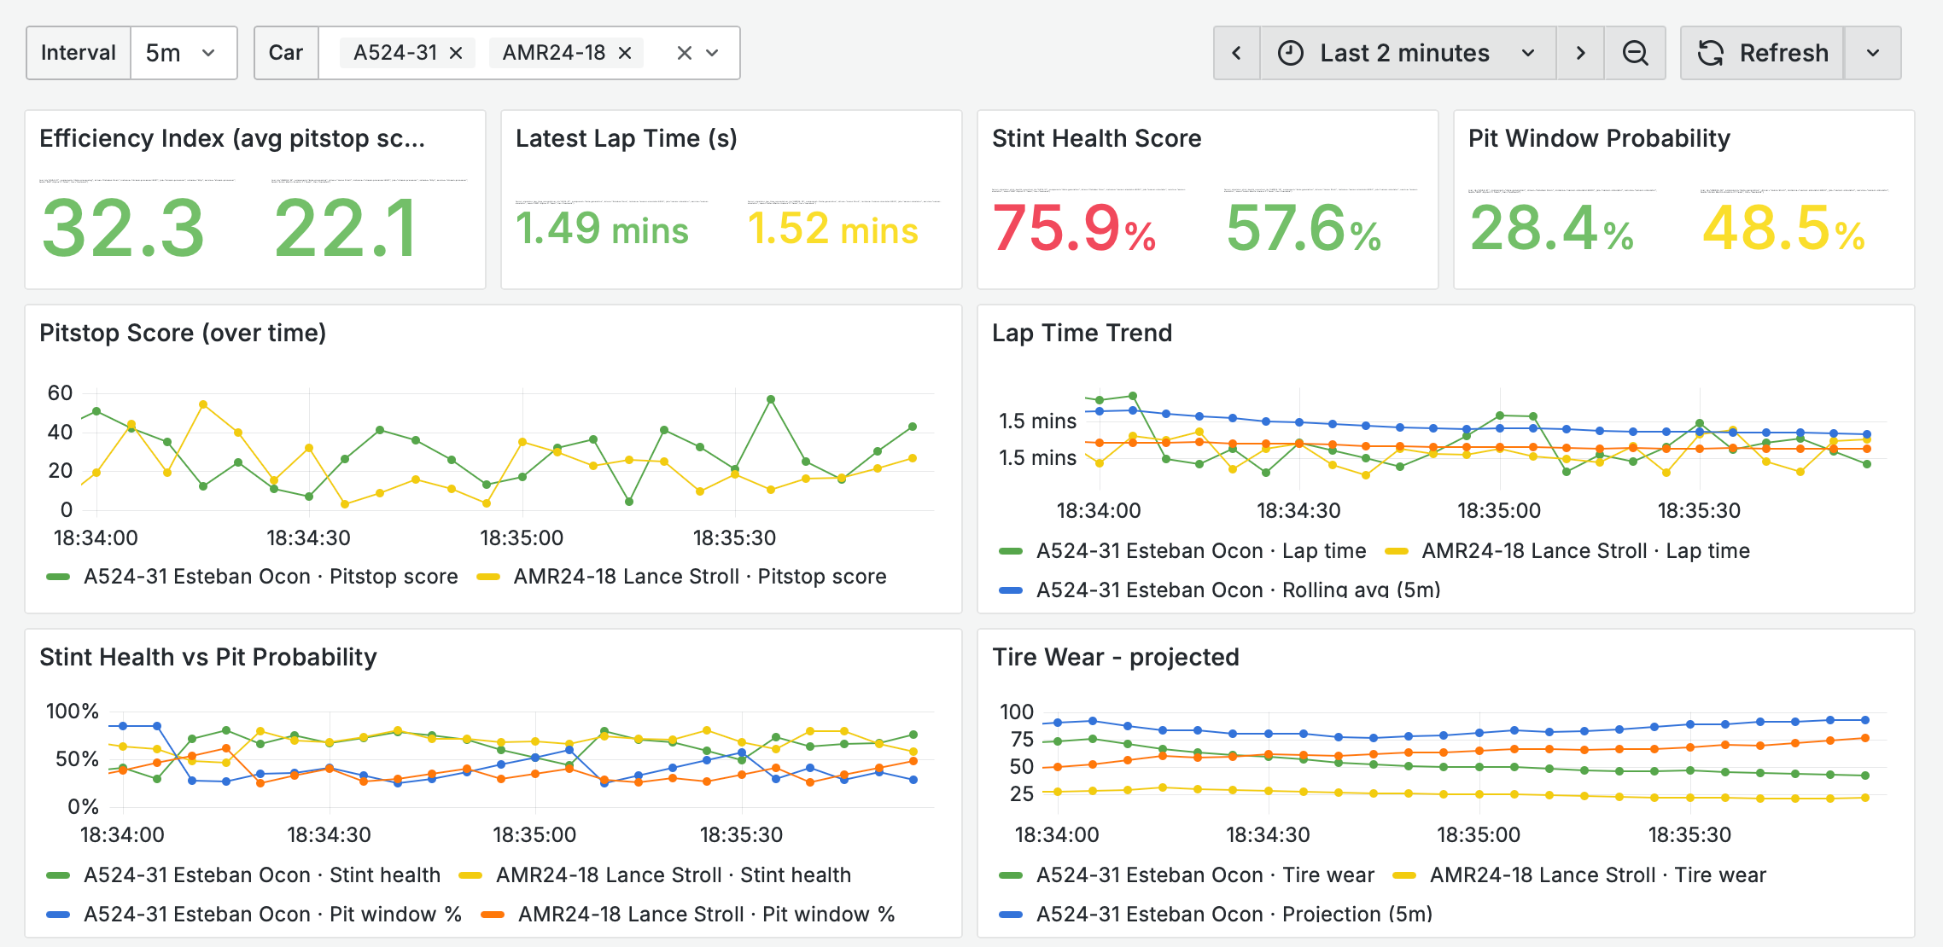
Grafana Dashboard
Storage Layer
Notes:
This is the Grafana dashboard, where all our telemetry and analytics come to life in real time.
Each panel represents a key performance indicator collected throughout the race.
At the top, we can see efficiency indexes, lap times, and pit window probabilities — metrics that directly help the strategy team make tactical calls during the race.
The graphs below track pit-stop scores, stint health, and tire wear trends, allowing engineers to instantly identify when a car’s performance starts to degrade or when a pit-stop becomes necessary.
All of these metrics are continuously updated by Prometheus and visualized in Grafana, giving teams a live, data-driven overview of the race’s evolution.
This is where our entire pipeline — from sensors to analytics — converges into actionable insight.

Slide 10
Deployment and Orchestration
From local prototyping to scalable cloud deployment.
Development
Production
Kubernetes Clusters
Scale and Automate
Docker-compose
-> single-node setup
all services: network, volumes, env
Deployments → Pods (replicas)
Services → ClusterIP / Ingress
HPA → autoscale Stream Processor
Deployments → Pods (replicas)
Storage Layer
Notes:
To make our platform easy to develop and scale, we designed a two-stage deployment strategy.
In development, everything runs locally with Docker Compose. It’s a single-node setup that mirrors the full production stack — simulator, stream processor, Airflow, Prometheus, and PostgreSQL
In production, the stack transitions to Kubernetes for orchestration. Each layer — data processing, orchestration, and monitoring — runs in its own namespace. Deployments scale automatically with HPA, while .yaml filesmanage configuration and credentials securely.
This setup gives us reliability, scalability, and isolation — so our real-time analytics pipeline can handle a race’s data bursts just as well in the cloud as on a laptop.

Slide 11
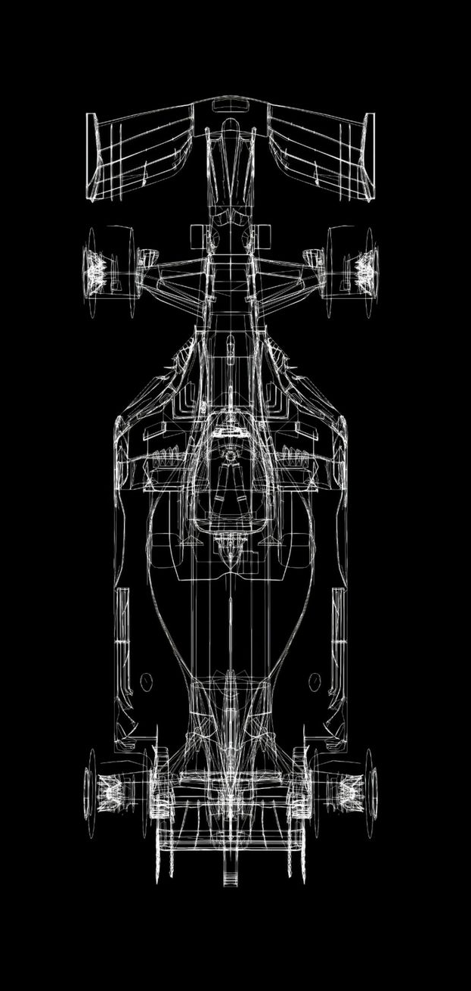

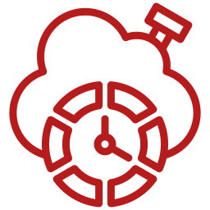
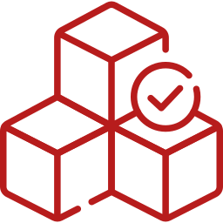

Performance and Scalability
Throughput
Average Latency
Availability
CPU Usage Under Load
~300 000 events / s (single CPU)
< 1 ms end-to-end
99.9 % (4 / 4 services UP)
~58 % under peak load
Scalability Features:
Horizontal Scaling (HPA): Stream Processor auto-adds pods when CPU ≥ 60 %, scales down < 40 %
Vertical Scaling: Turnable CPU/RAM per service in Kubernetes deployments
Caching & Storage: Redis buffers ingestion; PostgreSQL stores processed data reliably
Load Balancing: Kubernetes services distribute traffic evenly
Storage Layer
Notes:
Now that we’ve seen how the system operates, let’s look at how it performs under real race conditions.
On the performance side, the pipeline handles around 300,000 telemetry events per second — and still maintains under one millisecond of end-to-end latency from the sensors all the way to storage.
We’ve kept availability at 99.9% uptime, with CPU usage stabilizing around 58%, meaning we still have plenty of headroom during peak loads.
In terms of scalability, the platform adapts automatically. The Horizontal Pod Autoscaler in Kubernetes adds new Stream Processor pods when CPU usage goes above 60%, and scales down once the load drops.
On top of that, we can vertically scale each service’s CPU and memory, and rely on Redis to smooth data ingestion bursts, while PostgreSQL ensures reliable long-term storage.
Overall, the architecture remains stable, efficient, and cost-effective — even when pushed to racing extremes.”

Slide 12
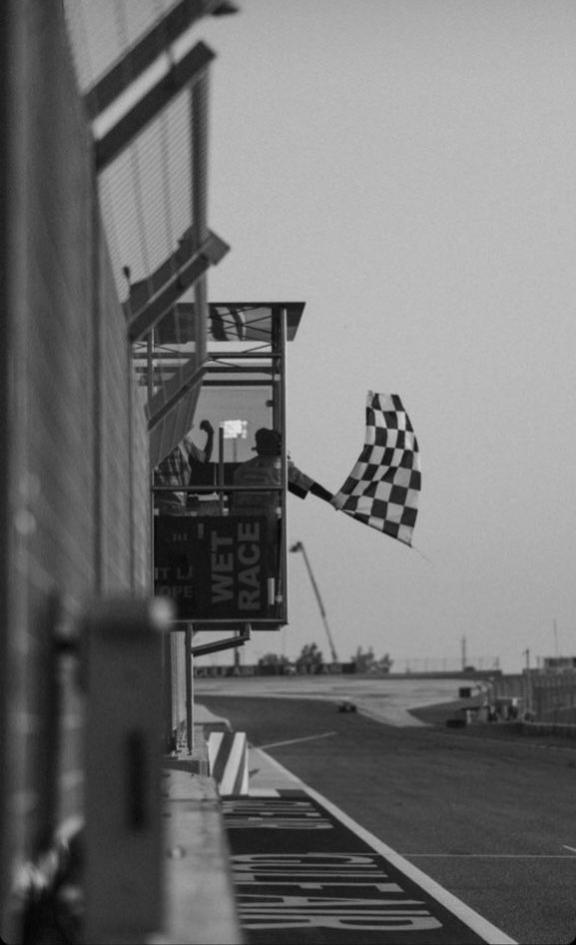
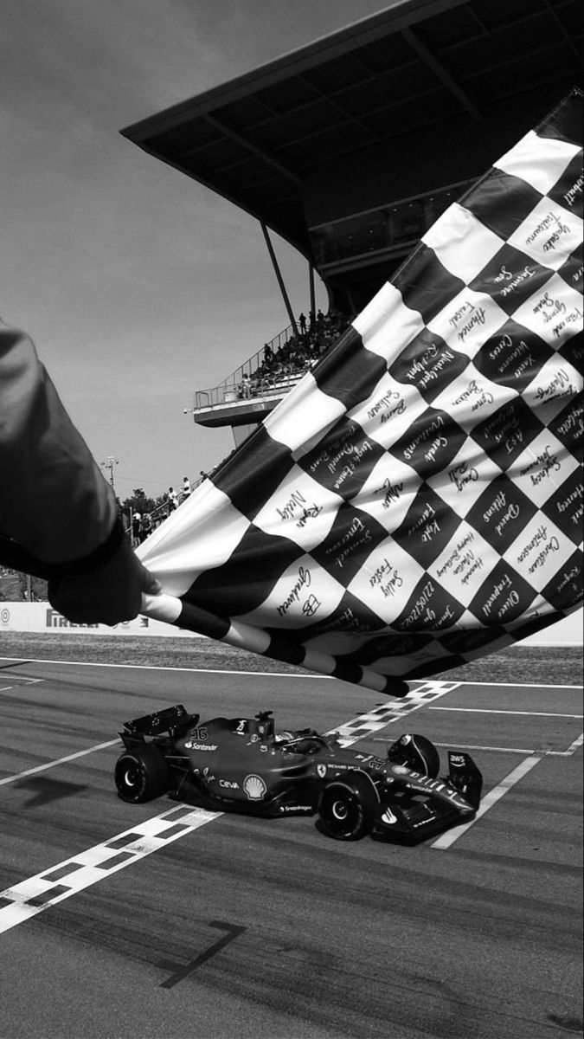


Conclusion and Next Step
From raw telemetry to race intelligence — in real time.
Fully containerized and automated F1 analytics platform
Real-time anomaly detection and performance scoring
End-to-end observability with Prometheus & Grafana
Scalable architecture for continuous telemetry and batch analytics
Integrate predictive models (tire degradation, race strategy optimization)
Extend to multi-race analytics for trend insights
Deploy on cloud infrastructure for scalability & collaboration
Storage Layer
Notes:
Before we wrap up, let’s take a quick look back at what we’ve achieved. Over the course of this project, we built a fully containerized and automated F1 analytics platform — capable of processing live telemetry, detecting anomalies in real time, and generating actionable performance insights.
We also ensured full observability with Prometheus and Grafana, so every component can be monitored and optimized during a race. The architecture we designed is scalable, reproducible, and ready for both real-time and post-race analytics.
As for next steps — we plan to integrate predictive models that forecast tire degradation and optimize pit-stop strategy decisions. We’ll also scale the platform to support multiple races and eventually deploy it to the cloud for true production-level performance.
In short, we’ve gone from raw telemetry to race intelligence — in real time. Thank you — and we’re happy to take your questions.

