Slide 1

Monogram Paris Data
Real-time retail data, landed,
transformed and verified
in Snowflake.
A streaming and batch pipeline for Monogram Paris: Kafka, Snowpipe Streaming, dbt and Airflow
June 2026
RNCP Bloc 3 thesis deliverable. Prepared by Enzo Berreur.

Slide 2
Executive summary
Architecture and streaming
Engineering quality
Quality and operations
- Three ingestion paths converge in one Snowflake star schema: direct INSERT for speed, Parquet COPY for cost, Kafka for real time
- Exactly-once streaming delivery is engineered, then proven: Kafka offsets double as Snowpipe offset tokens
- A dedicated SQL assertion counts duplicate partition and offset pairs after every run: zero found
- The pipeline is an installable, typed Python package with 7 CLI entry points, not a folder of scripts
- mypy passes on all 20 modules; ruff is a blocking CI gate; coverage is enforced on every push
- 25 unit and data-quality tests run in CI; integration tests cover the Snowflake paths
- Three layers of controls: 30+ dbt schema tests, singular business-rule tests, 6 operational SQL assertions
- Three Airflow DAGs on three clocks: 4-hour pipeline, daily reference refresh, 5-minute stream monitor
- Explicit SLOs for freshness, latency and run success; any failed check fails the run loudly
Monogram Paris Data
2

Slide 3
Architecture and real-time ingestion
Agenda
From raw events to trusted marts
Automation and operations
Monogram Paris Data
3

Slide 4
At Monogram Paris, stale data costs margin twice: stockouts in store, markdowns online.
2 speeds
9 sources
4 hours
Minutes
transactional events flow continuously; reference data changes daily
sales, returns, reviews, inventory, plus five master data tables
maximum age of warehouse data for merchandising decisions
freshness needed on flash-sale revenue, served by the streaming path
- Merchandising: buy and replenishment decisions read the star schema; stale stock positions mean empty shelves or end-of-season markdowns
- E-commerce: during a flash sale the team steers prices and stock by the minute; daily batches are useless that day
- Trust: returns and review data feed finance and fraud checks; a wrong number is worse than a late one, so every load is verified before it lands in the marts
Source: Business framing: docs/ARCHITECTURE.md; scope: README.md
4
Monogram Paris Data
Architecture and real-time ingestion

Slide 5
Three ingestion paths, one governed warehouse: every row crosses the same quality gate.
Direct INSERT
transactional
Data generator
Faker, 9 tables
INGEST raw
STAGING views
dbt, 8 models
MARTS star schema
dims, facts, SCD2
Parquet + COPY
reference
Event producer
sales events
Streamlit dashboard
Redpanda Kafka
3 partitions
Snowpipe Streaming
exactly-once
Analyst SQL
Orchestration and verification
Airflow, 3 DAGs
4h, daily, 5 min
dbt build + test
30+ tests
SQL assertions
6 checks
Source: docs/ARCHITECTURE.md; rendered diagram in docs/architecture.png
5
Monogram Paris Data
Architecture and real-time ingestion

Slide 6
One ingestion speed would be the wrong answer; latency is bought only where it earns margin.
Real time everywhere would triple compute cost. Batch everywhere would blind the flash sale.
Path
Carries
Business case
Latency
Direct INSERT
Sales, returns, reviews, inventory
Operational reporting inside the 4-hour SLA
Seconds per batch
Parquet + COPY
Products, customers, stores, suppliers
Master data at the lowest cost per row
Minutes, daily cadence
Kafka + Snowpipe Streaming
Live sales events
Flash-sale steering and live dashboards
Sub-minute
- All three paths land in the same INGEST schema; downstream dbt models never care how a row arrived
Source: python/monogram_etl/ingesters, python/monogram_etl/streaming
6
Monogram Paris Data
Architecture and real-time ingestion

Slide 7
Duplicates are not filtered out afterwards; they are made structurally impossible.
01
Produce
04
Prove
0
Events published to a 3-partition Redpanda topic
assert_stream_exactly_once.sql counts duplicate partition and offset pairs, every 5 minutes
duplicate events across all verified demo runs
02
Consume
One Snowpipe Streaming channel per partition; the Kafka offset is the offset token
<1 min
from Kafka publish to a queryable Snowflake row
03
Resume
Why the jury should care
After any crash the consumer seeks to the last committed token plus one: no replays, no gaps
• Most pipelines claim at-least-once and deduplicate later. This one moves the guarantee into the protocol, then verifies it in production on a schedule.
Source: docs/STREAMING.md; sql/validation/assert_stream_exactly_once.sql
7
Monogram Paris Data
Architecture and real-time ingestion

Slide 8
CHAPTER 2
From raw events to trusted marts
The star schema, the three quality layers and the code that builds them

Slide 9
Batch and streaming meet in a Kimball star schema: four conformed dimensions serve every fact.
Same dimensions, two more facts
dim_customer (SCD2 history)
• fact_returns joins the same four dimensions for refund analytics
• fct_sales_realtime joins the stream to the dims, so live numbers and history reconcile
• 8 staging views isolate cleaning from business logic
• SCD2 snapshot answers what did this customer look like at purchase time
fact_sales
grain: one sale line
dim_date
dim_product
dim_store
Source: dbt/models, docs/DATA_MODEL.md
9
Monogram Paris Data
From raw events to trusted marts

Slide 10
Bad data has to break three different walls before it can reach a merchandising decision.
30+
3
6
Schema tests (dbt)
Business-rule tests
Operational assertions
- not_null, unique and relationship tests on every key
- accepted_values on enums, numeric bounds on ratings
- Source freshness SLAs: warn at 6 hours, error at 24
- Sales amounts must reconcile across aggregates
- No future-dated sales can enter the marts
- No duplicate stream offsets, ever
- Freshness, referential integrity, row-count bounds
- Stream health: exactly-once, freshness, throughput
- Run by Airflow; any failure fails the DAG loudly
Source: dbt tests; sql/validation; docs/ERROR_HANDLING.md
10
Monogram Paris Data
From raw events to trusted marts

Slide 11
The 25 percent of the grade most candidates leave implicit: this pipeline is engineered like a product.
An installable, typed, tested Python package with one auth path and 7 CLI entry points.
20
25
0
1
modules pass mypy with zero issues
unit and data-quality tests green in CI
ruff violations; lint is a blocking gate
Snowflake connection class, context-managed
- Quality gates in CI: ruff blocking, pytest with an enforced coverage floor, Codecov reporting on every push
- Structure: config, generators, ingesters, streaming, diagnostics and utils packages; retry with jittered backoff; structured logging
- Operability: pip install -e . gives monogram-generate, monogram-ingest, monogram-stream and monogram-check commands; pre-commit mirrors CI
Source: pyproject.toml, python/monogram_etl, .github/workflows/ci.yml
11
Monogram Paris Data
From raw events to trusted marts

Slide 12
CHAPTER 3
Automation and operations
Three DAGs, explicit SLOs and a demo the jury can replay

Slide 13
Three DAGs on three clocks: the pipeline never depends on a human remembering to run it.
DAG
Schedule
What it does
On failure
monogram_etl_pipeline
Every 4 hours
DDL init, parallel dual-path ingest, dbt build and test, snapshot, all quality assertions
3 retries, exponential backoff, Slack callback
monogram_reference_refresh
Daily 03:00 UTC
Refreshes the five master data tables
Same retry contract
monogram_stream_monitor
Every 5 minutes
Stream freshness, exactly-once and throughput checks
Fails loudly within minutes of an incident
- Business effect: a freshness incident surfaces in at most 5 minutes, not at the next morning standup
Source: dags/, dags/callbacks.py
13
Monogram Paris Data
Automation and operations

Slide 14
Operations run against five written SLOs, each measured by a named check, not by eyeballing.
SLO
Target
Measured by
End-to-end pipeline latency
Under 30 minutes per run
Airflow SLA and success callbacks
Transactional freshness
Warn at 6 hours, error at 24
assert_data_freshness.sql
Stream freshness
Under 30 minutes, sub-minute typical
assert_stream_freshness.sql, every 5 minutes
dbt test pass rate
100 percent of error-severity tests
dbt build in the main DAG
Run success rate
95 percent or better over 7 days
Airflow run history
Source: docs/MONITORING.md
14
Monogram Paris Data
Automation and operations

Slide 15
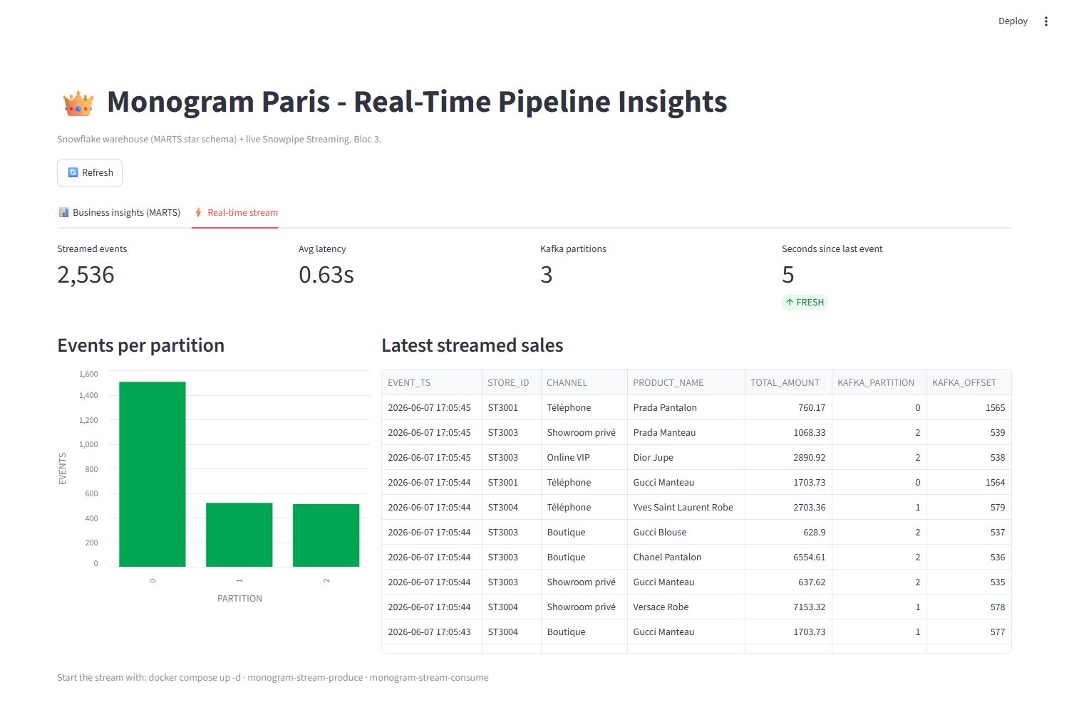
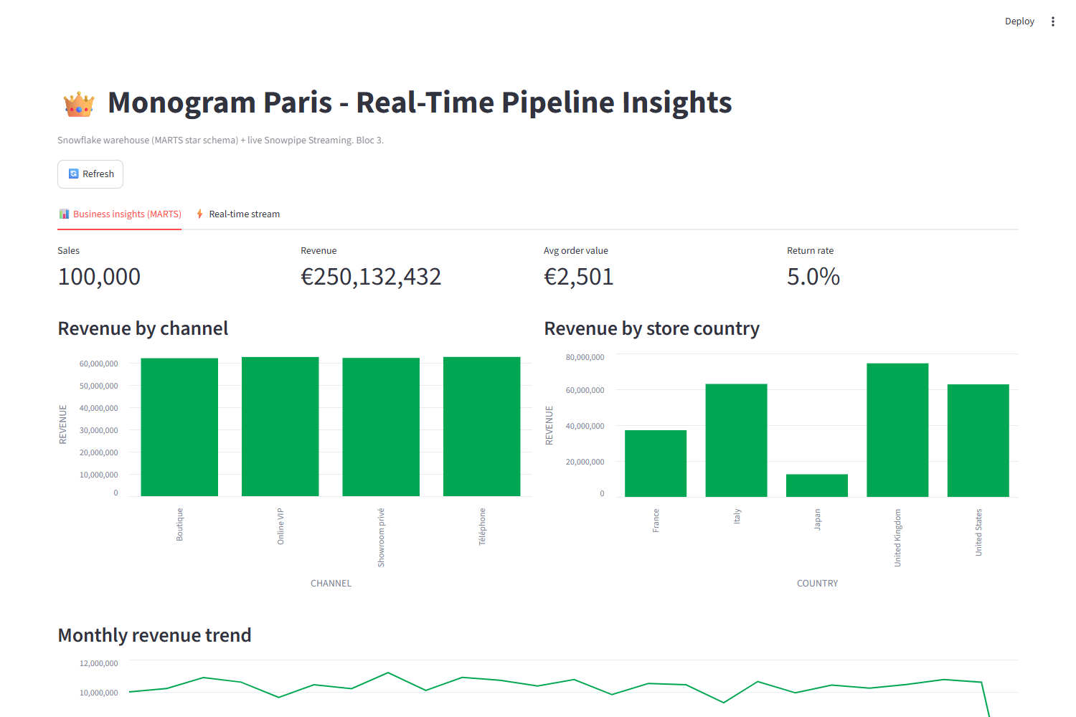
The same pipeline the jury will audit is the one the operator watches every day.
Live stream panel: latency, partitions, freshness
Business panel: revenue by channel and country
Source: dashboard/streamlit_app.py; docs/screenshots
15
Monogram Paris Data
Automation and operations

Slide 16
Three minutes from a Kafka event to a governed dashboard, live in front of the jury.
Ingest
Transform
Verify
Serve
0:00
1:00
2:00
3:00
Produce 150 events to Redpanda; consumer lands them in STREAM_SALES with offset tokens
dbt build: staging, star schema, realtime fact; 30+ tests green
Validation suite: freshness, integrity, exactly-once all pass
Streamlit: live latency and partitions, then revenue by channel
- demo.sh automates every step shown; the dry-run mode proves the stack without a Snowflake account
Source: demo.sh, docs/LOOM_SCRIPT.md
16
Monogram Paris Data
Automation and operations

Slide 17
Remaining gaps are documented tiers of work with named triggers, not blind spots.
Current limit
Why it is acceptable today
Next increment
INSERT-only ingestion is not idempotent
Data is regenerated between runs; contracts are documented
MERGE-based ingestion keyed on business ids
No dead-letter queue
A bad row fails the whole batch loudly, which is safe
Row-level DLQ with tolerance thresholds
Monitoring is queries plus a dashboard
Snowflake ACCOUNT_USAGE already covers cost and logins
Prometheus and Grafana for persistent metrics
Source: docs/ERROR_HANDLING.md, docs/MONITORING.md
17
Monogram Paris Data
Automation and operations

Slide 18
A pipeline the jury can replay, check and break on purpose.
• Live demo: ingestion, transformation, validation, dashboard
• Typed, tested, linted package; quality gates enforced in CI
• Security incident documented and history purged before publication
Enzo Berreur, RNCP Bloc 3, June 2026

