Slide 1

GreenGuard MLOps
A self-maintaining AI solution
for chemical-free weeding robots.
End-to-end MLOps: specification, serving, CI/CD, drift monitoring and automated retraining
June 2026
RNCP Bloc 4 thesis deliverable. Prepared by Enzo Berreur.

Slide 2
The MLOps loop matters more than the model
1
Herbicide bans and labour shortages make autonomous weeding a compliance issue, not a gadget
• France's Loi Labbe already bans synthetic herbicides in public green spaces; organic farming forbids them outright
• Manual weeding is the most labour-intensive task in chemical-free grounds care, exactly where labour is scarcest
2
A deliberately simple classifier proves a production-grade platform
• ResNet18 transfer learning reaches 0.89 macro F1 with about 400 images and a 4 minute CPU training run
• Serving degrades gracefully, every run is tracked in MLflow, every commit is tested, built and validated by CI
3
Drift detection closes the loop with gated, automated retraining
• One PSI engine feeds both the Grafana dashboard and the retrain decision, so they can never disagree
• A promotion gate ships a candidate only if it clears 0.85 macro F1 and does not regress against the live model
GreenGuard MLOps
2

Slide 3
Specifications and business case
Agenda
ML solution and serving
CI/CD, monitoring and retraining
GreenGuard MLOps
3

Slide 4
Weeding is turning into a compliance problem that hand labour can no longer absorb.
0
#1
2
24/7
synthetic herbicides allowed in French public green spaces under Loi Labbe
cost line in chemical-free grounds care is manual weeding labour
classes the robot must never confuse: the weed and the crop it protects
autonomous operation only pays if the perception model stays reliable unattended
- The product: GreenGuard robots remove weeds mechanically; the robot acts only when the camera is sure it sees a weed
- The economics: every percentage point of precision protects the asset; every point of recall is herbicide-free weeding that actually worked
- Why MLOps is the product: fields, seasons and lighting drift continuously; a model that cannot watch itself and retrain silently decays into a crop-cutting liability
Source: docs/SPECIFICATION.md sections 1-2
4
GreenGuard MLOps
Specifications and business case

Slide 5
Every business outcome maps to one ML metric and one live monitoring signal; nothing is tracked for decoration.
If a metric moves, someone knows which business promise is at risk.
Business outcome
ML metric
Live signal
Never cut the crop
Per-class precision, confusion matrix
Prediction mix, drift flag, retrain events
Do not miss weeds
Macro F1, recall on the weed class
Release gate at 0.85; drift flag in Grafana
Real-time operation on a moving robot
Inference latency
p90 latency vs the 500 ms target in Prometheus
Sustained accuracy across sites and seasons
Drift magnitude, retrain cadence
Dataset drift flag, drift share, retrain runs
Low maintenance cost
Automation coverage
Green CI/CD, drift-triggered retraining
Source: docs/SPECIFICATION.md, business outcome to metric table
5
GreenGuard MLOps
Specifications and business case

Slide 6
Seven functional requirements, each with a written acceptance criterion the jury can check in the repo.
Requirement
Acceptance criterion
Where it is verified
Data ingestion and preprocessing
Weekly Airflow DAG runs end to end
dandelion_data_pipeline
Reproducible training
Fixed seed, pinned deps, every run tracked
MLflow run history
Prediction API
Class plus probabilities; 400 on a non-image
POST /predict, tests/test_api.py
Health, version, metrics
Graceful startup; model metadata exposed
/health, /version, /metrics
Web UI
Upload an image, see class and confidence
Streamlit app
Drift detection
Per-feature PSI plus a dataset drift flag
Grafana drift dashboard, drift report
Automated retraining
Scheduled and drift-triggered, gated
dandelion_retrain_pipeline
Source: docs/SPECIFICATION.md; deliverables/cahier_des_charges.docx
6
GreenGuard MLOps
Specifications and business case

Slide 7
CHAPTER 2
ML solution and serving
400 images, a 4 minute training run, and an API that never goes down with its model

Slide 8
With 400 images, the architecture decision is the whole ML decision: transfer learning or nothing.
Too little data to learn vision from scratch; exactly enough to fine-tune it.
ResNet18 transfer learning (production)
4-block CNN from scratch (baseline)
Representation
ImageNet features reused; only the head retrains
Must learn edges and texture from 400 images
Data appetite
Hundreds of images suffice
Typically needs orders of magnitude more
Cost
About 4 minutes on CPU
Cheaper per epoch, far weaker ceiling
Role here
Serves production traffic
Kept in the codebase for offline ablation
- Augmentation on the training split only: random resized crop, horizontal flip, colour jitter; 80/20 split at seed 42
Source: notebooks/02_model_selection.ipynb, models/model.py
8
GreenGuard MLOps
ML solution and serving

Slide 9
The production model clears its release gate with margin, and the gate is enforced in code, not in a slide.
Validation metrics, ResNet18 production model, score, 0 to 1
release gate 0.85
Accuracy
0.9
4 min
Macro F1
0.89
full training run on CPU; no GPU budget needed
Precision (macro)
0.89
100%
Recall (macro)
0.89
of runs tracked in MLflow: params, metrics, artifacts
- Best checkpoint selected on validation accuracy; architecture and class names travel inside the checkpoint, so serving can never load the wrong shape
Source: docs/MODEL_CARD.md; MLflow metrics_summary.json
9
GreenGuard MLOps
ML solution and serving

Slide 10
The API treats the model as cargo: if the model is missing, serving stays up and says so.
Robot / Streamlit
image upload
FastAPI /predict
validate, infer
ResNet18 in memory
class + probabilities
Production posture
• Stateless container behind a Kubernetes Service with liveness and readiness probes
• Scalable horizontally; the model loads from MinIO, never trains in the serving path
MinIO checkpoint
loaded at startup
Prometheus
scrapes /metrics
Endpoint
Returns
Failure behaviour
POST /predict
Class, confidence, per-class probabilities
400 invalid image, 503 while loading
GET /health, /version
Readiness, classes, architecture, source
Reports initializing until ready
GET /metrics
Counters, latency histogram, drift gauges
Gauges skipped if no drift report
Source: app/api/main.py; tests/test_api.py; k8s/minikube-manifest.yaml
10
GreenGuard MLOps
ML solution and serving

Slide 11
CHAPTER 3
CI/CD, monitoring and retraining
Every commit tested and shipped; the data watched; the model able to replace itself

Slide 12
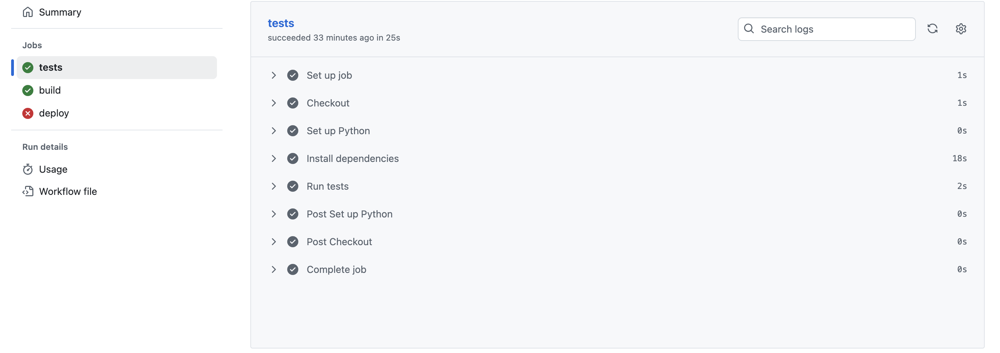
From git push to a deployable, schema-validated image with no human in the loop.
git push
any branch
Tests
pytest + coverage to Codecov
Build
Docker image, SHA tag
Publish
GitHub Container Registry
Validate
kubeconform on manifests
- Deterministic over flaky: offline manifest validation replaced a live Minikube rollout that failed randomly on hosted runners; the same manifests deploy to Minikube locally
- Traceable: SHA-tagged images mean any running pod maps to exactly one commit
- Hardened: manifests carry liveness and readiness probes and resource limits on all four deployments
CI run: tests, build, deploy validation
Source: .github/workflows/ci_cd.yml
12
GreenGuard MLOps
CI/CD, monitoring and retraining

Slide 13
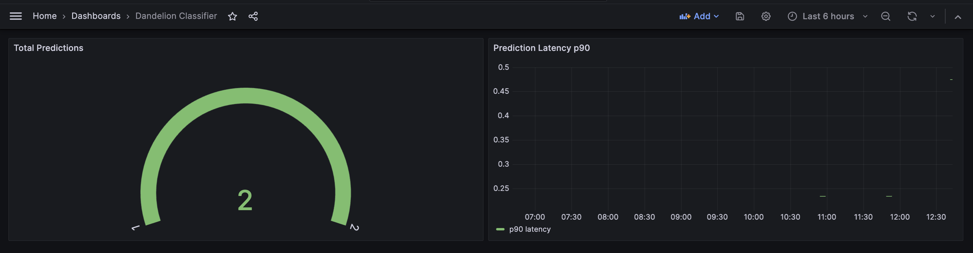
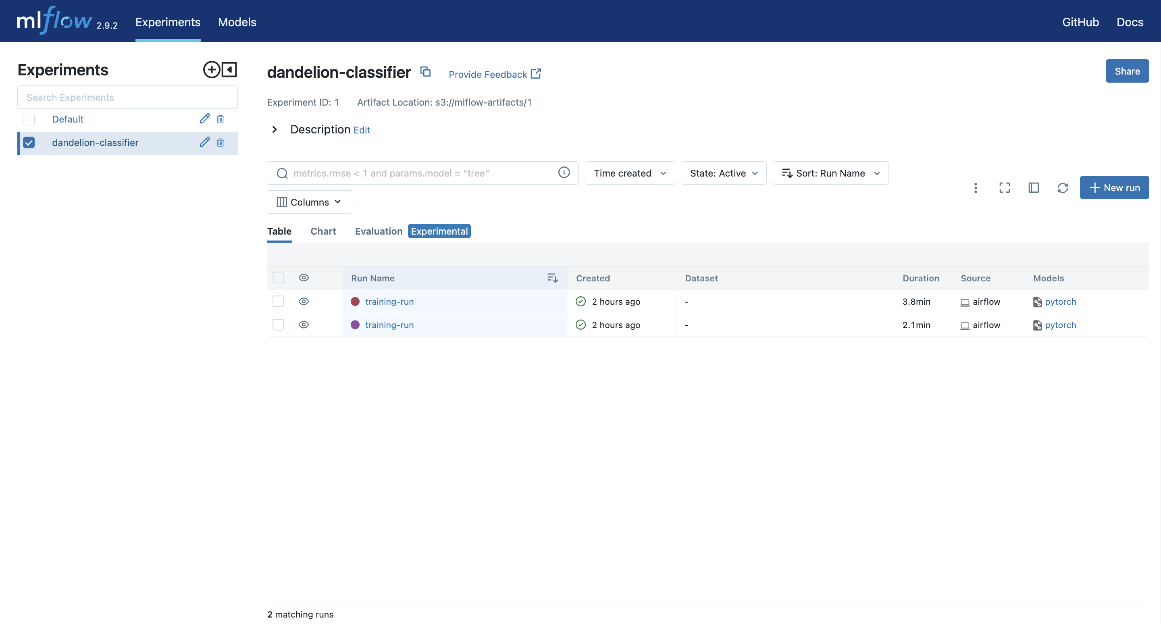
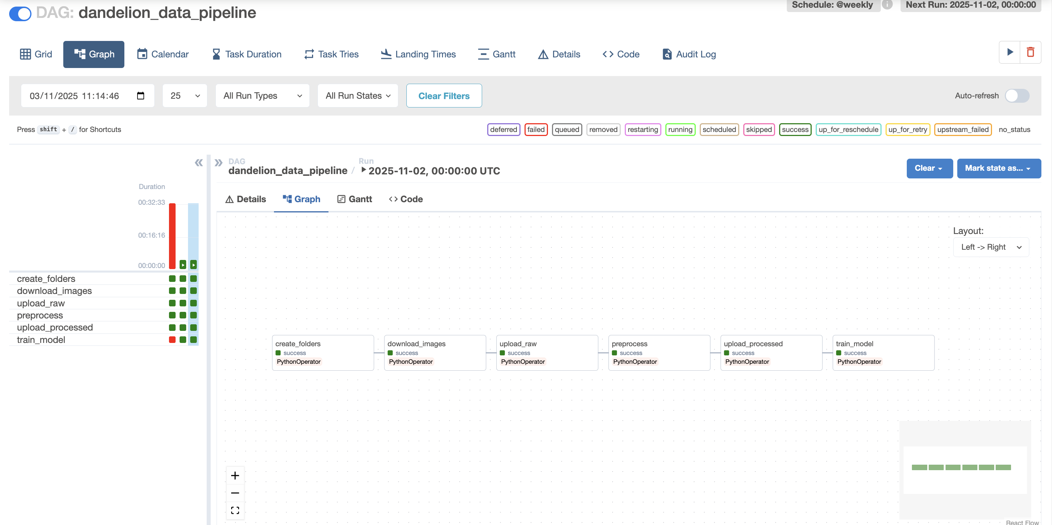
One Grafana stack answers three questions: is serving healthy, are the pipelines running, is the data still the same.
Classifier dashboard: total predictions and p90 latency vs the 500 ms target
MLflow: every training run tracked
Airflow: data and retrain DAGs
Source: monitoring/grafana/dashboards; Prometheus scrapes API and Airflow every 15 s; drift gauges served by the API
13
GreenGuard MLOps
CI/CD, monitoring and retraining

Slide 14
The model watches its own inputs and replaces itself only when the replacement is provably better.
Detect
PSI on 8 image features vs baseline, threshold 0.2
Decide
retrain on drift flag or insufficient data; monthly safety net
Retrain
Airflow syncs data, trains, logs to MLflow
Gate
promote only if F1 >= 0.85 and no regression vs live model
Refresh
checkpoint + metrics to MinIO; baseline updated
- One definition of drift: the same PSI engine feeds the Grafana dashboard and the retrain gate, so monitoring and automation can never disagree
- No silent failures: the drift check never breaks the DAG; the first run seeds the baseline instead of failing
- No accidental regressions: the promotion gate compares the candidate to the live model before anything is uploaded
Source: monitoring/drift/; retrain/promotion.py; airflow/dags/retrain_pipeline.py
14
GreenGuard MLOps
CI/CD, monitoring and retraining

Slide 15
Five minutes from a live prediction to a retraining decision, on the running stack.
Predict
Ship
Watch
Retrain
0:00
1:00
2:00
3:00
4:00
5:00
Streamlit upload and POST /predict: class, confidence; /version shows the model identity
GitHub Actions on the latest commit: tests, image build, manifest validation
Grafana: prediction mix and latency; drift dashboard with per-feature PSI
Trigger the retrain DAG: drift check, training in MLflow, promotion decision in the logs
- demo.sh runs the whole sequence on one command; docs/LOOM_SCRIPT.md scripts the narration shot by shot
Source: demo.sh; docs/LOOM_SCRIPT.md
15
GreenGuard MLOps
CI/CD, monitoring and retraining

Slide 16
Known limits each carry a named next increment; none of them blocks the loop the thesis demonstrates.
Current limit
Why it is acceptable today
Next increment
Binary classifier on an easy dataset
The thesis demonstrates the loop, not the model
Multi-class weeds, harder field imagery
Drift measured on image statistics
Interpretable, cheap, catches lighting and season shifts
Embedding-based drift for semantic change
Retraining fully automated
Gated by the F1 floor plus regression check
Human approval step and retrain cooldown
No alerting rules yet
Dashboards reviewed during weekly ops
Prometheus alerts wired to the retrain webhook
Source: docs/MODEL_CARD.md limitations; docs/DEFENSE.md
16
GreenGuard MLOps
CI/CD, monitoring and retraining

Slide 17
From a working model to a self-maintaining AI product.
• Live demo: prediction API, CI/CD run, drift dashboard, retraining DAG
• Code, tests, coverage and documentation public on GitHub
• Cahier des charges and model card in the deliverables folder
Enzo Berreur, RNCP Bloc 4, June 2026

