Slide 1
HexaBank
AI Maturity Case
Enzo BERREUR, Leo WEISS, Elea NIZAM, Camil NITEL

Slide 2
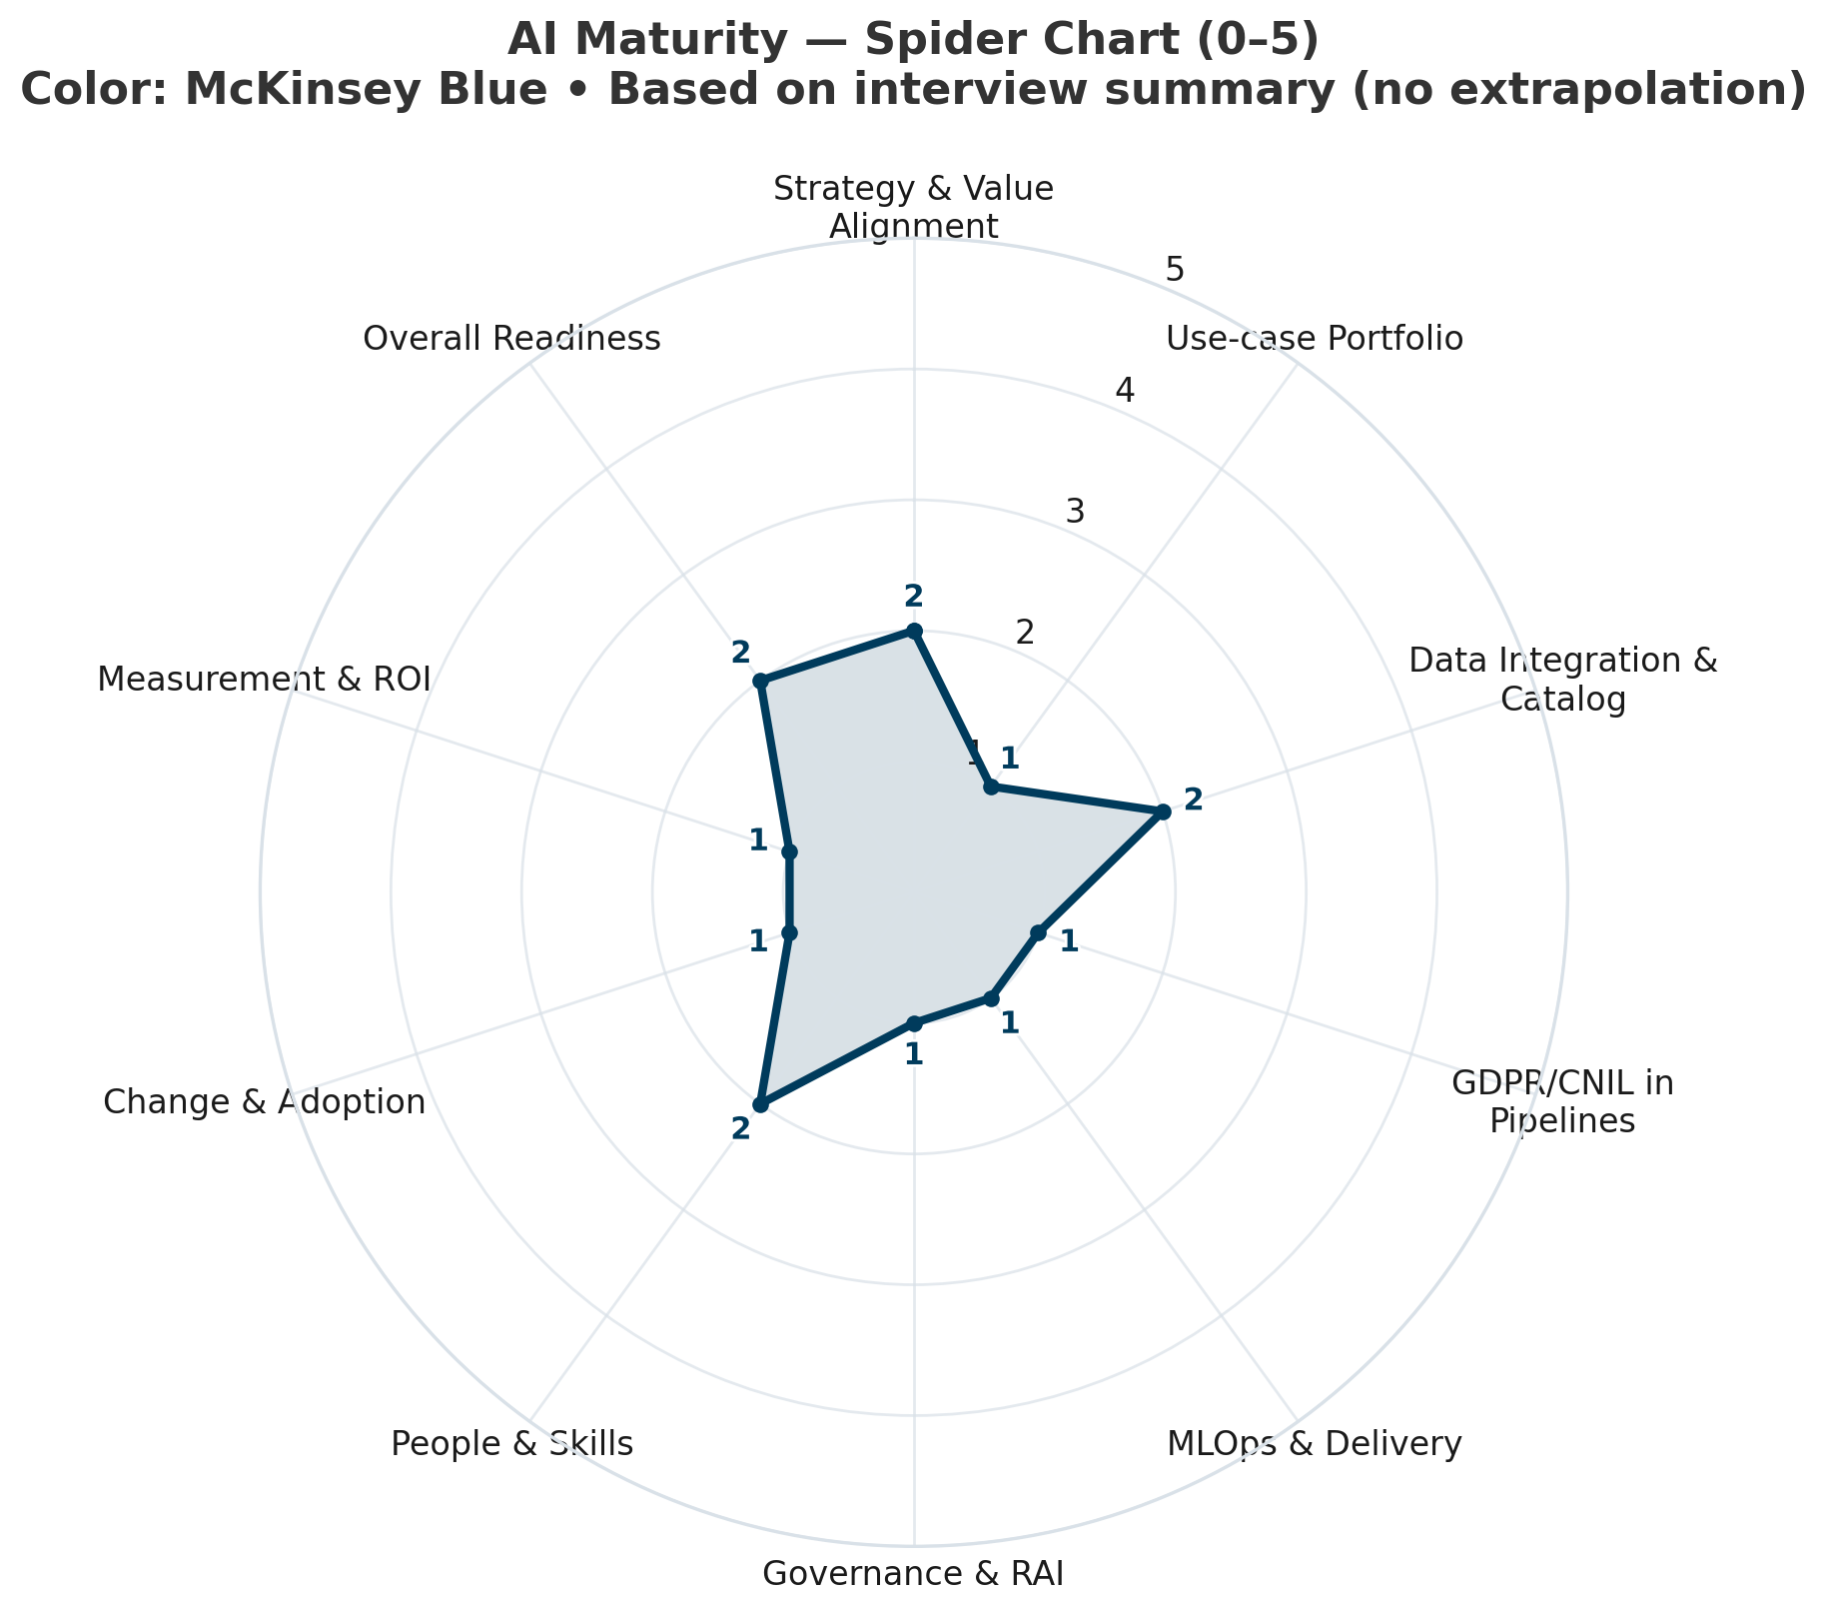
Early AI maturity with strategic intent but gaps in governance, MLOps, and measurement
Strenght
Weakness
Strategy & Value Alignment
AI initiatives are at least connected to the business roadmap and selected KPIs, though links are still partial and not consistently codified
Governance & RAI / Measurement & ROI
AI risk governance and outcome measurement are fragmented or missing, limiting industrialization and stakeholder trust
Low-confidence area
Overall Readiness Sponsorship and risk appetite appear present but are insufficiently documented; clarify budget, mandate, and model-risk tolerance

Slide 3
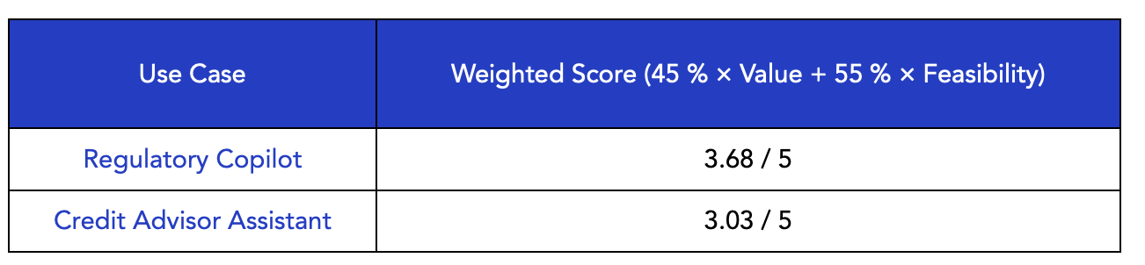
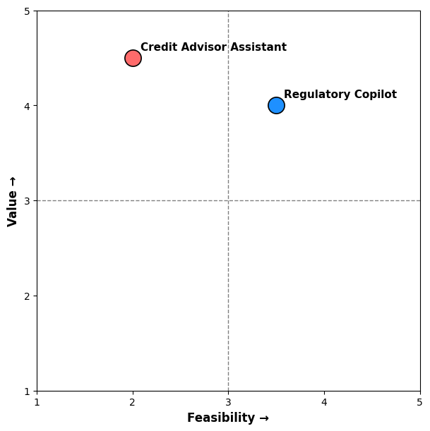
Regulatory Copilot is compliant by design, high-ROI, low-friction, the practical first step before complex AI
Use case | Project description
Regulatory Copilot | Turn new ACPR/ECB/EU AI Act rules into action an internal assistant that interprets regulations, aligns them to HexaBank’s controls, drafts compliance updates, and highlights non-conformities with concrete doc changes
Credit Advisor Assistant | Deliver faster, clearer credit decisions a copilot that condenses client financials/risk/docs and drafts explainable credit memos or renewal notes—analysts review and submit

Slide 4
Chosen framework: NIST AI risk management framework (RMF)
      Step 1 — Assess risks & harms
      Step 2 — Monitor effectiveness & performance
Objective: Identify, evaluate, and mitigate legal, ethical, and operational risks of the Regulatory Copilot before deployment
Define AI policy & risk appetite statement -> set regulatory boundaries and clarify prohibited uses (e.g., final legal decisions)
Create a stakeholder register -> list data-protection, risk, and compliance owners to ensure clear accountability
Conduct impact and harms analysis -> evaluate possible misinterpretations or biased summaries of regulations
Map data lineage and legal constraints -> record sources, confidentiality levels, and CNIL requirements
Establish incident response playbook -> define triggers, mitigation paths, and reporting duties to regulators
Objective: Track accuracy, reliability, and compliance of the Copilot over time and adjust proactively
Set fit-for-purpose metrics -> precision / recall for regulatory summaries and compliance alignment scores
Define accept/reject thresholds -> e.g., ≥ 90 % agreement between LLM and compliance expert summaries
Deploy continuous monitoring dashboard -> flag performance drift or inconsistent outputs
Schedule quarterly audits & feedback loops -> include compliance officers and model owners in reviews
Maintain change-management log -> document model updates, retrains, and corrective actions for traceability

