Slide 1

SERVERLESS BOTS
Bot Framework + Azure Functions + Dependency Injection?
@EnzoJFCano

Slide 2
WHO?
ENZO CANO
@EnzoJFCano
Lead Software Engineer – SOUTHWORKS
Learner on demand. Curious by default.

Slide 3
WHAT?
Technical Background.
How bots work.
How functions work.
Situation!
Implementation.
DEMO time!
?.

Slide 4
Bot architecture - 101
AZURE
BOT
SERVICE
🗣 –[ ]-🤖

Slide 5
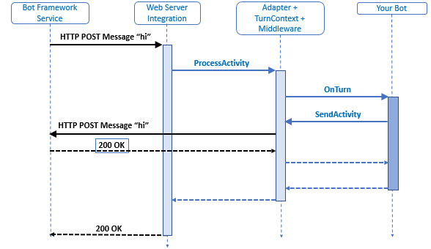
How bots work

Slide 6
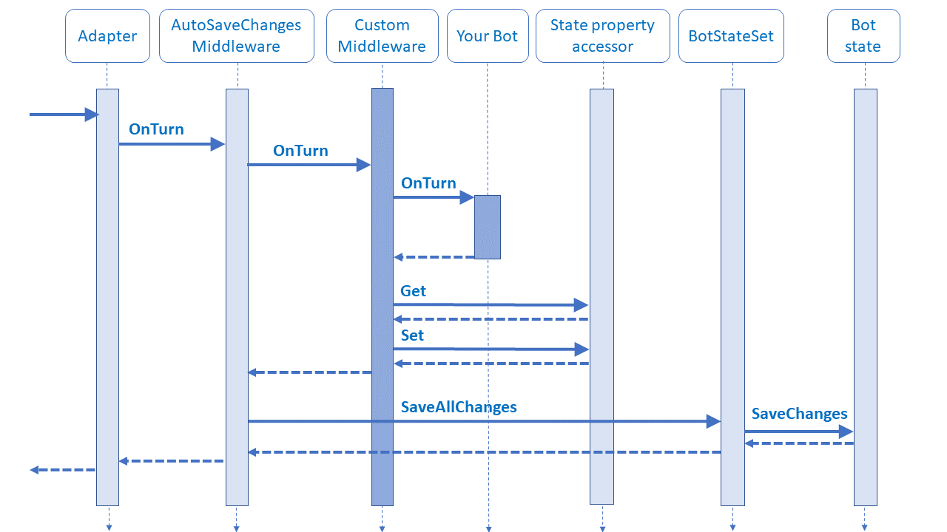
How bots work+

Slide 7
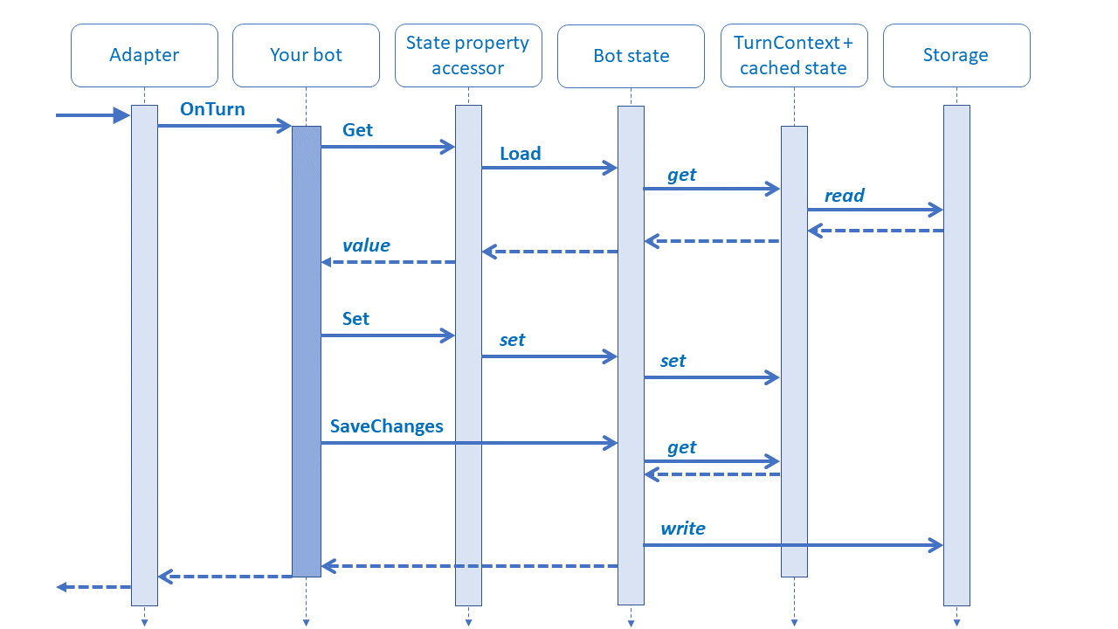
How bots work++

Slide 8
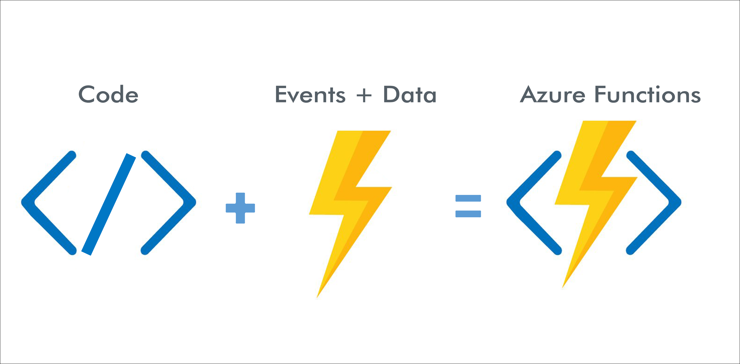
How functions work

Slide 9
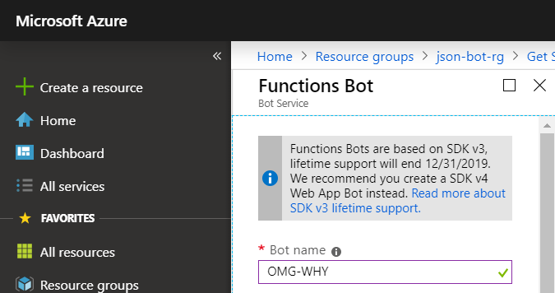
Situation!

Slide 10

How bots should work

Slide 11
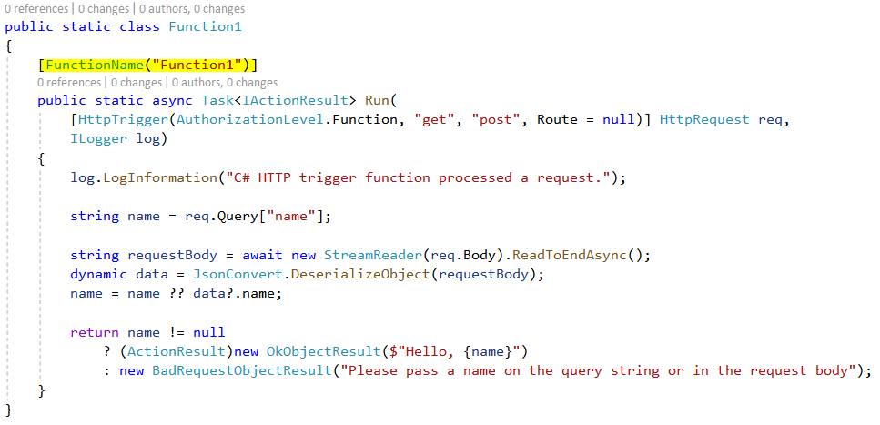
Simple HTTP Function

Slide 12
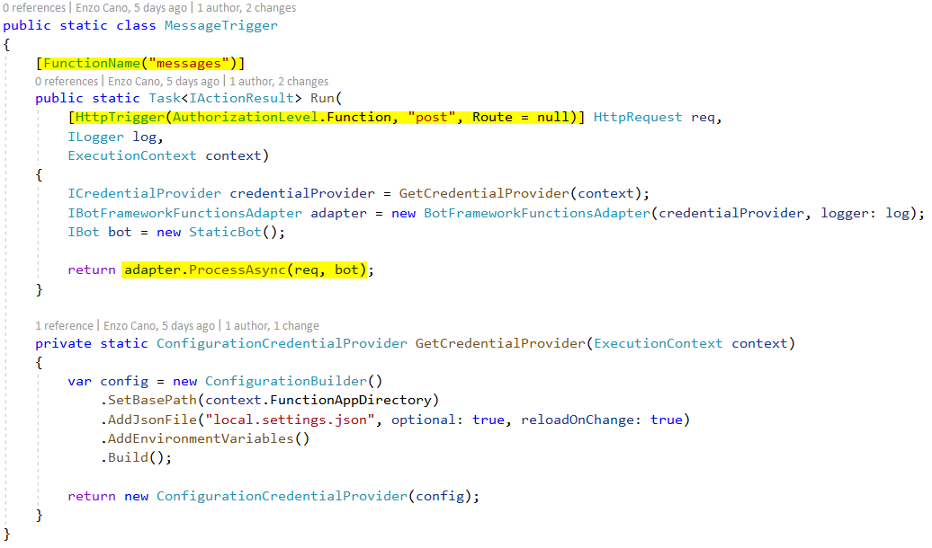
Static Function + Bot

Slide 13
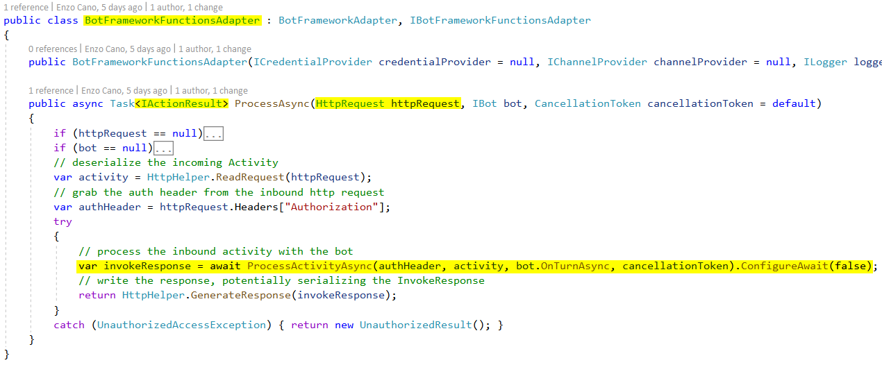
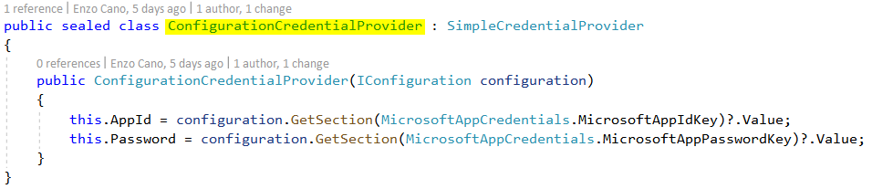
Behind the scene

Slide 14
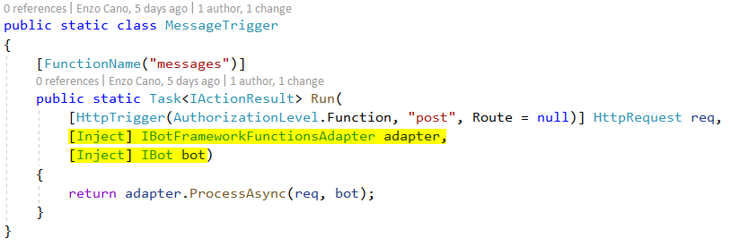
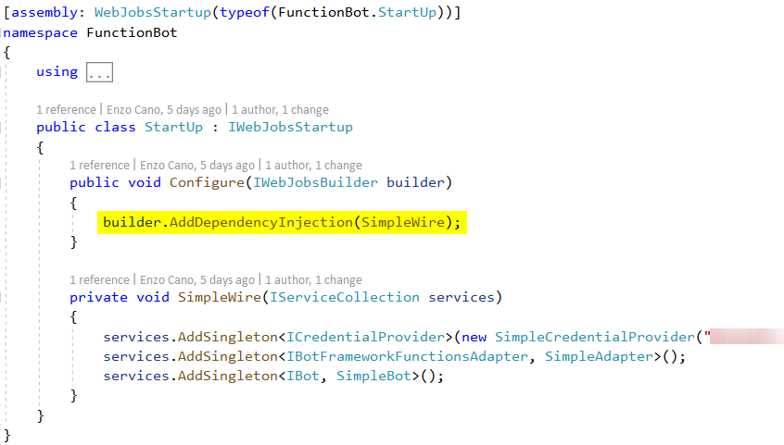
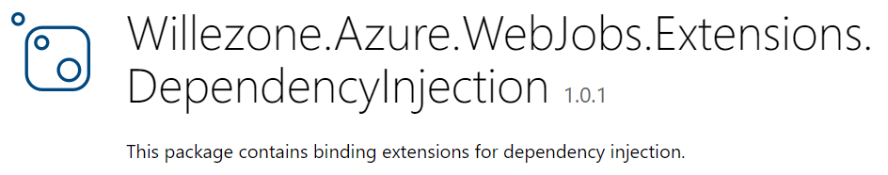
Function (with DI) + Bot

Slide 15
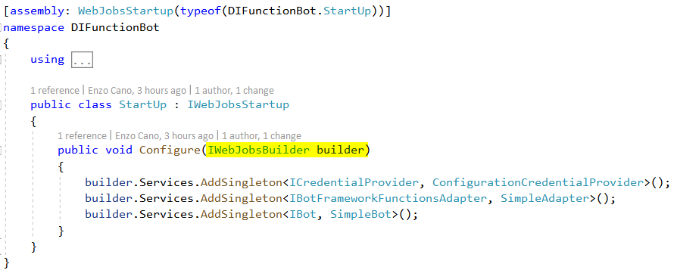
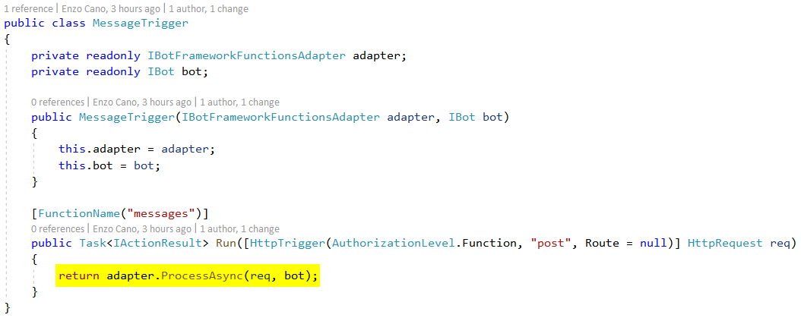
Function + Bot [NEXT]

Slide 16
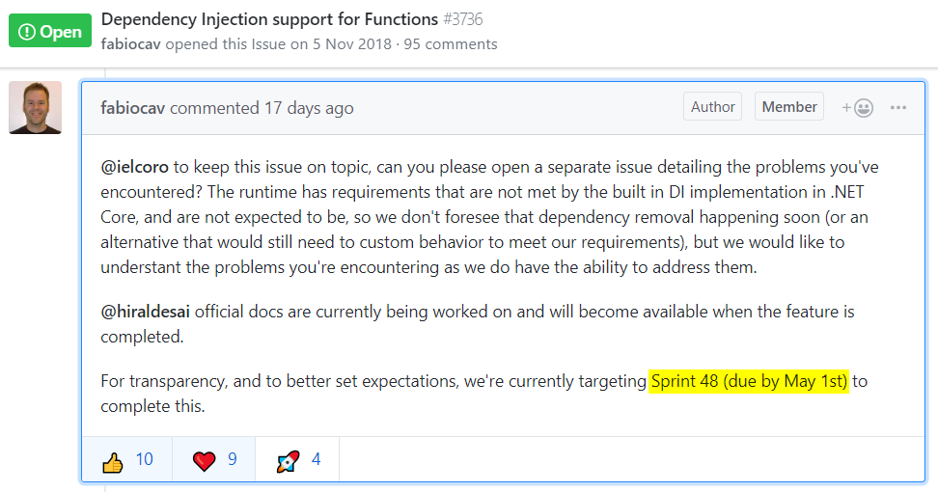
Function + Bot [ 😐 ]

Slide 17
DEMO time!

Slide 18
?

Slide 19
WHO?
ENZO CANO
@EnzoJFCano
Lead Software Engineer – SOUTHWORKS
Learner on demand. Curious by default.

Slide 20
¿¡¡?!?!

