Slide 1

Serverless Bots
Bot Framework + Azure Functions + Dependency Injection
Enzo.Cano@southworks.com

Slide 2
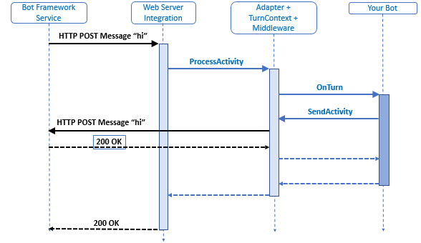
How bots work
Notes:
Communication
USER <-> BOT
USER – Bot Framework Service – Bot
USER – BFS – Web Server Integration – Bot
USER – BFS – Adapter(WSI + Turn Context) – Bot
USER – BFS – Adapter – Middleware(s) – Bot

Slide 3
How bots work

Slide 4
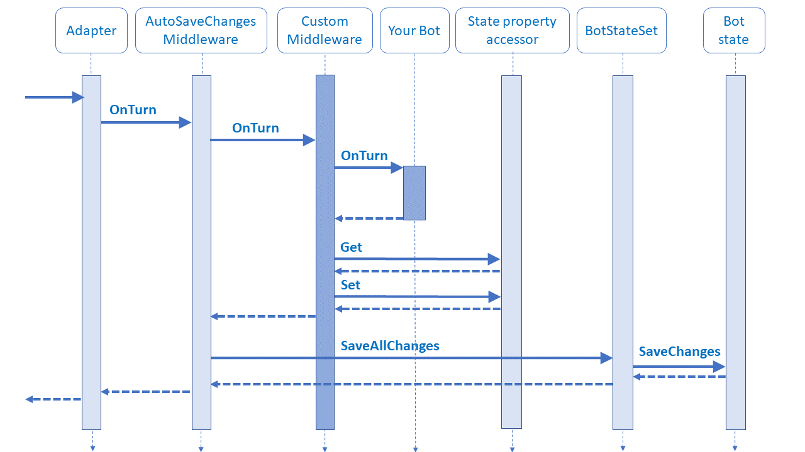
How bots work+
Notes:
Communication
USER <-> BOT
USER – Bot Framework Service – Bot
USER – BFS – Adapter(WSI + Turn Context) – Bot
USER – BFS – Adapter – Middleware(s) – Bot
USER – BFS – Adapter – AutoSaveState middleware – Custom middleware – Your BOT – State property accessors – Bot states - Storage

Slide 5
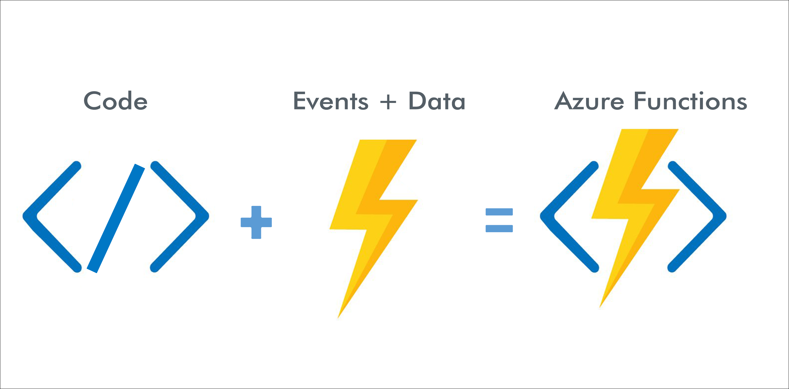
How functions work

Slide 6
?

Slide 7
¿¡¡?!?!

