Slide 1

Serverless Bots
Functions + Bots + Dependency Injection + JSON (?)
Enzo.Cano@southworks.com

Slide 2
DISCLAIMER
I will NOT talk about chori-bot or related topics

Slide 3
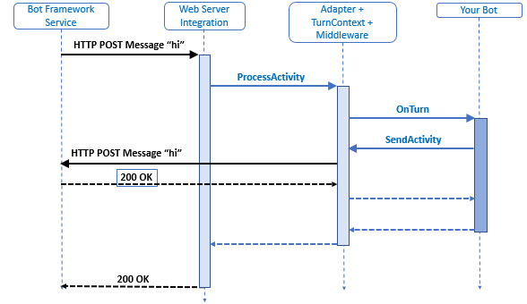
How bots work

Slide 4
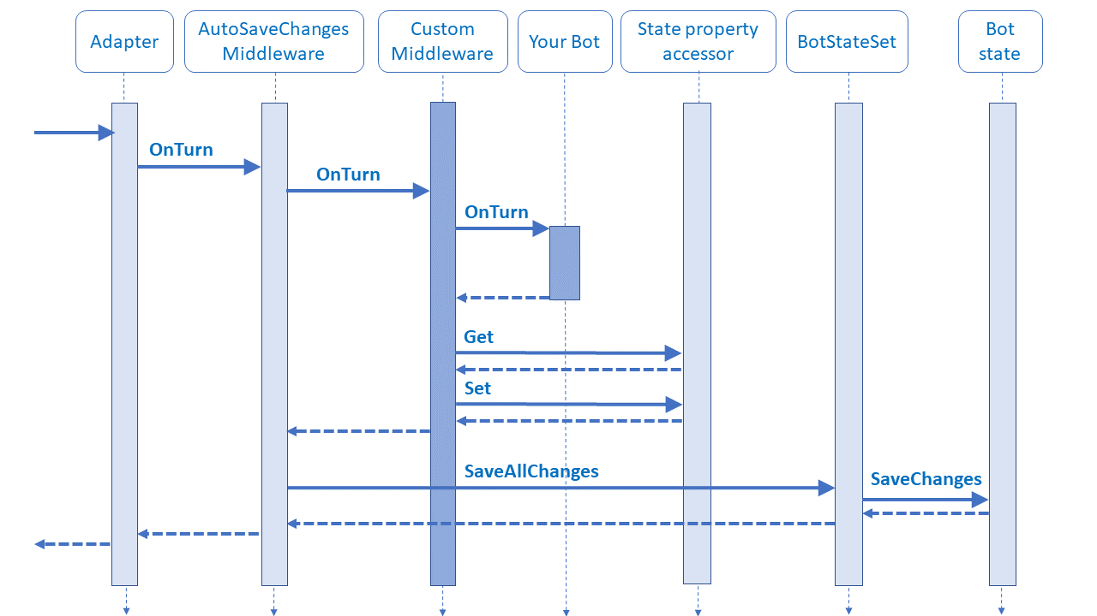
How bots work+

Slide 5
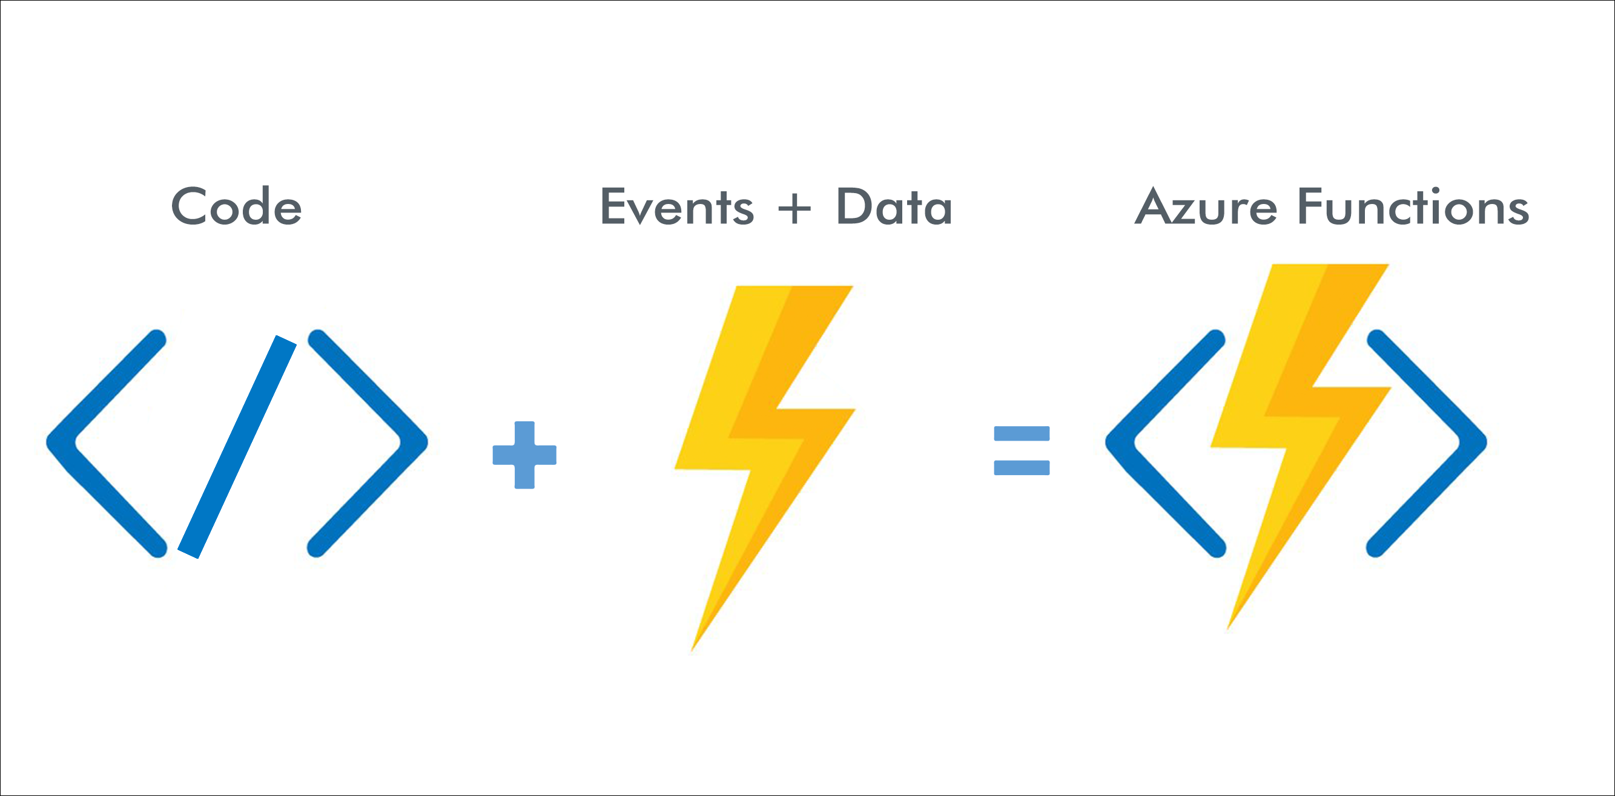
How functions work

Slide 6
?

Slide 7
¿¡¡?!?!

