Slide 1

SERVERLESS BOTS
Bot Framework + Azure Functions + Dependency Injection?
@EnzoJFCano

Slide 2
WHO?
ENZO CANO
@EnzoJFCano
Lead Software Engineer – SOUTHWORKS
Learner on demand. Curious by default.

Slide 3
Bot architecture - 101
AZURE
BOT
SERVICE
🗣 –[ ]-🤖

Slide 4
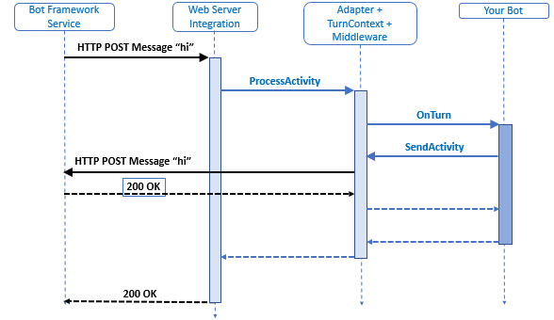
How bots work

Slide 5
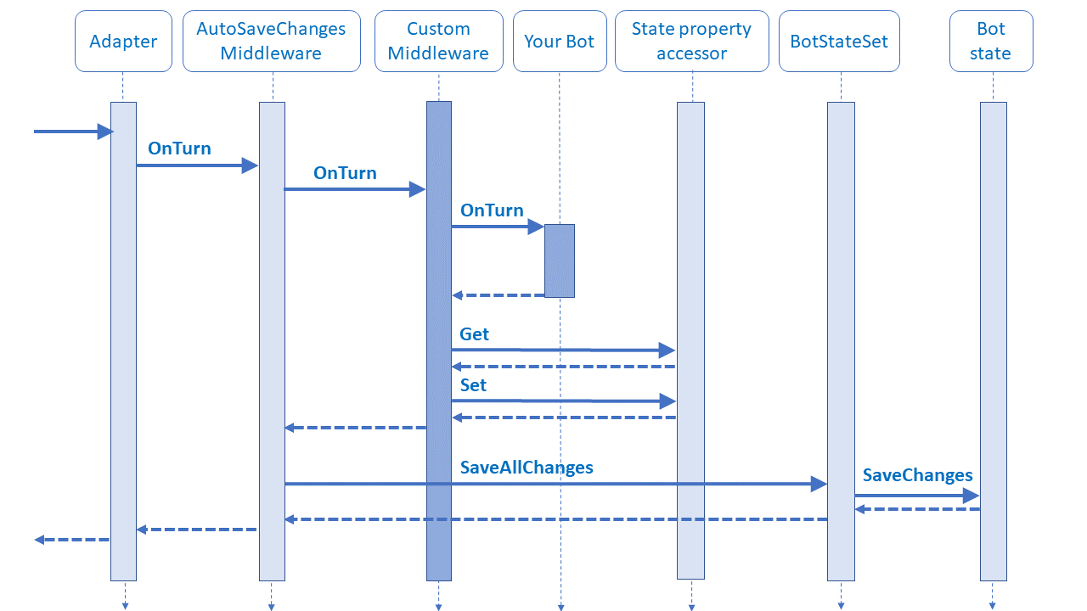
How bots work+

Slide 6
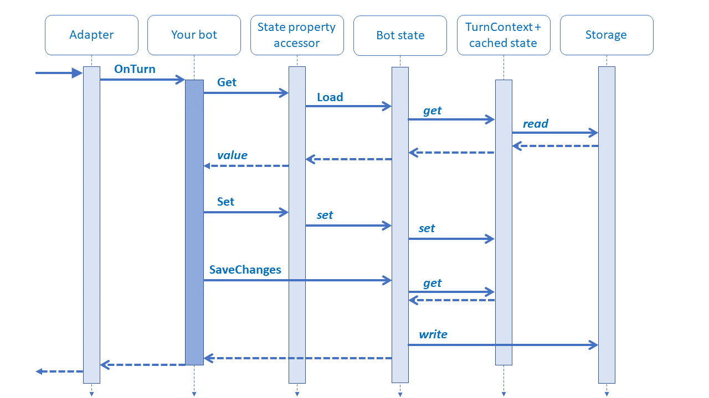
How bots work++

Slide 7
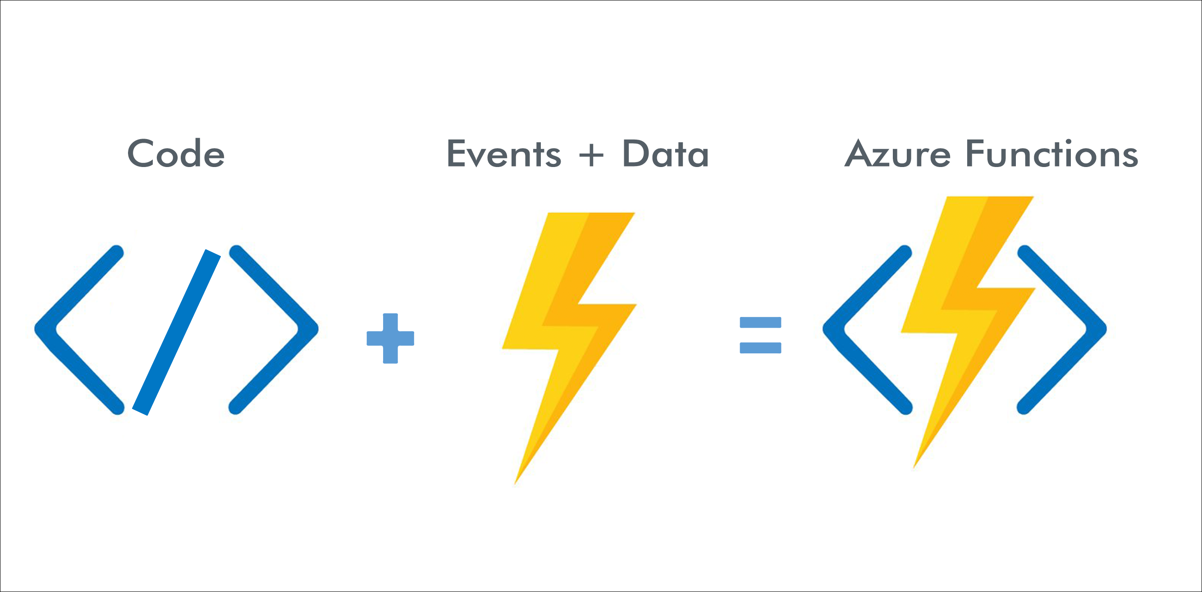
How functions work

Slide 8
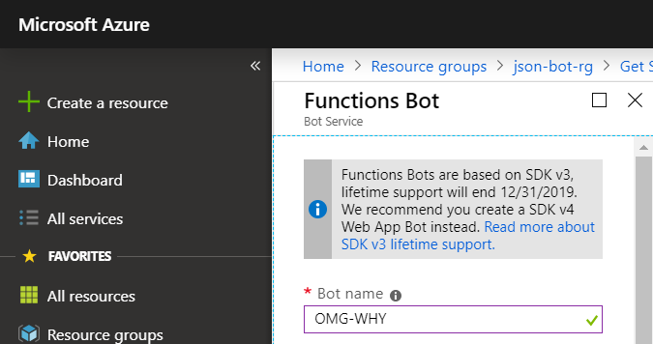
Situation!

Slide 9

How bots should work

Slide 10
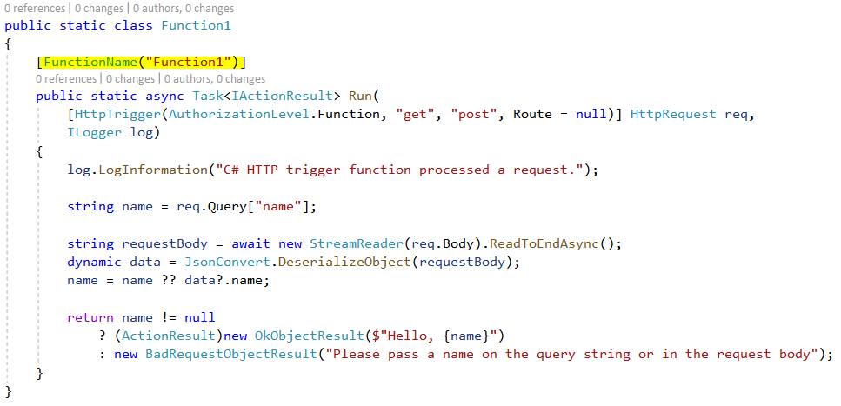
Simple HTTP Function

Slide 11
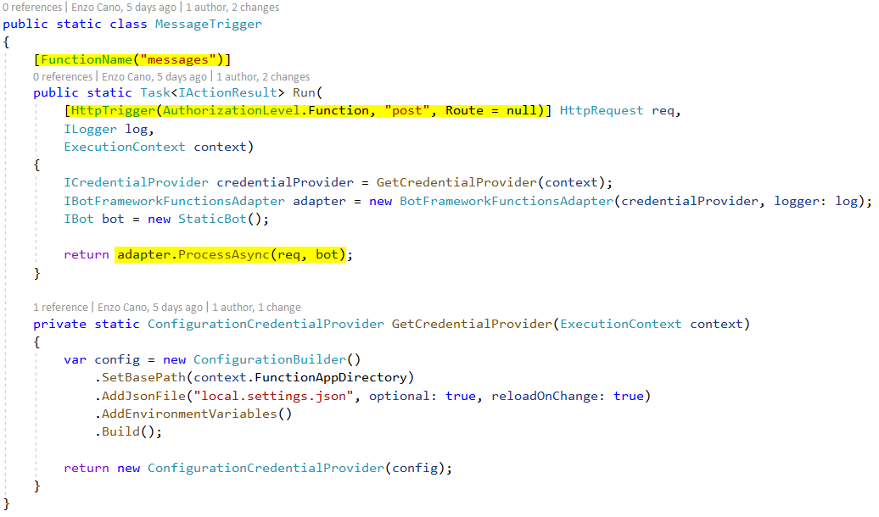
Static Function + Bot

Slide 12
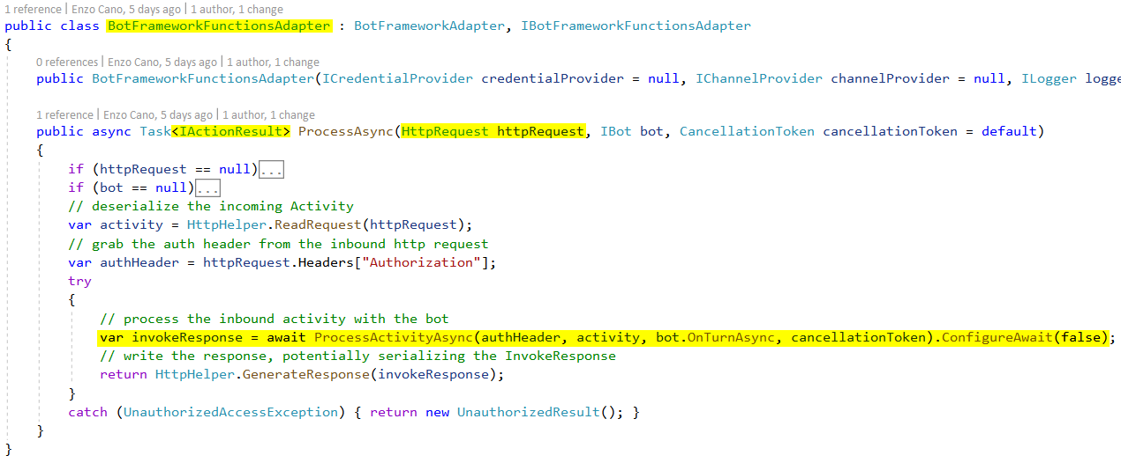
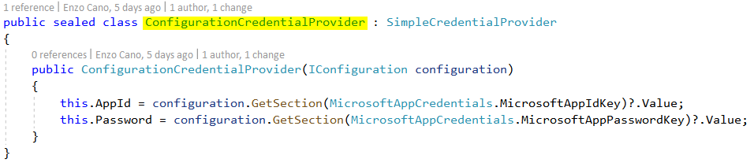
Behind the scene

Slide 13
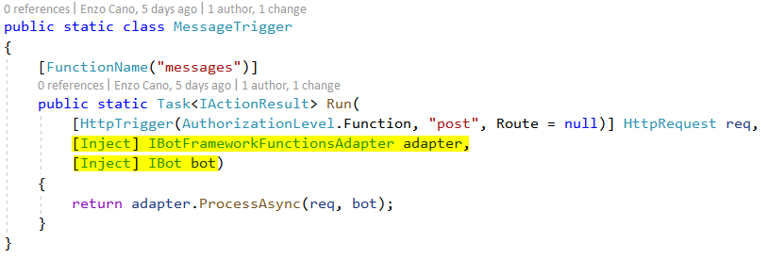
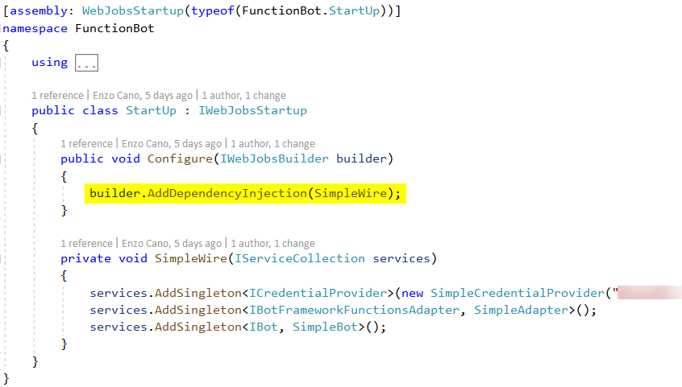
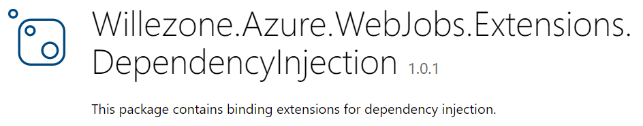
Function (with DI) + Bot

Slide 14
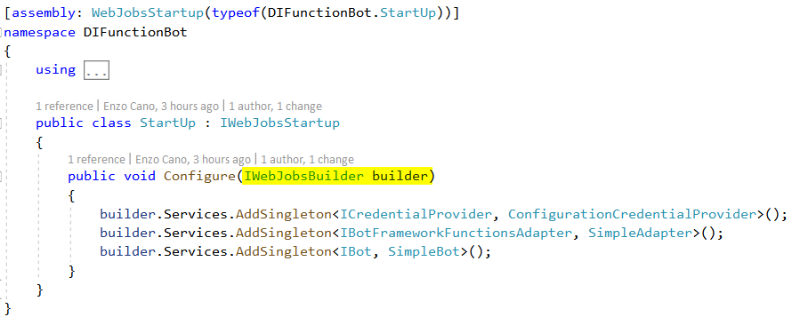
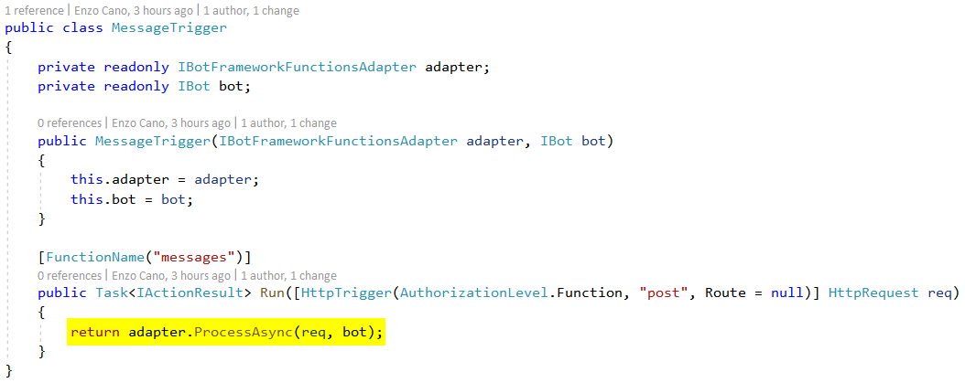
Function + Bot [NEXT]

Slide 15
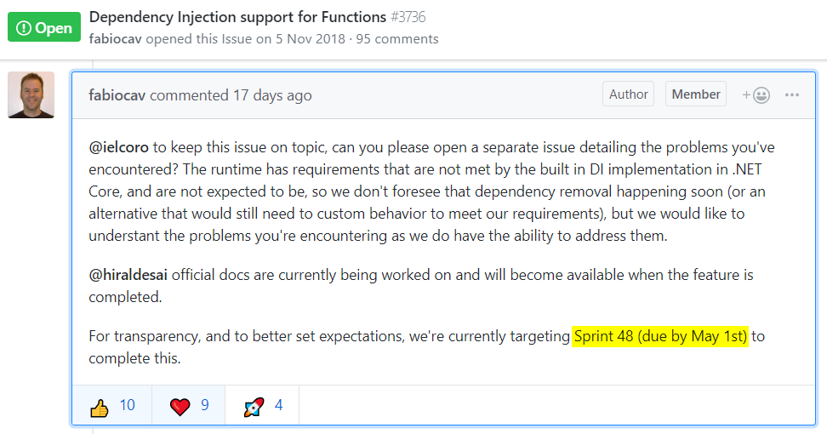
Function + Bot [😐]

Slide 16
?

Slide 17
¿¡¡?!?!

