Slide 1

Fragmented Data

Slide 2

Manual & Paper-based System

Slide 3
Managing Requests
Keeping Records
Tracking Supplies
Retrieving Documents
SLOW AND PRONE TO MISTAKES

Slide 4


Slide 5
Delays in Processing Requests
Documents Misplaced
Duplicated Records
Inaccurate Data
MISALLOCATION OF DOCUMENTS

Slide 6
Difficulty Tracking and Monitoring Supply Levels
SHORTAGES OR OVERSTOCKING

Slide 7
Reduced Transparency
Accountability
Duplicated Records
Inaccurate Data
DIFFICULT AUDIT ACTIVITIES

Slide 8
lower productivity and inefficiency in office operations, limiting the ability of the City Agriculture Office to effectively serve its community.

Slide 9
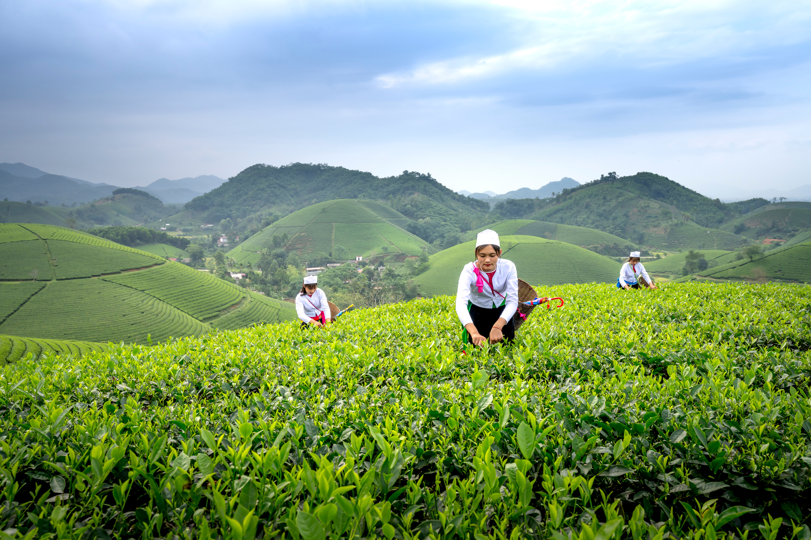
AgriSys
A DECISION SUPPORT SYSTEM WITH DESCRIPTIVE ANALYTICS FOR CITY AGRICULTURE OFFICES

Slide 10
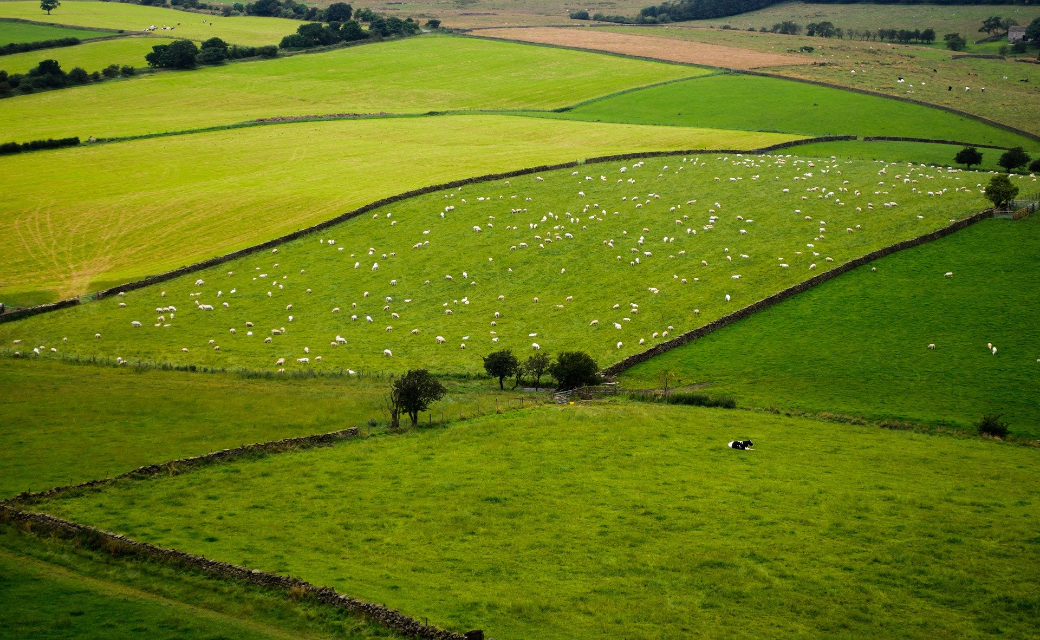

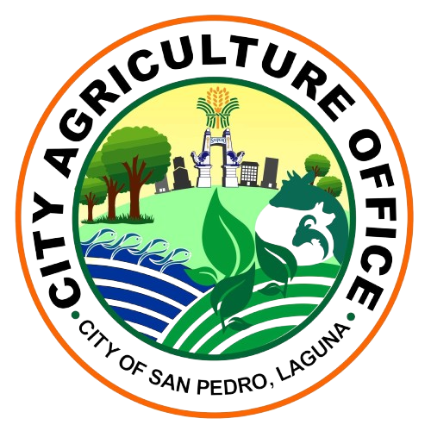

Slide 11
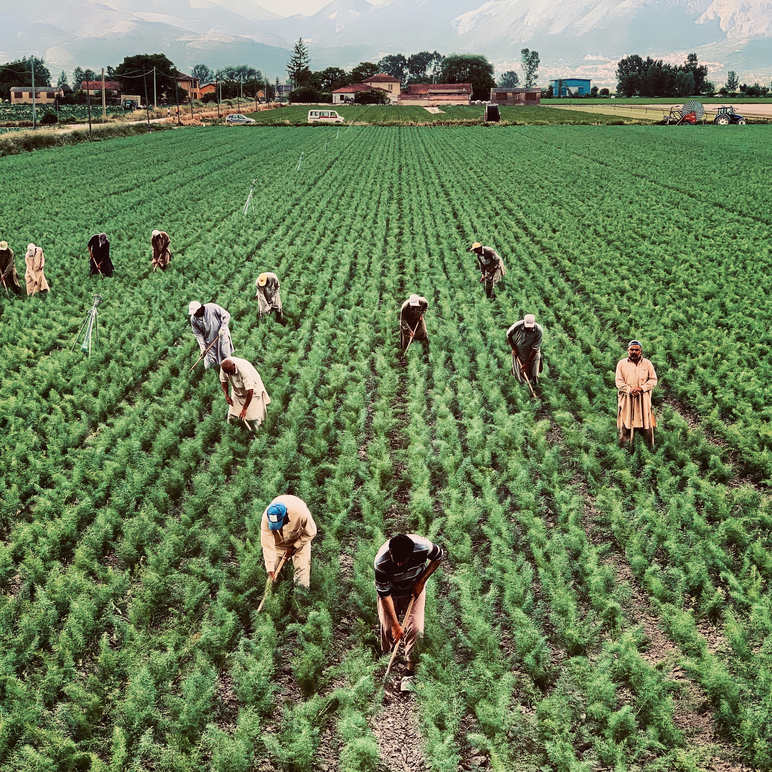
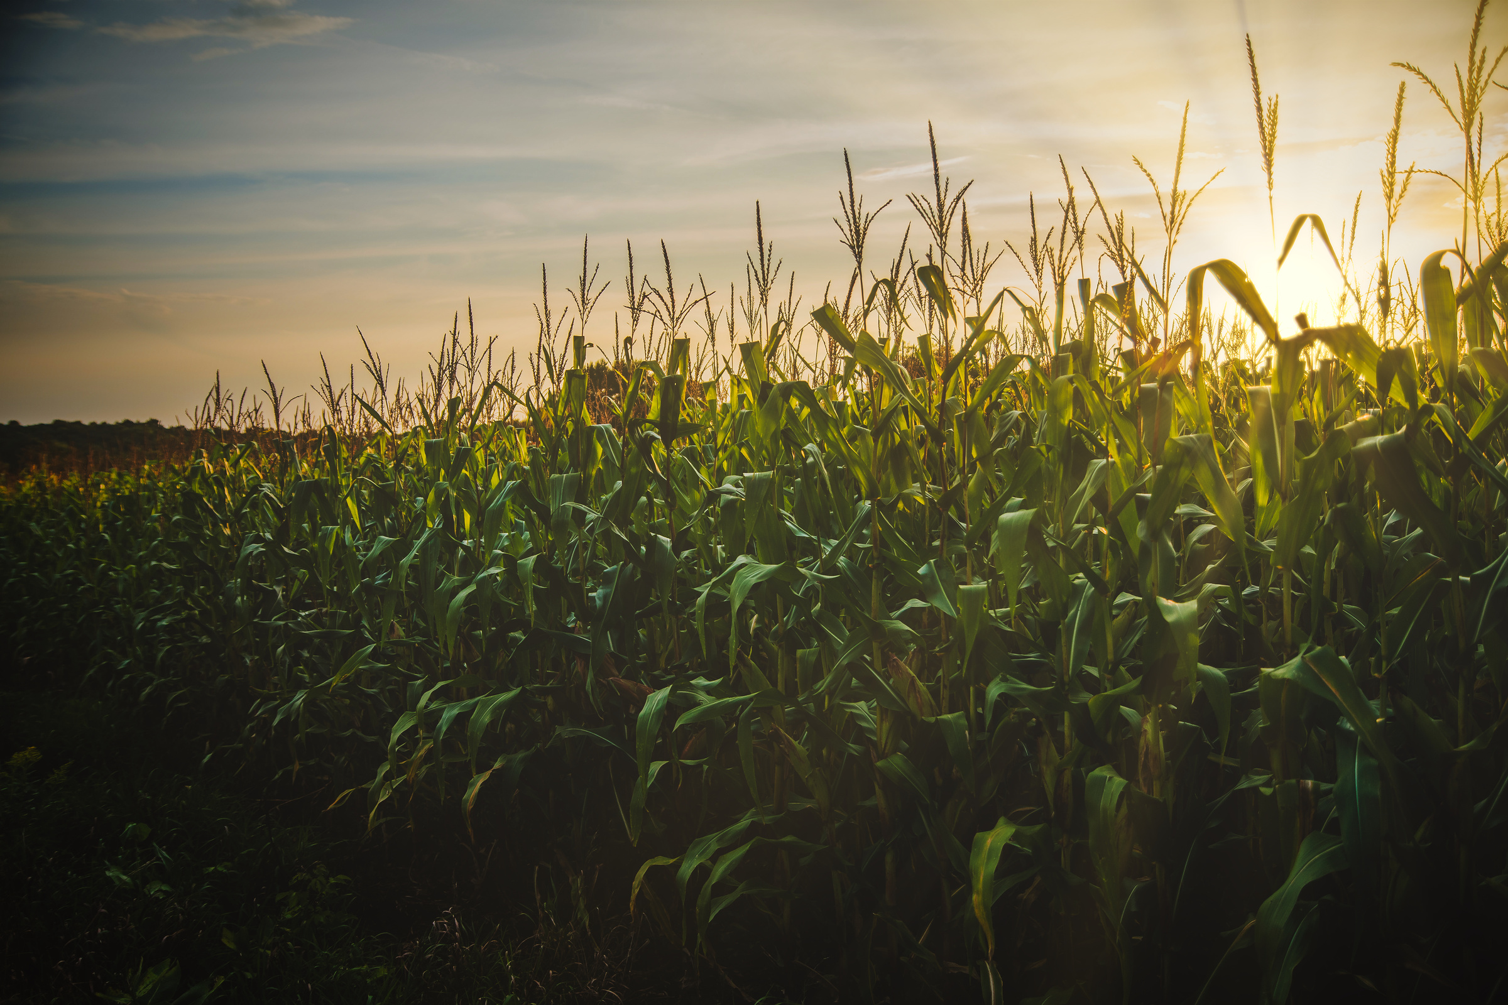
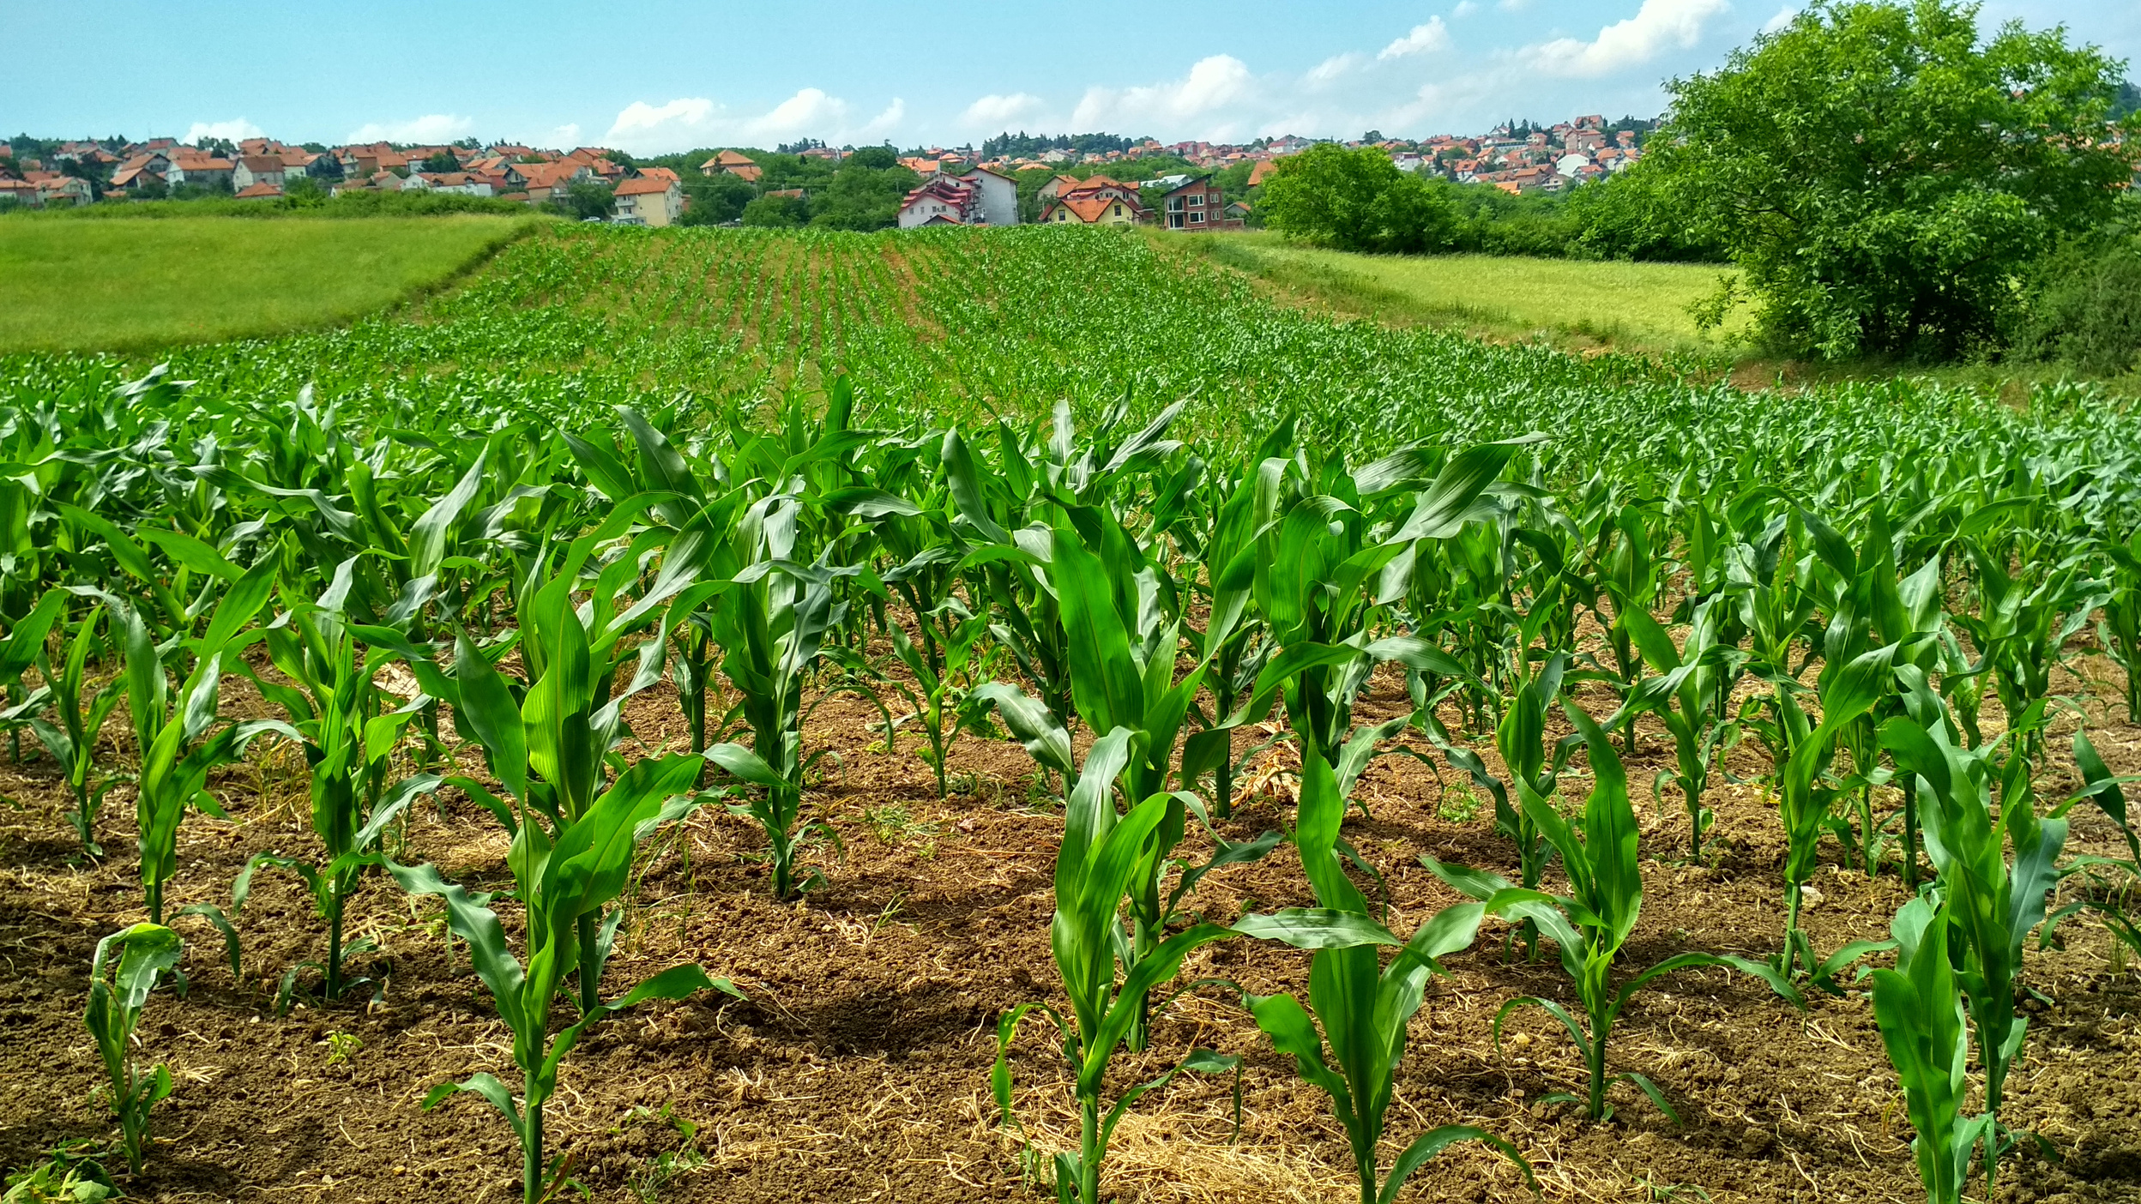
Statement of the Problem
1. What are the common challenges encountered by CAgO in terms of:
1.1.Manual Request Processing
1.2.Record-Keeping
1.3.Document Retrieval
1.4.Supplies Dispersal
1.5.Agricultural Supply Management

Slide 12
Statement of the Problem
2. What are the major features that are perceived important by the respondents?
3. What is the level of satisfaction of the City Agriculture Office regarding AgriSys in terms of the ISO/IEC 25010:2023 quality characteristics?
3.1. Functional Suitability 3.4. Reliability
3.2. Interaction Capability 3.5. Performance Efficiency
3.3. Security

Slide 13
Expected Output
Digitalized and centralized data management system
Enhanced Record Keeping
Real-time tracking and monitoring of agricultural supply stock levels
Efficient processing and tracking of requests for agricultural inputs
Improved data accuracy, consistency and transparency

Slide 14
System Demonstration

