Slide 1
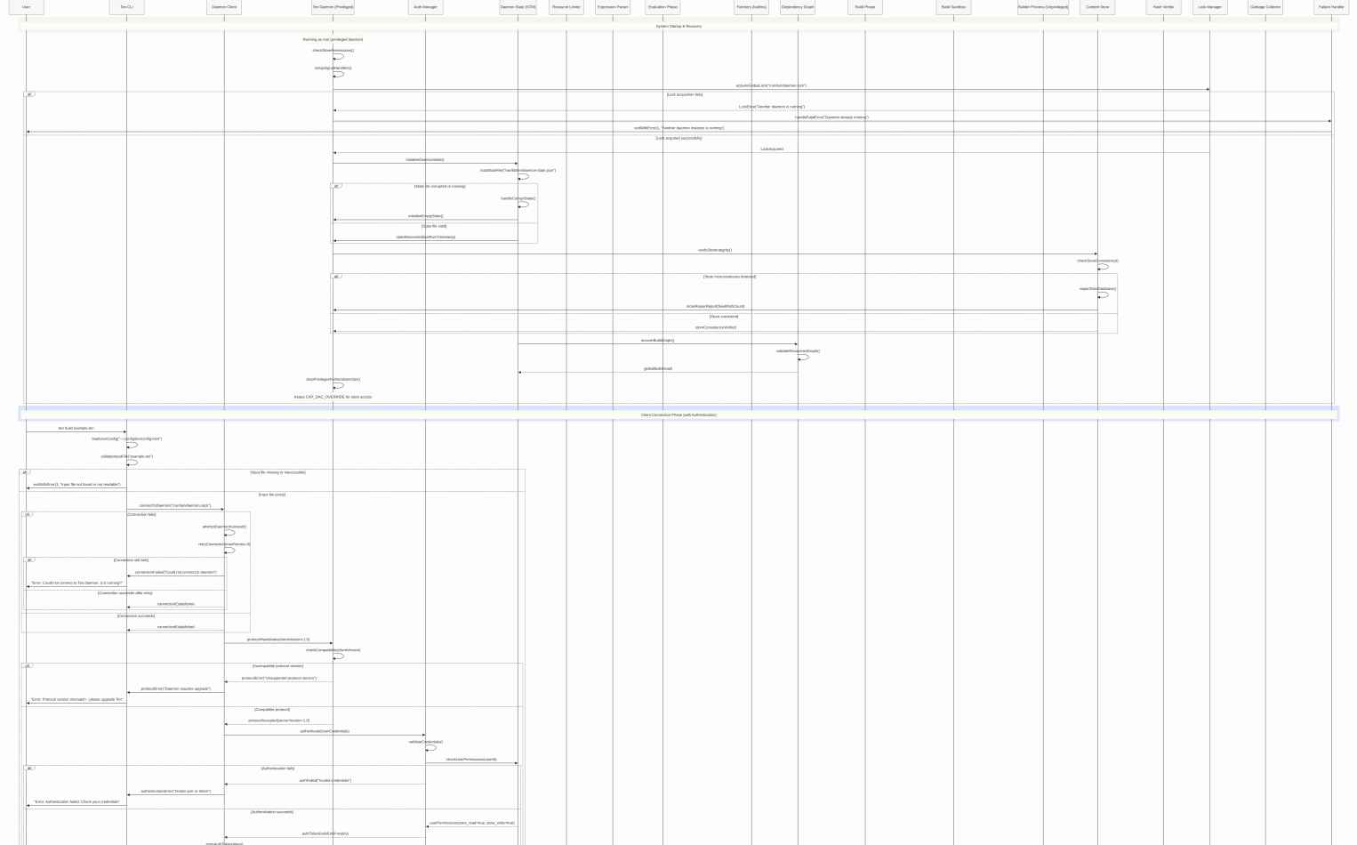
Ten DSL: Pure functional build system in Haskell
Created and presented for the Software Development Project, by Enzo Joly
https://github.com/enzojoly/ten

Slide 2
Problem Statement:
The State of Software Deployment
EXISTING METHODS
Distributing binaries (“copy the binary”/.exe)
Distributing source code w/ build instructions (scripts)
‘Nix’ DSL &-like systems (codify build instructions)
SOFTWARE OFTEN RELIES UPON SPECIFIC
DYNAMIC LINKING LIBRARIES, TO BUILD AND RUN

Slide 3
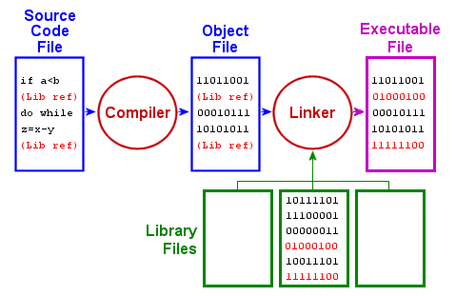
Image source:
https://karthikdega.wordpress.com/2013/10/23/how-to-compile-a-program-and-install-a-software-from-source-code/

Slide 4
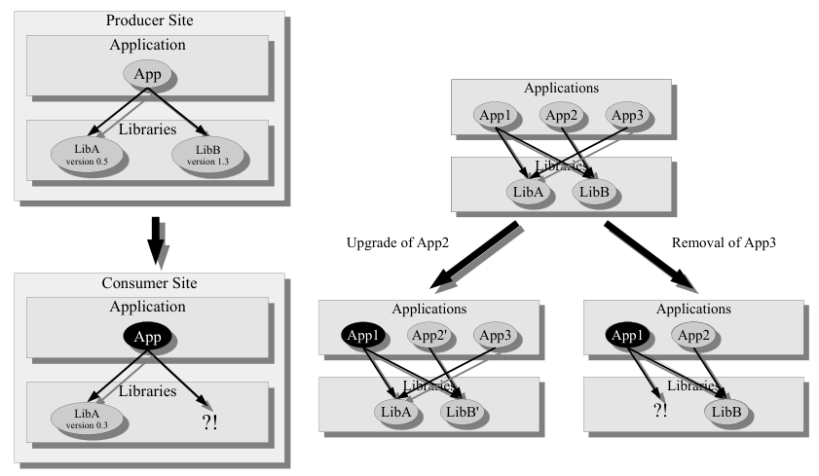
Dependency Existence and Transience
Image source: Eelco Dolstra, The Pure Functional Software Deployment Model p9

Slide 5
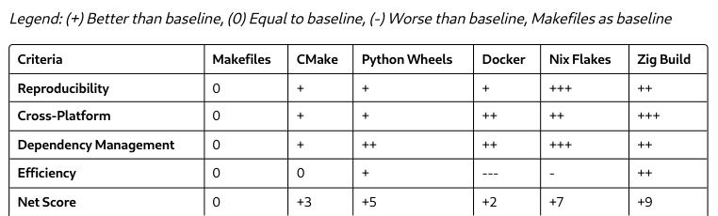
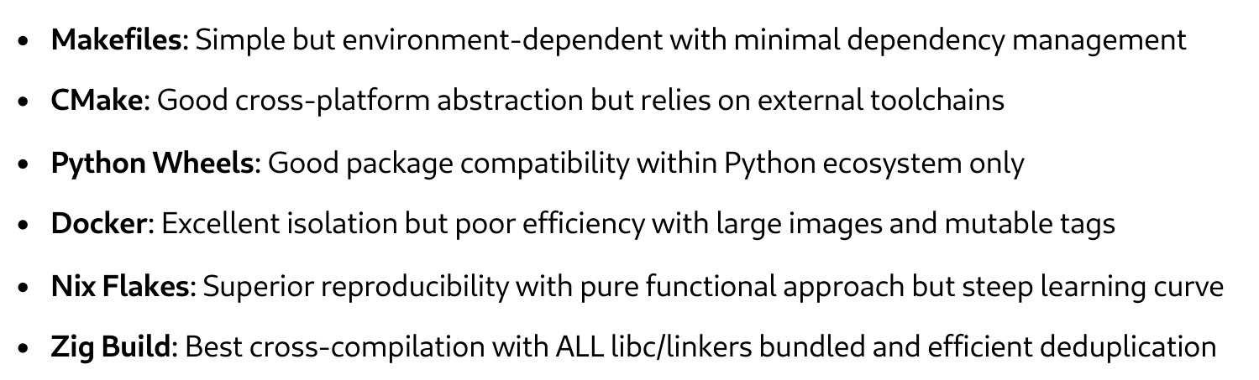
Comparing the State of the Art

Slide 6
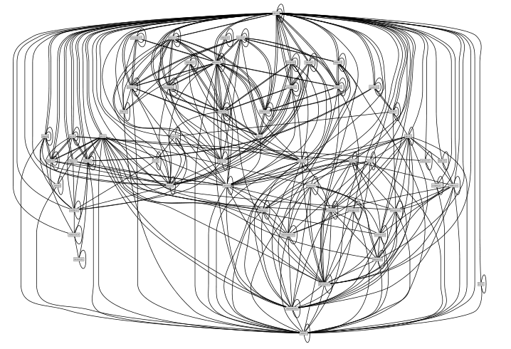
Problem Statement:
The State of Software Deployment II
To build ANY version, of ANY software, on ANY* machine:
We must control ALL variables that affect:
- HOW SOFTWARE BUILDS
- HOW SOFTWARE RUNS
Image source: Eelco Dolstra, The Pure Functional Software Deployment Model p10

Slide 7
Codifying Build Instructions: Derivations
drv {
name =
system =
builder =
args = []
src = builtIns.fetchTarball {
  url = https://github…../...src.tar.gz;
sha256 = “sha256: …”;
}
}
Paths as first class citizens:
“/dev/null” → String value (of a path)
/dev/null → ‘Nix path’
derivation {
name = “my-programme”;
system = “aarch64-darwin”;
src = ./main.c;
builder = “/bin/bash”;
args = [“-c” ``
/usr/bin/clang $src -o $out
`` ]
}
derivation {
name = “glibc-4.1.2”;
system = “aarch64-darwin”;
src = builtIns.fetchTarball {...};
builder = “/bin/bash”;
clang = import ./clang.nix # we can build our own clang and import it from the nix store (this is a nested derivation, the hash for glibc is now dependent on the derivation of clang itself. If clang changes, the hash for glibc does too).
buildPhase = [ ``
export CC=$clang/bin/clang
# ...
`` ]
}
Hard-coded bash and clang
This is a declarative method for build specification

Slide 8
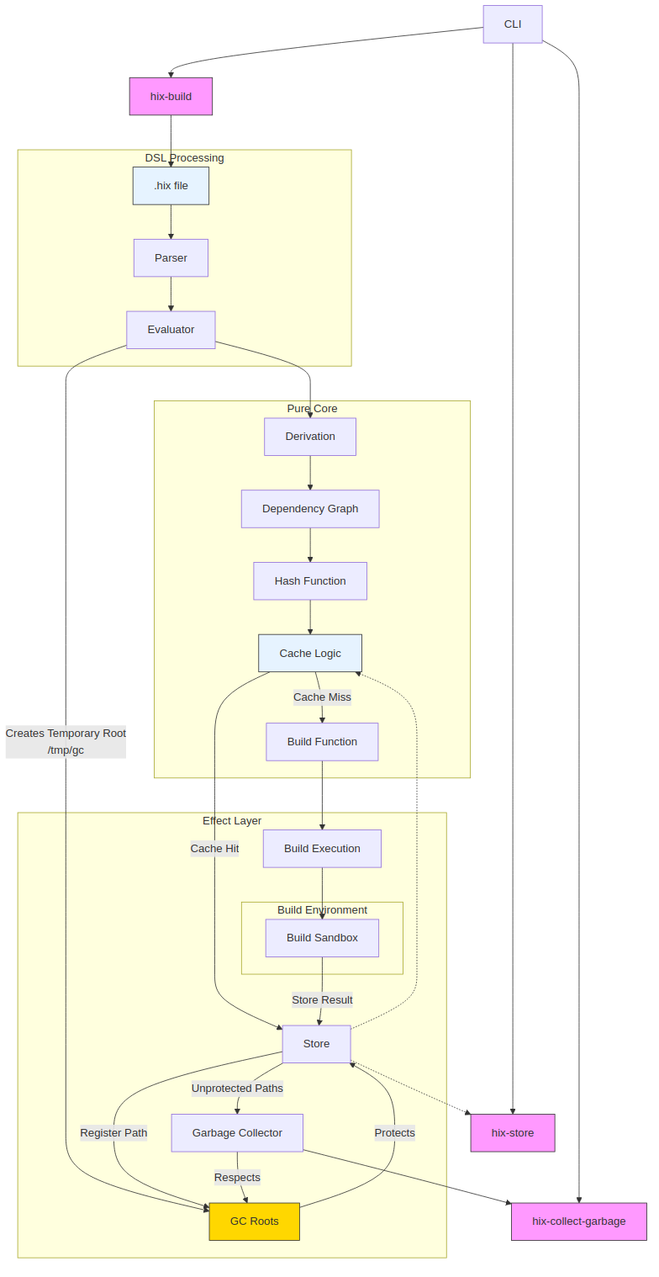
Project Proposal
“ I propose the creation of a DSL for building software. A pure functional Haskell syntax to create a build system that is both transactional and atomic.”
Build Determinism, Store Immutability, Path Independence, Closure Completeness, Evaluation Purity
- Filepaths [hashing store paths to verify deployments are identical]
- Derivations [declarative use of filepaths to create build recipes]

Slide 9
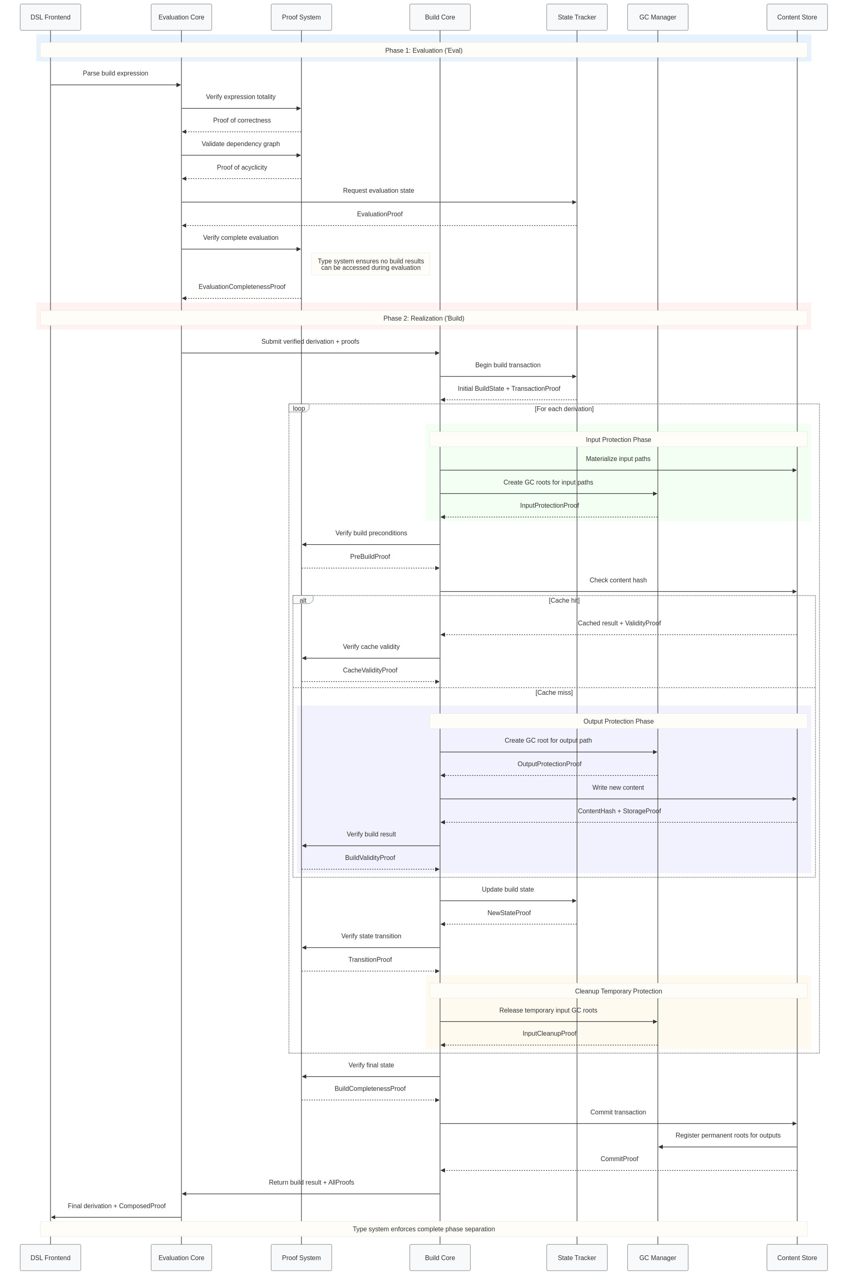

Slide 10
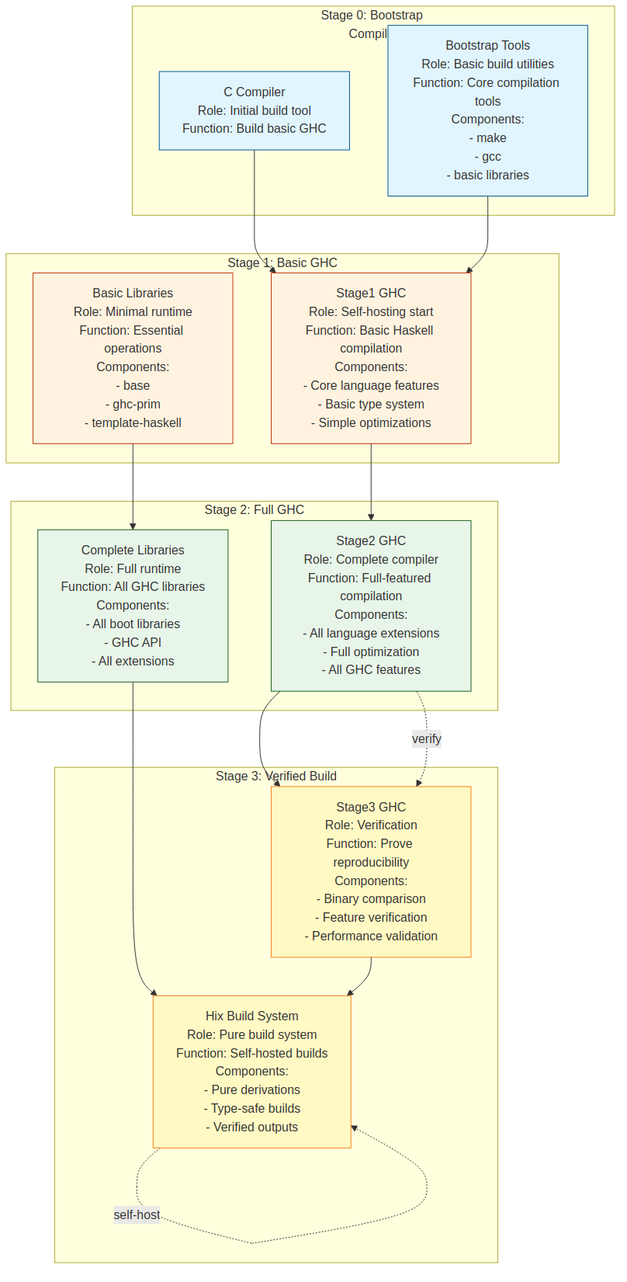
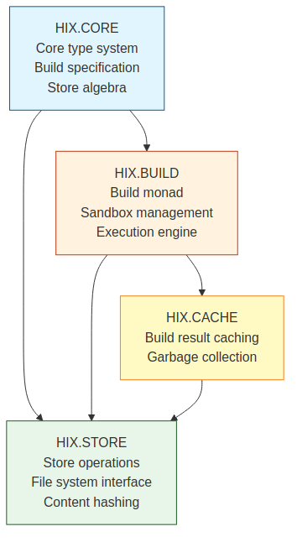
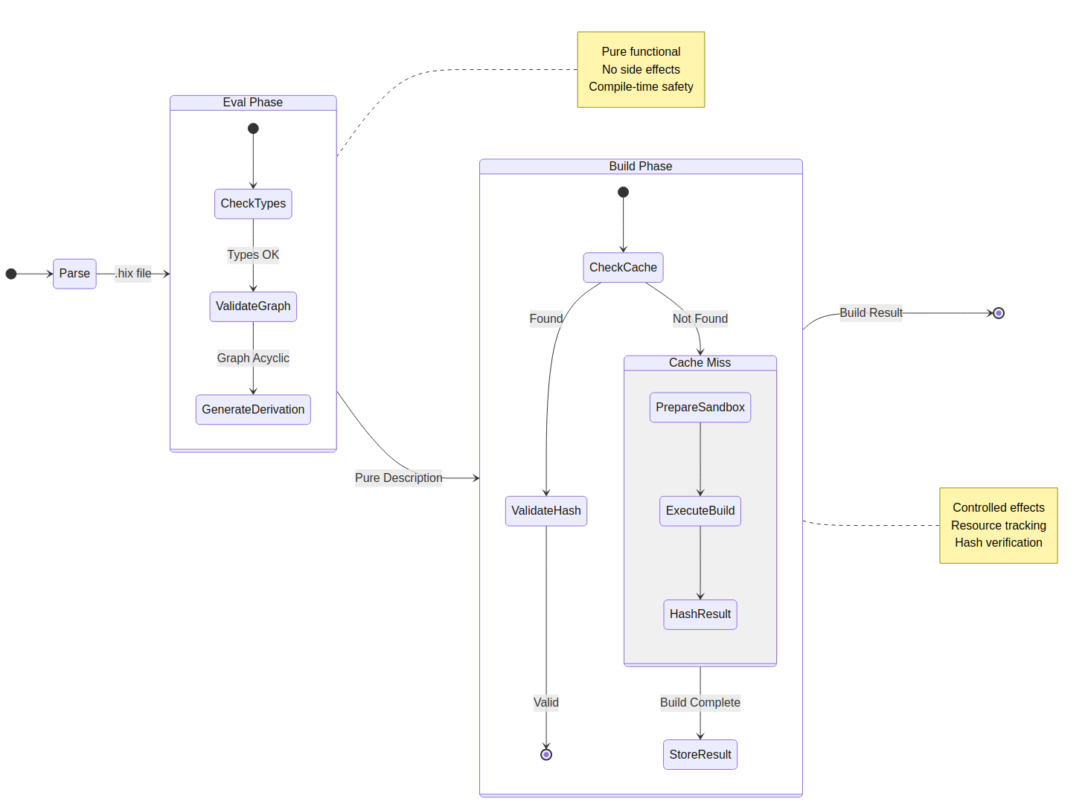
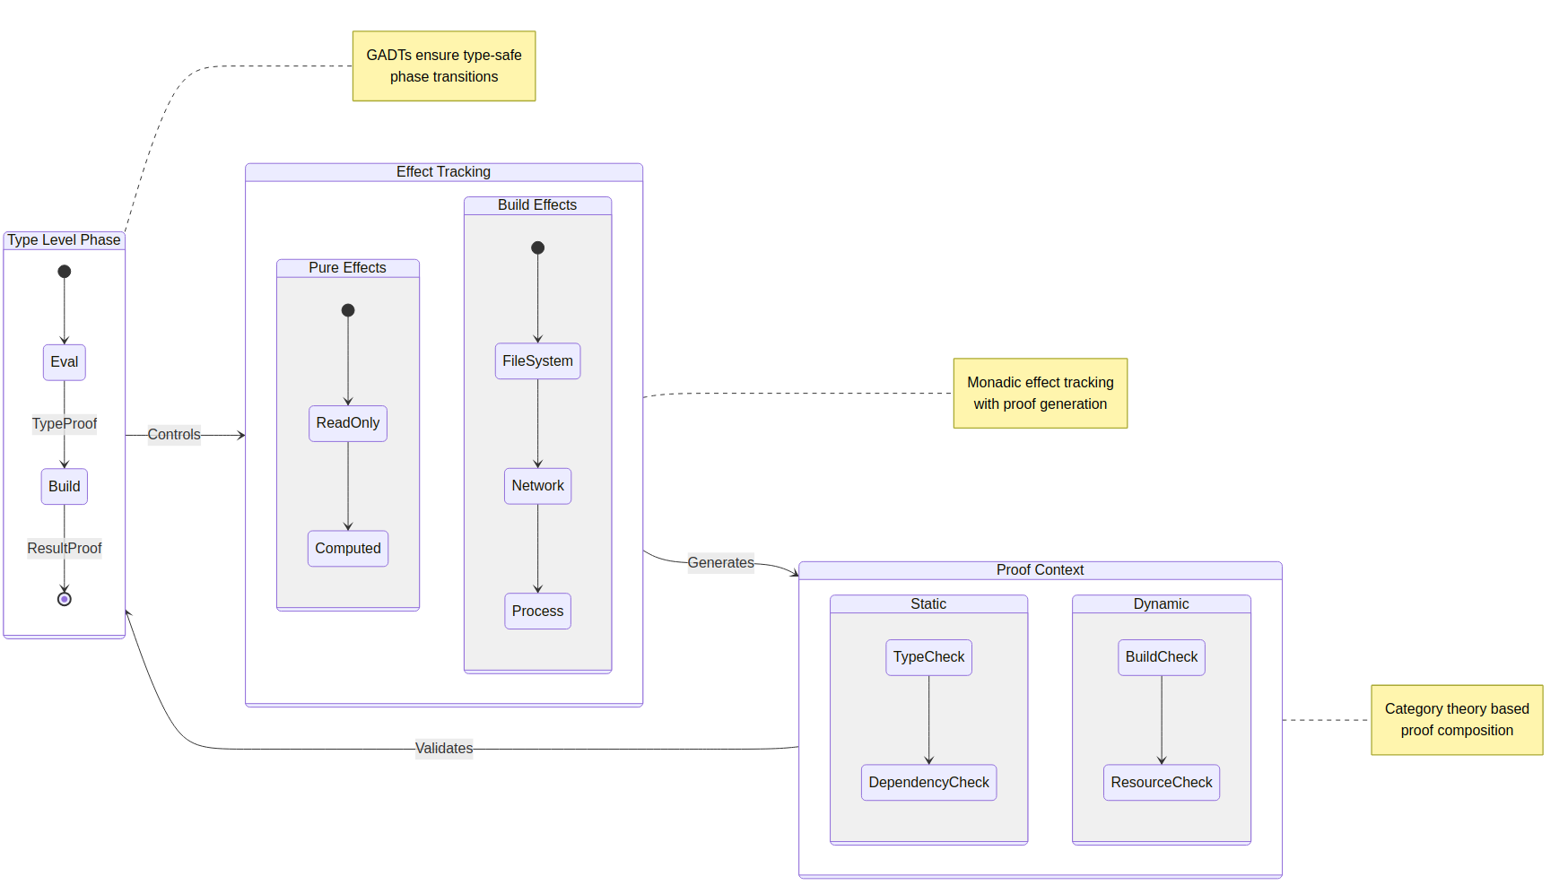
Functional & Non-Functional Requirements

Slide 11
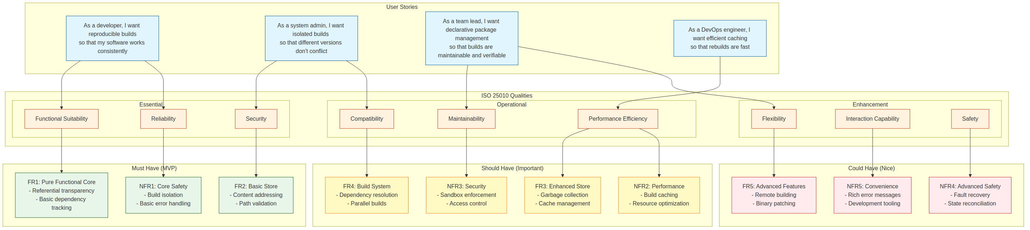
Software Requirements - ISO25010:2011
FR1: Pure Functional Core Requirements
1. Referential Transparency
* Same inputs must always produce the same outputs
2. Immutable Store
* All build outputs must be immutable
* Must prevent modification of stored artefacts
* Must create new paths for new versions
* Must maintain hash-based addressing for all artefacts
3. Declarative Specifications
* Build recipes must be purely declarative
* Must support functional composition of build steps
* Must enable reasoning about builds as pure functions
FR3: Holistic Executive Cohesion of Modular Architecture
5. Pure functional builds
* Builds are functions that take inputs and produce deterministic outputs
6. Content-addressed storage
* Store paths derived from the hash of their contents
7. Immutable store
* Once built, derivations are immutable
8. Garbage collection
* Removes unreferenced items from the store
9. Layered architecture
* Core storage, derivation layer, package management layer
* Monad Transformer Stack, layering is the nature of the build monad
10. Daemon-based operation
* The ten-daemon handles privilege operations, client makes requests
FR2: DSL-Store Pipeline for Build Specification
4. Ten Expression Language
* Must provide a purely functional DSL for build specifications
* Must handle path references in a purely functional manner

Slide 12
Software Requirements – ISO25010:2023 cont.
functional suitability
functional completeness
functional correctness
functional appropriateness
performance efficiency
time behaviour
resource utilisation
capacity
compatibility
co-existence
interoperability
interaction capability
appropriateness recognisability
learnability
replaceability
safety
operational constraint
risk identification
adaptability
scalability
installability
operability
user error protection
user engagement
inclusivity
user assistance
self-descriptiveness
reliability
faultlessness
availability
fault tolerance
recoverability
security
confidentiality
integrity
non-repudiation
accountability
authenticity
resistance
maintainability
modularity
fail safe
hazard warning
safe integration
reusability
analysability
modifiability
testability
flexibility
FR1: Pure Functional Core Requirements
FR2: DSL Interface for Build Specification
FR3: Holistic Executive Cohesion of Modular Architecture
FR4: Derivation Management
FR5: Store Management
FR6: Error Handling & System Integration
NFR1: Reliability Requirements
NFR2: Security Requirements
NFR3: Performance Requirements
NFR4: Usability Requirements
NFR5: Compatibility Requirements
NFR6: Maintainability Requirements

Slide 13
Use Case Summary
Package building/customisation
Software version/variant control and management
Robust integrity and reliability for software deployment
“Just works” – intuitive and applicable design patterns
Infrastructure as Code (IaC)
Discoverable
Linux only! (MVP)

Slide 14

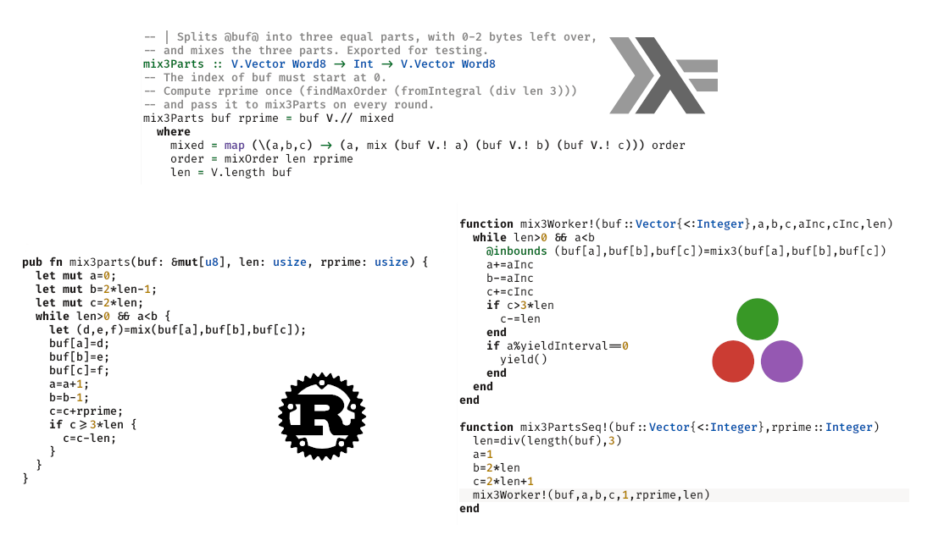
Why Haskell?
This is a complicated question!
Image source: https://www.linkedin.com/pulse/comparison-haskell-rust-julia-same-algorithms-pierre-abbat-zq9gc/

Slide 15
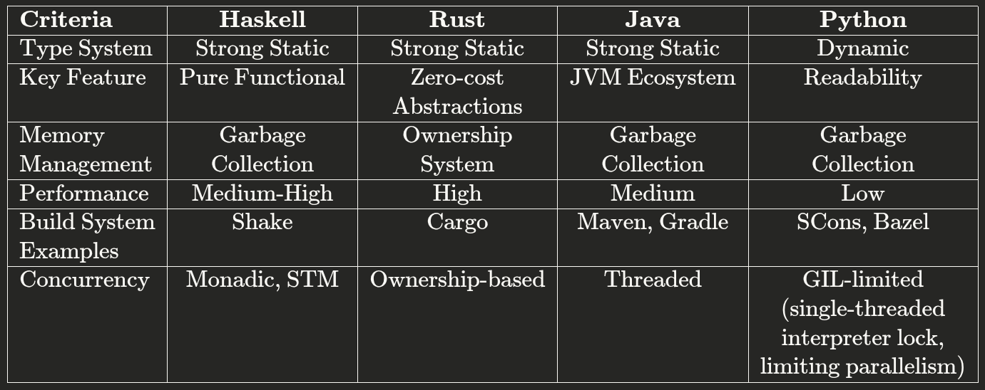
Why Haskell? II
Image source: Anthropic’s Claude 3.7 Sonnet

Slide 16

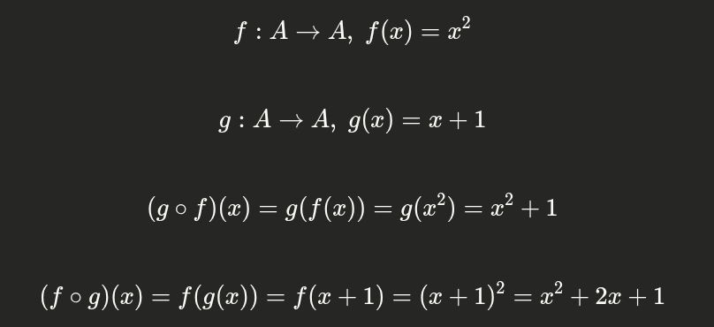

Why Haskell? III
So, what is a MONAD?
Pure functions guarantee the same output for the same input! (deterministic)
However, if all of our functions are pure that means we have no side-effects...
Side-effects (such as Network communication, IO, Database mutation etc.) allow us to create programmes that are USEFUL
Function composition
Associativity (not commutative)
Functions under composition
Lambda function for addition
Image source: Anthropic’s Claude 3.7 Sonnet

Slide 17
Monadic Composition - Stateless State
These are our pure functions
These are our monadic functions w/ side-effects
g : a → b
f : b → c
f ∘ g : a → c
g : a → Mb
f : b → Mc
: a → Mc
g(a) >>= f
In this equation a lambda (anonymous function) of ‘a’ calls a function g of type (a → Mb) and BINDs (>>=) Mb into f of type (b → Mc)
λa.((λa.Mb)(a) >>= λb.Mc)
a --------------------------------------------------→ Mc
This looks confusing, but if we annotate the types, we see that there’s nothing scary here
λa.[((λa.Mb)(a) >>= λb.Mc)]
g
f
a --------------------------------------------------→ Mc
g is of type : a → Mb
g(a) is of type : Mb
[ Mb → (b → Mc) → Mc ]
the type of the bind operator (takes an Mb and a function from b → Mc and returns an Mc

Slide 18
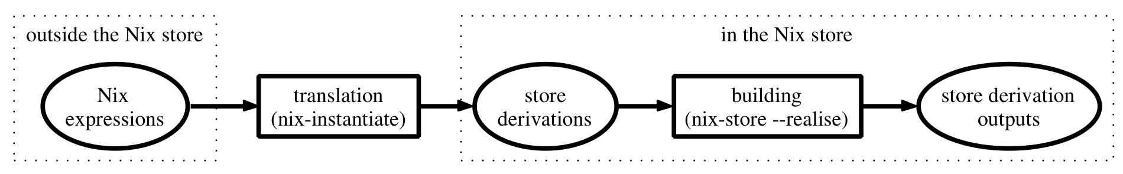
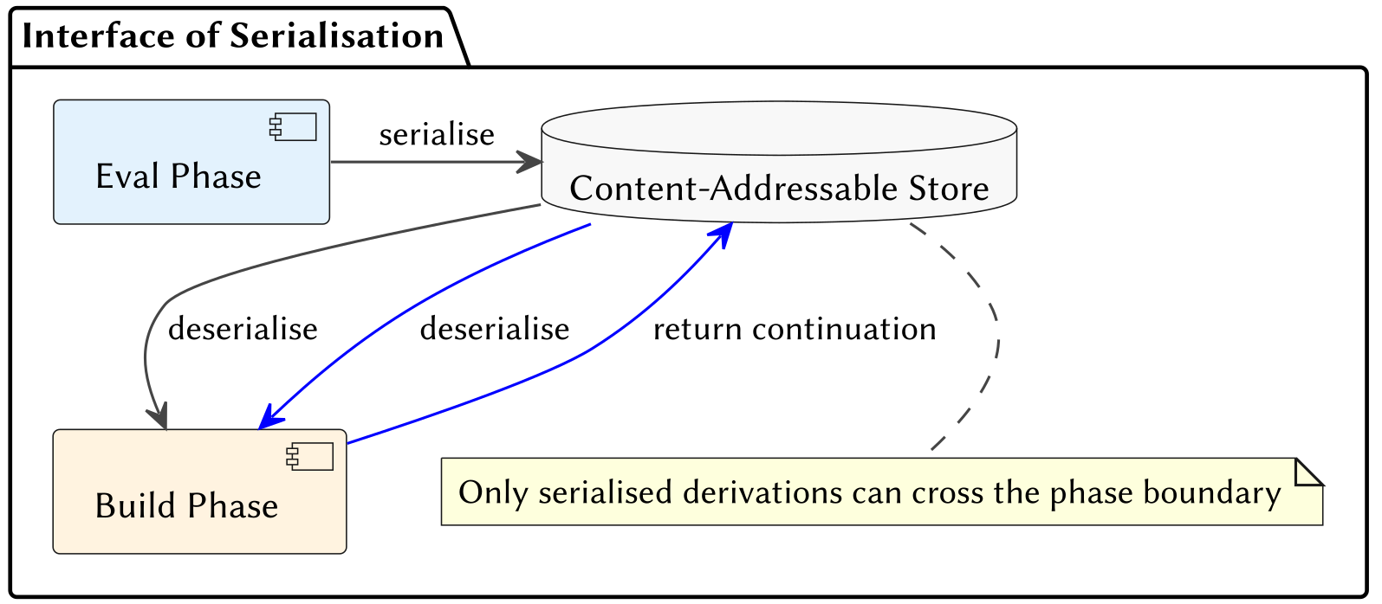
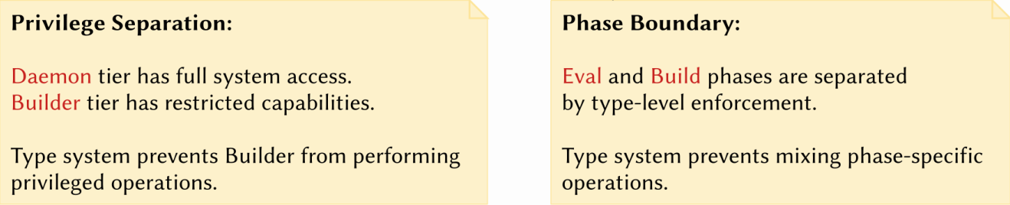
Ten’s Inviolable Boundary: Phases
Image source: Eelco Dolstra, The Pure Functional Software Deployment Model p39

Slide 19
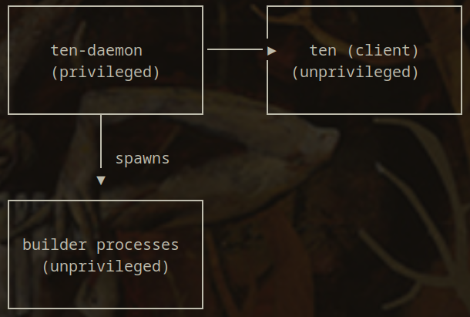
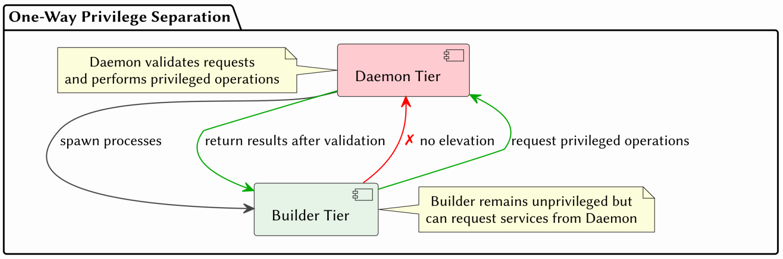
Ten’s Inviolable Boundary: Tiers

Slide 20
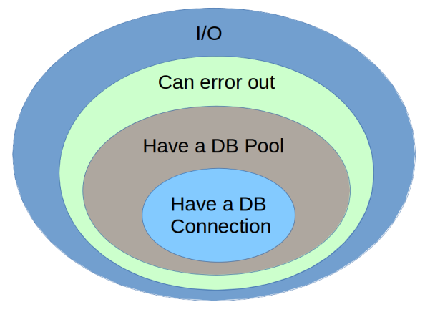
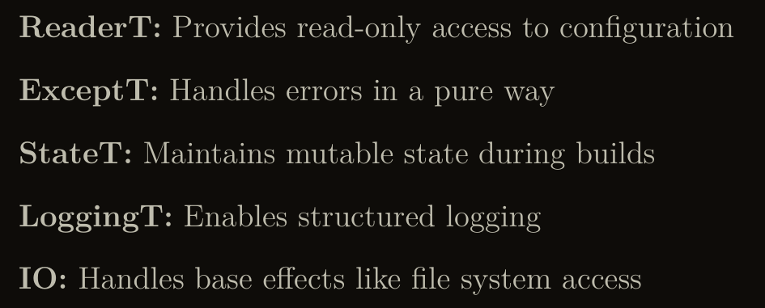
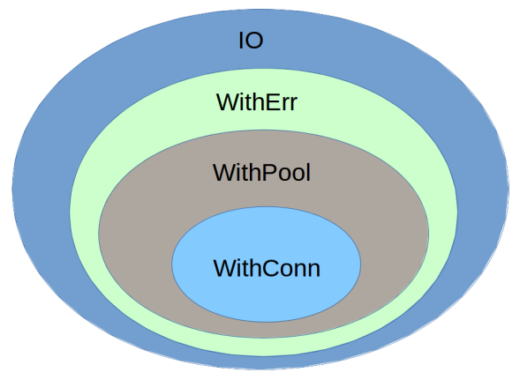
MonadT Composition – Lifting across context
Pure functional languages like Haskell DISALLOW implicit state.
State is passed EXPLICITLY
Pertinent information is threaded through the system and side-effects are managed and controlled by way of composition
The management of our monad(s), and by extension effects, is performed with a “Monad Transformer Stack”
above & below image source: https://github.com/bhurt/presentations/blob/master/hsgems.odp
Monad Transformers: Domains that encompass domains; monads that stack on top of monads

Slide 21
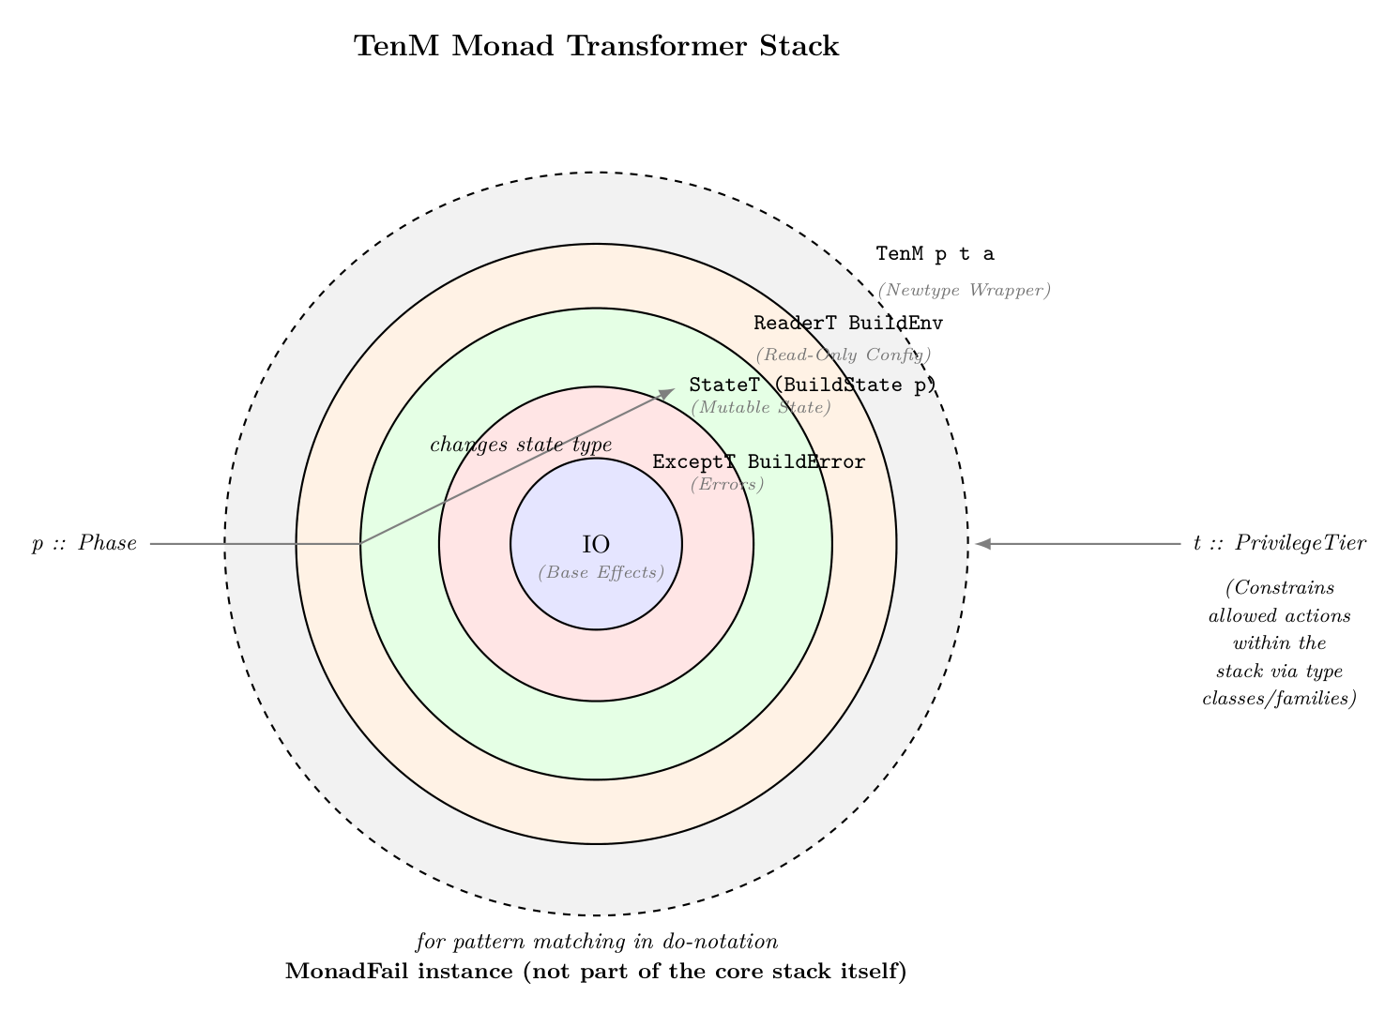

Slide 22
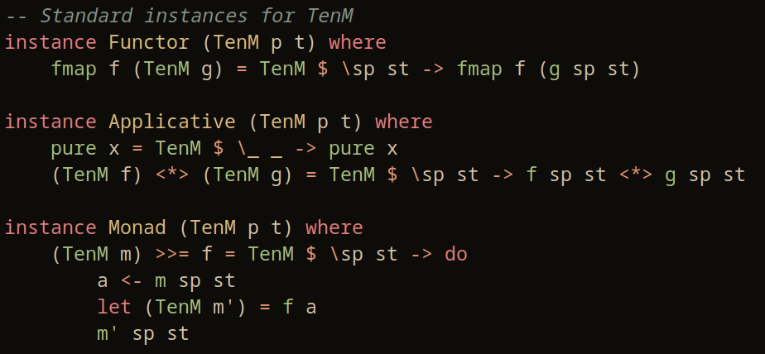
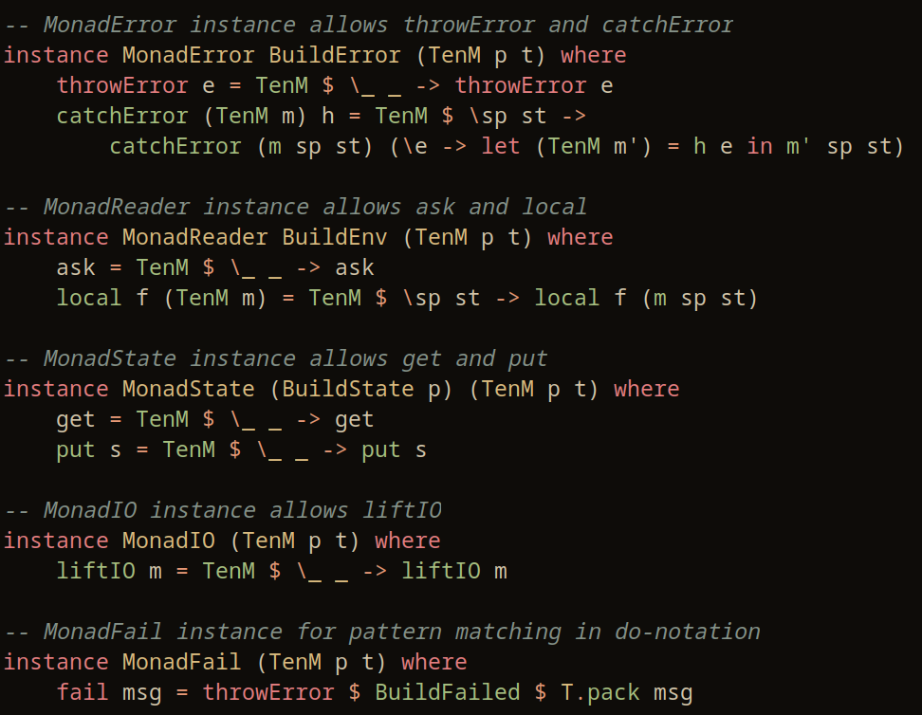
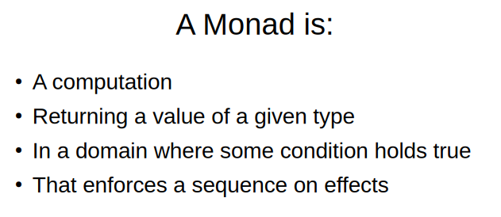
TenM
Parameterised by Phantom Types: Phase and PrivilegeTier
\
Phantom types add extra type safety and constraints to a program without adding any runtime overhead.
Functor Instances for TenM
s represents the singleton evidence for the Phase and PrivilegeTier parameters.
The singletons SPhase and SPrivilegeTier are used to carry type-level evidence for the Phase and PrivilegeTier parameters
image source: https://github.com/bhurt/presentations/blob/master/hsgems.odp
This evidence is used to ensure that the monad TenM is correctly parameterised with the appropriate Phase and PrivilegeTier

Slide 23
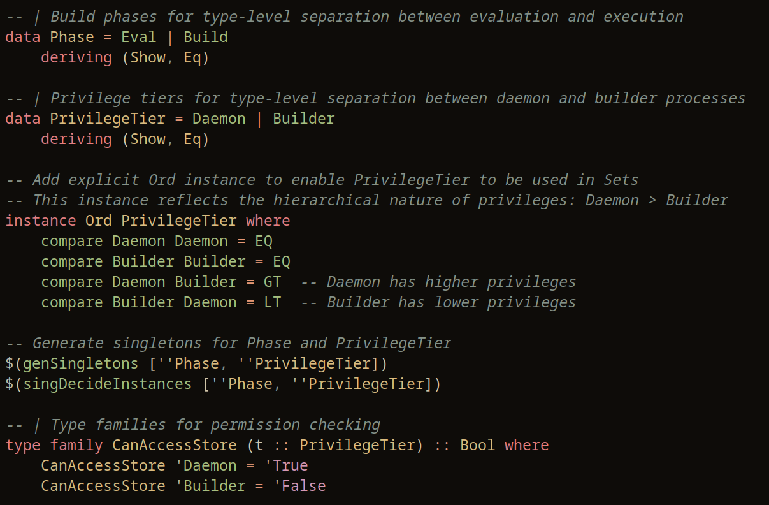

Slide 24
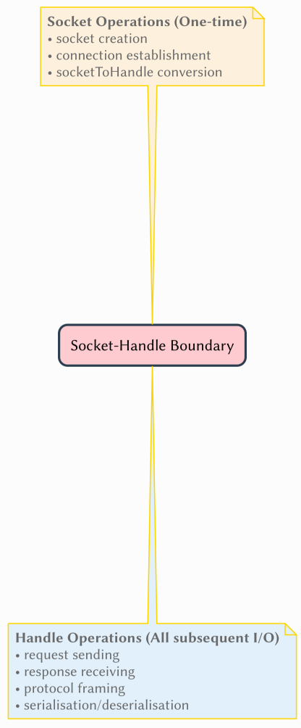
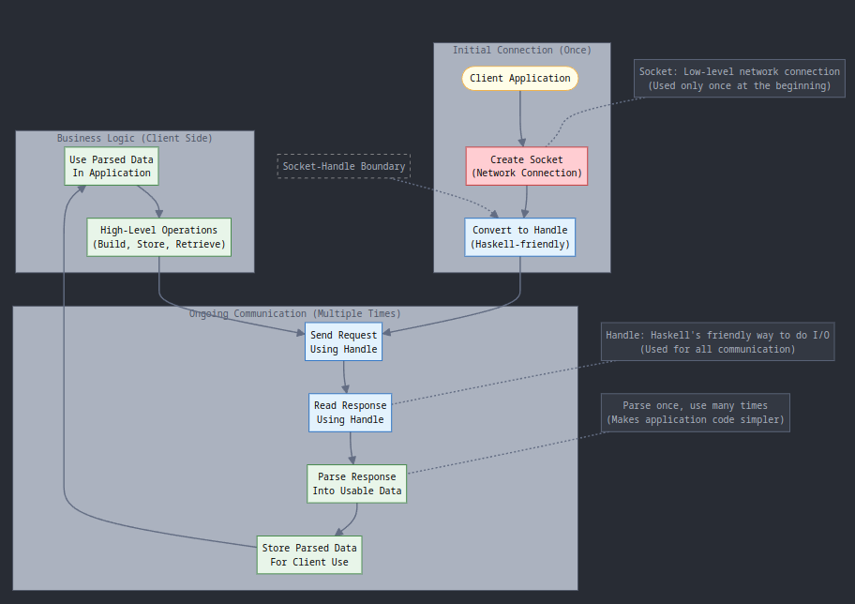
Further Architectural Choices...

Slide 25
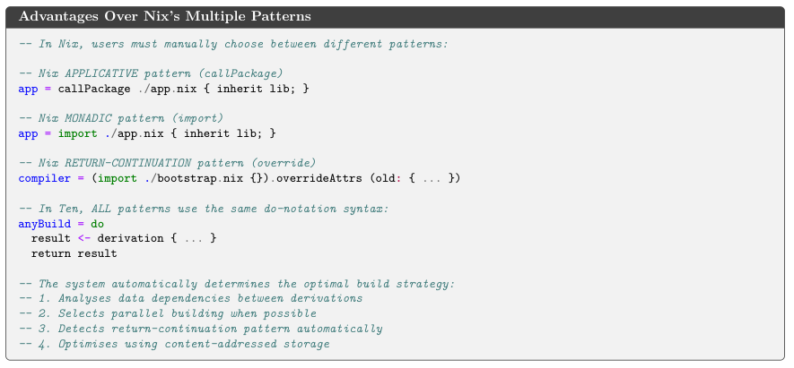

Slide 26
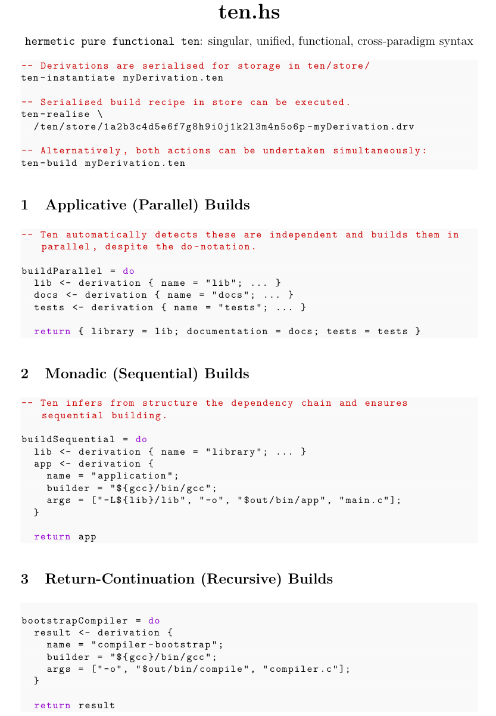
API

Slide 28
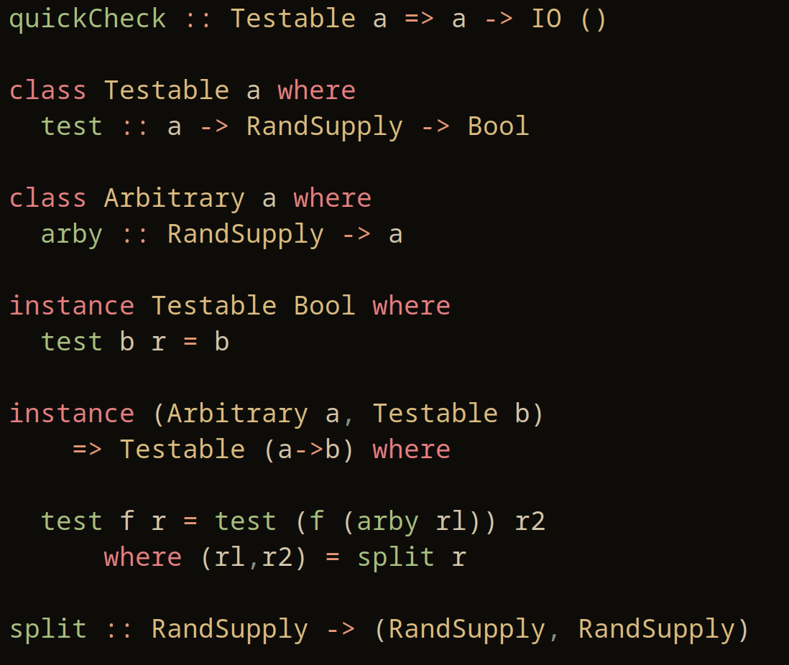
Testing Framework(s) - Overview
The test files provided show a comprehensive testing framework for the Ten build system using a combination of:
HSpec: As the main testing framework providing the DSL for test organization
Hunit: For traditional unit testing with specific assertions
QuickCheck: For property-based testing that generates random test cases to verify invariants
(assuming)

Slide 29
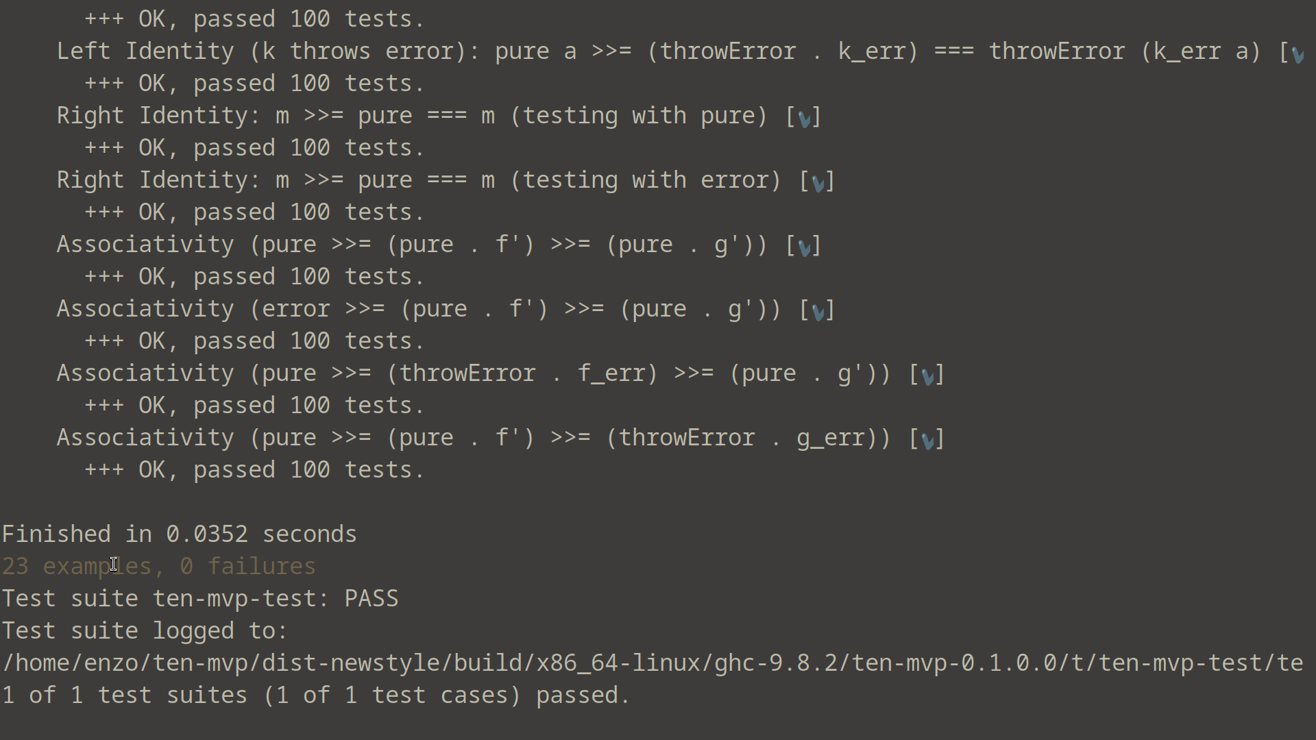
TenM Miniaturised - ten-mvp
The newtype TenM definition is identical.
The underlying monad transformer stack (ReaderT/StateT/ExceptT/IO) is identical.
100x less code
Singleton instances to link type-level parameters to runtime is identical
Property-based testing w/ QuickCheck
Fundamental mechanics & structure preserved
https://github.com/enzojoly/ten-mvp

Slide 30
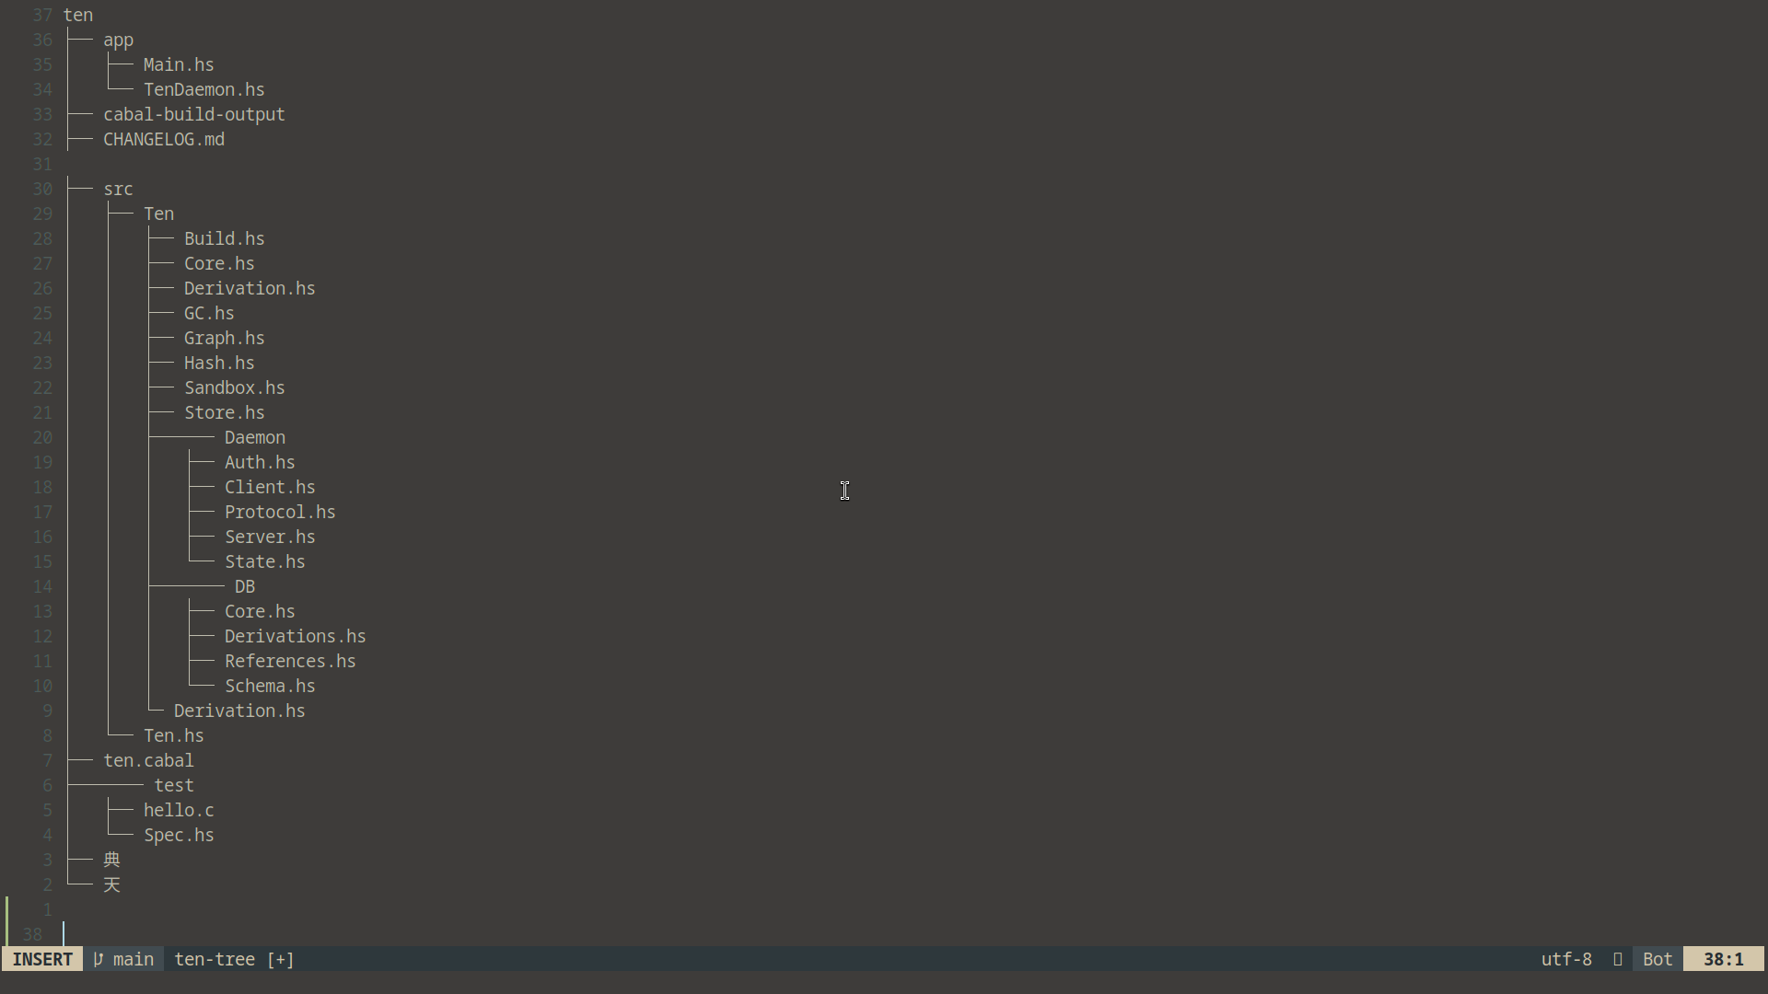
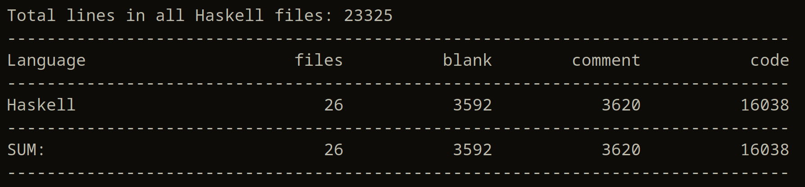


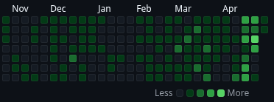
Present State of Affairs: Ten Build System
23,325 loc (Haskell)
Pre- CLI.hs, Ten.hs (source) and app/ removal:
30k+ Total Lines
20k+ Code
Ten executable – Build success
research backup
cabal build – successful compilation
(100% code confirmed ubiquitously type-safe)
ten codebase
~400 commits
ten mvp
Spec.hs – Rudimentary Test Suite implemented
cabal test – successful testing, non-exhaustive (minimal)
– 17 tests, 13 passing, 4 failures (inconclusive)
Test Results Summary
The test output shows mixed results:
Passing Tests:
All StorePath unit tests and properties (7 tests)
All Hash tests (2 tests)
All Derivation tests (2 tests)
All Sandbox tests (1 test)
All Build tests (1 test)
https://github.com/enzojoly/ten
Failing Tests:
All Graph unit tests (2 tests)
All Graph property tests (2 tests)
The failing tests all show a similar error pattern: PrivilegeError "Privilege tier mismatch"
Test Categories
The tests cover several critical aspects of the Ten build system:
StorePath Tests: Validating path format, hash validation, and path conversion
Hash Tests: Ensuring hashing functions produce consistent and unique outputs
Graph Tests: Testing dependency graph operations (cycle detection and topological sorting)
Derivation Tests: Verifying serialization/deserialization and equality comparison
Sandbox Tests: Testing configuration for isolated build environments
Build Tests: Verifying build result validation
Property-based Tests: Using QuickCheck for generative testing of system invariants

Slide 31
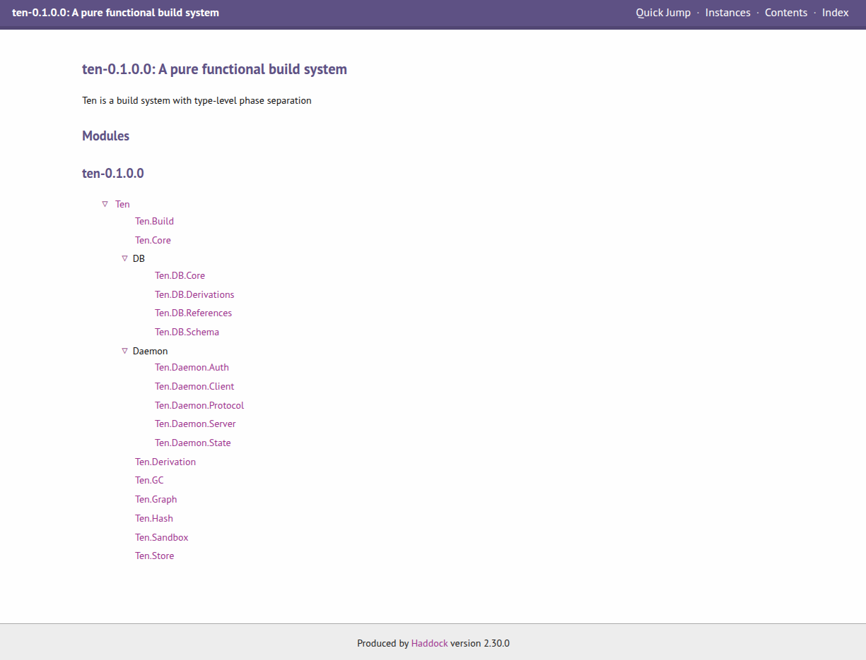
Future Work
Codified build recipe DSL implementation (from concept)
Exhaustive Test Suite integration
Command-line interface
Optimisation, custom implementations for imported libraries
Visualisation mode for operational demos?
QOL features

Slide 32
Thanks for watching!
joly@enzojoly.dev

