Slide 1
FieldOps
Staffing & Operations
Management
A working app for managers coordinating teams across different locations
Portfolio demonstration with simulated data
01
Notes:
FieldOps helps managers decide where qualified available workers should be assigned and whether collection and quality-review capacity can meet a deadline. The example client business collects recordings for AI training. The app uses predefined rules and calculations.
Independent portfolio demonstration. All organizations, workers, costs and results are simulated. Source: https://github.com/enzosafadi/FieldOps and docs/VALIDATION.md.

Slide 2
The operating problem
Enough workers on the schedule can still mean a missed client deadline
340
320
Accepted recordings required
Projected before intervention
In the retail scenario, quality review limits delivery. Additional collectors alone leave the forecast unchanged.
Fictional client scenario. Four-hour planning window. Delivery counts accepted work.
02
Notes:
Baseline Retail interactions: accepted 229, target 340, QA capacity 26 units/hour and observed first-pass acceptance 229/260. The model projects 320 accepted by deadline.
Independent portfolio demonstration. All organizations, workers, costs and results are simulated. Source: https://github.com/enzosafadi/FieldOps and docs/VALIDATION.md.

Slide 3
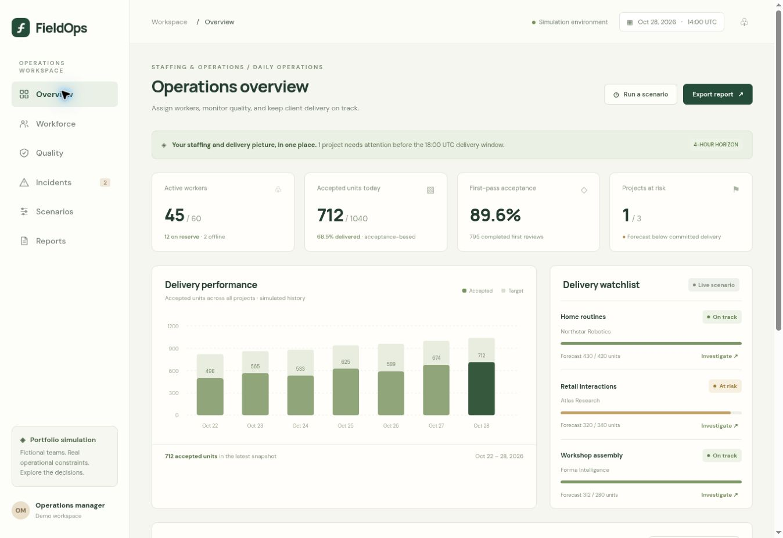
The manager’s operating view
60 workers
3 client projects
The overview connects current staffing with accepted output and delivery risk.
Managers open an at-risk project to inspect the constraint.
Actual app screen. The baseline includes 45 active workers and 12 available reserves.
03
Notes:
The overview screenshot uses the baseline state. Two workers are offline and one is absent. All values originate from deterministic simulated data.
Independent portfolio demonstration. All organizations, workers, costs and results are simulated. Source: https://github.com/enzosafadi/FieldOps and docs/VALIDATION.md.

Slide 4
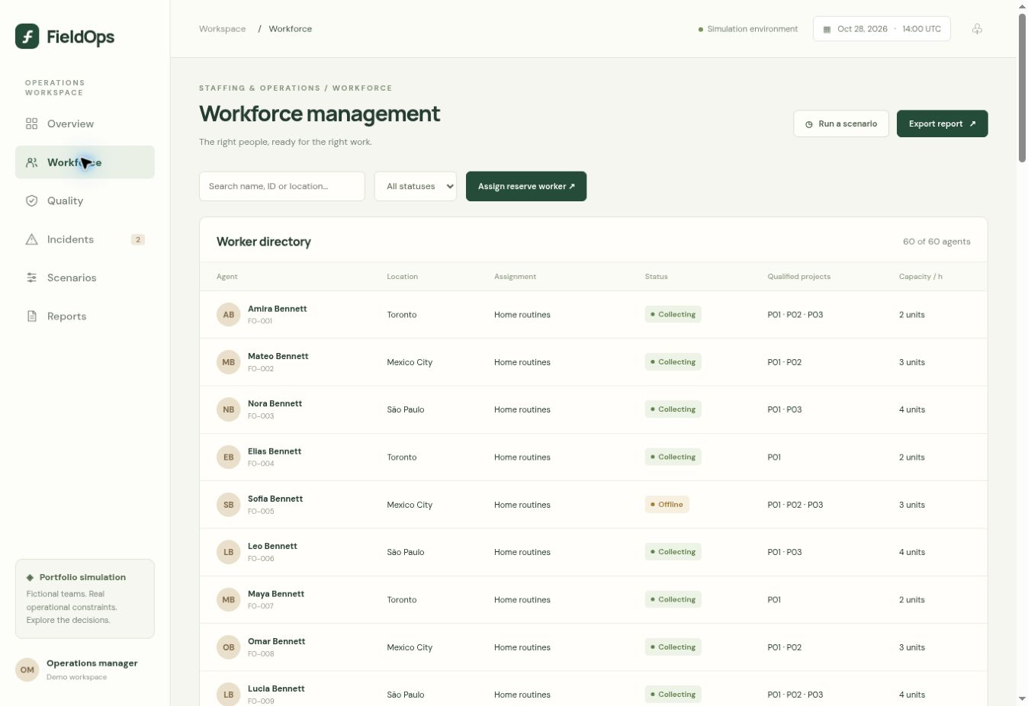
Staffing decisions respect eligibility
Managers search by worker or location and review current assignments.
The app checks availability, project qualifications and an existing assignment before allocating reserve staff.
One shared shift window
14:00–18:00 UTC
Fictional worker directory. An assigned worker cannot receive a second project in this window.
04
Notes:
The workforce screenshot follows the illustrated intervention and therefore shows the worker assignment after it. No private personnel records are used. Validation rejects unavailable and unqualified workers and duplicate assignments.
Independent portfolio demonstration. All organizations, workers, costs and results are simulated. Source: https://github.com/enzosafadi/FieldOps and docs/VALIDATION.md.

Slide 5
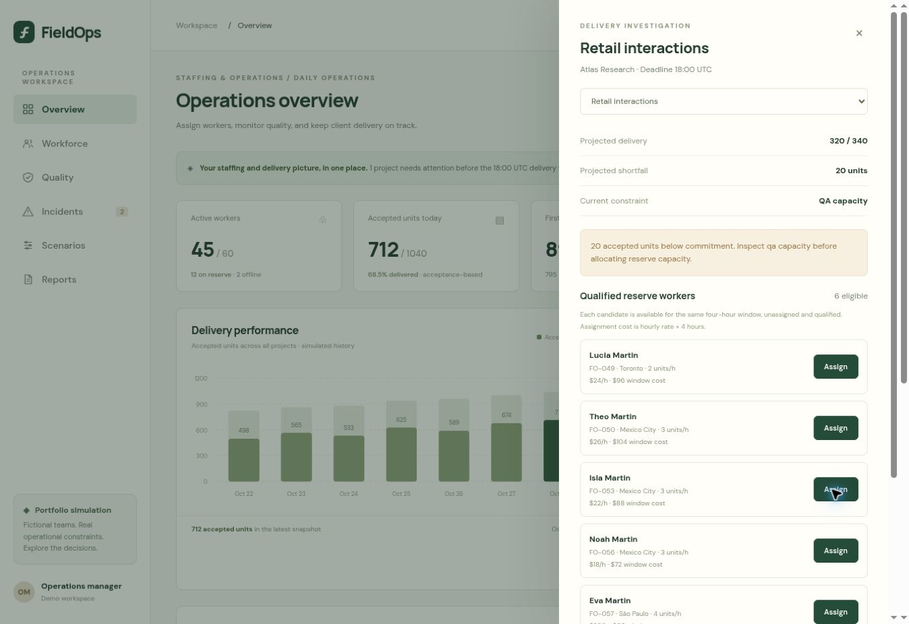
The investigation explains the bottleneck
Retail interactions projects a shortfall of 20 accepted recordings.
The investigation identifies QA capacity as the constraint and shows qualified reserve workers with their modeled cost.
The manager adds review capacity after assessing the staffing action
Actual investigation screen before intervention. Historical accepted output remains fixed.
05
Notes:
Lucia Martin costs $24/hour for four hours, or $96. A QA block adds six review units/hour at $72 for the window. Adding the collector alone does not remove the QA bottleneck.
Independent portfolio demonstration. All organizations, workers, costs and results are simulated. Source: https://github.com/enzosafadi/FieldOps and docs/VALIDATION.md.

Slide 6
Simulated result of the intervention
Measure | Baseline | After action
Retail projected accepted units | 320 | 341
Portfolio projected accepted units | 1,062 | 1,083
Projects below commitment | 1 | 0
Remaining-window direct cost | $3,904 | $4,072
21 more projected accepted units for $168 in added modeled cost
Simulated forecasts, not achieved client outcomes. Costs exclude existing QA labor and overhead.
06
Notes:
Intervention: assign Lucia Martin to Retail interactions, then add one QA reserve block. Assignment costs $96 and QA costs $72, total $168. Projected portfolio output rises by 21. These figures do not establish profit, realized savings or ROI. Source model: dist/model.mjs.
Independent portfolio demonstration. All organizations, workers, costs and results are simulated. Source: https://github.com/enzosafadi/FieldOps and docs/VALIDATION.md.

Slide 7
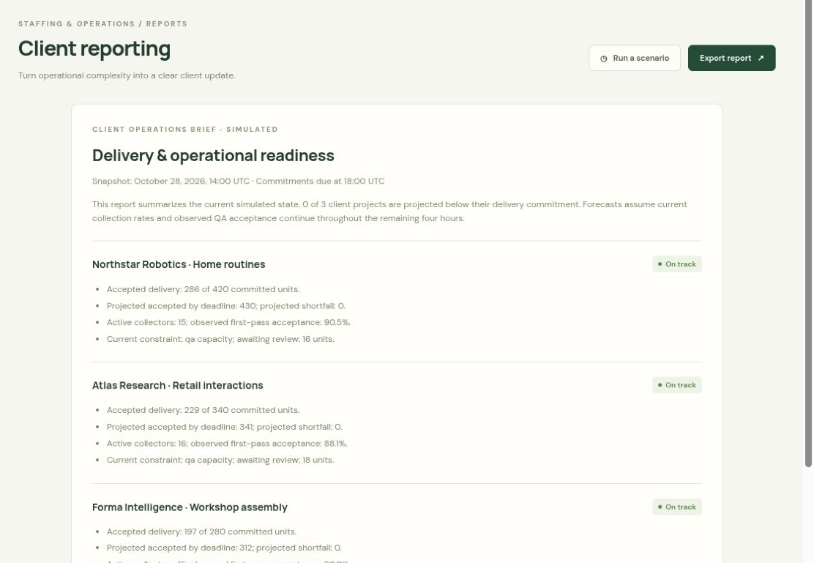
The client report follows the scenario
The report explains accepted output, the deadline forecast and each project’s constraint.
Managers can download a CSV or print a summary. The audit records their corrective actions.
Changes persist in the current browser and can be reset
Actual report screen after intervention. All client and operational information is simulated.
07
Notes:
Browser verification confirmed downloaded CSV contains the three project rows, matching forecasts, simulation disclosure and audit actions. Native print-to-PDF is a browser feature. The screenshot shows the client summary after both interventions.
Independent portfolio demonstration. All organizations, workers, costs and results are simulated. Source: https://github.com/enzosafadi/FieldOps and docs/VALIDATION.md.

Slide 8
Completed portfolio prototype
Delivered
Defined scope
Interactive application
Business case and introduction
Model checks and walkthrough
Screenshots and presentation
Deterministic simulation
Browser-local storage
One shared shift window
No live workforce integrations
github.com/enzosafadi/FieldOps
Public demo source. Hosted app currently requires the owner’s ChatGPT access.
08
Notes:
The portfolio prototype is complete within its documented scope. The separate FieldOps-Private repository retains development materials. Real multi-user operations would require a backend, operational data governance, integration work and further validation. All metrics here remain simulated.
Independent portfolio demonstration. All organizations, workers, costs and results are simulated. Source: https://github.com/enzosafadi/FieldOps and docs/VALIDATION.md.

