Slide 1





Air quality monitoring and management
25 May 2021, 14:00 CEST

Slide 2
This webinar aims to provide advanced knowledge about the primary principles of air quality monitoring and management. The participants will be informed:
about EO technologies and data to collect spatiotemporal measurements and forecasts of air pollution
how to make usable satellite-derived and ground-based data into air quality planning and decision
About relationships among emission sources, meteorological conditions, monitoring and modelling of air pollution for practical applications
Agenda
Session A: The basics for air quality monitoring and management
Session B: The ground truth: air quality measurements in urban scale
Session C: Transforming Earth Observation data into real insights for air quality
Session D: Air pollution modelling: what is it and what can it tell us?
Organizers
The Webinar was organized by the University of Patras (UPAT), in the framework of the EO4GEO project.

Slide 3
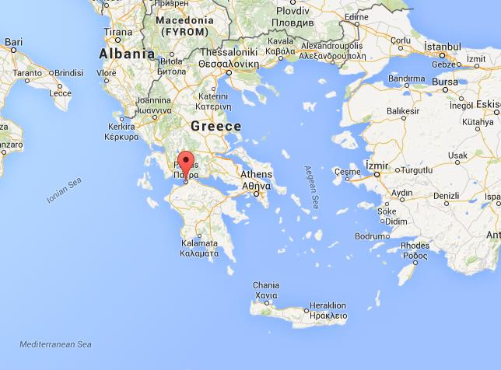
The Laboratory of Atmospheric Physics – University of Patras
Research Axes
Measurements, quality control, processing and homogenization of meteorological and environmental time series.
Stable isotopes (¹⁸Ο & ²Η) in rain and in atmospheric water vapor
Ultraviolet radiation: Measurements, modelling and biological dose rates
Solar Radiation: Measurements, modelling and solar energy
Artificial intelligence methods applied to atmospheric and environmental physics problems
Weather and atmospheric pollution forecasting modelling
More info: https://www.atmosphere-upatras.gr/en
Where is Patras?

Slide 4


The EO4GEO project

Slide 5
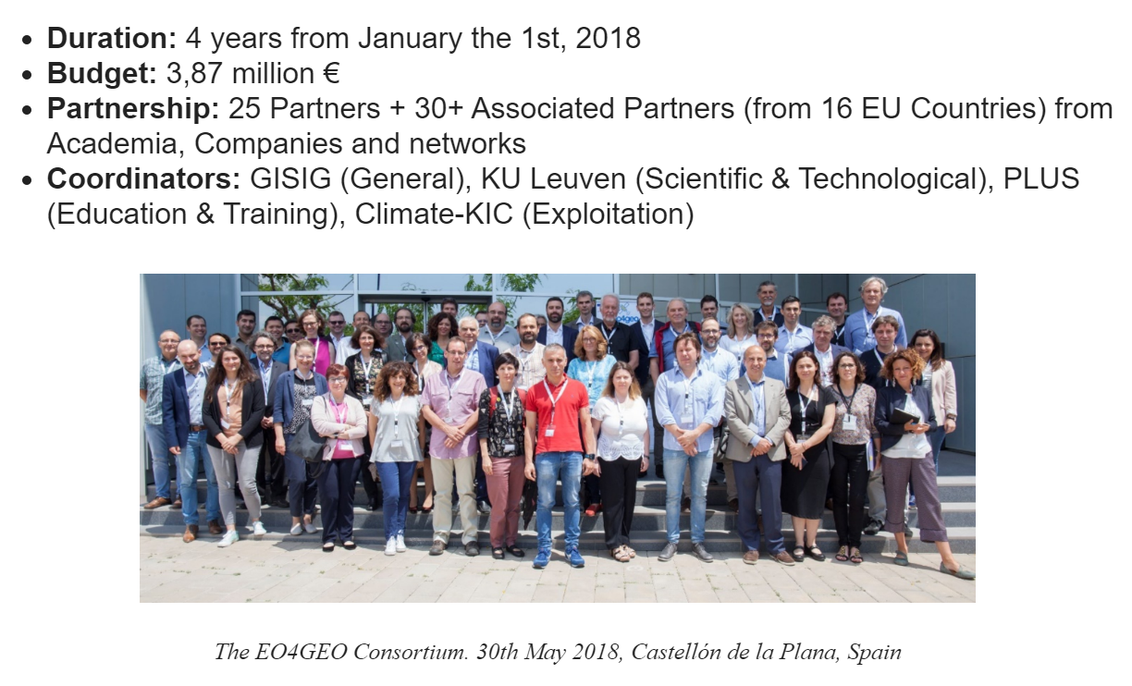
The EO4GEO project

Slide 6
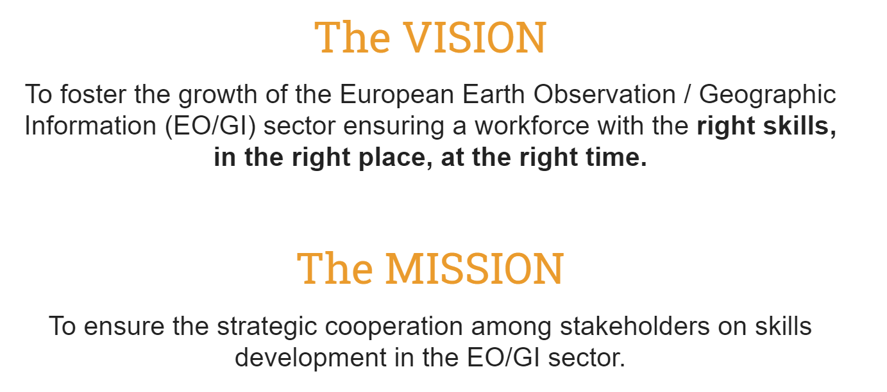
The EO4GEO project

Slide 7
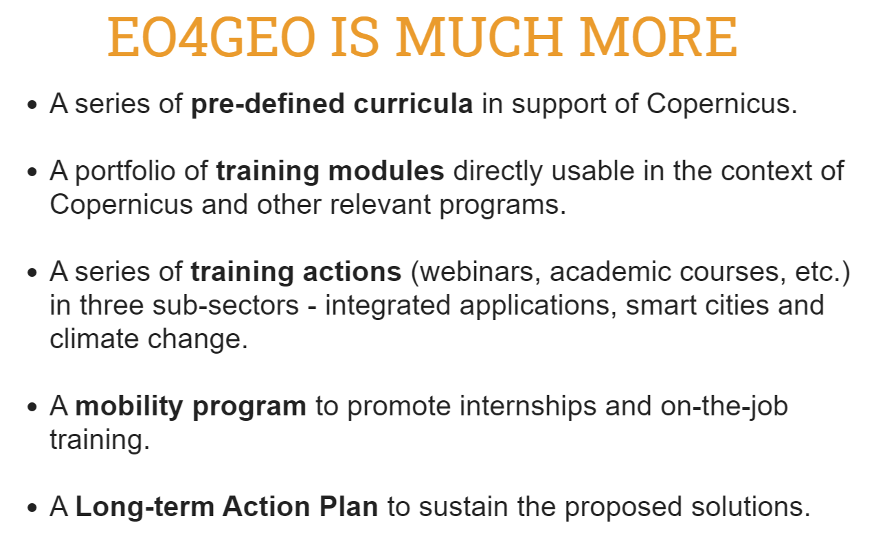

The EO4GEO project
www.eo4geo.eu
@EO4GEOtalks

Slide 8


Air quality monitoring and management

