Slide 1


Air Quality Monitoring and Management
Andreas Kazantzidis
Laboratory of Atmospheric Physics – University of Patras
Patras, Greece, 17/12/2021

Slide 2

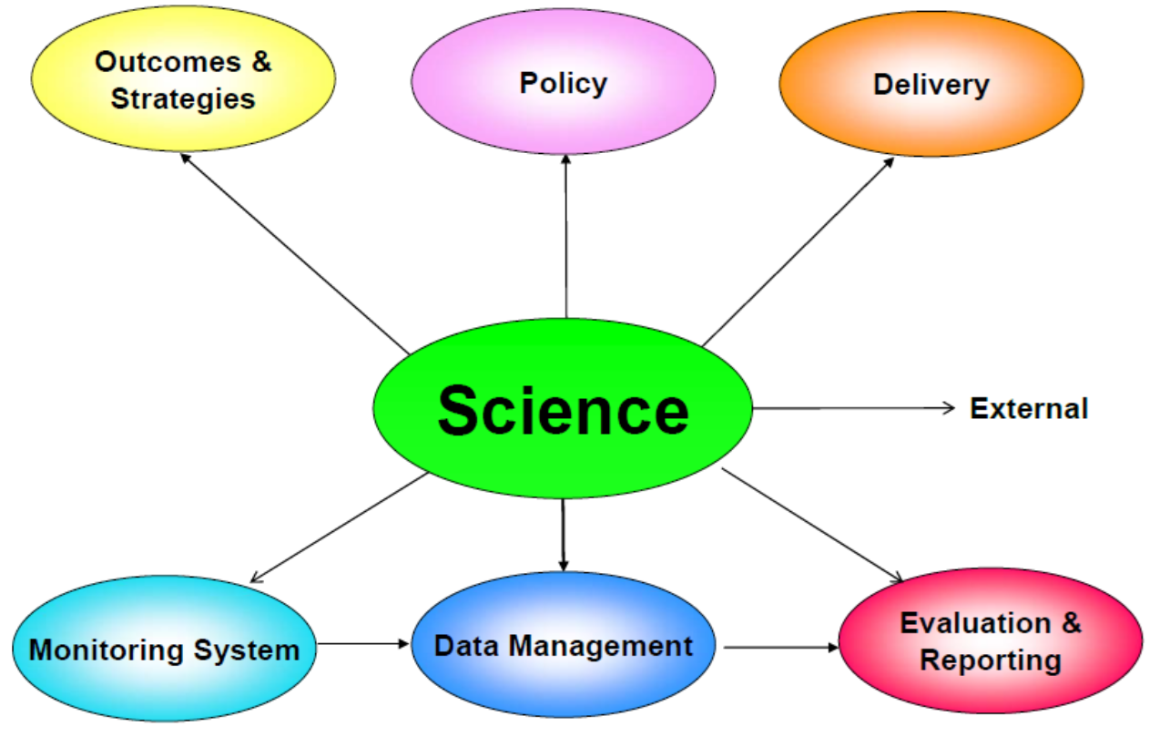
You Can't Manage What You Don't Measure

Slide 3
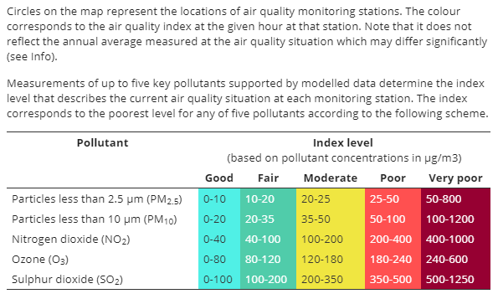
The European Air Quality Index
Allows users to understand more about air quality where they live, work or travel.
The Index is based on concentration values for five key pollutants (particulate matter (PM₁₀, PM_{2.5}), ozone (O₃), nitrogen dioxide (NO₂), sulphur dioxide (SO₂).

Slide 4
Air quality planning
Emission Inventory
Monitoring Network

Slide 5
Matrix for Air Quality Planning
Adopt air quality standards
Establish air monitoring network
Develop emissions inventory
Develop control strategies
Test strategies through modeling
Involve and educate public on strategies
Adopt air quality management plan

Slide 6
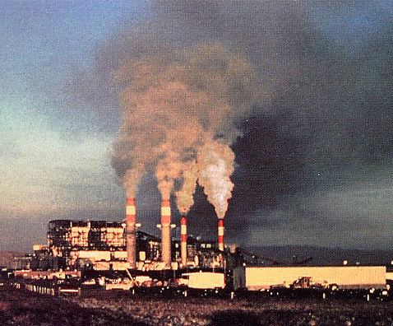

What is an Emission Inventory?
Complete listing, by source, of air pollutant emissions
Covers a specific geographic area
Covers a specific period of time

Slide 7

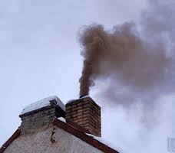

What can Emission Inventory tell you?
Where air pollution is emitted
How much is emitted from each source
What sources would be most effective to control

Slide 8

What can Emission Inventory NOT tell you?
The distance that air pollutant emissions are transported
The amount of air pollution to which people are exposed
The health risk from the air pollution

Slide 9
Why is emission inventory needed
Identify sources of pollution
Identify pollutants of concern
Identify distribution and trends
Input to air quality monitoring
Input to air quality modeling
Input to develop control strategies

Slide 10

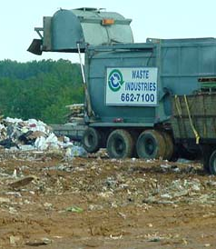


Building an Emission Inventory
Point Sources
Area Sources
NonRoad Mobile Sources
OnRoad Mobile Sources
Inventory

Slide 11
Air Quality Measurement
What is air quality?
complicated by a lack of knowledge as to what is "clean" and what we mean by quality
main reason for air pollution control programs is to protect public health - define air quality based on its effects on people and the environment
effects of air pollution are chronic and not immediately obvious

Slide 12
Air Quality Measurement
Measurements of air quality generally fall into three classes:
Measurements of Emissions - also called source sampling - when a particular emission source is measured, generally by on the spot tests
Meteorological Measurement - Measures meteorological factors that show how pollutants are transferred from source to recipient
Ambient Air Quality - Measures the quality of all the air in a particular place. Almost all the evidence of health effects is based on these measurements

Slide 13
Air Quality Measurement
Site Selection
General Requirements for Site Selection
purpose of monitoring
number and type of instruments required
duration of measurements
should be easily accessible
Meteorological Monitoring
changing weather conditions can produce dramatic changes in air quality and ambient pollution levels
Choice of Monitoring Equipment, Calibration Procedures, Data Handling

Slide 14
Role of air quality monitoring
Establish air quality monitoring network
Determine key pollutants for which monitoring will be done
Establish guidelines for sitting monitors, data handling and reporting
Measures concentrations of key pollutants to compare to air quality standards and develop control strategies

Slide 15
Role of Air Quality Modeling
Test control strategies based on modeling inputs (emissions inventory data, meteorological data)
Validate against monitored air quality data
Weigh evidence, take mid-course correction, and make changes to strategies if necessary

Slide 16
Developing Control Strategies
Determine key pollutants of concern from air monitoring
Review contributions of pollutants from source sectors using emission inventory
Evaluate control strategies based on technical feasibility, cost effectiveness, affordability to source, public acceptability, and adverse effects on other environmental media

Slide 17
Enforcing Control Strategies
Ensure legal authority to enforce through statute, regulations, court
Incorporate strategies in permit conditions for existing and new sources
Outreach to affected sectors, industry, and the general public to promote compliance

Slide 18
Lessons Learned
Effective air quality planning requires a reliable database for decision-making
Building database requires documentation, computerization, training, and continuous efforts
Choices of control strategies will vary based sources, growth, feasibility, and acceptability
Public participation and awareness of urban air quality issues is key to political will and ultimate success

Slide 19
Air quality management system
Source:
Larssen

