Slide 1




Forecasting Particulate Pollution in an Urban Area:
From Copernicus to Sub-Km Scale
Air quality monitoring and management
Ioannis Kioutsioukis
Associate Professor

Slide 2
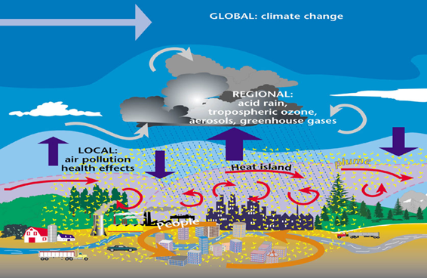
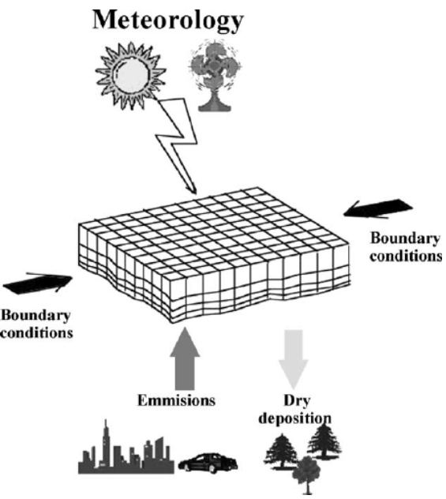
Modelling the fate of atmospheric pollutants
Air quality monitoring and management
Two approaches
Deterministic
Data Driven

Slide 3
Chemical-Weather Models
Deterministic chemical-weather models are based on mathematical equations that represent the dynamical, chemical and physical processes of the atmosphere in relation to pollutants.
Models are driven by meteorology and emissions, site and surrounding conditions
Models simulate the chemical transformation and the dispersion, transport and removal of pollutants
Models output pollutant concentrations at time steps within grid cells at a user-specified domain

Slide 4
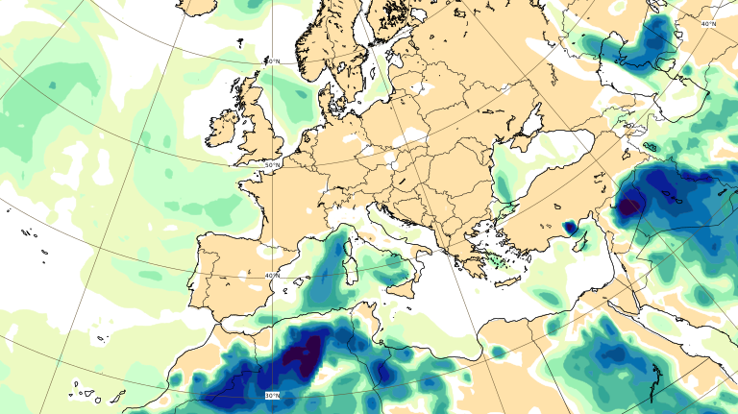
Copernicus Atmosphere Monitoring Service (CAMS)
An open-access platform, which provides air-quality data on a global scale
For the European domain, CAMS delivers daily air- quality forecasts at high resolution (10km)
Nine air quality models use anthropogenic emissions, meteorological and chemical conditions to produce 4-day air-quality forecasts

Slide 5
Data Driven Models
Data driven models seek input-output relationships in a historical database
They require training prior to forecasting on the basis of past monitoring (air quality) data.
They provide forecast at the location of the monitoring stations.
They can be used as stand-alone models or as tools to improve the skill of deterministic air quality models.
Example: By combining dense air quality measurements and the corresponding operational CAMS forecasts, through a data-driven model, we can access high-resolution air quality forecasts
INPUT
MODEL
OUTPUT

Slide 6
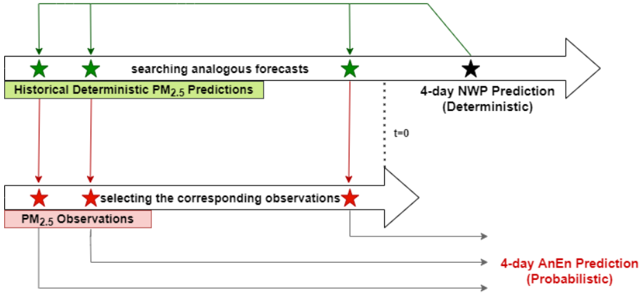
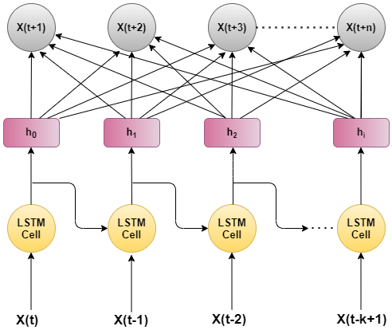
Examples
Analog Ensemble:
Uses time-series of past predictions by an air quality model and their corresponding observations
Focus on the current deterministic forecast
Selects the most similar historical forecasts to the current air quality forecast
Uses the mean value of their corresponding observations as the current AnEn forecast.
Long Short-Term Memory networks:
Have hidden layers and internal memory, which preserve the long-term information
Have the structure of a chain of repeating modules
Connect previous information with the current
Consider the past conditions to make the current forecast

Slide 7
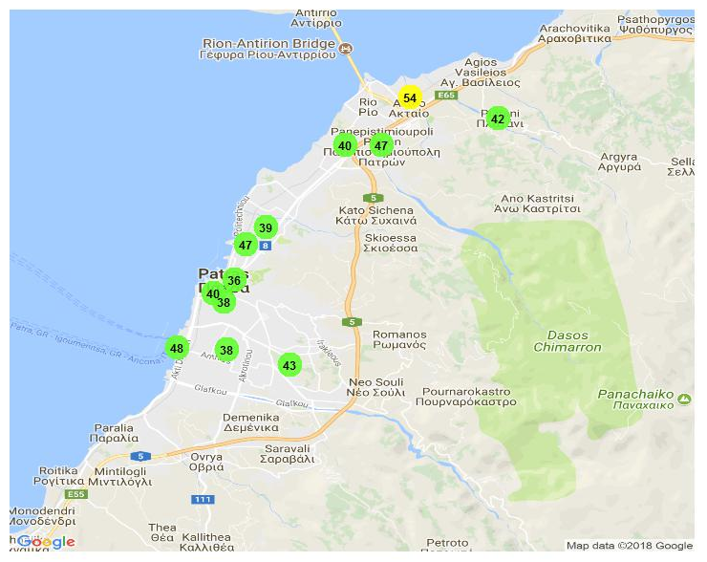
Low-cost sensors
Low-cost sensors are used to monitor air quality in cities
Low-cost sensors gain popularity for their:
Potential to be installed in dense distribution
Affordable operational cost
Calibrating them with the appropriate techniques can generate reliable data in increased spatial coverage.
Patras air network

Slide 8
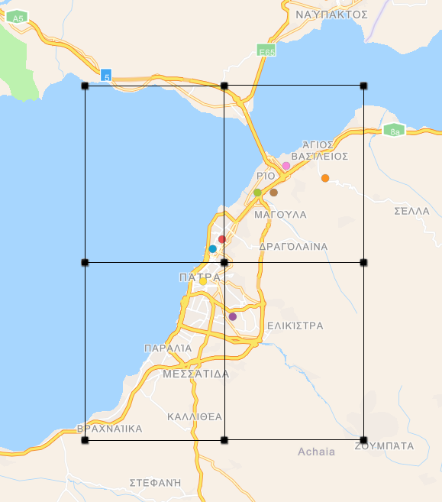
Air quality and Smart Cities: case study
Patras: urban coastal Mediterranean city in western Greece
It has one of the largest ports in Country and its climate is Mediterranean with a moderate temperature range, warm, dry summers, and mild wet winters.
The main sources of anthropogenic particulate matter are traffic (road, maritime) and indoor activities (incl. wood burning, cooking, etc).
Patras Air is a dense network of low-cost sensors measuring air pollution

Slide 9
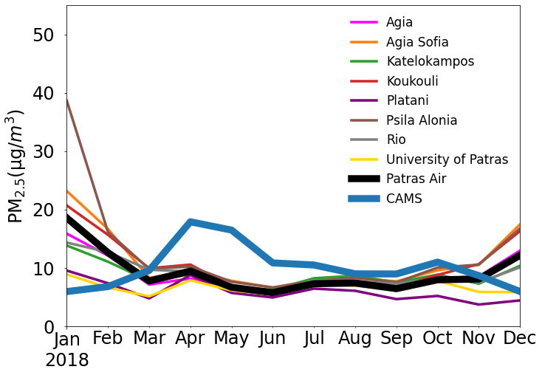
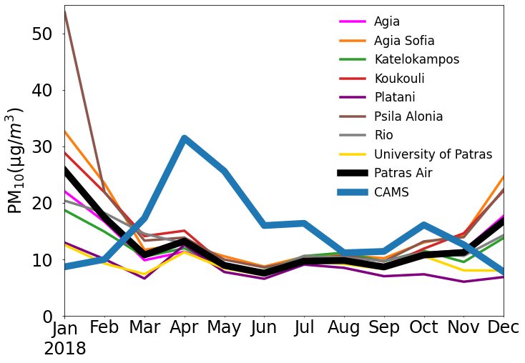
CAMS vs PatrasAir

Slide 10

Hybrid modelling
Through a hybrid-scheme utilizing deterministic & data-driven models with a dense monitoring network, we could obtain PM_{2.5} and PM₁₀ forecasts at fine scale
Input
Models
Output

Slide 11
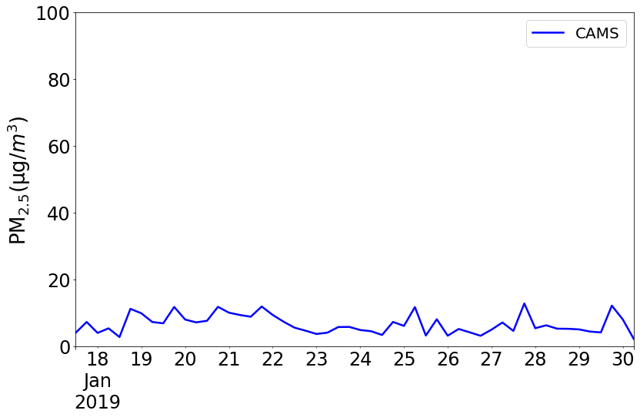
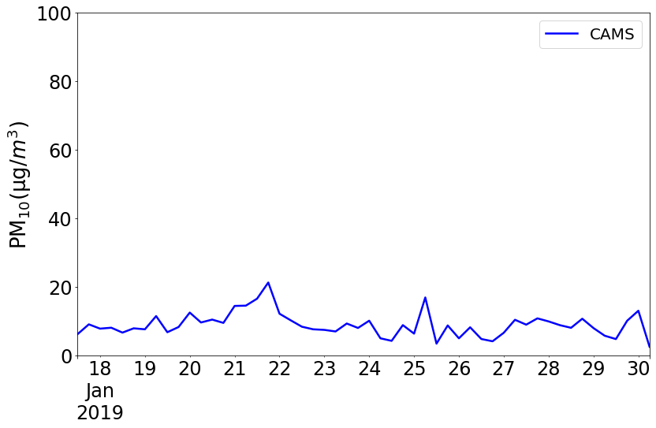
PM timeseries: Jan 2019 (1/3)

Slide 12
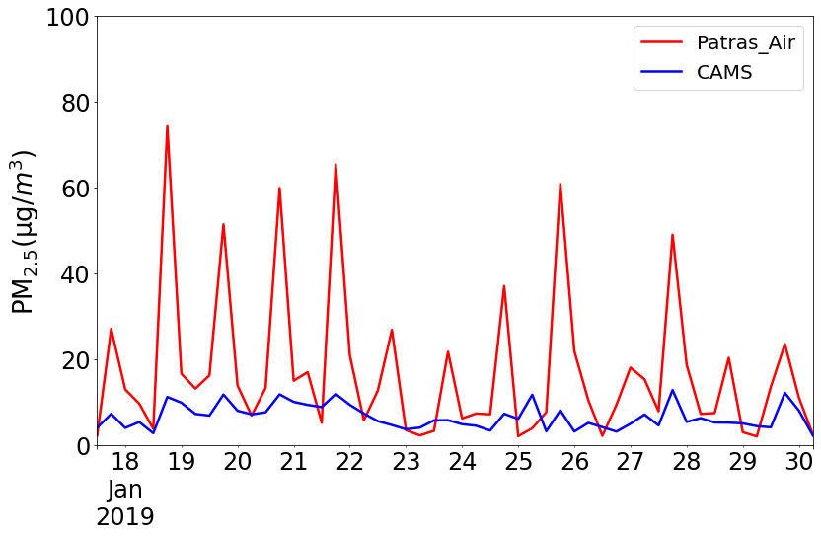
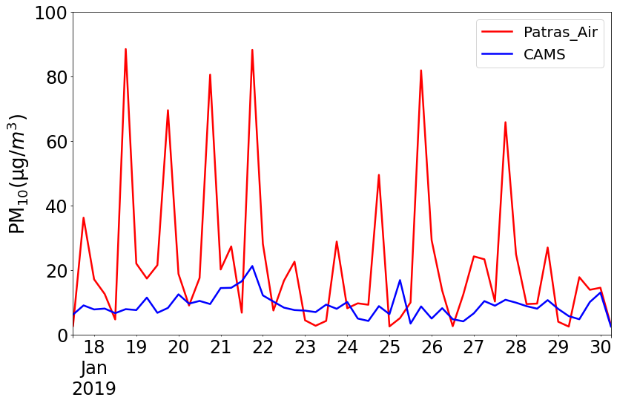
PM timeseries: Jan 2019 (2/3)

Slide 13
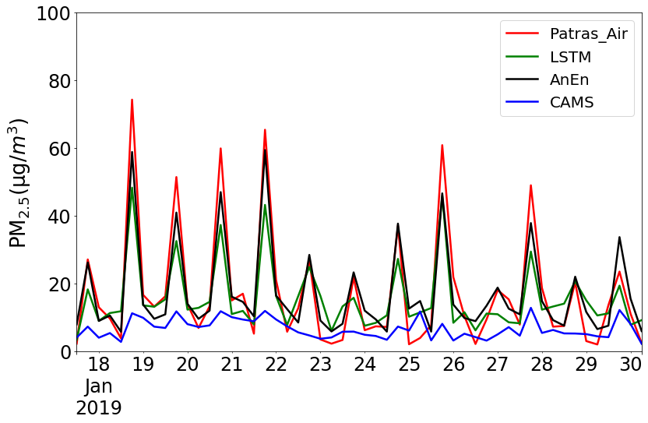
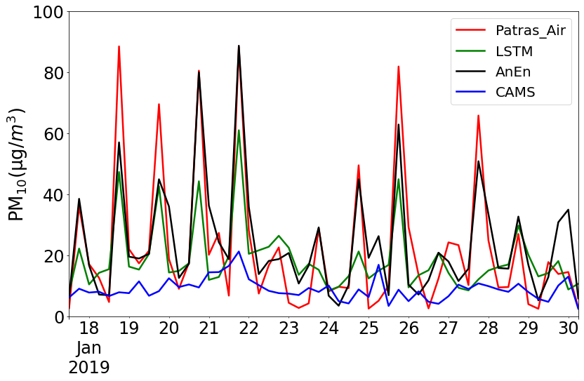
PM timeseries: Jan 2019 (3/3)

Slide 14
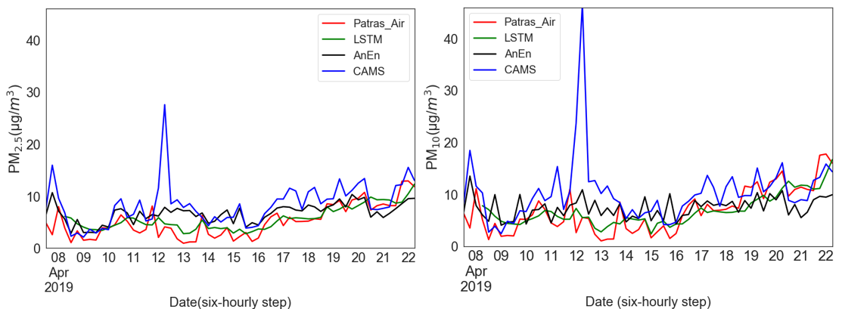
PM timeseries: Apr 2019

Slide 15
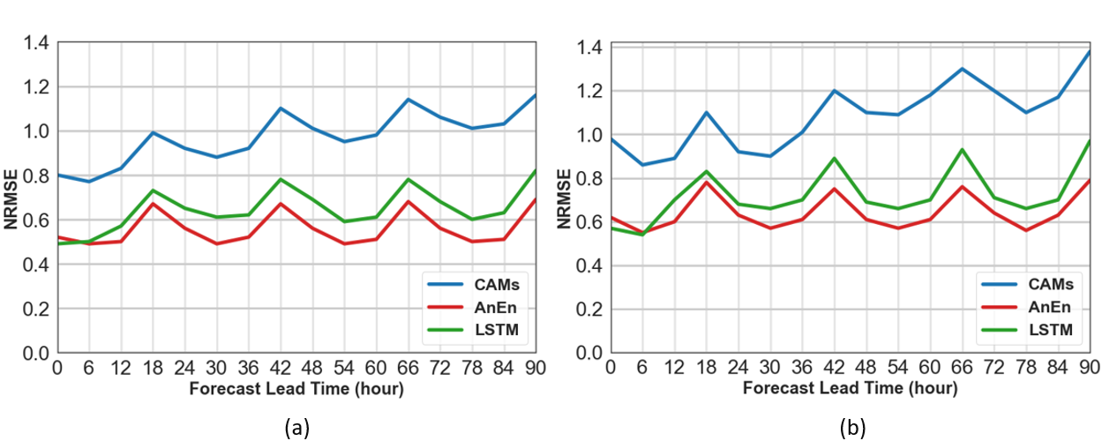
Evolution of forecast skill

Slide 16
Extremes
 | POD | FAR | MIS | CSI
PM_{2.5} ≥ 20
CAMS | 0.06 | 0.95 | 0.94 | 0.03
AnEn | 0.52 | 0.46 | 0.48 | 0.36
LSTM | 0.20 | 0.42 | 0.80 | 0.16
PM₁₀ ≥ 40
CAMS | 0.02 | 0.99 | 0.98 | 0.01
AnEn | 0.40 | 0.48 | 0.60 | 0.30
LSTM | 0.04 | 0.55 | 0.96 | 0.04

Slide 17
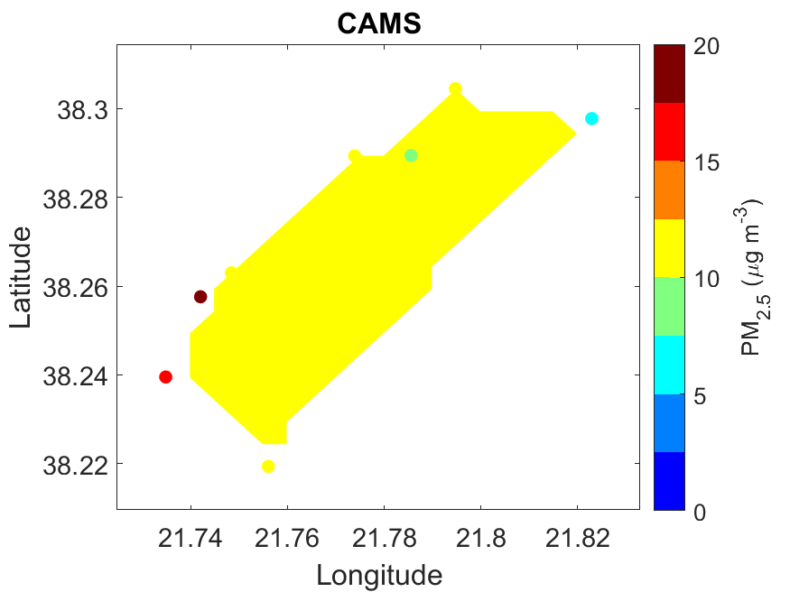
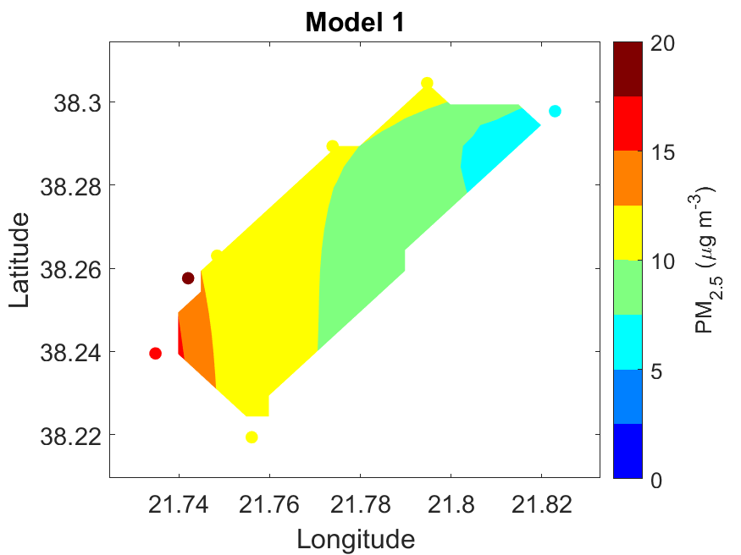
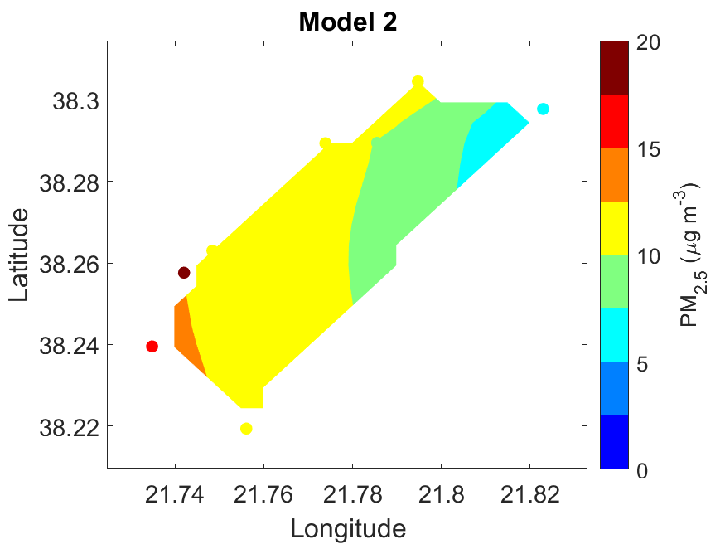
PM maps
02-2019 00:00 UTC

Slide 18
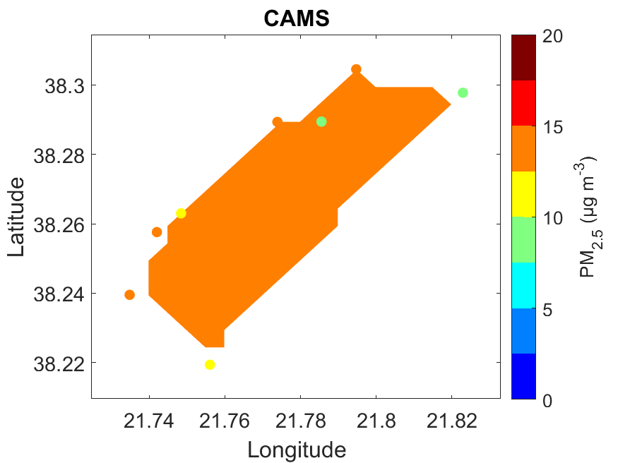
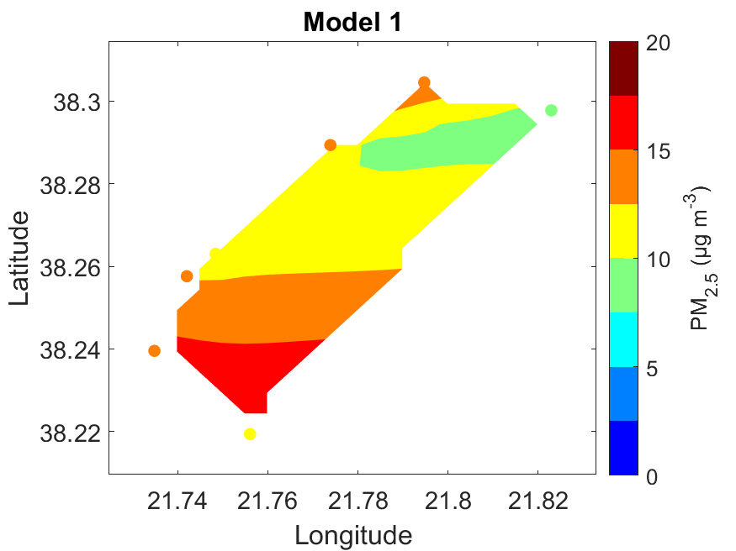
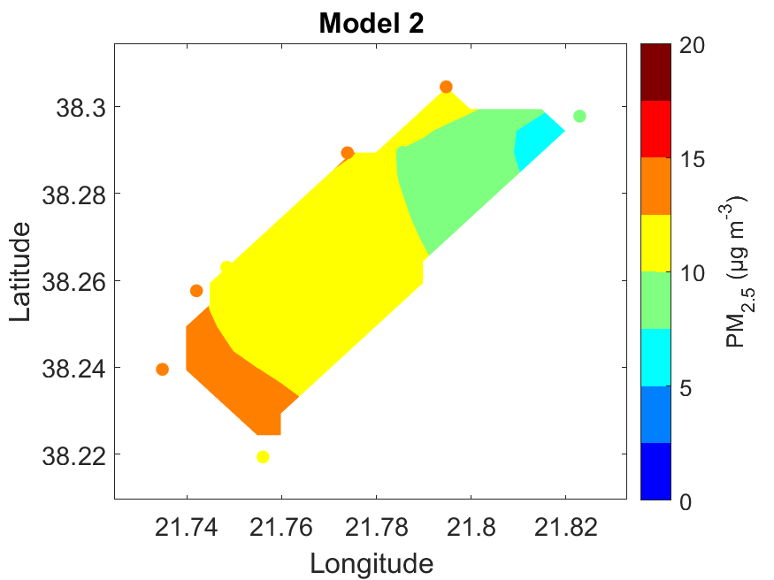
02-2019 00:06 UTC
PM maps

Slide 19
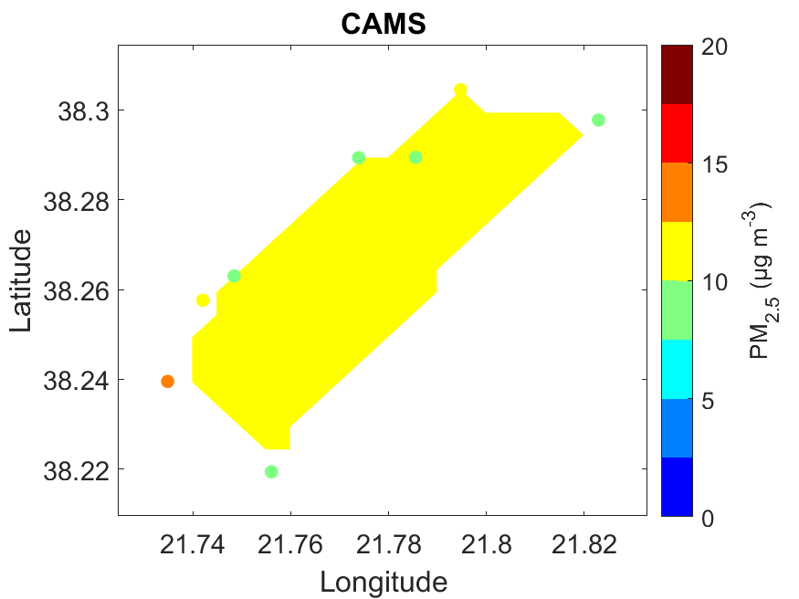
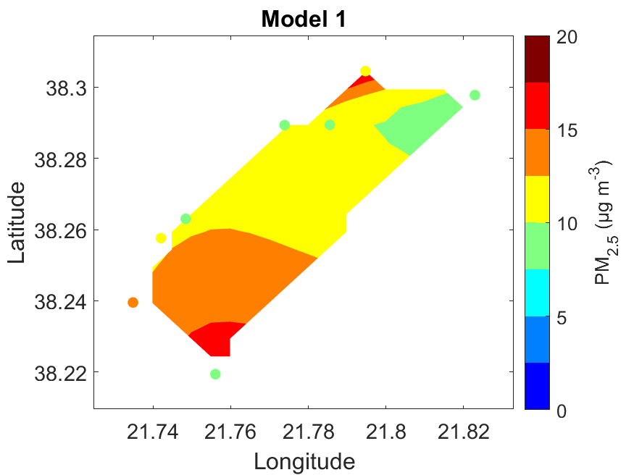
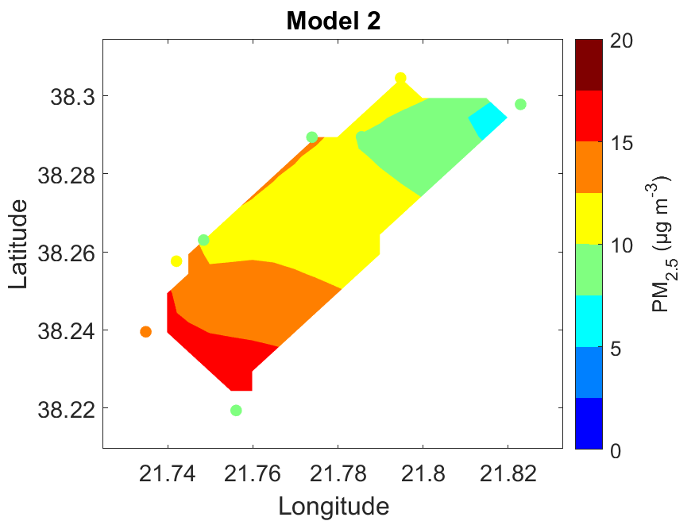
02-2019 12:00 UTC
PM maps

Slide 20
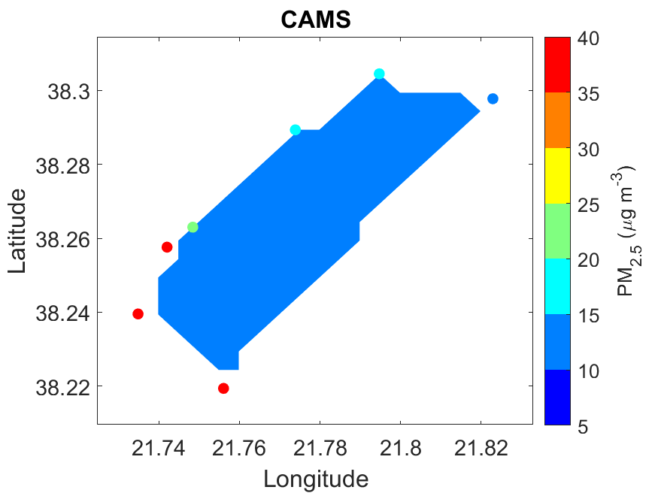
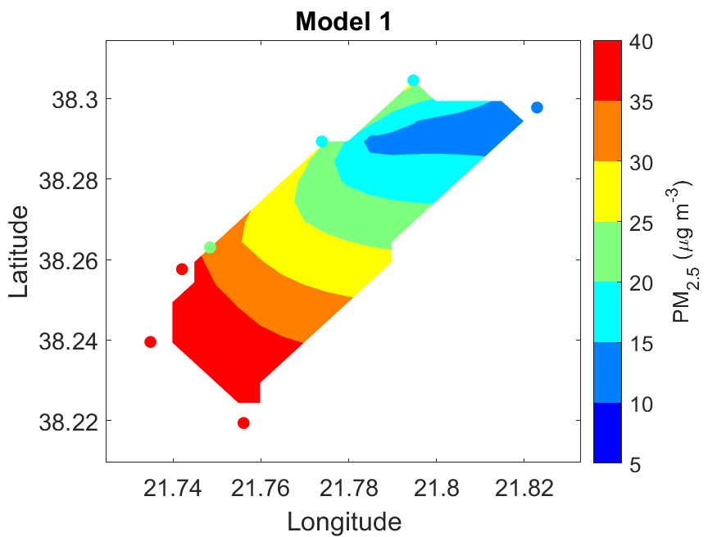
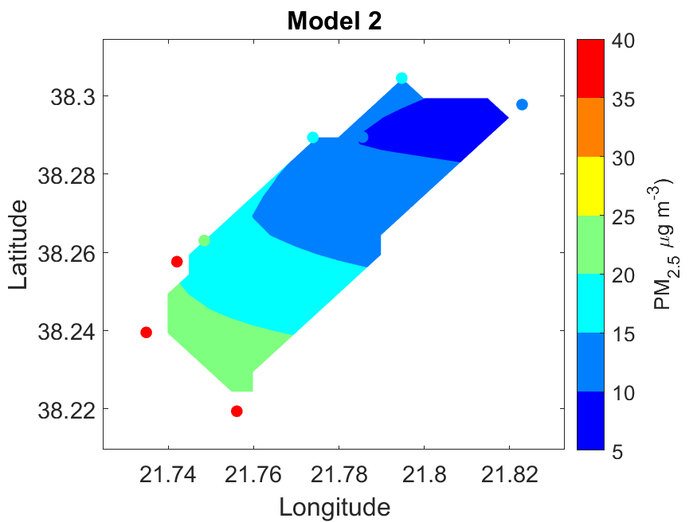
02-2019 18:00 UTC
PM maps

Slide 21




Internet of Thinks (IOT) for Smart Cities
Our research could incorporate the Internet of Things (IoT) to convert the fine-scale forecasts into an application (app) for the Internet and mobile phone users, with obvious application in public health and impact assessment.
Internet of Thinks for Smart Cities

Slide 22
Conclusions
[1] The combination of
Deterministic models
Data-driven models
Air pollution monitoring at a dense network
adds value to the measurements providing accurate PM predictions at fine scale within an urban agglomeration.
[2] The scheme has the potential to contribute significantly to public health awareness.

Slide 23
Thank you!
Acknowledgements
Areti Pappa
Giorgios Kosmopoulos
Andreas Kazantzidis
Contact
Ioannis Kioutsioukis
Associate Professor
kioutio@upatras.gr

