Slide 2
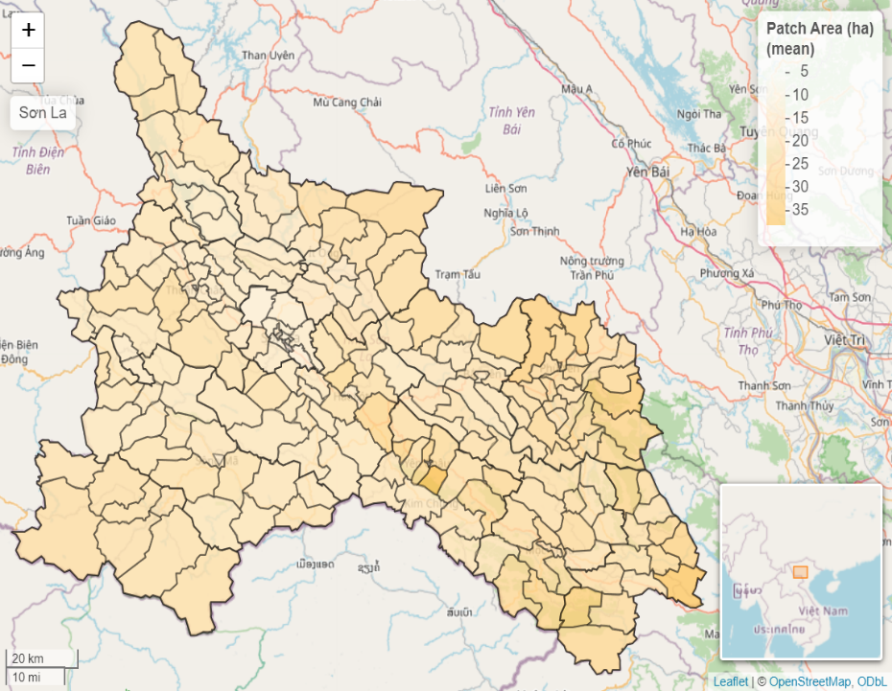
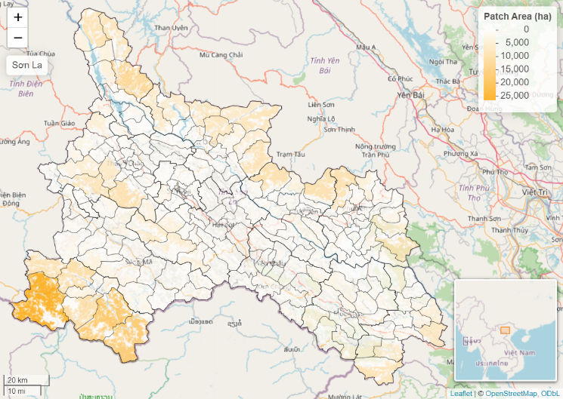

Slide 3
Figure 2. Mean patch area (aggregated values on the left, values per pixel on the right) for the Son La region in northern Vietnam.

