Slide 1
Linux

Slide 2
What is shell
The shell is the operating system’s command line interface and interpreter for the set of commands that are used to comminate with the system

Slide 3
What is linux?
Open source unix-like operation system. It runs on embedded system (HW which has microprocessor) and cloud infrastructure
It’s opensource (view,edit and share the source code) and community support
Though it’s opensource, company charge distribution fee (users can use it but need to pay money to use the customized version)
Notes:
An embedded system is a microprocessor-based computer hardware system with software that is designed to perform a dedicated function

Slide 4
Major linux distrubtions
Redhat enterprice linx (RHEL) : commercial market.
Ubuntu: Free

Slide 5
Web servers
Web servers liste on port 80 and 443 for an incoming request and assign the request to a process to return the response.
Apache : free and opensource.
nginX: free and opensource.
Lighttpd: free and opensource.

Slide 6
Database server
Database server listen to the incoming request(often SQL) and respond with data.
Relational database: PostgreSQL & MySQL
NoSQL: MongoDB

Slide 7
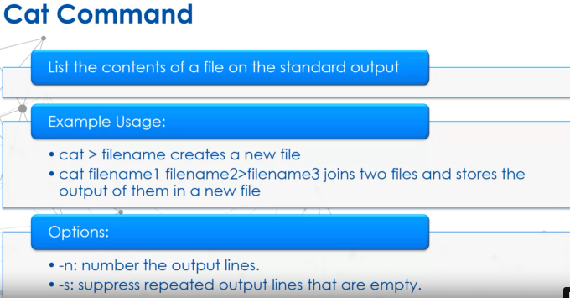
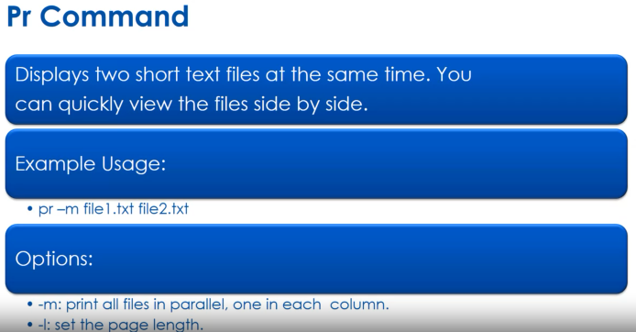
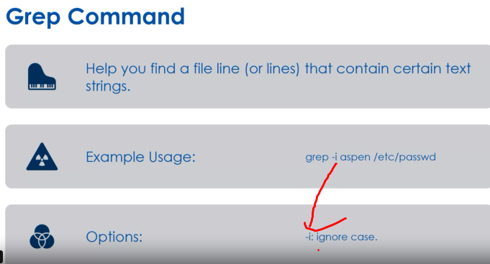
Reading files

Slide 8
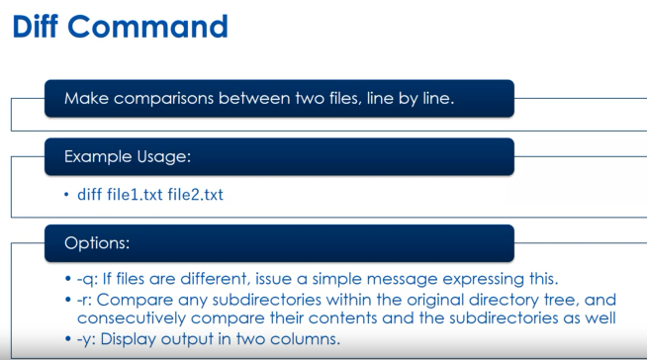
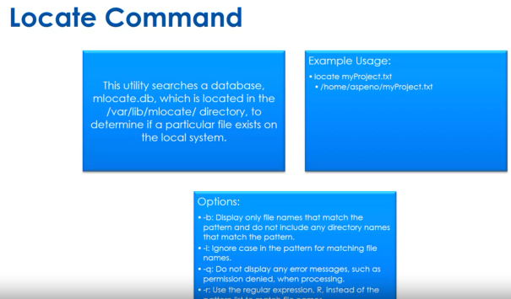
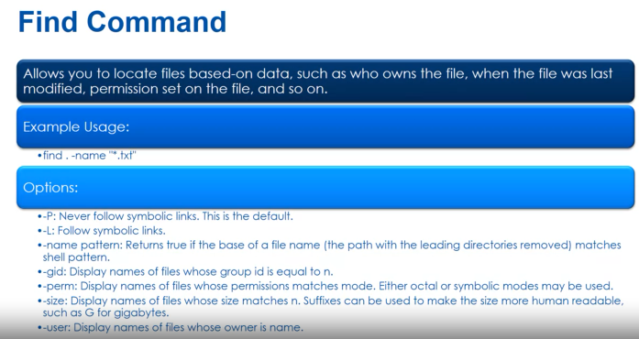
Continue…

