Slide 1
forêt : blessa [bless-her]
new regions + finer light systems.
[fabriqué au kansas]

Slide 2
forêt : blessa [bless-her]
new regions + finer light systems.
found faith, shape, and strength in my brothers rhythm.
acknowledgments.
MOTHER.
GOD.
[fabriqué au kansas]

Slide 3
[fabriqué au kansas]
new regions + finer light systems.
forêt : blessa [bless-her]
found faith, shape, and strength in my brothers rhythm.
acknowledgments.
MOTHER.
GOD.

Slide 4
light systems.
lights systems can be people, places, or things.
light systems is a moto, a framework, and a collection of promises made to our family and communities.

Slide 5
region.
regional guide of cultural computations.
region is a journal dedicated to the artistic expressions of migrant communities and their first generation descendants in the midwest.

Slide 6
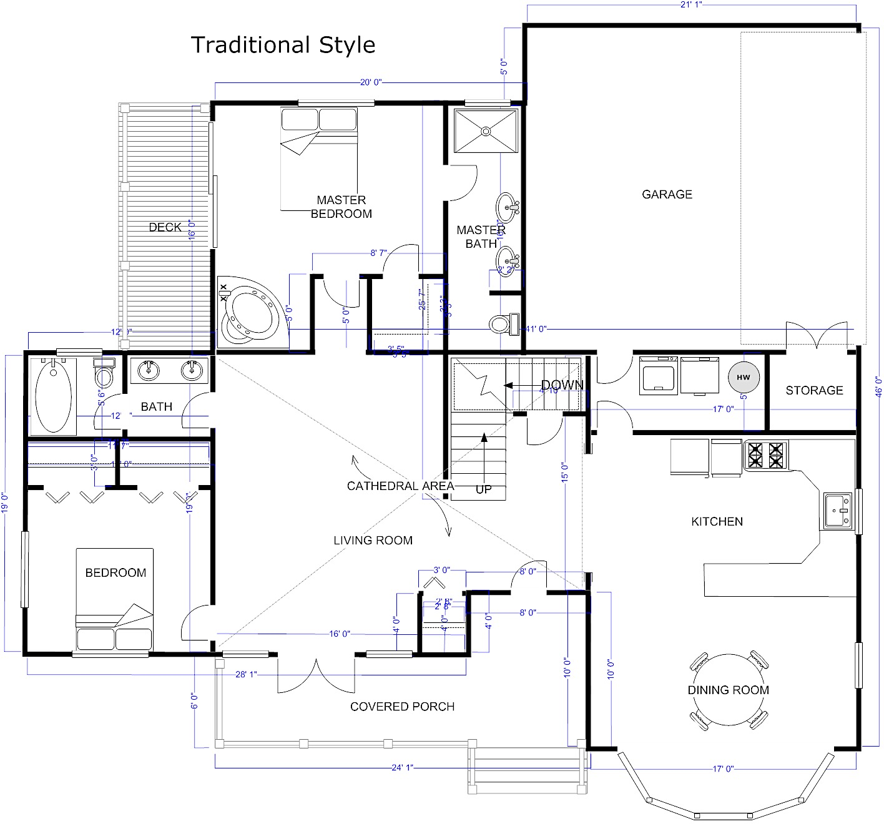
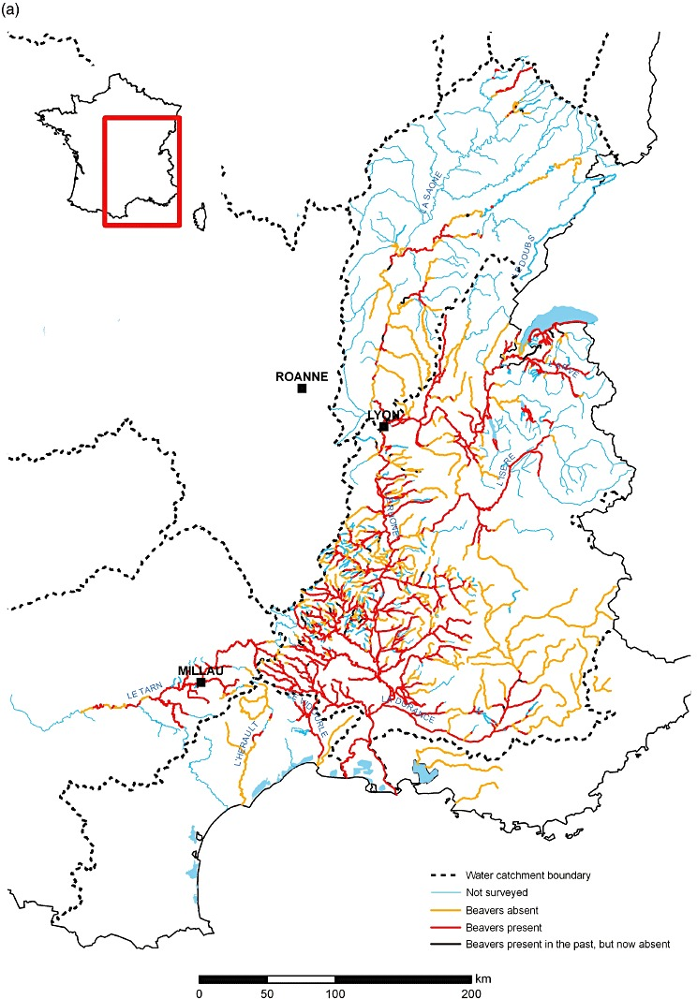
=
X
Architecture.
The process and the product of planning, designing, and constructing buildings or any other structures.
Geography.
The study of the physical features of the earth and its atmosphere, and of human activity as it affects and is affected by these systems and processes.

Slide 7
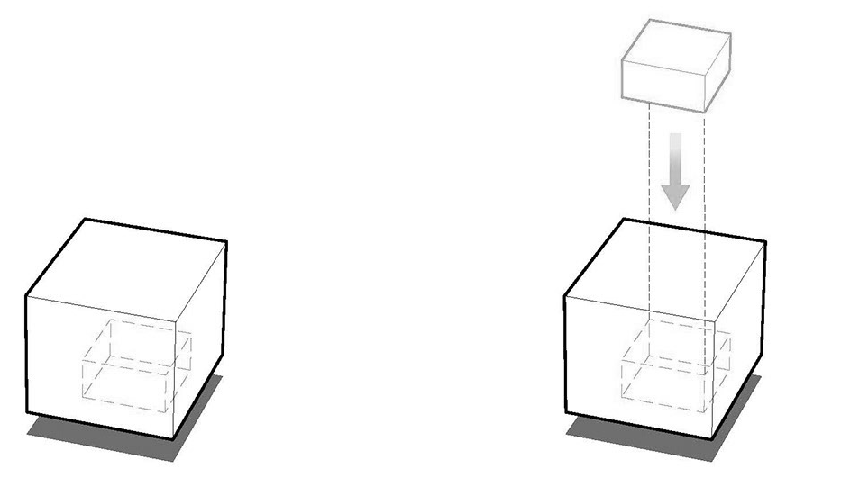
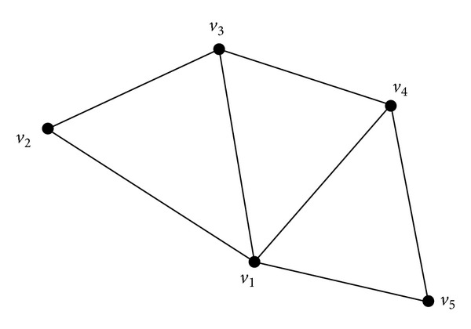
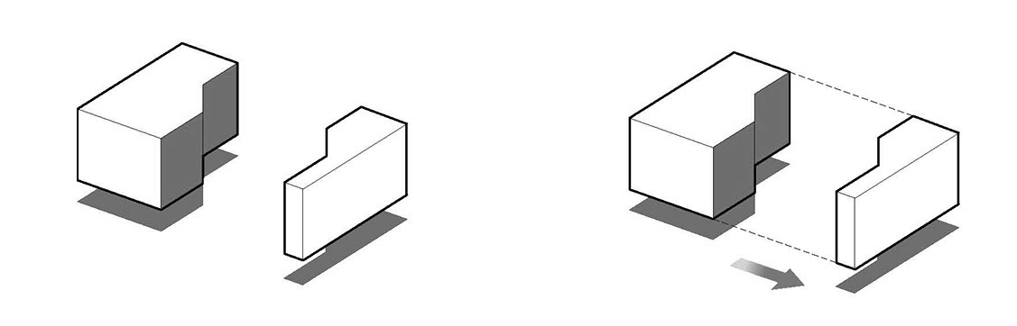
X
Architecture.
The process and the product of planning, designing, and constructing buildings or any other structures.
Geography.
The study of the physical features of the earth and its atmosphere, and of human activity as it affects and is affected by these systems and processes.
.
floor plans
3D-shapes can be characterized by their number of vertices, number of faces, and connecting edges.
Graphs can be characterized by the structure (mapping) of their vertices (nodes) and edges (links)

Slide 8
forêt : blessa [bless-her]
new regions + finer light systems.
[fabriqué au kansas]

Slide 9
[fabriqué au kansas]
new regions + finer light systems.
forêt : blessa [bless-her]
found faith, shape, and strength in my brothers rhythm.
acknowledgments.
MOTHER.
GOD.

