Slide 1
region.
regional guide of cultural computations.
region is a journal dedicated to the artistic expressions of migrant communities and their first generation descendants in the midwest.

Slide 2
region.
regional guide of cultural computations.
region is a journal dedicated to the artistic expressions of migrant communities and their first generation descendants in the midwest.

Slide 3
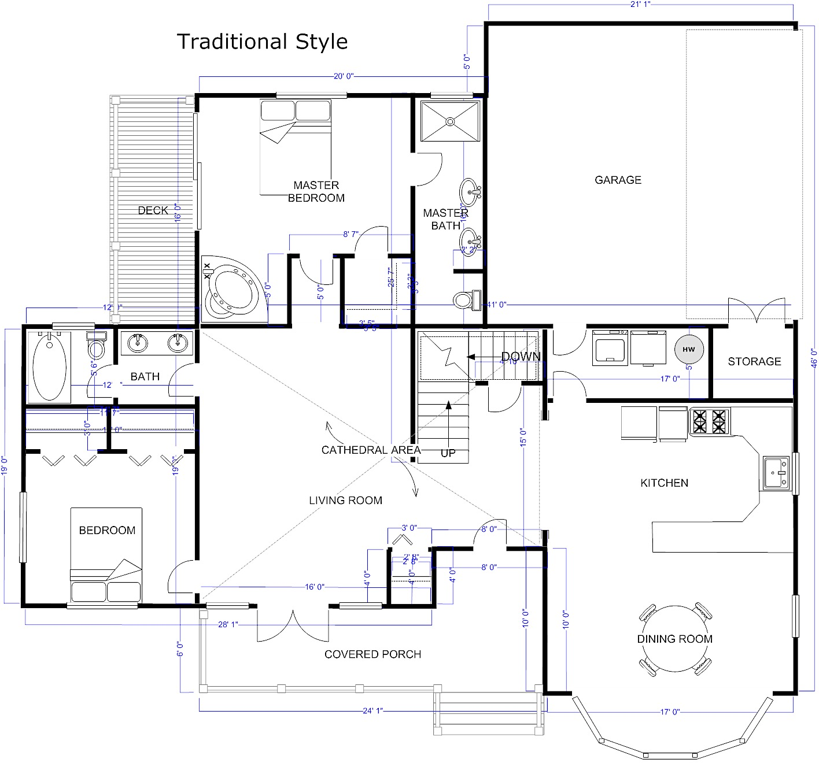
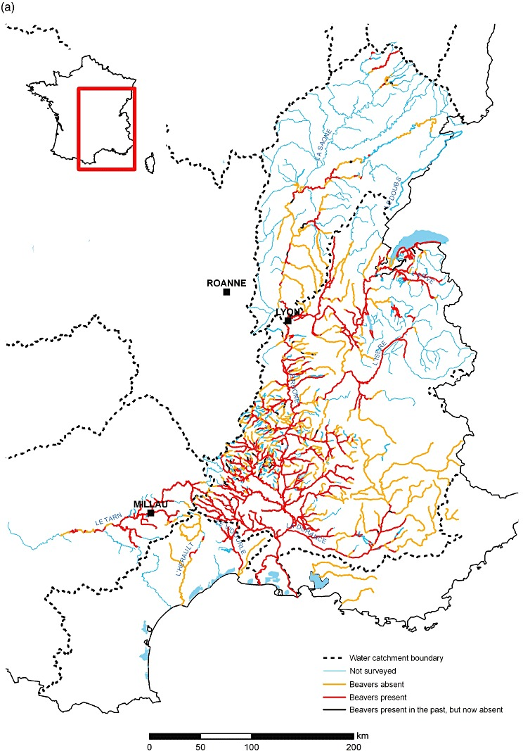
=
X
Architecture.
The process and the product of planning, designing, and constructing buildings or any other structures.
Geography.
The branch of biology that deals with the relations of organisms to one another and to their physical surroundings.
floor plans

Slide 4
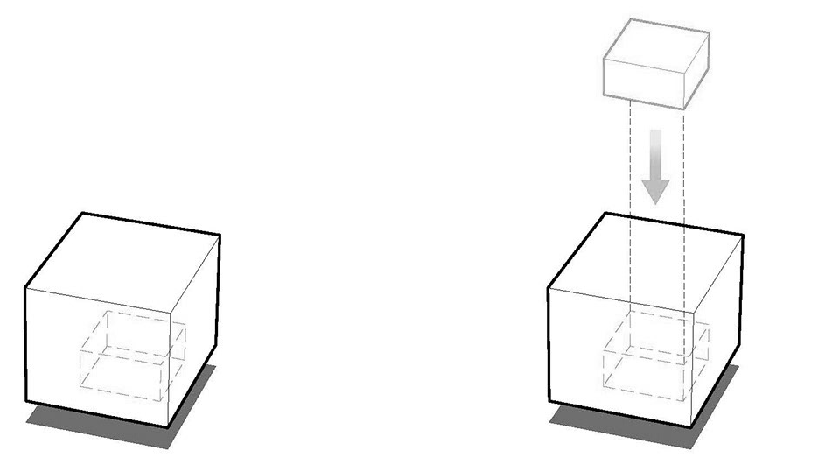
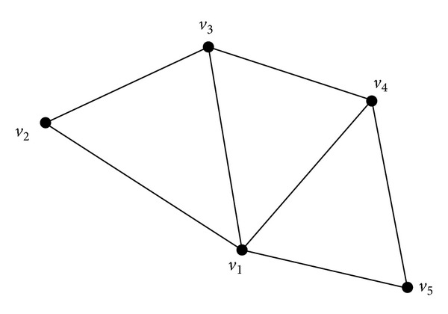
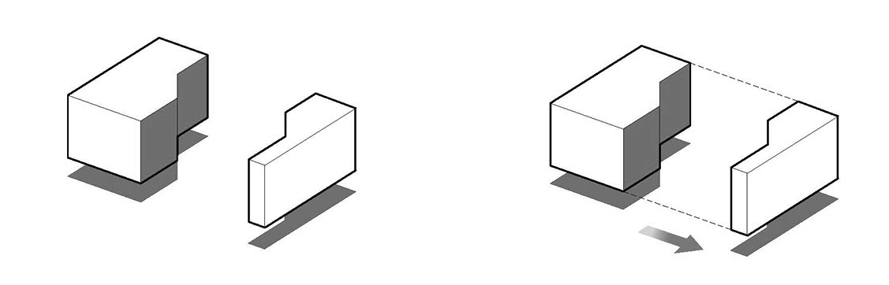
X
Architecture.
The process and the product of planning, designing, and constructing buildings or any other structures.
Geography.
The branch of biology that deals with the relations of organisms to one another and to their physical surroundings.
floor plans
3D-shapes can be characterized by their number of vertices, number of faces, and connecting edges.
Graphs can be characterized by the structure (mapping) of their vertices (nodes) and edges (links)

Slide 5


Slide 6
region
regional guide of cultural computations.
region is a journal dedicated to the artistic expressions of migrant communities and their first generation descendants in the midwest.

Slide 7
region.
regional guide of cultural computations.
region is a journal dedicated to the artistic expressions of migrant communities and their first generation descendants in the midwest.

Slide 8
region.
regional guide of cultural computations.
region is a journal dedicated to the artistic expressions of migrant communities and their first generation descendants in the midwest.

Slide 9

regional guide of cultural computations.
region is a journal dedicated to the artistic expressions of migrant communities and their first generation descendants in the midwest.

Slide 10
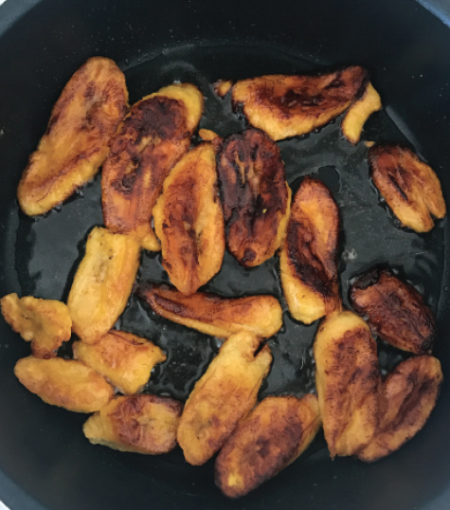
region
regional guide of cultural computations.
region is a journal dedicated to the artistic expressions of migrant communities and their first generation descendants in the midwest.

Slide 11
region
regional guide of cultural computations.
region is a journal dedicated to the artistic expressions of migrant communities and their first generation descendants in the midwest.

Slide 12
region
regional guide of cultural computations.
region is a journal dedicated to the artistic expressions of migrant communities and their first generation descendants in the midwest.

Slide 13
region
regional guide of cultural computations.
region is a journal dedicated to the artistic expressions of migrant communities and their first generation descendants in the midwest.

Slide 14
region
regional guide of cultural computations.
region is a journal dedicated to the artistic expressions of migrant communities and their first generation descendants in the midwest.

Slide 15
region
regional guide of cultural computations.
region is a journal dedicated to the artistic expressions of migrant communities and their first generation descendants in the midwest.

Slide 16
region
regional guide of cultural computations.
region is a journal dedicated to the artistic expressions of migrant communities and their first generation descendants in the midwest.

Slide 17
regional guide of cultural computations.
region is a journal dedicated to the artistic expressions of migrant communities and their first generation descendants in the midwest.

Slide 18
region
regional guide of cultural computations.
region is a journal dedicated to the artistic expressions of migrant communities and their first generation descendants in the midwest.

Slide 19
region
regional guide of cultural computations.
region is a journal dedicated to the artistic expressions of migrant communities and their first generation descendants in the midwest.

Slide 20
region
regional guide of cultural computations.

Slide 21
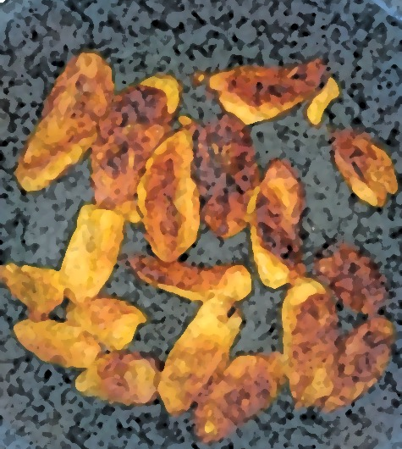
region
regional guide of cultural computations.

Slide 22
BROWSER
HTML
USER
FRONTEND
CSS
APPLICATION
BACKEND
STORAGE
PYTHON
JAVASCRIPT
POSTGRESQL

Slide 23
Pushing Info
BROWSER
Pulling Info
APPLICATION
FRONTEND
HTML
CSS
JAVASCRIPT
Heroku
Local Development
BACKEND
PYTHON
STORAGE
DATABASE

Slide 24
Pushing Info
chrome | ie | firefox | safari
Pulling Info
APPLICATION
FRONTEND
dashboard
login
sign-up
user
progress
material
bootstrap
semantic ui
Local Development
node.js
angular.js
vue.js
Heroku
BACKEND
pip
django
virtualnev
STORAGE
postgresql

Slide 25
r
features.
a.
a.
Feature
Feature brief
Feature
Feature brief
Contributors:
Outcome: Allow users to sign-up and make an account
Contributors:
Outcome: Allow users to sign-up and make an account
c.
d.
User Storage
User information can be stored remotely
Feature
Feature brief
Contributors:
Outcome: Allow users to sign-up and make an account
Contributors:
Outcome: Allow users to sign-up and make an account

Slide 26
-
…
Start
-
-
-
-
…
-
-
-
…
-
-
…
-
-
-

Slide 27
Goal: Transition from the current repository to the future repository by collecting all of the needed code, graphics, and other files and placing them in the “” repository. Once the file migration has been completed, set the app to open at the ”” repository. Of course, the link to the live app will still be the same:
Current repository.
Local-Name:
“”
Future repository.
Local-Name:
“”
Application Transition
Multimedia Files
Code

