Slide 1



Solution Briefing
AWS Cloud Governance Platform — Contoso Financial
[Presenter Name] | June 09, 2026

Slide 2
Slide 2: Business Opportunity
Opportunity
3–4 compliance findings per quarter driving costly remediation overhead
Manual provisioning with shared admin credentials creates security exposure
Q2 2026 regulatory review demands evidence-ready automated controls
Success Criteria
80% reduction in remediation effort before April 2026 hard deadline
Zero manual console access in production with full audit trail
ISO 27001 controls validated and evidence collected pre-review
AWS Cloud Governance Platform — Contoso Financial

Slide 3
Slide 3: Engagement Scope
Parameter | Scope |  | Parameter | Scope
Single business unit (~100 users) | ~4500 employees across platform team and workload owners |  | Single AWS region | Two regions: ap-southeast-2 (primary) + ap-southeast-4 (DR)
Dev + Prod (2 environments) | Three production environments + dev/test/staging per workload |  | New identity deployment | Federation with existing on-premises enterprise directory
Single framework | ISO 27001 + internal security baseline + financial services regulations |  | No ITSM integration | Existing SIEM + ticketing platform integrations required
Greenfield IaC | All new accounts and guardrails via IaC; legacy workloads excluded |  | Basic SCPs | Comprehensive preventive + detective guardrails (no manual console access in prod)
Standard business hours support | 99.9% platform availability; DR RTO < 4h / RPO < 1h
AWS Cloud Governance Platform — Contoso Financial

Slide 4
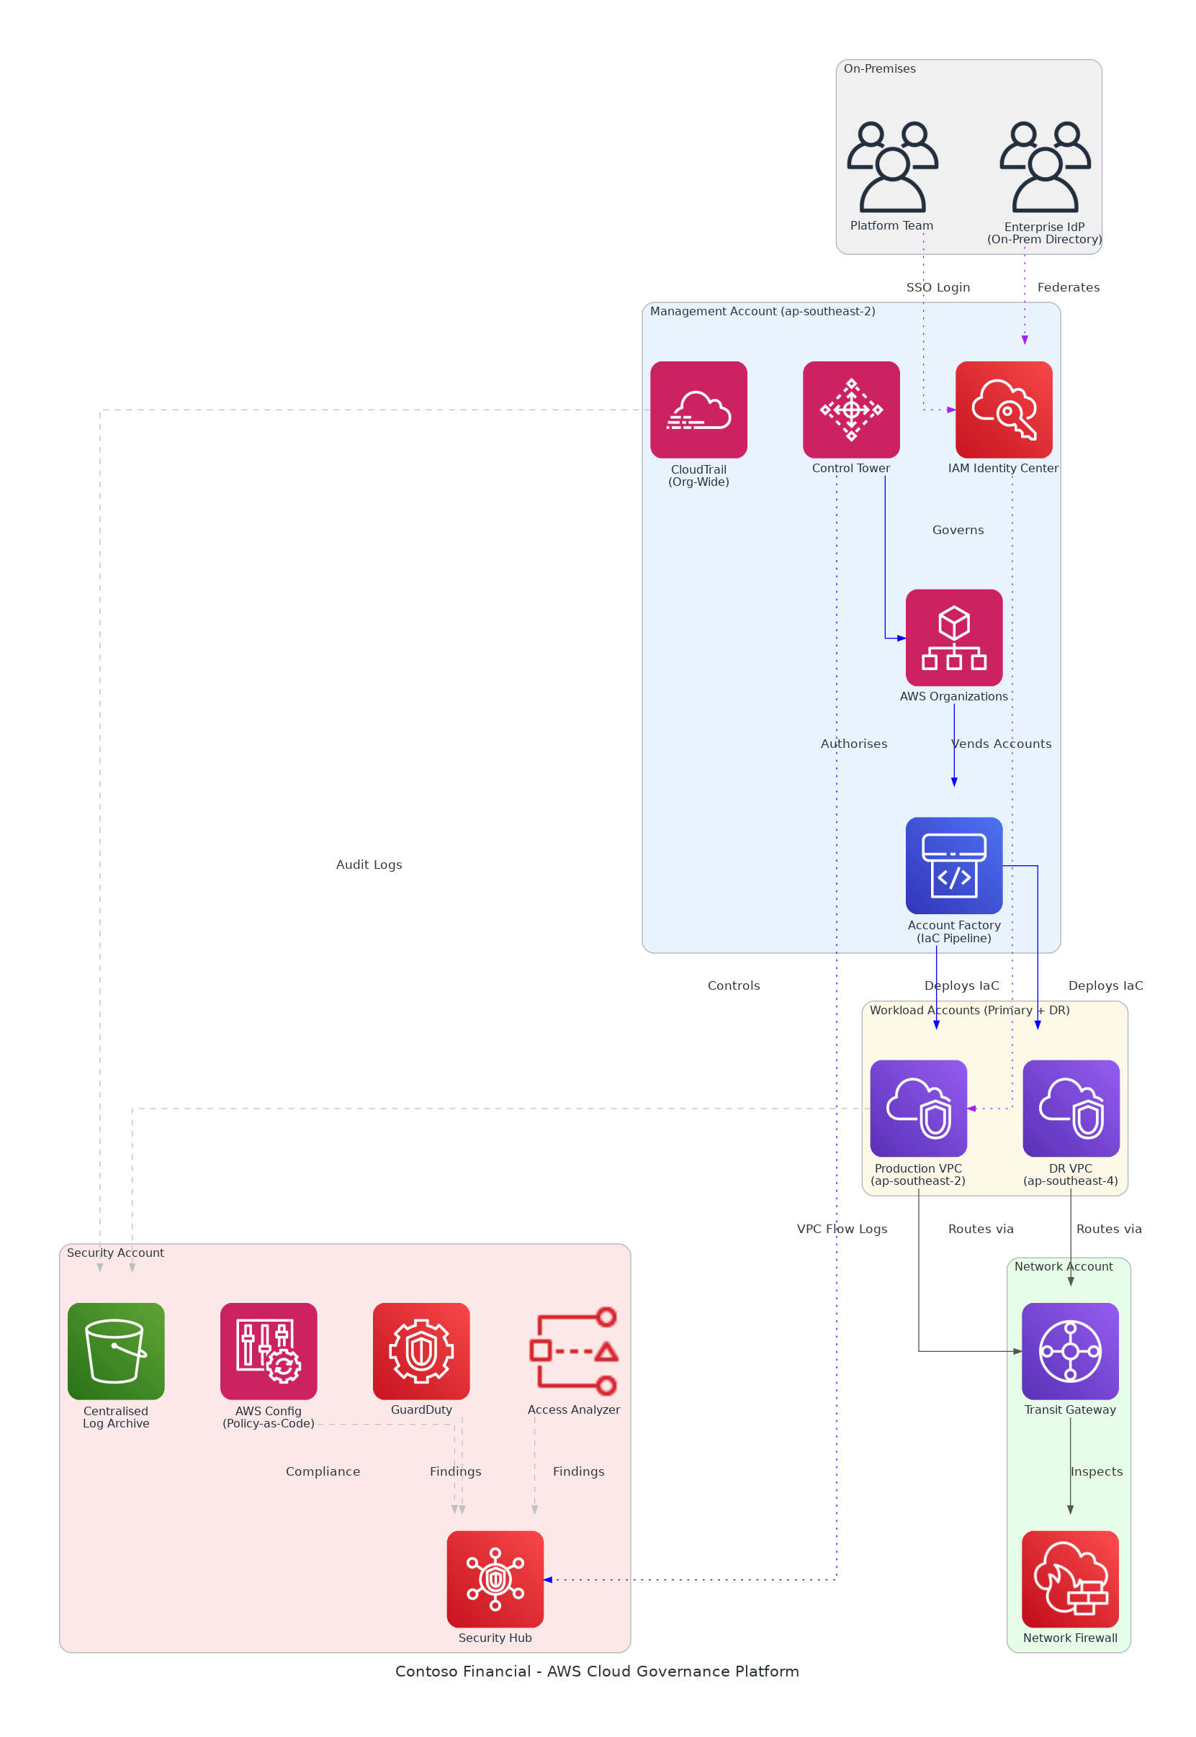
Slide 4: Solution Overview
Governance & Provisioning
Control Tower + AFT automates compliant account vending at scale
SCPs enforce no-console-access and region-lock guardrails organisation-wide
Security & Compliance
Security Hub aggregates GuardDuty, Config and Access Analyzer findings
Centralised S3 log archive with 12-month retention for audit evidence
Network & Identity
Transit Gateway hub-spoke with Network Firewall for full traffic inspection
On-prem IdP federation via IAM Identity Center — no shared credentials
AWS Cloud Governance Platform — Contoso Financial

Slide 5
Slide 5: Implementation Approach
Phase 1: Foundation & Design (Weeks 1-6)
Deploy Control Tower, AWS Organizations hierarchy, and core account structure
Configure IAM Identity Center federation with on-premises enterprise directory
Establish centralised logging, Security Hub, and GuardDuty organisational baselines
Phase 2: Guardrails & Workload Onboarding (Months 2-3)
Implement SCPs, Config rules, and policy-as-code guardrails across all accounts
Onboard three environments via AFT pipeline with ITSM change-approval integration
Enable Transit Gateway hub-spoke routing with Network Firewall traffic inspection
Phase 3: Validation & Handover (Month 4)
Execute ISO 27001 control validation and compile evidence package for audit
Conduct platform runbook review and knowledge transfer to Contoso platform team
Deliver post-implementation review and 30-day hypercare support handover
AWS Cloud Governance Platform — Contoso Financial

Slide 6
Slide 6: Timeline & Milestones
Phase No | Phase Description | Timeline | Key Deliverables
Phase 1 | Foundation & Design | Weeks 1-6 | Control Tower live, IAM Identity Center federated, Security Hub and GuardDuty active
Phase 2 | Guardrails & Workload Onboarding | Months 2-3 | SCPs enforced, all environments onboarded via AFT, ITSM workflow integrated
Phase 3 | Validation & Handover | Month 4 | ISO 27001 evidence package complete, runbooks delivered, hypercare handover signed off
AWS Cloud Governance Platform — Contoso Financial

Slide 7
Slide 7: Success Stories
ASX-Listed Retail Bank (45 accounts, 2,800 employees)
Challenge: 6-week manual provisioning cycle; $420K annual audit remediation
Solution: Control Tower, AFT pipeline, CIS Level 1 Security Hub organisation-wide
Result: Provisioning cut to 4 hours; 89% compliance score within 60 days
Regional Insurance Group (Multi-region, APRA-regulated)
Challenge: Shared admin credentials in prod; failed two consecutive APRA audits
Solution: IAM Identity Center federation, SCPs, automated Config evidence collection
Result: Clean APRA audit within 90 days; zero shared-credential findings since
Government-Owned Finance Entity (In-country data sovereignty required)
Challenge: No guardrails enforcing region lock; active data residency breach risk
Solution: Transit Gateway hub-spoke, region-lock SCPs, centralised S3 logging
Result: Full data residency compliance certified; 100% policy coverage in 8 weeks
AWS Cloud Governance Platform — Contoso Financial

Slide 8
Slide 8: Our Partnership Advantage
What We Bring
12+ years delivering AWS cloud governance and security solutions in APAC
60+ successful AWS Landing Zone implementations across financial services
AWS Advanced Consulting Partner with Security and Cloud Operations Competency
Certified AWS Solutions Architects specialising in Control Tower and AFT
Value to You
Pre-built AFT modules and Config rule libraries accelerate deployment by 40%
Proven ISO 27001 evidence-collection framework maps controls to AWS services
Direct AWS APAC security specialist support through our partner network
Best practices from 60+ implementations prevent common misconfiguration pitfalls
AWS Cloud Governance Platform — Contoso Financial

Slide 9
Slide 9: Investment Summary
Cost Category | Year 1 List | Year 1 Credits | Year 1 Net | Year 2 | Year 3 | 3-Year Total
Professional Services | $0 | $0 | $0 | $0 | $0 | $0
Cloud Services | $9,956 | ($28,000) | ($18,044) | $9,956 | $9,956 | $1,867
Connectivity | $5,718 | $0 | $5,718 | $5,718 | $5,718 | $17,154
Software Licenses | $4,056 | ($1,200) | $2,856 | $4,056 | $4,056 | $10,968
Support & Maintenance | $14,400 | $0 | $14,400 | $14,400 | $14,400 | $43,200
TOTAL | $34,130 | ($29,200) | $4,930 | $34,130 | $34,130 | $73,189
AWS Cloud Governance Platform — Contoso Financial

Slide 10
Slide 10: Next Steps
Decision: Executive approval (James Wu + CISO) for project by [specific date]
Kickoff: Target project start within 30 days of approval to protect April 2026 deadline
Team Formation: Identify CISO security lead, confirm Priya Nair as technical lead and Rachel Moore as PM
Week 1-2: Contract finalisation, AWS account baseline assessment, and federation design workshop
Week 3-4: Control Tower deployment begins; IAM Identity Center federation configuration starts
AWS Cloud Governance Platform — Contoso Financial

Slide 11
Slide 11: Thank You

