Slide 1



Solution Briefing
Amatra Intelligent Solution Builder
[Presenter Name] | June 10, 2026

Slide 2
Slide 2: Business Opportunity
Opportunity
Reduce artifact turnaround from 3 weeks to under 2 business days
Triple proposal throughput from 8 to 24 active engagements per quarter
Cut consulting hours per engagement by 40% with automated generation
Success Criteria
90% of generated artifacts pass internal QA on first review
Platform available at 99.9% uptime in production (us-west-2)
Full ROI realised within 12 months through increased proposal volume
Amatra Intelligent Solution Builder

Slide 3
Slide 3: Engagement Scope
Parameter | Scope |  | Parameter | Scope
Single business unit (~50 users) | ~120 employees; pre-sales + delivery + sales teams as primary users |  | Single AWS region | us-west-2 (United States data residency required)
3–4 standard artifact templates | 7+ artifact types (briefing; SoW; infra costs; LOE; detailed design; impl guide; Terraform) |  | 1 identity provider | Okta to Amazon Cognito migration; Google Workspace (existing); legacy EC2 monolith retirement
Dev + Prod | Dev / Staging / Prod (3 environments) with CI/CD pipeline |  | Single LLM integration | Amazon Bedrock (Claude models) for multi-artifact generation; async jobs 30–60 min
None specified | SOC 2 Type II + GDPR-aligned data handling |  | 99.5% availability | 99.9% platform availability; <2 business day artifact turnaround
Amatra Intelligent Solution Builder

Slide 4
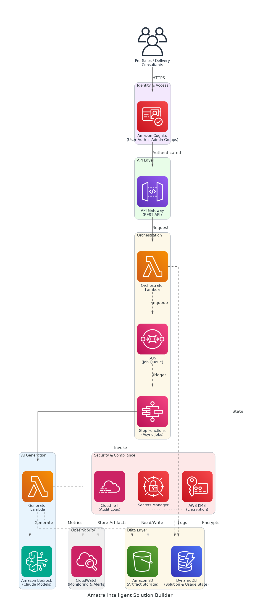
Slide 4: Solution Overview
AI Generation Layer
Amazon Bedrock (Claude) powers consulting-grade artifact generation
Async Step Functions + SQS handle 30–60 min jobs reliably
Platform & Data
Lambda + API Gateway deliver a secure, scalable REST API
DynamoDB tracks solution state; S3 stores all generated artifacts
Security & Compliance
Cognito manages auth with admin groups and usage-limit enforcement
KMS encryption and CloudTrail audit logs support SOC 2 Type II
Amatra Intelligent Solution Builder

Slide 5
Slide 5: Implementation Approach
Phase 1: Foundation & Pre-Sales MVP (Months 1-4)
Establish AWS environment, Cognito identity migration from Okta
Build Bedrock generation pipeline for 7 pre-sales artifact types
Deliver working MVP with QA validation by 2026-09-30
Phase 2: Delivery & Terraform Automation (Months 5-7)
Extend platform to delivery artifact and Terraform automation phases
Integrate legacy artifact templates (Word/Excel/PowerPoint pipelines)
Complete end-to-end testing and internal rollout by 2026-12-15
Phase 3: Optimisation & General Availability (Months 8-9)
Tune Bedrock prompts based on QA first-pass rates and user feedback
Activate admin usage controls, monitoring dashboards, and alerts
General Availability to all ~120 internal users by Q1 2027
Amatra Intelligent Solution Builder

Slide 6
Slide 6: Timeline & Milestones
Phase No | Phase Description | Timeline | Key Deliverables
Phase 1 | Foundation & Pre-Sales MVP | Months 1-4 | AWS environment live, Cognito identity migration complete, Pre-sales generation MVP operational (by 2026-09-30)
Phase 2 | Delivery & Terraform Automation | Months 5-7 | Delivery artifacts automated, Terraform pipeline integrated, Legacy templates migrated (by 2026-12-15)
Phase 3 | Optimisation & General Availability | Months 8-9 | Prompt tuning complete, Admin controls active, Full GA to all users (Q1 2027)
Amatra Intelligent Solution Builder

Slide 7
Slide 7: Success Stories
Mid-Market Cloud Consultancy (50 consultants, AWS-focused)
Challenge: 4-week proposal cycle limiting to 6 engagements per quarter
Solution: Bedrock-powered generation with S3 + DynamoDB artifact store
Result: Turnaround cut to 3 days; throughput grew 3x in 90 days
B2B SaaS Professional Services Firm (100 employees, North America)
Challenge: Manual SOW creation taking 12 hours per engagement, high rework
Solution: Serverless Lambda pipeline with Bedrock Claude for SOW generation
Result: 85% reduction in drafting time; QA first-pass rate reached 92%
Enterprise IT Reseller (Pre-Sales Team of 20, multi-vendor)
Challenge: Inconsistent artifact quality causing 30% proposal loss rate
Solution: Standardised AI generation with template-driven quality controls
Result: Proposal win rate up 22%; consulting hours per deal cut by 38%
Amatra Intelligent Solution Builder

Slide 8
Slide 8: Our Partnership Advantage
What We Bring
10+ years delivering AWS serverless and AI/ML solutions at scale
60+ successful automation platform builds across consulting verticals
AWS Advanced Consulting Partner with Machine Learning Competency
Certified solutions architects with Bedrock and Step Functions expertise
Value to You
Pre-built Bedrock prompt library fast-tracks artifact generation quality
Proven async job architecture eliminates timeout risk on long-running jobs
Direct AWS ML specialist support through Advanced Partner network
Best practices from 60+ builds prevent common serverless pitfalls
Amatra Intelligent Solution Builder

Slide 9
Slide 9: Investment Summary
Cost Category | Year 1 List | Year 1 Credits | Year 1 Net | Year 2 | Year 3 | 3-Year Total
Professional Services | $0 | $0 | $0 | $0 | $0 | $0
Cloud Services | $61,347 | ($5,000) | $56,347 | $61,347 | $61,347 | $179,041
Connectivity | $173 | $0 | $173 | $173 | $173 | $518
Software Licenses | $1,632 | $0 | $1,632 | $1,632 | $1,632 | $4,896
Support & Maintenance | $6,120 | $0 | $6,120 | $6,120 | $6,120 | $18,360
TOTAL | $69,272 | ($5,000) | $64,272 | $69,272 | $69,272 | $202,815
Amatra Intelligent Solution Builder

Slide 10
Slide 10: Next Steps
Decision: Executive (CTO) approval for project phase by [specific date]
Kickoff: Target project start date within 30 days of approval
Team Formation: Identify executive sponsor, VP Engineering lead, Head of Solutions QA contact, and Security & Compliance reviewer
Week 1-2: Contract finalization, AWS account provisioning, and Cognito migration planning
Week 3-4: Bedrock prompt framework design and first artifact template onboarded
Amatra Intelligent Solution Builder

Slide 11
Slide 11: Thank You

