Slide 1



Solution Briefing
Amatra Agentic Pre-Sales Platform on AWS
[Presenter Name] | June 05, 2026

Slide 2
Slide 2: Business Opportunity
Opportunity
Reduce per-engagement senior-consultant effort from 10 hours to under 1 hour
Eliminate manual validation retries and enable parallel pipeline throughput
Scale to 200+ solutions/month without adding headcount or quality loss
Success Criteria
90% reduction in per-engagement effort measured against 6-10 hour baseline
End-to-end generation under 60 minutes at 95th-percentile latency
ROI realised within 12 months via consultant time savings and pipeline growth
Amatra Agentic Pre-Sales Platform on AWS

Slide 3
Slide 3: Engagement Scope
Parameter | Scope |  | Parameter | Scope
Single team of 5-10 consultants | ~120 consultants (US & CA) |  | Single AWS region | us-west-2 (primary; isolated from us-east-1 workloads)
Single agent workflow | 5 agents per solution (Input Validator + 4 generators) |  | 3 artifacts | 12 artifacts (5 presales + 6 delivery + 1 automation bundle)
1 integration | 5 integrations (Bedrock; Cognito; DynamoDB; S3; GitHub) |  | Dev only | 3 environments (dev / staging / prod)
No quota enforcement | Per-user monthly quotas + global pool (1000 sol/mo) |  | Ad hoc (manual) | 200 solutions/month steady-state target
Best effort | End-to-end in under 1 hour; PoC live by end of April 2026
Amatra Agentic Pre-Sales Platform on AWS

Slide 4
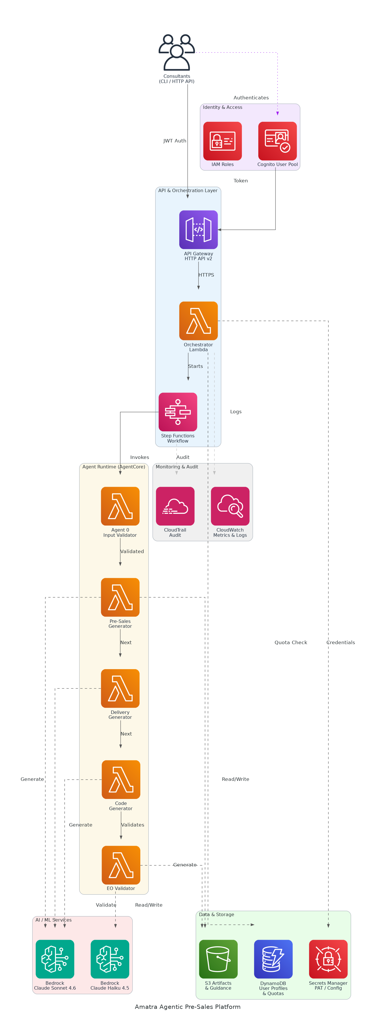
Slide 4: Solution Overview
Orchestration & API Layer
API Gateway HTTP API v2 with Cognito JWT auth and 11 Lambda routes
Step Functions workflow coordinating 5 Bedrock AgentCore agents
AI Generation & Validation
Claude Sonnet 4.6 for artifact generation; Haiku 4.5 for cost-efficient validation
Per-artifact format-check plus LLM quality review with up to 3 retries
Data, Storage & Delivery
S3 for artifacts, DynamoDB for quotas/profiles, Secrets Manager for PAT
Automated GitHub commit and eof-tools converter pipeline for DOCX/PPTX/XLSX
Amatra Agentic Pre-Sales Platform on AWS

Slide 5
Slide 5: Implementation Approach
Phase 1: Foundation & Security (Weeks 1-4)
Provision Cognito User Pool, API Gateway, DynamoDB, S3, and baseline IAM
Implement JWT authentication, post-confirmation Lambda, and quota enforcement
Establish tagging strategy, CloudTrail audit logging, and Secrets Manager rotation
Phase 2: Agents & Integration (Weeks 5-9)
Register 5 Strands agents on AgentCore Runtime with Docker image pipeline
Integrate eof-tools converters into agent container image and validate all 12 types
Build Step Functions orchestration graph and end-to-end generation workflow
Phase 3: Validation & Green Baseline (Weeks 10-12)
Run end-to-end validation across all 12 artifact types with real client data
Achieve green CloudWatch metrics baseline and surface per-phase token usage
Deliver CLI package, runbooks, and executive sponsor demonstration
Amatra Agentic Pre-Sales Platform on AWS

Slide 6
Slide 6: Timeline & Milestones
Phase No | Phase Description | Timeline | Key Deliverables
Phase 1 | Foundation & Security | Weeks 1-4 | Cognito User Pool live, API Gateway with JWT auth, DynamoDB quota tables operational
Phase 2 | Agents & Integration | Weeks 5-9 | 5 agents registered on AgentCore Runtime, all 12 artifact converters validated, end-to-end generation workflow operational
Phase 3 | Validation & Green Baseline | Weeks 10-12 | All 12 artifact types passing validation, green CloudWatch dashboard, executive sponsor demo ready
Amatra Agentic Pre-Sales Platform on AWS

Slide 7
Slide 7: Success Stories
North American IT Managed Services Firm (200+ consultants)
Challenge: Manual proposal generation consuming 8 hours per engagement, no audit trail
Solution: Strands multi-agent pipeline on Bedrock with Step Functions orchestration
Result: 85% effort reduction per engagement, full audit trail in CloudTrail
AWS Partner Network Consultancy (Pre-Sales Engineering Team)
Challenge: 4-5 LLM iteration cycles per artifact, blocking parallel pipeline throughput
Solution: Automated format-check plus Haiku validation with bounded 3-retry logic
Result: Zero manual retries, 3x pipeline throughput within 60 days of go-live
Global Systems Integrator (Sales Operations, 500+ reps)
Challenge: Inconsistent artifact quality, 30% rework rate, no per-user quota controls
Solution: Cognito-gated API, DynamoDB quota enforcement, and LLM quality gate
Result: Rework rate cut to under 5%, quota overruns eliminated, CRO-approved rollout
Amatra Agentic Pre-Sales Platform on AWS

Slide 8
Slide 8: Our Partnership Advantage
What We Bring
10+ years delivering AWS serverless and AI/ML solutions at enterprise scale
40+ successful agentic automation implementations for AWS consulting partners
AWS Advanced Consulting Partner with Machine Learning and DevOps Competencies
Certified solutions architects specialising in Bedrock AgentCore and Strands Agents
Value to You
Pre-built Strands agent templates accelerate AgentCore onboarding by 60%
Proven quota-enforcement pattern reduces DynamoDB design risk significantly
Direct AWS Bedrock specialist support through our partner engineering channel
Best practices from 40+ implementations prevent common LLM retry cost traps
Amatra Agentic Pre-Sales Platform on AWS

Slide 9
Slide 9: Investment Summary
Cost Category | Year 1 List | Year 1 Credits | Year 1 Net | Year 2 | Year 3 | 3-Year Total
Professional Services | $0 | $0 | $0 | $0 | $0 | $0
Cloud Services | $88,920 | ($30,000) | $58,920 | $110,466 | $143,606 | $313,992
Support & Maintenance | $8,880 | $0 | $8,880 | $10,656 | $12,787 | $32,323
TOTAL | $97,800 | ($30,000) | $67,800 | $121,122 | $156,393 | $345,315
Amatra Agentic Pre-Sales Platform on AWS

Slide 10
Slide 10: Next Steps
Decision: Executive and CTO approval for project by [specific date]
Kickoff: Target project start date within 30 days of approval
Team Formation: Identify AWS account owner, IAM approver, eof-tools SME, and UAT lead
Week 1-2: Contract finalisation, AWS us-west-2 account access, and Phase 1 architecture review
Week 3-4: Cognito User Pool provisioned, IAM baseline deployed, DynamoDB quota tables live
Amatra Agentic Pre-Sales Platform on AWS

Slide 11
Slide 11: Thank You

