Slide 1
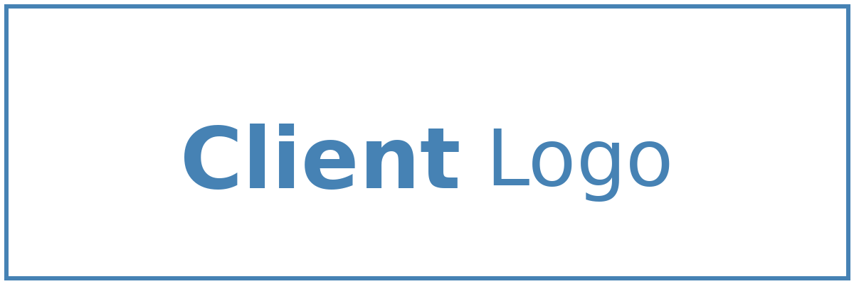


Solution Briefing
AWS Multi-Account Landing Zone
[Presenter Name] | August 16, 2026

Slide 2
Slide 2: Business Opportunity
Opportunity
Establish a greenfield multi-account AWS platform built for scale
Enforce security guardrails across all accounts from day one
Automate account vending to eliminate manual provisioning delays
Success Criteria
100% of accounts enrolled in Control Tower guardrails at go-live
New AWS account provisioning in under 30 minutes via Account Factory
Landing zone fully operational within 3 months of project start
AWS Multi-Account Landing Zone

Slide 3
Slide 3: Engagement Scope
Parameter | Scope |  | Parameter | Scope
Single AWS account (dev only) | Multi-account OU hierarchy (Security / Infra / Workloads / Sandbox / Suspended) |  | Single AWS region | us-east-1 (primary) + us-east-2 (DR/secondary)
Single environment (prod) | Development / Non-Production / Production (3 environments) |  | Flat OU structure | 7-OU hierarchy (Root / Security / Infrastructure / Workloads-Prod / Workloads-NonProd / Sandbox / Suspended)
Basic VPC per account | Hub-and-spoke via Transit Gateway; VPC IPAM; Network Firewall; centralised egress; VPN on-premises link |  | No formal compliance framework | AWS FSBP mandatory; NIST 800-53 / SOC 2 / HIPAA to be confirmed with client security team
Manual console configuration | >=95% IaC coverage (Terraform + AFT); CI/CD pipeline tooling TBD |  | No external integrations | Centralised monitoring (CloudWatch / Security Hub / GuardDuty); SNS alerting; third-party SIEM TBD
AWS Multi-Account Landing Zone

Slide 4
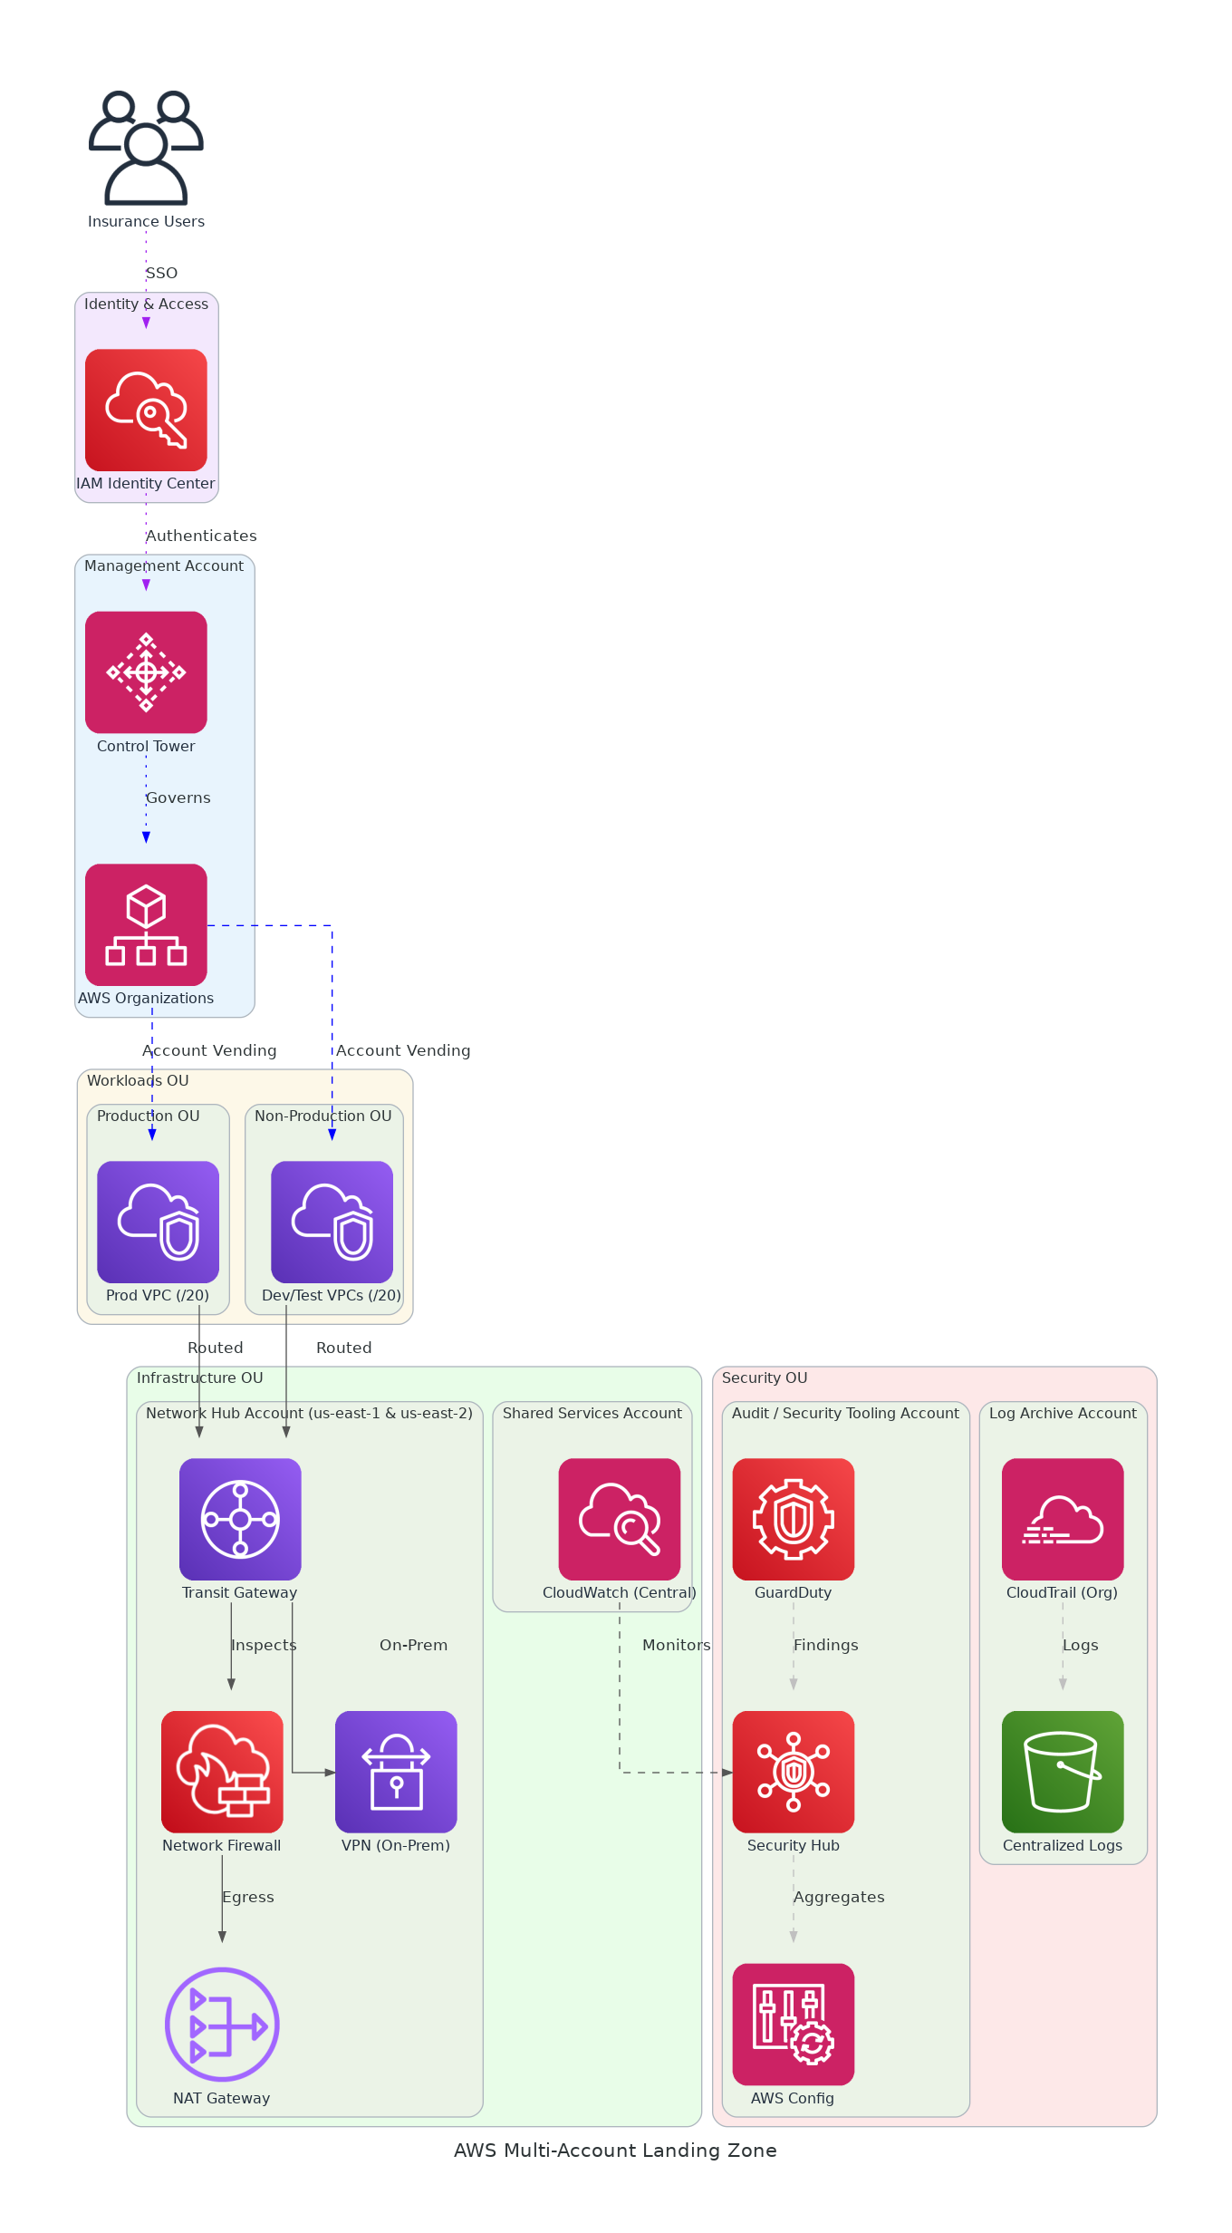
Slide 4: Solution Overview
Governance & Identity
Control Tower + Organizations enforce guardrails across all accounts
IAM Identity Center provides centralised SSO for all AWS accounts
Networking
Transit Gateway hub-spoke with Network Firewall for traffic inspection
VPN connectivity to on-premises; VPC IPAM manages IP address space
Security & Compliance
Security Hub aggregates findings; GuardDuty detects threats in both regions
CloudTrail org trail and Config rules ensure audit and compliance coverage
AWS Multi-Account Landing Zone

Slide 5
Slide 5: Implementation Approach
Phase 1: Foundation & Governance (Weeks 1-4)
Deploy Control Tower, OU structure, SCPs/RCPs across both regions
Configure IAM Identity Center SSO and centralised logging accounts
Establish Log Archive and Audit accounts with CloudTrail org trail
Phase 2: Networking & Connectivity (Weeks 5-8)
Deploy Transit Gateway in us-east-1 and us-east-2 with hub VPCs
Configure Network Firewall, NAT Gateway, VPC IPAM, and spoke templates
Establish VPN to on-premises; validate east-west and north-south inspection
Phase 3: Security, Automation & Handover (Weeks 9-12)
Enable Security Hub (FSBP), GuardDuty, Config rules, and CloudTrail Lake
Deploy AFT pipeline for automated account vending with tagging enforcement
Deliver runbooks, team onboarding, and knowledge transfer to client team
AWS Multi-Account Landing Zone

Slide 6
Slide 6: Timeline & Milestones
Phase No | Phase Description | Timeline | Key Deliverables
Phase 1 | Foundation & Governance | Weeks 1-4 | Control Tower live, OU structure deployed, IAM Identity Center SSO operational, Centralised logging active
Phase 2 | Networking & Connectivity | Weeks 5-8 | Transit Gateway hub-spoke in both regions, Network Firewall operational, VPN to on-premises established
Phase 3 | Security, Automation & Handover | Weeks 9-12 | Security Hub FSBP enabled, AFT account vending pipeline live, 2 workload accounts vended, Runbooks delivered
AWS Multi-Account Landing Zone

Slide 7
Slide 7: Success Stories
Insurance Technology Provider (Greenfield, US-based)
Challenge: No AWS presence; manual account setup causing 6-week delays
Solution: Control Tower, AFT, and Transit Gateway hub-spoke across two regions
Result: Account provisioning reduced to 20 minutes; 100% guardrail compliance at launch
Financial Services Firm (Multi-region, 30+ accounts)
Challenge: Ad-hoc accounts with inconsistent security; failed compliance audit
Solution: Control Tower consolidation, SCPs, Security Hub FSBP standard enforced
Result: 87% Security Hub compliance score within 45 days; audit remediation closed
Healthcare Provider (Regulated, HIPAA-aligned)
Challenge: Siloed AWS accounts, no centralised logging, 4-week provisioning lead time
Solution: Organizations OU redesign, CloudTrail Lake, AFT with mandatory tagging
Result: Provisioning cut to 25 minutes; centralised audit trail across all accounts
AWS Multi-Account Landing Zone

Slide 8
Slide 8: Our Partnership Advantage
What We Bring
10+ years delivering AWS cloud foundation and governance solutions
60+ AWS Landing Zone and Control Tower deployments across industries
AWS Advanced Consulting Partner with Security and Cloud Operations competencies
Certified AWS Solutions Architects and Control Tower specialists on every engagement
Value to You
Pre-built AFT modules and Terraform templates reduce delivery time by 40%
Proven OU and SCP design patterns eliminate costly re-architecture later
Direct AWS specialist support through partner network during your engagement
Best practices from 60+ implementations help avoid common configuration pitfalls
AWS Multi-Account Landing Zone

Slide 9
Slide 9: Investment Summary
Cost Category | Year 1 List | Year 1 Credits | Year 1 Net | Year 2 | Year 3 | 3-Year Total
Professional Services | $0 | $0 | $0 | $0 | $0 | $0
Cloud Services | $28,422 | ($15,000) | $13,422 | $28,422 | $28,422 | $70,266
Software Licenses | $480 | $0 | $480 | $480 | $480 | $1,440
Support & Maintenance | $4,200 | $0 | $4,200 | $4,200 | $4,200 | $12,600
TOTAL | $33,102 | ($15,000) | $18,102 | $33,102 | $33,102 | $84,306
AWS Multi-Account Landing Zone

Slide 10
Slide 10: Next Steps
Decision: Executive approval for project by [specific date]
Kickoff: Target project start date within 30 days of approval
Team Formation: Identify executive sponsor, cloud/infrastructure owner, security lead, and FinOps contact
Week 1-2: Contract finalization, AWS account setup, and kick-off workshop with RACI completion
Week 3-4: OU design and SCP policy review, Control Tower deployment begins, architecture sign-off
AWS Multi-Account Landing Zone

Slide 11
Slide 11: Thank You

