Slide 1



Solution Briefing
AWS Agentic Pre-Sales Orchestration Platform
[Presenter Name] | June 05, 2026

Slide 2
Slide 2: Business Opportunity
Opportunity
Replace 6-10 hours of senior-consultant manual effort per engagement
Achieve parallel pipeline throughput across the entire sales organisation
Deliver complete five-artifact presales bundles in under one hour
Success Criteria
90% reduction in per-engagement effort by end of Phase 1
Sub-60-minute end-to-end artifact generation with zero human-in-loop
ROI realization within 6 months through consultant capacity recapture
AWS Agentic Pre-Sales Orchestration Platform

Slide 3
Slide 3: Engagement Scope
Parameter | Scope |  | Parameter | Scope
Single business unit | ~120 consultants across US and Canada |  | Single AWS region | us-west-2 (primary)
3–4 Lambda functions | 5 agents + 14 CLI subcommands + 11 API Lambda routes |  | 4–6 artifact types | 12 artifacts per solution (5 presales + 6 delivery + 1 automation)
1–2 integrations | 4 integrations (Bedrock AgentCore + Cognito + GitHub + DynamoDB quota) |  | Dev + Prod | Dev / Staging / Prod (3 environments)
Standard AWS security baseline | CTO sign-off required; JWT auth; per-user + global quotas; audit trail |  | Business-hours availability | POC target; production path to 99.9% uptime
AWS Agentic Pre-Sales Orchestration Platform

Slide 4
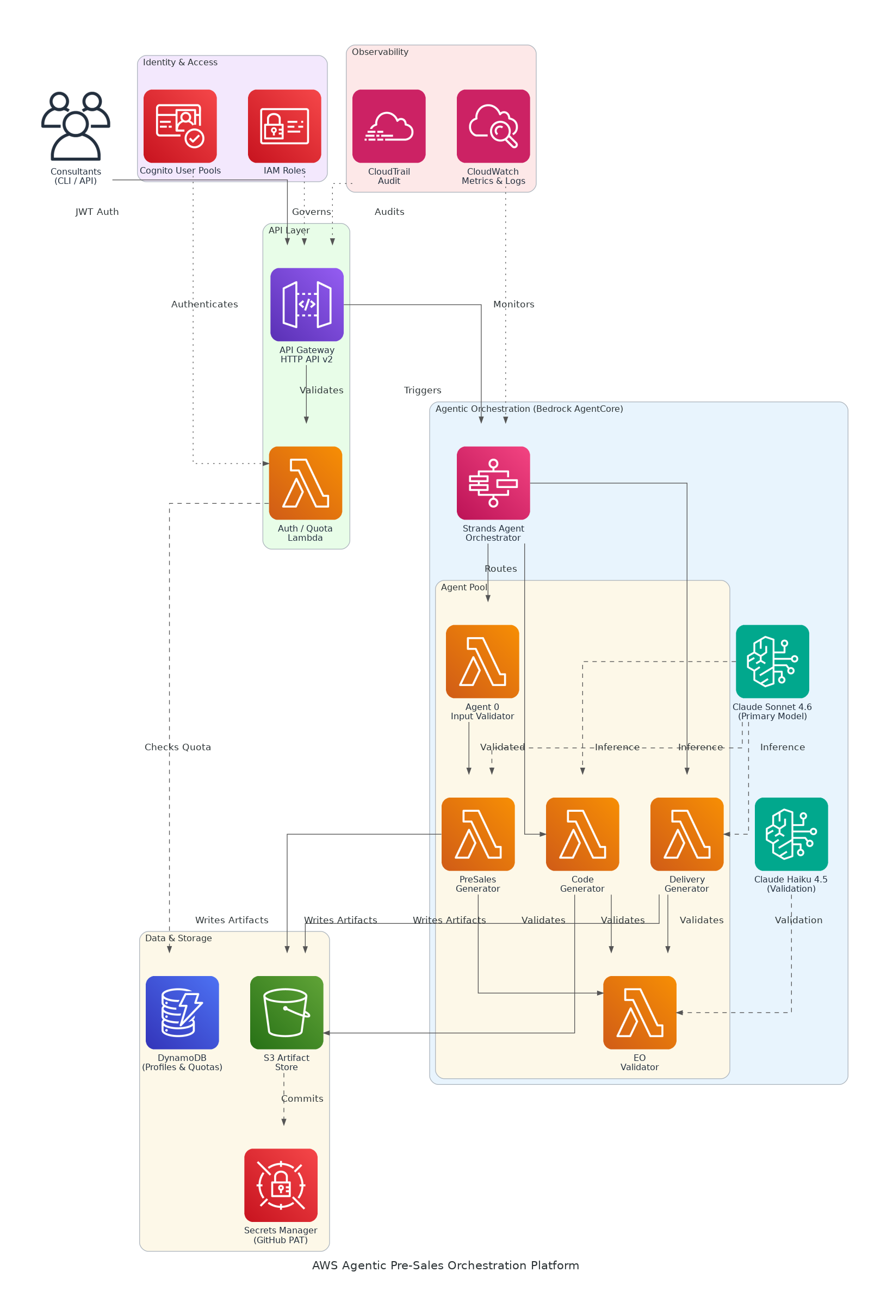
Slide 4: Solution Overview
AI/ML & Orchestration
Bedrock AgentCore Runtime hosting five specialised Strands agents
Claude Sonnet 4.6 generation with Haiku 4.5 cost-efficient validation
Platform & Integration
API Gateway HTTP API v2 with Cognito JWT and per-user quota enforcement
S3 artifact store, DynamoDB profiles, and GitHub commit via Secrets Manager
Operations & Compliance
CloudWatch metrics and CloudTrail audit trail for full observability
Deterministic eof-tools converter pipeline baked into agent container image
AWS Agentic Pre-Sales Orchestration Platform

Slide 5
Slide 5: Implementation Approach
Phase 1: Foundation & Identity (Weeks 1-4)
Provision Cognito User Pools, API Gateway HTTP API, and DynamoDB tables
Configure IAM roles, S3 bucket policies, and Secrets Manager for GitHub PAT
Deploy baseline CloudWatch dashboards and CloudTrail audit logging
Phase 2: Agent Build & Integration (Weeks 5-9)
Implement five Strands agents with Bedrock AgentCore Runtime registration
Build Docker image pipeline baking eof-tools converter library into agents
Wire 11 Lambda routes, CLI subcommands, and quota enforcement logic
Phase 3: Validation & Go-Live (Weeks 10-12)
Run end-to-end validation across all 12 artifact types with green metrics
Conduct load testing at 200 solutions/month steady-state throughput
Deliver runbook, handoff training, and Phase 2 scope backlog
AWS Agentic Pre-Sales Orchestration Platform

Slide 6
Slide 6: Timeline & Milestones
Phase No | Phase Description | Timeline | Key Deliverables
Phase 1 | Foundation & Identity | Weeks 1-4 | Cognito user pool live, API Gateway + DynamoDB operational, IAM baseline configured
Phase 2 | Agent Build & Integration | Weeks 5-9 | Five agents registered in AgentCore, Docker image pipeline green, CLI + quota logic deployed
Phase 3 | Validation & Go-Live | Weeks 10-12 | All 12 artifacts validated end-to-end, CloudWatch baseline green, executive demo delivered
AWS Agentic Pre-Sales Orchestration Platform

Slide 7
Slide 7: Success Stories
Global Systems Integrator (500+ consultants, North America)
Challenge: 8-12 hours per presales pack, no audit trail, lost pipeline velocity
Solution: Bedrock-powered multi-agent pipeline with deterministic validation gates
Result: 85% effort reduction; 3x pipeline capacity gained in 60 days
AWS Advanced Partner, Financial Services Practice (200 consultants)
Challenge: Inconsistent artifact quality causing 30% re-work rate pre-delivery
Solution: LLM generation plus automated format-check and retry loop on Bedrock
Result: Re-work cut to 5%; CSAT up 22 points within 90 days
Mid-Market IT Consultancy, DevOps Focus (80 consultants)
Challenge: Two senior architects tied up on presales docs, delaying delivery work
Solution: Serverless Strands agent platform with GitHub auto-commit on approval
Result: Architects redirected to delivery; revenue per consultant up 40%
AWS Agentic Pre-Sales Orchestration Platform

Slide 8
Slide 8: Our Partnership Advantage
What We Bring
10+ years delivering AWS serverless and AI/ML solutions at enterprise scale
30+ agentic automation implementations across consulting and SaaS sectors
AWS Advanced Consulting Partner with Machine Learning Competency
Certified solutions architects specialising in Bedrock and multi-agent design
Value to You
Pre-built Strands agent templates cut Phase 2 build time by 40%
Proven eof-tools integration pattern eliminates converter rewrite risk
Direct AWS Bedrock specialist access through our partner engineering desk
Best practices from 30+ implementations prevent common quota and latency pitfalls
AWS Agentic Pre-Sales Orchestration Platform

Slide 9
Slide 9: Investment Summary
Cost Category | Year 1 List | Year 1 Credits | Year 1 Net | Year 2 | Year 3 | 3-Year Total
Professional Services | $0 | $0 | $0 | $0 | $0 | $0
Cloud Services | $64,427 | ($15,000) | $49,427 | $76,816 | $96,682 | $222,925
Software Licenses | $6,300 | $0 | $6,300 | $6,300 | $6,300 | $18,900
Support & Maintenance | $5,400 | $0 | $5,400 | $5,400 | $5,400 | $16,200
TOTAL | $76,127 | ($15,000) | $61,127 | $88,516 | $108,382 | $258,025
AWS Agentic Pre-Sales Orchestration Platform

Slide 10
Slide 10: Next Steps
Decision: Executive approval for Phase 1 project start by [specific date]
Kickoff: Target project start date within 30 days of CTO and budget approval
Team Formation: Identify AWS account owner, security lead, and Amatra product owner
Week 1-2: Contract finalisation, us-west-2 account provisioning, and Cognito setup
Week 3-4: API Gateway routes live, DynamoDB schema deployed, first CLI auth demo
AWS Agentic Pre-Sales Orchestration Platform

Slide 11
Slide 11: Thank You

