Slide 1



Solution Briefing
Amatra Agentic Orchestration Platform
Marcus Patel | June 04, 2026

Slide 2
Slide 2: Business Opportunity
Opportunity
Reduce per-engagement effort by 90% from 6-10 hours to under 1 hour
Unlock parallel pipeline throughput for a 120-consultant sales organisation
Scale to 200+ solutions per month at under $5 model spend per solution
Success Criteria
End-to-end presales bundle generated in under 60 minutes, zero human loops
95%+ artifact validation pass rate across all 12 artifact types
ROI realised within 6 months through senior-consultant time savings
Amatra Agentic Orchestration Platform

Slide 3
Slide 3: Engagement Scope
Parameter | Scope |  | Parameter | Scope
Single-agent workflow | 5 agents (Input Validator; Pre-Sales Generator; Delivery Generator; Code Generator; EO Validator) |  | 3-5 artifacts per solution | 12 artifacts per solution (5 presales + 6 delivery + 1 automation bundle)
5 Lambda routes + 5 CLI subcommands | 11 Lambda routes + 14 CLI subcommands behind API GW HTTP API v2 |  | Single production environment | 3 environments (dev / staging / prod)
Single-pass validation | Deterministic format-check + LLM quality check with up to 3 retries per artifact |  | None | 3 integrations (GitHub PAT commit; DynamoDB quota enforcement; eof-tools converter pipeline)
No quota enforcement | Per-user quota 10 solutions/month; global pool 1000 solutions/month enforced atomically in DynamoDB |  | Basic logging only | CloudWatch metrics baseline; per-phase token usage in CLI + admin API; graded artifact delivery policy
Amatra Agentic Orchestration Platform

Slide 4
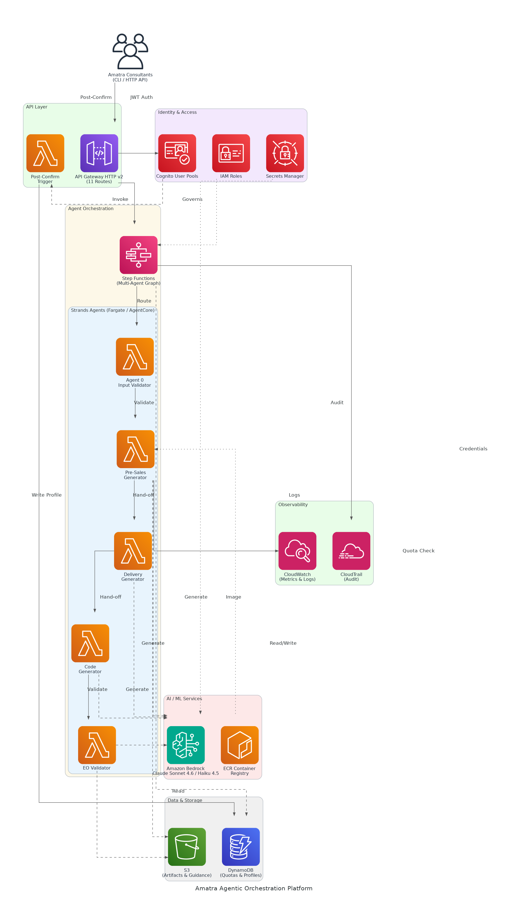
Slide 4: Solution Overview
Agent & Orchestration Layer
Five Strands agents on AgentCore Runtime per solution generation
Step Functions multi-agent graph with up to 3 validation retries
Platform & Security
Cognito JWT auth, 11 API Gateway routes, 14 CLI subcommands
DynamoDB quota enforcement, S3 artifact storage, Secrets Manager
AI & Observability
Claude Sonnet 4.6 generation, Haiku 4.5 cost-efficient validation
CloudWatch metrics, CloudTrail audit, per-phase token usage reporting
Amatra Agentic Orchestration Platform

Slide 5
Slide 5: Implementation Approach
Phase 1: Foundation & Security (Months 1-4)
Provision Cognito, API Gateway, DynamoDB, S3, and baseline IAM
Build pip-installable CLI with 14 subcommands and JWT auth flow
Establish per-user quota enforcement and DynamoDB profile schema
Phase 2: Agent Build & Integration (Months 5-9)
Develop 5 Strands agents and register with AgentCore Runtime
Build Docker image pipeline and integrate eof-tools converter library
Wire Bedrock Claude models, Step Functions graph, and retry logic
Phase 3: Validation & Go-Live (Months 10-12)
End-to-end validation across all 12 artifact types with green metrics
Configure CloudWatch dashboards, CloudTrail audit, and usage endpoints
Deliver exec demo, GitHub commit pipeline, and operations handoff
Amatra Agentic Orchestration Platform

Slide 6
Slide 6: Timeline & Milestones
Phase No | Phase Description | Timeline | Key Deliverables
Phase 1 | Foundation & Security | Months 1-4 | Cognito auth live, API Gateway 11 routes operational, DynamoDB quota schema deployed
Phase 2 | Agent Build & Integration | Months 5-9 | 5 Strands agents registered, eof-tools Docker image pipeline, Bedrock model integration complete
Phase 3 | Validation & Go-Live | Months 10-12 | 12 artifact types validated, CloudWatch green baseline, exec demo delivered
Amatra Agentic Orchestration Platform

Slide 7
Slide 7: Success Stories
Global Systems Integrator (250+ consultants, APAC & EMEA)
Challenge: 8+ hours per proposal, 40% rework from validation failures
Solution: Agentic Bedrock pipeline with LLM format-check and retry loops
Result: Proposal time cut to 45 min; rework rate reduced to under 5%
AWS Partner Network Consultancy (60 consultants, North America)
Challenge: Manual artifact assembly blocking 3 concurrent deals per week
Solution: Strands multi-agent graph with Step Functions and S3 artifact store
Result: Pipeline throughput tripled; senior consultants freed for solutioning
Managed Services Provider (100 consultants, Financial Services focus)
Challenge: No audit trail, quota controls, or per-user identity for AI usage
Solution: Cognito JWT auth, DynamoDB quotas, CloudTrail audit on Bedrock calls
Result: Full SOC2 audit readiness achieved; $180K annual AI spend controlled
Amatra Agentic Orchestration Platform

Slide 8
Slide 8: Our Partnership Advantage
What We Bring
10+ years delivering AWS cloud and AI/ML platform solutions
40+ agentic and automation platform builds across AWS partner ecosystem
AWS Advanced Consulting Partner with Machine Learning Competency
Certified solutions architects with Bedrock, Strands, and AgentCore expertise
Value to You
Pre-built eof-tools integration accelerates agent container delivery by 60%
Proven quota and identity pattern reduces Cognito and DynamoDB build risk
Direct AWS Bedrock specialist support through partner network access
Best practices from 40+ builds prevent common multi-agent failure modes
Amatra Agentic Orchestration Platform

Slide 9
Slide 9: Investment Summary
Cost Category | Year 1 List | Year 1 Credits | Year 1 Net | Year 2 | Year 3 | 3-Year Total
Professional Services | $0 | $0 | $0 | $0 | $0 | $0
Cloud Services | $33,308 | ($5,000) | $28,308 | $37,268 | $41,810 | $107,386
Support & Maintenance | $6,000 | $0 | $6,000 | $6,000 | $6,000 | $18,000
TOTAL | $39,308 | ($5,000) | $34,308 | $43,268 | $47,810 | $125,386
Amatra Agentic Orchestration Platform

Slide 10
Slide 10: Next Steps
Decision: Executive approval and CTO sign-off for PoC project by [specific date]
Kickoff: Target project start date within 30 days of approval
Team Formation: Identify executive sponsor (Sarah Lin), technical lead (Marcus Patel), and CTO for Cognito user pool sign-off
Week 1-2: Contract finalisation, AWS us-west-2 account setup, and IAM baseline provisioning
Week 3-4: Cognito User Pool configuration, API Gateway scaffold, and DynamoDB schema deployed
Amatra Agentic Orchestration Platform

Slide 11
Slide 11: Thank You

