Slide 1



Solution Briefing
ANP Streaming AI Recommendation Engine
Jonas Bull | June 08, 2026

Slide 2
Slide 2: Business Opportunity
Opportunity
Serve 2.4B+ global Christians underserved by Western-centric streaming platforms
Deliver emotion-based discovery bridging mental wellbeing and personal faith
Scale personalization from 100 to 100,000+ MAUs without added headcount
Success Criteria
API-accessible recommendation engine live within 12 weeks of kickoff
90%+ mood-to-content match accuracy validated against curated test sets
Investor-ready tiered cost model across 100, 10K, and 100K MAU scenarios
ANP Streaming AI Recommendation Engine

Slide 3
Slide 3: Engagement Scope
Parameter | Scope |  | Parameter | Scope
Single department ~100 MAU | Starting at 0; projections for 100 / 10K / 100K MAU |  | Single-genre catalog ~1000 tracks | Existing FlutterFlow / Firebase catalog with titles + metadata; lyric and transcript files where available
1 baseline recommendation model | Content-intelligence classifier + preference-learning model + mood-to-content matcher + playlist generator + retraining pipeline |  | Single prod environment | Dev + Staging environments; production deployment out of scope for this engagement
1 downstream consumer | FlutterFlow mobile app calling secured REST API; no frontend modification required |  | Basic metadata schema | User preference vectors + content metadata + mood taxonomy; defined and documented in Phase 1
Standard AWS best practices | Dedicated AWS account provided by customer; security controls under existing or new dedicated security account |  | Single handoff session | Two formal knowledge-transfer sessions + full operational runbook delivery
ANP Streaming AI Recommendation Engine

Slide 4
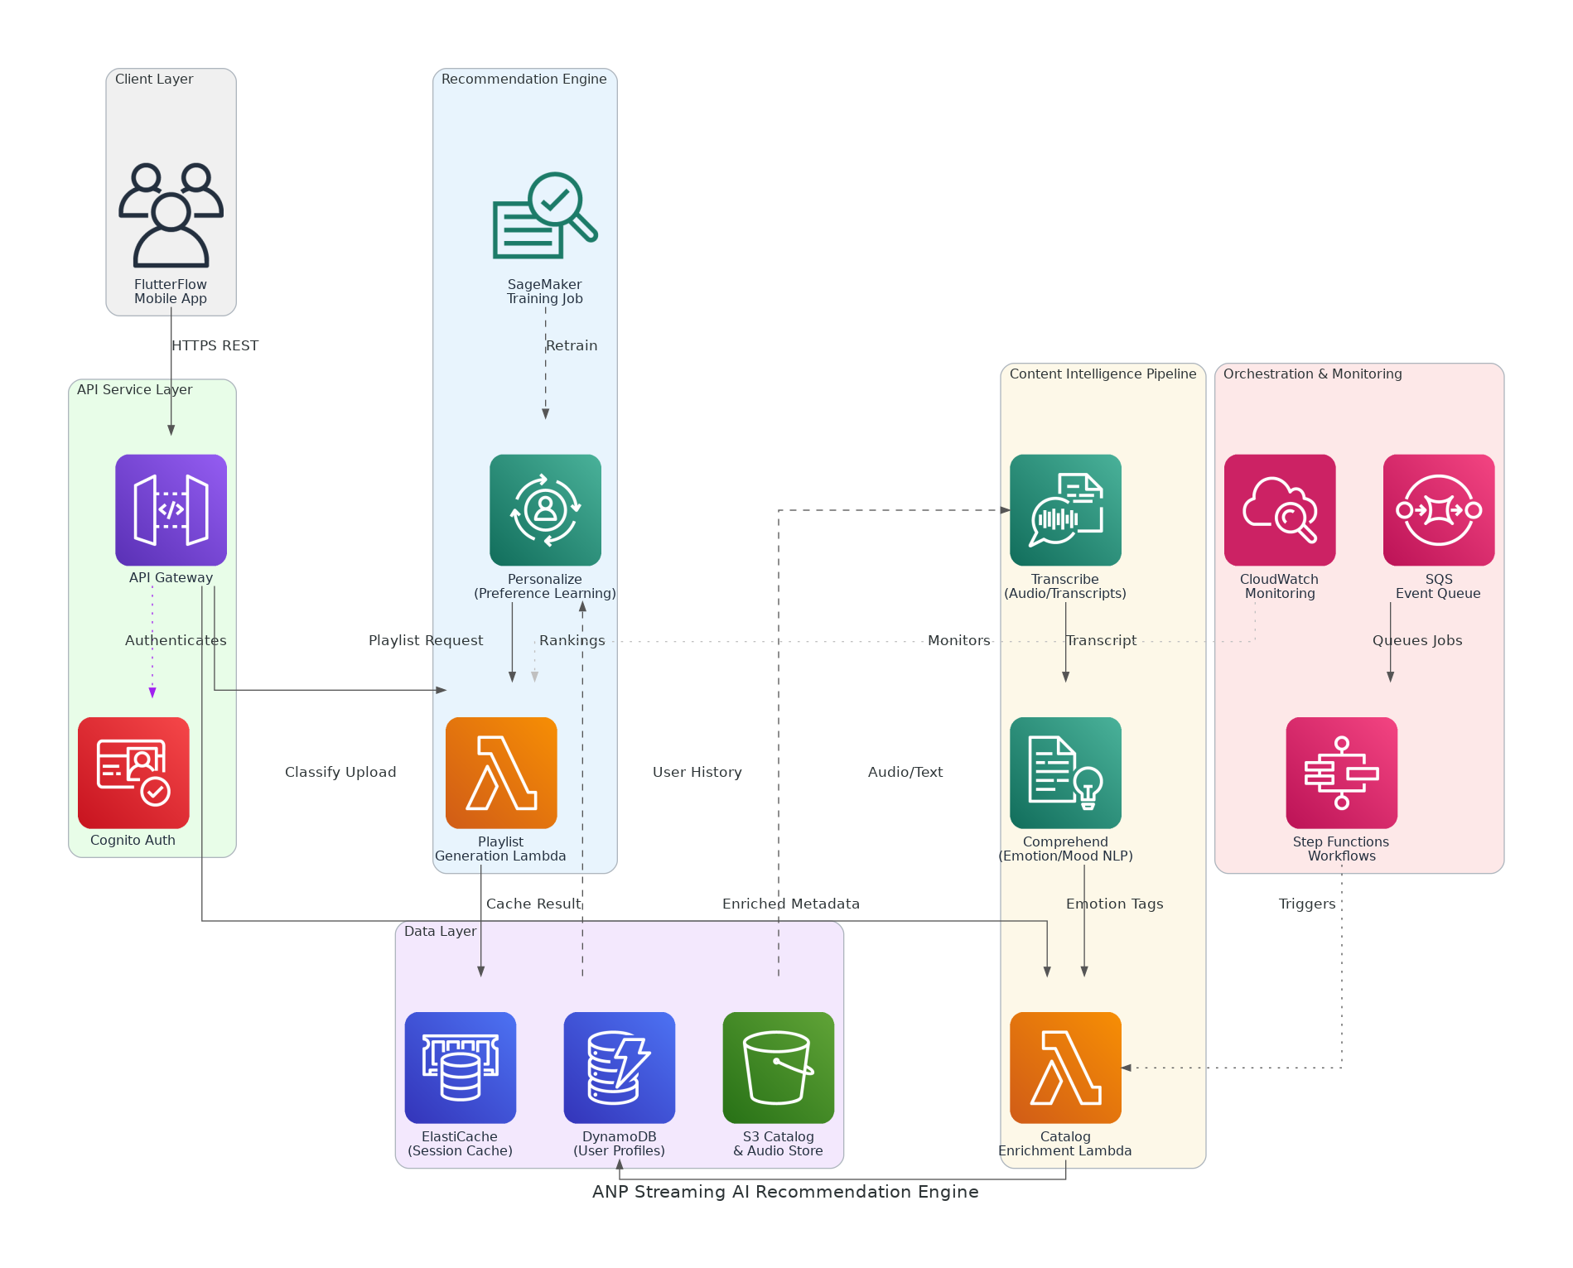
Slide 4: Solution Overview
Content Intelligence
Transcribe + Comprehend for emotion, mood, and theme classification
SageMaker pipeline enriches catalog metadata at artist upload time
Recommendation Engine
Amazon Personalize for preference learning and mood-to-content matching
Lambda-based playlist generation with session context and feedback signals
API & Data Layer
API Gateway + Cognito expose secured REST endpoints to FlutterFlow
DynamoDB user profiles, S3 catalog store, ElastiCache session caching
ANP Streaming AI Recommendation Engine

Slide 5
Slide 5: Implementation Approach
Phase 1: Discovery & Content Intelligence (Months 1-2)
Requirements workshop, AWS architecture, data schemas, and mood taxonomy
Deploy Transcribe/Comprehend pipeline for lyric and transcript classification
Enrich existing catalog with emotion, mood, and thematic attributes
Phase 2: Recommendation Engine & API (Months 2-3)
Build Personalize preference-learning model and mood-to-content matcher
Implement playlist generation Lambda with feedback and retraining pipeline
Deploy authenticated API layer (profile, classify, playlist, feedback endpoints)
Phase 3: Integration & Handoff (Month 3)
End-to-end validation against FlutterFlow call patterns in production
Deliver API contracts, model configs, runbooks, and tiered cost models
Two knowledge-transfer sessions and full operational handoff to ANP team
ANP Streaming AI Recommendation Engine

Slide 6
Slide 6: Timeline & Milestones
Phase No | Phase Description | Timeline | Key Deliverables
Phase 1 | Discovery & Content Intelligence | Months 1-2 | AWS architecture approved, mood taxonomy defined, catalog enrichment pipeline live, tiered cost model delivered
Phase 2 | Recommendation Engine & API | Months 2-3 | Personalize model trained, playlist generation API live, feedback/retraining pipeline operational
Phase 3 | Integration & Handoff | Month 3 | FlutterFlow integration validated, full documentation delivered, two KT sessions completed
ANP Streaming AI Recommendation Engine

Slide 7
Slide 7: Success Stories
Faith & Wellness Media Platform (Series A, 80K MAU)
Challenge: Manual content tagging took 3+ hours per upload, delaying releases
Solution: Comprehend + Lambda pipeline auto-classifying themes at ingest time
Result: Tagging under 60 seconds; catalog growth doubled in 90 days
Independent Music Streaming Startup (SaaS, 50K subscribers)
Challenge: Generic playlist logic driving 62% skip rate and 40% monthly churn
Solution: Amazon Personalize preference model replacing rule-based recommendation
Result: Skip rate dropped 38%; retention improved 22% in first quarter
Podcast & Audio Content Network (SMB, 25K monthly listeners)
Challenge: Zero personalization; listeners searched manually with no mood discovery
Solution: Transcribe-based mood taxonomy and API-served playlist engine on AWS
Result: Session length up 34%; NPS up 18 points within 60 days
ANP Streaming AI Recommendation Engine

Slide 8
Slide 8: Our Partnership Advantage
What We Bring
10+ years delivering AWS AI/ML and cloud-native solutions at scale
50+ successful AI/ML implementations across media, health, and SaaS verticals
AWS Advanced Consulting Partner with Machine Learning Competency
Certified ML and solutions architects with Personalize and SageMaker expertise
Value to You
Pre-built content classification templates accelerate catalog enrichment pipeline
Proven Personalize onboarding methodology reduces model cold-start time by 40%
Direct AWS ML specialist support and $25,000 Partner Funding fully applied
Best practices from 50+ implementations eliminate common AI/ML pitfalls
ANP Streaming AI Recommendation Engine

Slide 9
Slide 9: Investment Summary
Cost Category | Year 1 List | Year 1 Credits | Year 1 Net | Year 2 | Year 3 | 3-Year Total
Professional Services | $0 | $0 | $0 | $0 | $0 | $0
Cloud Services | $2,563 | ($2,500) | $63 | $2,563 | $2,890 | $5,516
Support & Maintenance | $1,200 | $0 | $1,200 | $1,200 | $1,200 | $3,600
TOTAL | $3,763 | ($2,500) | $1,263 | $3,763 | $4,090 | $9,116
ANP Streaming AI Recommendation Engine

Slide 10
Slide 10: Next Steps
Decision: Executive approval for project kickoff by [specific date]
Kickoff: Target project start date within 30 days of AWS funding approval
Team Formation: Identify app/workload owner, infrastructure architect, and security architect
Week 1-2: AWS funding portal submission, account provisioning, and requirements workshop
Week 3-4: Mood taxonomy design, Firebase schema mapping, and catalog sample ingestion begins
ANP Streaming AI Recommendation Engine

Slide 11
Slide 11: Thank You

