Slide 1



Solution Briefing
AWS AI/ML Clinical Decision Support Platform
[Presenter Name] | June 29, 2026

Slide 2
Slide 2: Business Opportunity
Opportunity
Reduce sepsis mortality 15% via real-time AI risk scoring across 18 hospitals
Cut false-positive alert fatigue 40% replacing inconsistent rule-based alerts
Prevent costly 30-day readmissions with predictive risk models at scale
Success Criteria
15% sepsis mortality reduction within 12 months of go-live
40% false-positive alert reduction validated by nursing staff
20% readmission rate reduction across all facilities by 18 months
AWS AI/ML Clinical Decision Support Platform

Slide 3
Slide 3: Engagement Scope
Parameter | Scope |  | Parameter | Scope
Single hospital unit | ~4200 staff across 18 hospitals and 60+ clinics |  | Single facility | 18 hospitals + 60+ outpatient clinics (southeastern US)
Low-volume EHR feeds | ~2.1 million patients annually; real-time vitals, labs, and EHR events |  | No external integrations | Epic FHIR R4 API, Mirth Connect HL7 v2.3, Azure AD SSO, SQL Server nightly export
Single environment | Dev / QA / Staging / Production (4 environments) |  | Single pre-built model | 3 custom models (sepsis; readmission; rapid response) + LLM summarization
No specific compliance | HIPAA BAA + HITECH + SOC 2 Type II + PHI audit logging |  | Best-effort (99.0%) | 99.95% platform availability (excluding maintenance windows)
Single-phase delivery | 3 phases: Phase 1 by 2026-10-31; Phase 2 by 2027-02-28; Phase 3 by 2027-06-30
AWS AI/ML Clinical Decision Support Platform

Slide 4
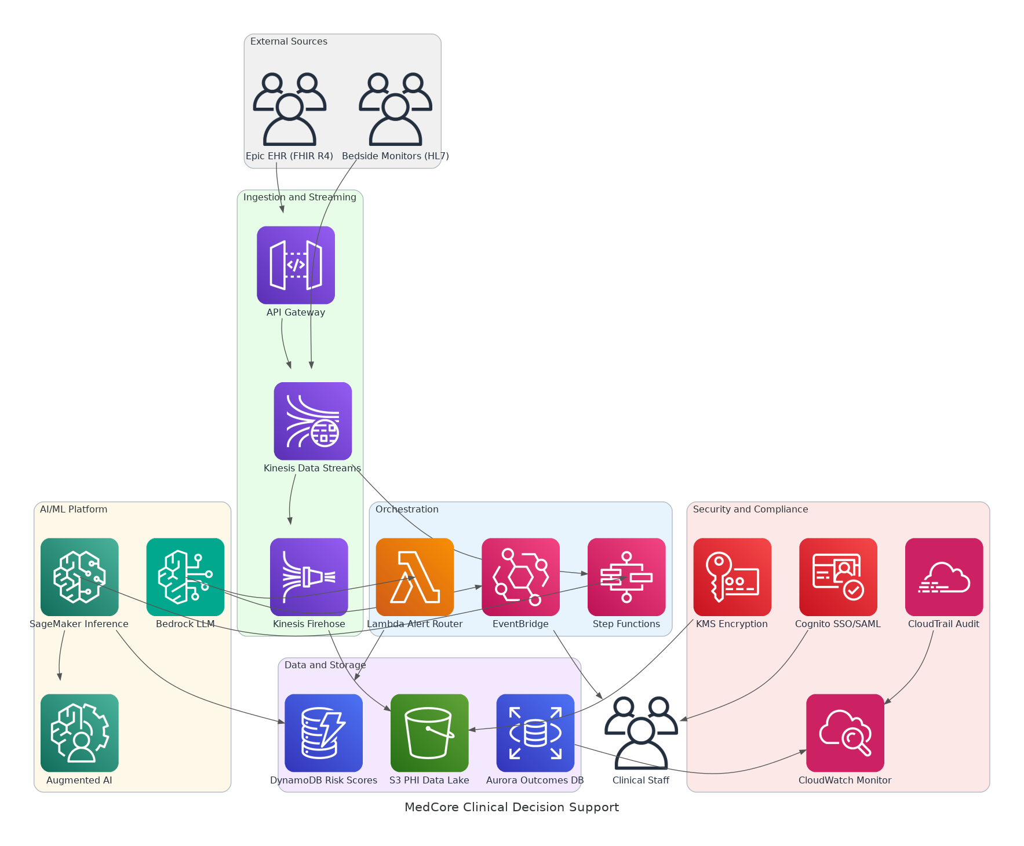
Slide 4: Solution Overview
Ingestion & AI/ML
Kinesis streams Epic FHIR and HL7 vitals for sub-3-second inference
SageMaker serves sepsis, readmission, and rapid-response risk models
Alerting & Explainability
Bedrock LLM generates plain-language clinical narratives per alert
EventBridge routes role-based alerts to nursing and physician dashboards
Security & Compliance
KMS encrypts all PHI at rest; CloudTrail logs every PHI access event
Cognito federates Azure AD identities via SAML 2.0 with RBAC enforcement
AWS AI/ML Clinical Decision Support Platform

Slide 5
Slide 5: Implementation Approach
Phase 1: Foundation and Sepsis Pilot (Months 1-4)
Deploy AWS data ingestion pipeline with Epic FHIR and HL7 v2.3 feeds
Train and validate sepsis risk model; achieve 95%+ accuracy benchmark
Stand up HIPAA-compliant infrastructure with KMS, CloudTrail, and Cognito
Phase 2: Model Expansion and Dashboard (Months 5-8)
Deploy readmission and rapid-response models with explainability outputs
Launch clinical dashboard with role-based alert workflows and SSO
Integrate Bedrock LLM for plain-language alert narrative generation
Phase 3: Full Rollout and Optimisation (Months 9-12)
Phased go-live across all 18 hospitals and 60 outpatient clinics
Fine-tune models with production feedback and outcome data
Complete operations handoff, runbooks, and SOC 2 audit preparation
AWS AI/ML Clinical Decision Support Platform

Slide 6
Slide 6: Timeline & Milestones
Phase No | Phase Description | Timeline | Key Deliverables
Phase 1 | Foundation and Sepsis Pilot | Months 1-4 | Ingestion pipeline live, Sepsis model validated at 95%+ accuracy, HIPAA-compliant infrastructure operational
Phase 2 | Model Expansion and Dashboard | Months 5-8 | Readmission and rapid-response models live, Clinical dashboard with RBAC deployed, Bedrock alert narratives enabled
Phase 3 | Full Rollout and Optimisation | Months 9-12 | All 18 hospitals live, Models fine-tuned on production data, SOC 2 audit documentation complete
AWS AI/ML Clinical Decision Support Platform

Slide 7
Slide 7: Success Stories
Regional Health System (12 hospitals, southeastern US)
Challenge: Rule-based sepsis alerts with 35% false-positive rate, delayed response
Solution: SageMaker real-time inference with FHIR ingestion and A2I review
Result: 18% sepsis mortality reduction; false positives cut 42% in 6 months
National Health Insurer (500K members, Medicare and commercial)
Challenge: 25% readmission rate, manual care-gap identification, $48M annual cost
Solution: AWS ML readmission model integrated with care manager workflow tools
Result: 22% readmission reduction; $10.5M annual savings within 12 months
Academic Medical Centre (Level 1 trauma, 900-bed, HIPAA and SOC 2)
Challenge: Siloed EHR and vitals data, no unified risk view, 6-second alert lag
Solution: Kinesis streaming, SageMaker inference, Bedrock clinical narratives
Result: Sub-2-second risk updates; 80% clinician adoption within 60 days
AWS AI/ML Clinical Decision Support Platform

Slide 8
Slide 8: Our Partnership Advantage
What We Bring
12+ years delivering AWS AI/ML solutions in regulated healthcare environments
40+ clinical AI implementations across health systems, IDNs, and insurers
AWS Advanced Consulting Partner with Machine Learning and Health Competencies
HIPAA-certified architects with Epic FHIR integration expertise
Value to You
Pre-built FHIR ingestion and SageMaker accelerators cut build time by 30%
Proven model validation methodology reduces time to clinical-grade accuracy
Direct AWS Healthcare and Life Sciences specialist support via partner network
Best practices from 40+ implementations prevent HIPAA and SOC 2 compliance gaps
AWS AI/ML Clinical Decision Support Platform

Slide 9
Slide 9: Investment Summary
Cost Category | Year 1 List | Year 1 Credits | Year 1 Net | Year 2 | Year 3 | 3-Year Total
Professional Services | $0 | $0 | $0 | $0 | $0 | $0
Cloud Services | $233,280 | ($38,000) | $195,280 | $233,280 | $260,498 | $689,058
Connectivity | $9,432 | $0 | $9,432 | $9,432 | $9,432 | $28,296
Software Licenses | $7,920 | ($2,400) | $5,520 | $7,920 | $7,920 | $21,360
Support & Maintenance | $21,600 | $0 | $21,600 | $21,600 | $21,600 | $64,800
TOTAL | $272,232 | ($40,400) | $231,832 | $272,232 | $299,450 | $803,514
AWS AI/ML Clinical Decision Support Platform

Slide 10
Slide 10: Next Steps
Decision: Executive approval for Phase 1 pilot by [specific date]
Kickoff: Target Phase 1 start date within 30 days of CMO and CIO approval
Team Formation: Identify Clinical Informatics Lead, EHR Integration Lead, and CISO for BAA sign-off
Week 1-2: Contract finalization, AWS account setup in Clinical Applications OU, and BAA execution
Week 3-4: Epic FHIR API connectivity confirmed and sepsis training data samples collected
AWS AI/ML Clinical Decision Support Platform

Slide 11
Slide 11: Thank You

