Slide 1



Solution Briefing
ANP Streaming AI Mood & Recommendation API
Jonas Bull | June 08, 2026

Slide 2
Slide 2: Business Opportunity
Opportunity
Boost listener engagement by surfacing mood-matched songs and podcasts instantly
Auto-tag every new upload with mood labels, eliminating manual curation effort
Deliver personalized playlists without rebuilding the existing FlutterFlow frontend
Success Criteria
90%+ mood-classification accuracy validated against labeled content samples
Personalized playlist API live within 6 weeks of engagement kickoff
AWS funding offsets 100% of professional-services investment in Year 1
ANP Streaming AI Mood & Recommendation API

Slide 3
Slide 3: Engagement Scope
Parameter | Scope |  | Parameter | Scope
Single business unit | Small faith-based streaming user base at launch |  | 1 REST API endpoint | 2 endpoints (mood classifier + recommendation)
Core AI/ML services only | Lambda, Bedrock, API Gateway, DynamoDB |  | Dev and Prod | Dev + Prod (no dedicated QA env)
Single source system | Firebase catalog (read-only) + FlutterFlow API calls |  | Small catalog | Existing catalog with lyrics and transcripts
Standard AWS security baseline | IAM least privilege + API key auth + HTTPS only
ANP Streaming AI Mood & Recommendation API

Slide 4
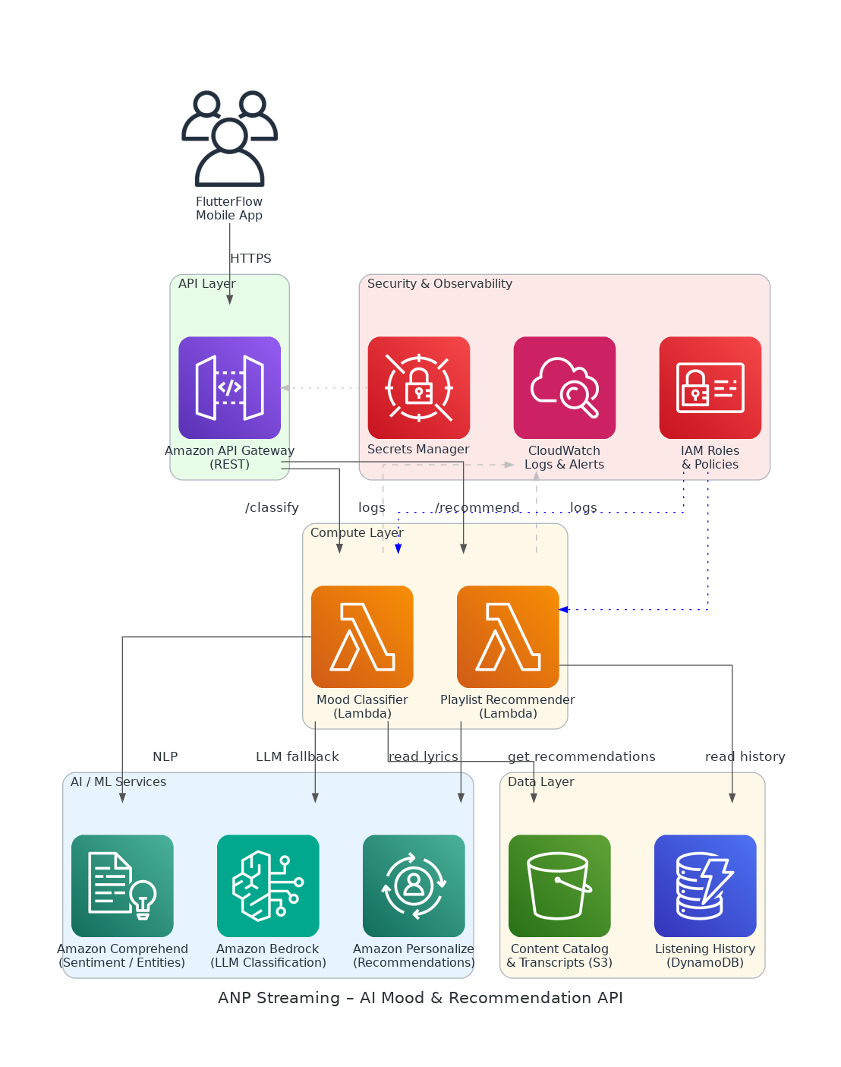
Slide 4: Solution Overview
AI / ML Services
Comprehend and Bedrock for mood classification from lyrics/transcripts
Amazon Personalize for real-time personalized playlist recommendations
Platform Architecture
Serverless Lambda functions behind API Gateway for both endpoints
S3 catalog, DynamoDB history, CloudWatch monitoring for full observability
Security & Integration
IAM roles and Secrets Manager enforce least-privilege access controls
REST API callable from FlutterFlow with no frontend changes required
ANP Streaming AI Mood & Recommendation API

Slide 5
Slide 5: Implementation Approach
Phase 1: Discovery & Design (Weeks 1-2)
Finalize AWS architecture and API contract with ANP technical contact
Export Firebase catalog to S3 and validate lyric/transcript data quality
Provision AWS account, IAM roles, dev environment, and CI/CD pipeline
Phase 2: Build & Integrate (Weeks 3-4)
Implement mood-classification Lambda using Comprehend and Bedrock
Build playlist-recommendation Lambda with Amazon Personalize integration
Deploy API Gateway, connect endpoints, and run accuracy validation tests
Phase 3: Validate & Hand Off (Weeks 5-6)
Conduct end-to-end testing with ANP team against production catalog
Integrate REST API into FlutterFlow app and confirm no UI changes needed
Deliver API documentation, runbooks, and operational handoff to ANP team
ANP Streaming AI Mood & Recommendation API

Slide 6
Slide 6: Timeline & Milestones
Phase No | Phase Description | Timeline | Key Deliverables
Phase 1 | Discovery & Design | Weeks 1-2 | AWS environment live, API contract signed off, Firebase catalog in S3
Phase 2 | Build & Integrate | Weeks 3-4 | Mood classifier deployed, Recommendation endpoint live, Accuracy >90% validated
Phase 3 | Validate & Hand Off | Weeks 5-6 | FlutterFlow integration confirmed, API docs delivered, Operations handoff complete
ANP Streaming AI Mood & Recommendation API

Slide 7
Slide 7: Success Stories
Christian Media Network (50K monthly active listeners)
Challenge: Manual content tagging 3 hours per upload, zero personalization
Solution: AWS Comprehend and Lambda API for auto-tagging and mood feeds
Result: Tagging cut to 10 seconds; 35% lift in session length
Independent Podcast Platform (100K subscribers)
Challenge: Generic recommendations driving 40% churn within two sessions
Solution: Amazon Personalize with listening-history integration via serverless API
Result: Churn reduced 28%; average sessions per user increased by 1.8x
Faith-Based Devotional App (30K users)
Challenge: No discovery; users abandoning app after exhausting favorites
Solution: Mood-classification API and personalized playlist endpoint on AWS
Result: Daily active users up 22%; app store rating up to 4.5
ANP Streaming AI Mood & Recommendation API

Slide 8
Slide 8: Our Partnership Advantage
What We Bring
10+ years delivering AWS cloud and AI/ML solutions at scale
100+ successful serverless API implementations across media and SaaS
AWS Advanced Consulting Partner with Machine Learning Competency
Certified solutions architects specializing in Comprehend and Personalize
Value to You
Pre-built serverless AI patterns accelerate delivery from weeks to days
Proven mood-classification approach cuts accuracy iteration cycles by 50%
Direct AWS ML specialist support unlocks partner funding for your project
Best practices from 100+ builds prevent common integration pitfalls early
ANP Streaming AI Mood & Recommendation API

Slide 9
Slide 9: Investment Summary
Cost Category | Year 1 List | Year 1 Credits | Year 1 Net | Year 2 | Year 3 | 3-Year Total
Professional Services | $0 | $0 | $0 | $0 | $0 | $0
Cloud Services | $2,903 | ($1,500) | $1,403 | $2,903 | $2,903 | $7,210
Support & Maintenance | $348 | $0 | $348 | $348 | $348 | $1,044
TOTAL | $3,251 | ($1,500) | $1,751 | $3,251 | $3,251 | $8,254
ANP Streaming AI Mood & Recommendation API

Slide 10
Slide 10: Next Steps
Decision: Executive approval from Lilly Goyah for pilot engagement by [specific date]
Kickoff: Target engagement start date within 30 days of approval
Team Formation: Identify ANP technical contact for catalog access and API review
Week 1-2: Contract finalization, AWS account access granted, Firebase catalog export to S3
Week 3-4: Mood-classification Lambda built and tested; accuracy results shared with ANP
ANP Streaming AI Mood & Recommendation API

Slide 11
Slide 11: Thank You

