Slide 1



Solution Briefing
Google Cloud Landing Zone
['Presenter Name'] | November 24, 2025

Slide 2
Business Opportunity
Opportunity
  Eliminate 6-8 week project provisioning delays with self-service infrastructure
  Reduce security misconfigurations by 80% using standardized Terraform modules
  Enable 10+ application teams to deploy to GCP with built-in governance and compliance
Success Criteria
  Project provisioning time reduced from weeks to hours with automated workflows
  100% compliance with SOC 2 and PCI-DSS through enforced security baseline
  ROI realization within 18 months through improved team velocity and reduced security incidents
Google Cloud Landing Zone

Slide 3
Engagement Scope
Parameter | Scope |  | Parameter | Scope
Number of GCP Projects | 10 projects managed |  | Availability Requirements | Standard (99.9%)
Team Count | 5 application teams |  | Infrastructure Complexity | Hub-spoke VPC with Interconnect
Hybrid Connectivity | Dedicated Interconnect 10 Gbps |  | Security Requirements | SCC Premium Chronicle SIEM
Network Architecture | Shared VPC hub-spoke |  | Compliance Frameworks | SOC 2 PCI-DSS
Platform Admins | 8 administrators |  | Project Provisioning Time | 1 hour with automation
Folder Structure | By environment (dev/staging/prod) |  | Security Baseline | Cloud Foundation Toolkit
Logging Volume | 500 GB/month centralized |  | Shared Services | Logging Monitoring Security VPN
Project Provisioning | Manual with Terraform modules |  | Deployment Regions | 3 GCP regions (multi-regional)
Google Cloud Landing Zone

Slide 4
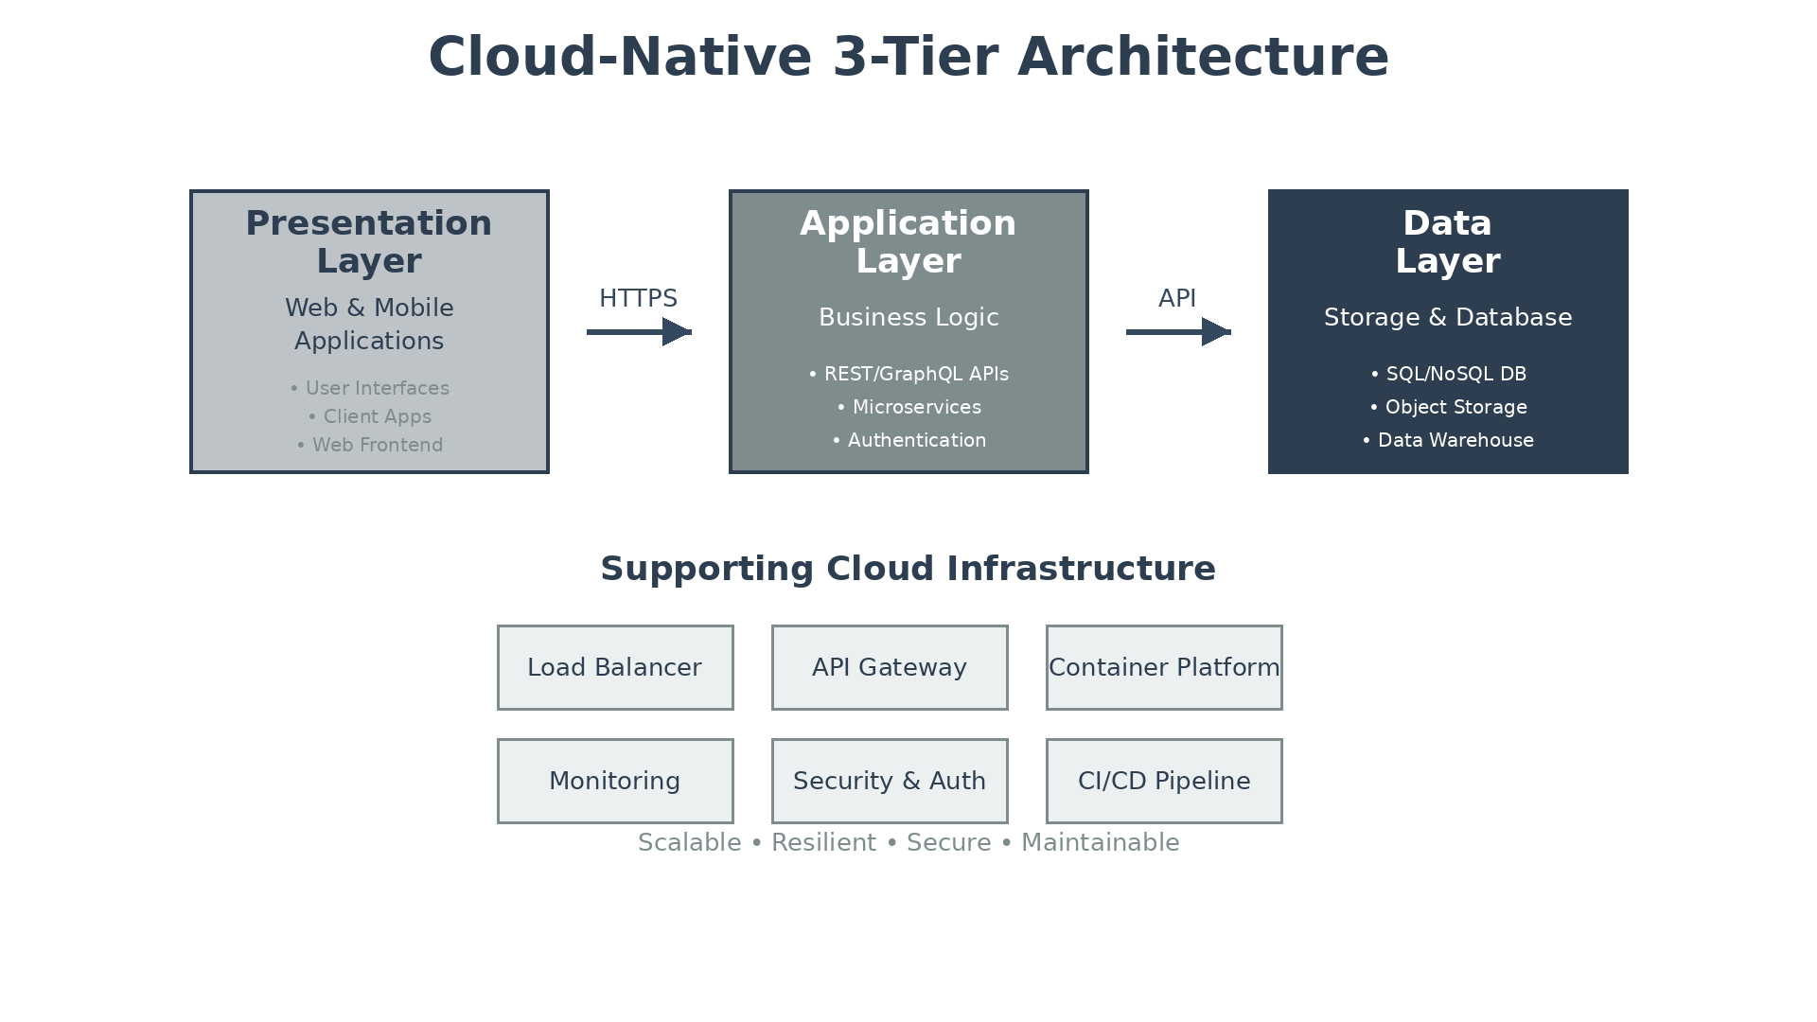
Solution Overview
Platform Foundation
  Organization hierarchy with folders for dev, staging, production environments
  Cloud Foundation Toolkit Terraform modules for repeatable project provisioning
  Centralized billing with department chargeback and cost allocation
Security and Network
  Security Command Center Premium for continuous threat detection and monitoring
  Shared VPC hub-spoke architecture with centralized internet egress
  Dedicated Interconnect 10 Gbps for low-latency hybrid connectivity
Google Cloud Landing Zone

Slide 5
Implementation Approach
Phase 1: Foundation (Weeks 1-4)
  Establish GCP Organization, billing accounts, and folder hierarchy
  Configure Shared VPC hub-spoke network and Dedicated Interconnect connectivity
  Deploy security baseline with Cloud Armor, IDS, and Security Command Center
Phase 2: Automation (Weeks 5-8)
  Build Terraform Cloud Foundation Toolkit modules for project provisioning
  Implement centralized logging to Cloud Logging and BigQuery for analytics
  Configure IAM policies, Organization Policy constraints, and service controls
Phase 3: Onboarding (Weeks 9-12)
  Pilot with 2 application teams to validate self-service workflows
  Establish FinOps dashboards with cost allocation and budget alerts
  Complete administrator training and transition to operations team
Google Cloud Landing Zone

Slide 6
Timeline & Milestones
Phase No | Phase Description | Timeline | Key Deliverables
Phase 1 | Foundation & Security | Weeks 1-4 | Organization structure, Shared VPC, Interconnect live, Security baseline active
Phase 2 | Automation & Governance | Weeks 5-8 | Terraform modules, Centralized logging, IAM and policy enforcement
Phase 3 | Pilot & Onboarding | Weeks 9-12 | 2 teams onboarded, FinOps dashboards, Operations training completed
Google Cloud Landing Zone

Slide 7
Success Stories
Client Success: Financial Services Company
  Client: Regional bank with $50B assets across 8 states
  Challenge: 6-8 week project provisioning delays blocking innovation. No security standards causing audit findings. 15+ application teams manually configuring GCP with inconsistent controls costing $4M annually in security remediation and delayed time-to-market.
  Solution: Deployed Cloud Landing Zone with Terraform automation and Security Command Center Premium.
  Results: 95% faster provisioning (6 weeks to 4 hours). Zero security misconfigurations. $3.8M annual savings. SOC 2 and PCI-DSS compliance achieved. Full ROI in 14 months.
  Testimonial: "The landing zone transformed our cloud adoption from chaotic to controlled. Teams get the agility they need while we maintain the security and compliance our regulators demand." — Michael Chen, VP of Cloud Engineering
Google Cloud Landing Zone

Slide 8
Our Partnership Advantage
What We Bring
  8+ years delivering Google Cloud landing zones for Fortune 1000 enterprises
  35+ successful GCP implementations across financial services, healthcare, retail
  Google Cloud Premier Partner with Infrastructure and Security Specializations
  Certified Professional Cloud Architects with Cloud Foundation Toolkit expertise
Value to You
  Pre-built Terraform modules accelerate deployment by 40%
  Proven security baseline based on CIS Google Cloud Foundation Benchmark
  Direct access to Google Cloud specialists through our partner network
  Best practices from 35+ implementations avoid common pitfalls
Google Cloud Landing Zone

Slide 9
Investment Summary
Cost Category | Year 1 List | Year 1 Credits | Year 1 Net | Year 2 | Year 3 | 3-Year Total
Professional Services | $0 | $0 | $0 | $0 | $0 | $0
Cloud Services | $49,948 | ($10,000) | $39,948 | $51,547 | $53,092 | $144,587
Software Licenses | $48,000 | $0 | $48,000 | $48,000 | $48,000 | $144,000
Support & Maintenance | $18,000 | $0 | $18,000 | $18,540 | $19,096 | $55,636
TOTAL | $115,948 | ($10,000) | $105,948 | $118,087 | $120,188 | $344,223
Google Cloud Landing Zone

Slide 10
Next Steps
Decision: Executive approval for landing zone foundation by [specific date]
Kickoff: Target project start within 30 days of approval
Team Formation: Identify platform lead, network admin, security lead, and 2 pilot application teams
Week 1-2: Contract finalization and GCP Organization setup, architecture workshop
Week 3-4: Network foundation deployed, Interconnect connectivity established, security baseline active
Google Cloud Landing Zone

Slide 11
Thank You

