Slide 1
Solution Briefing
IBM Red Hat Ansible Automation Platform
['Presenter Name'] | November 24, 2025

Slide 2
Business Opportunity
Opportunity
  Reduce manual server configuration from 8 hours to 45 minutes
  Eliminate configuration drift across 500 servers with standardization
  Configure 100 network devices in 10 minutes vs 2 days manual
Success Criteria
  90% reduction in manual configuration effort by task time
  Zero configuration drift violations through automated compliance
  $400K annual labor cost avoidance from eliminated tasks
IBM Red Hat Ansible Automation Platform

Slide 3
Engagement Scope
Parameter | Scope |  | Parameter | Scope
Server Count | 500 servers (Linux/Windows) |  | Deployment Platform | AWS/Azure cloud infrastructure
Network Device Count | 100 network devices |  | Availability Requirements | HA controller cluster (99.5% uptime)
Playbook Count | 100 custom automation playbooks |  | Infrastructure Complexity | Controller HA + distributed execution nodes
ITSM Integration | ServiceNow ticket-driven workflows |  | Security Requirements | RBAC + credential vault integration
External Systems | Monitoring systems + credential vault |  | Compliance Frameworks | SOC2 ISO 27001
Automation Users | 50 operations staff |  | Execution Capacity | 100 concurrent job executions
User Roles | 5 roles (operator admin developer approver auditor) |  | Automation Orchestration | Event-driven automation + scheduled jobs
Automation Executions | 10000+ job runs per month |  | Deployment Environments | 2 environments (dev/staging + prod)
IBM Red Hat Ansible Automation Platform
Notes:
Additional Scope Parameters (not displayed on slide):
• Inventory Management: 600 managed nodes total

Slide 4
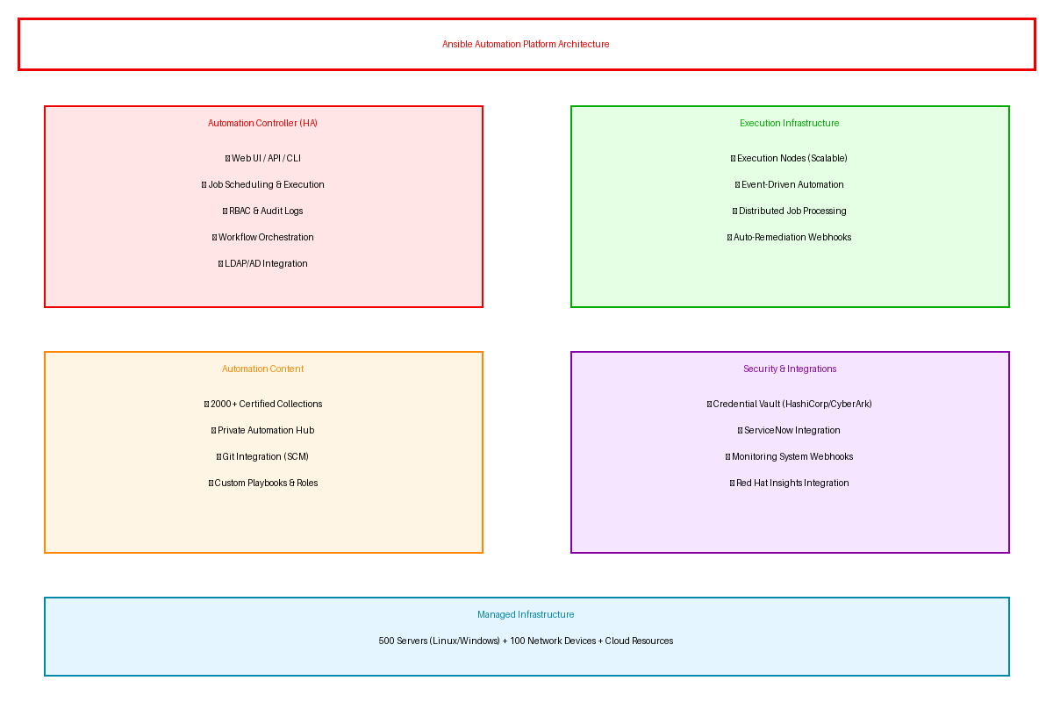
Solution Overview
Automation Platform
  HA controller cluster with web UI API and CLI
  Distributed execution nodes for scalable job processing
  Event-driven automation with webhooks and auto-remediation
Automation Content
  2000+ certified Ansible collections for servers cloud network
  Private Automation Hub for organization playbooks
  Git integration with HashiCorp Vault or CyberArk
IBM Red Hat Ansible Automation Platform

Slide 5
Implementation Approach
Phase 1: Foundation (Months 1-2)
  Deploy Ansible Platform with HA controller on AWS/Azure
  Integrate AD for SSO and configure RBAC for teams
  Develop initial 10 foundational playbooks for common use cases
Phase 2: Automation Expansion (Months 3-4)
  Develop 50 custom playbooks for organization automation
  Implement ServiceNow integration for ticket-driven workflows
  Configure event-driven automation with monitoring integration
Phase 3: Production & Scale (Months 5-6)
  Production rollout with scheduled and on-demand execution
  Enable self-service automation portal for operations
  Knowledge transfer training and runbook documentation
IBM Red Hat Ansible Automation Platform

Slide 6
Timeline & Milestones
Phase No | Phase Description | Timeline | Key Deliverables
Phase 1 | Foundation & Setup | Months 1-2 | HA controller deployed, RBAC configured, 10 foundational playbooks operational
Phase 2 | Automation Expansion | Months 3-4 | 50 custom playbooks developed, ServiceNow integration live, Event-driven automation active
Phase 3 | Production & Scale | Months 5-6 | Self-service portal enabled, Network automation deployed, Operations team trained
IBM Red Hat Ansible Automation Platform

Slide 7
Success Stories
Client Success: Technology Services Provider
  Client: Managed services provider supporting 200+ enterprise customers with 5000 servers
  Challenge: Manual server configuration taking 4-8 hours per server. Configuration drift causing 30% of support tickets. Network changes requiring 2-day maintenance windows blocking deployments.
  Solution: Deployed Ansible Platform managing 5000 servers and 800 devices. Developed 200 playbooks with ServiceNow integration.
  Results: 85% reduction in configuration time (8 hours to 1 hour) and zero drift violations. Network changes reduced from 2 days to 30 minutes. Support tickets reduced 40% through automated remediation. $600K annual labor savings.
  Testimonial: "Ansible transformed our operations from firefighting to strategic service delivery. Our customers see faster deployments and our engineers focus on innovation instead of repetitive tasks." — Jennifer Liu, VP of Operations
IBM Red Hat Ansible Automation Platform

Slide 8
Our Partnership Advantage
What We Bring
  7+ years delivering Ansible automation solutions
  25+ successful Ansible Platform deployments
  Red Hat Certified Ansible Specialist team
  IT automation and infrastructure expertise
Value to You
  Pre-built playbook libraries accelerate deployment
  Proven automation methodology reduces development time
  Direct Red Hat specialist support through partnership
  Best practices from 25+ implementations
IBM Red Hat Ansible Automation Platform

Slide 9
Investment Summary
Cost Category | Year 1 List | Year 1 Credits | Year 1 Net | Year 2 | Year 3 | 3-Year Total
Professional Services | $0 | $0 | $0 | $0 | $0 | $0
Cloud Services | $26,520 | ($2,000) | $24,520 | $26,520 | $26,520 | $77,560
Software Licenses | $115,000 | ($10,000) | $105,000 | $115,000 | $115,000 | $335,000
Support & Maintenance | $17,652 | $0 | $17,652 | $17,652 | $17,652 | $52,956
TOTAL | $159,172 | ($12,000) | $147,172 | $159,172 | $159,172 | $465,516
IBM Red Hat Ansible Automation Platform

Slide 10
Next Steps
Decision: Executive approval for Ansible implementation by [specific date]
Kickoff: Target platform deployment within 30 days of approval
Team Formation: Identify automation team infrastructure contacts and use cases
Week 1-2: Infrastructure inventory and Ansible platform deployment planning
Week 3-4: Controller deployment RBAC setup and first automation playbooks developed
IBM Red Hat Ansible Automation Platform

Slide 11
Thank You

