Slide 1
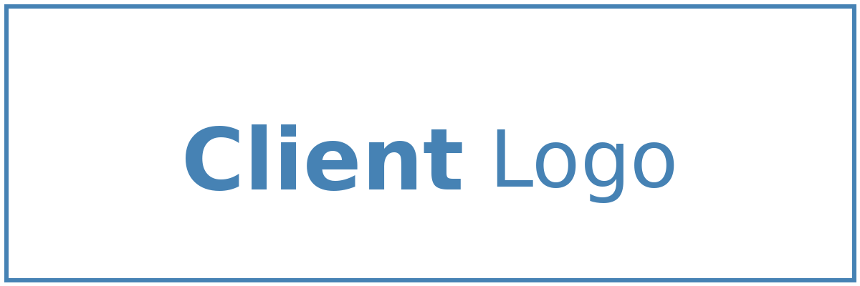


Solution Briefing
Microsoft Sentinel SIEM Implementation
Alison Smith | November 22, 2025

Slide 2
Business Opportunity
Opportunity
  Gain complete visibility into security events across your entire IT environment with centralized monitoring
  Detect threats faster using built-in AI and machine learning to identify suspicious patterns automatically
  Reduce security incident response time by 50-70% through automated playbooks and workflows
Success Criteria
  Achieve full security monitoring coverage within 3 months with all critical systems connected
  Reduce mean time to detect threats from days to minutes with automated alerting
  Enable security team to handle 3x more incidents without additional staff through automation
Microsoft Sentinel SIEM Implementation

Slide 3
Engagement Scope
Parameter | Scope |  | Parameter | Scope
Data Connectors | 10-15 connectors |  | Availability Requirements | 24/7 monitoring
Analytics Rules | 50 custom detection rules |  | Infrastructure Complexity | Log Analytics + Sentinel workspace
Log Sources | Azure AD Office365 Firewall Endpoints |  | Security Requirements | RBAC MFA audit logging
SOAR Playbooks | 10 automated playbooks |  | Compliance Frameworks | SOC2 NIST CSF
Total Users | 10 SOC analysts |  | Detection Response | MTTR <1 hour
User Roles | 3 roles (analyst engineer admin) |  | Query Performance | Standard KQL queries
Daily Log Ingestion | 50 GB/day |  | Deployment Environments | 2 environments (dev prod)
Retention Period | 90 days hot 2 years archive |  | Deployment Regions | Single Azure region (East US)
Microsoft Sentinel SIEM Implementation

Slide 4
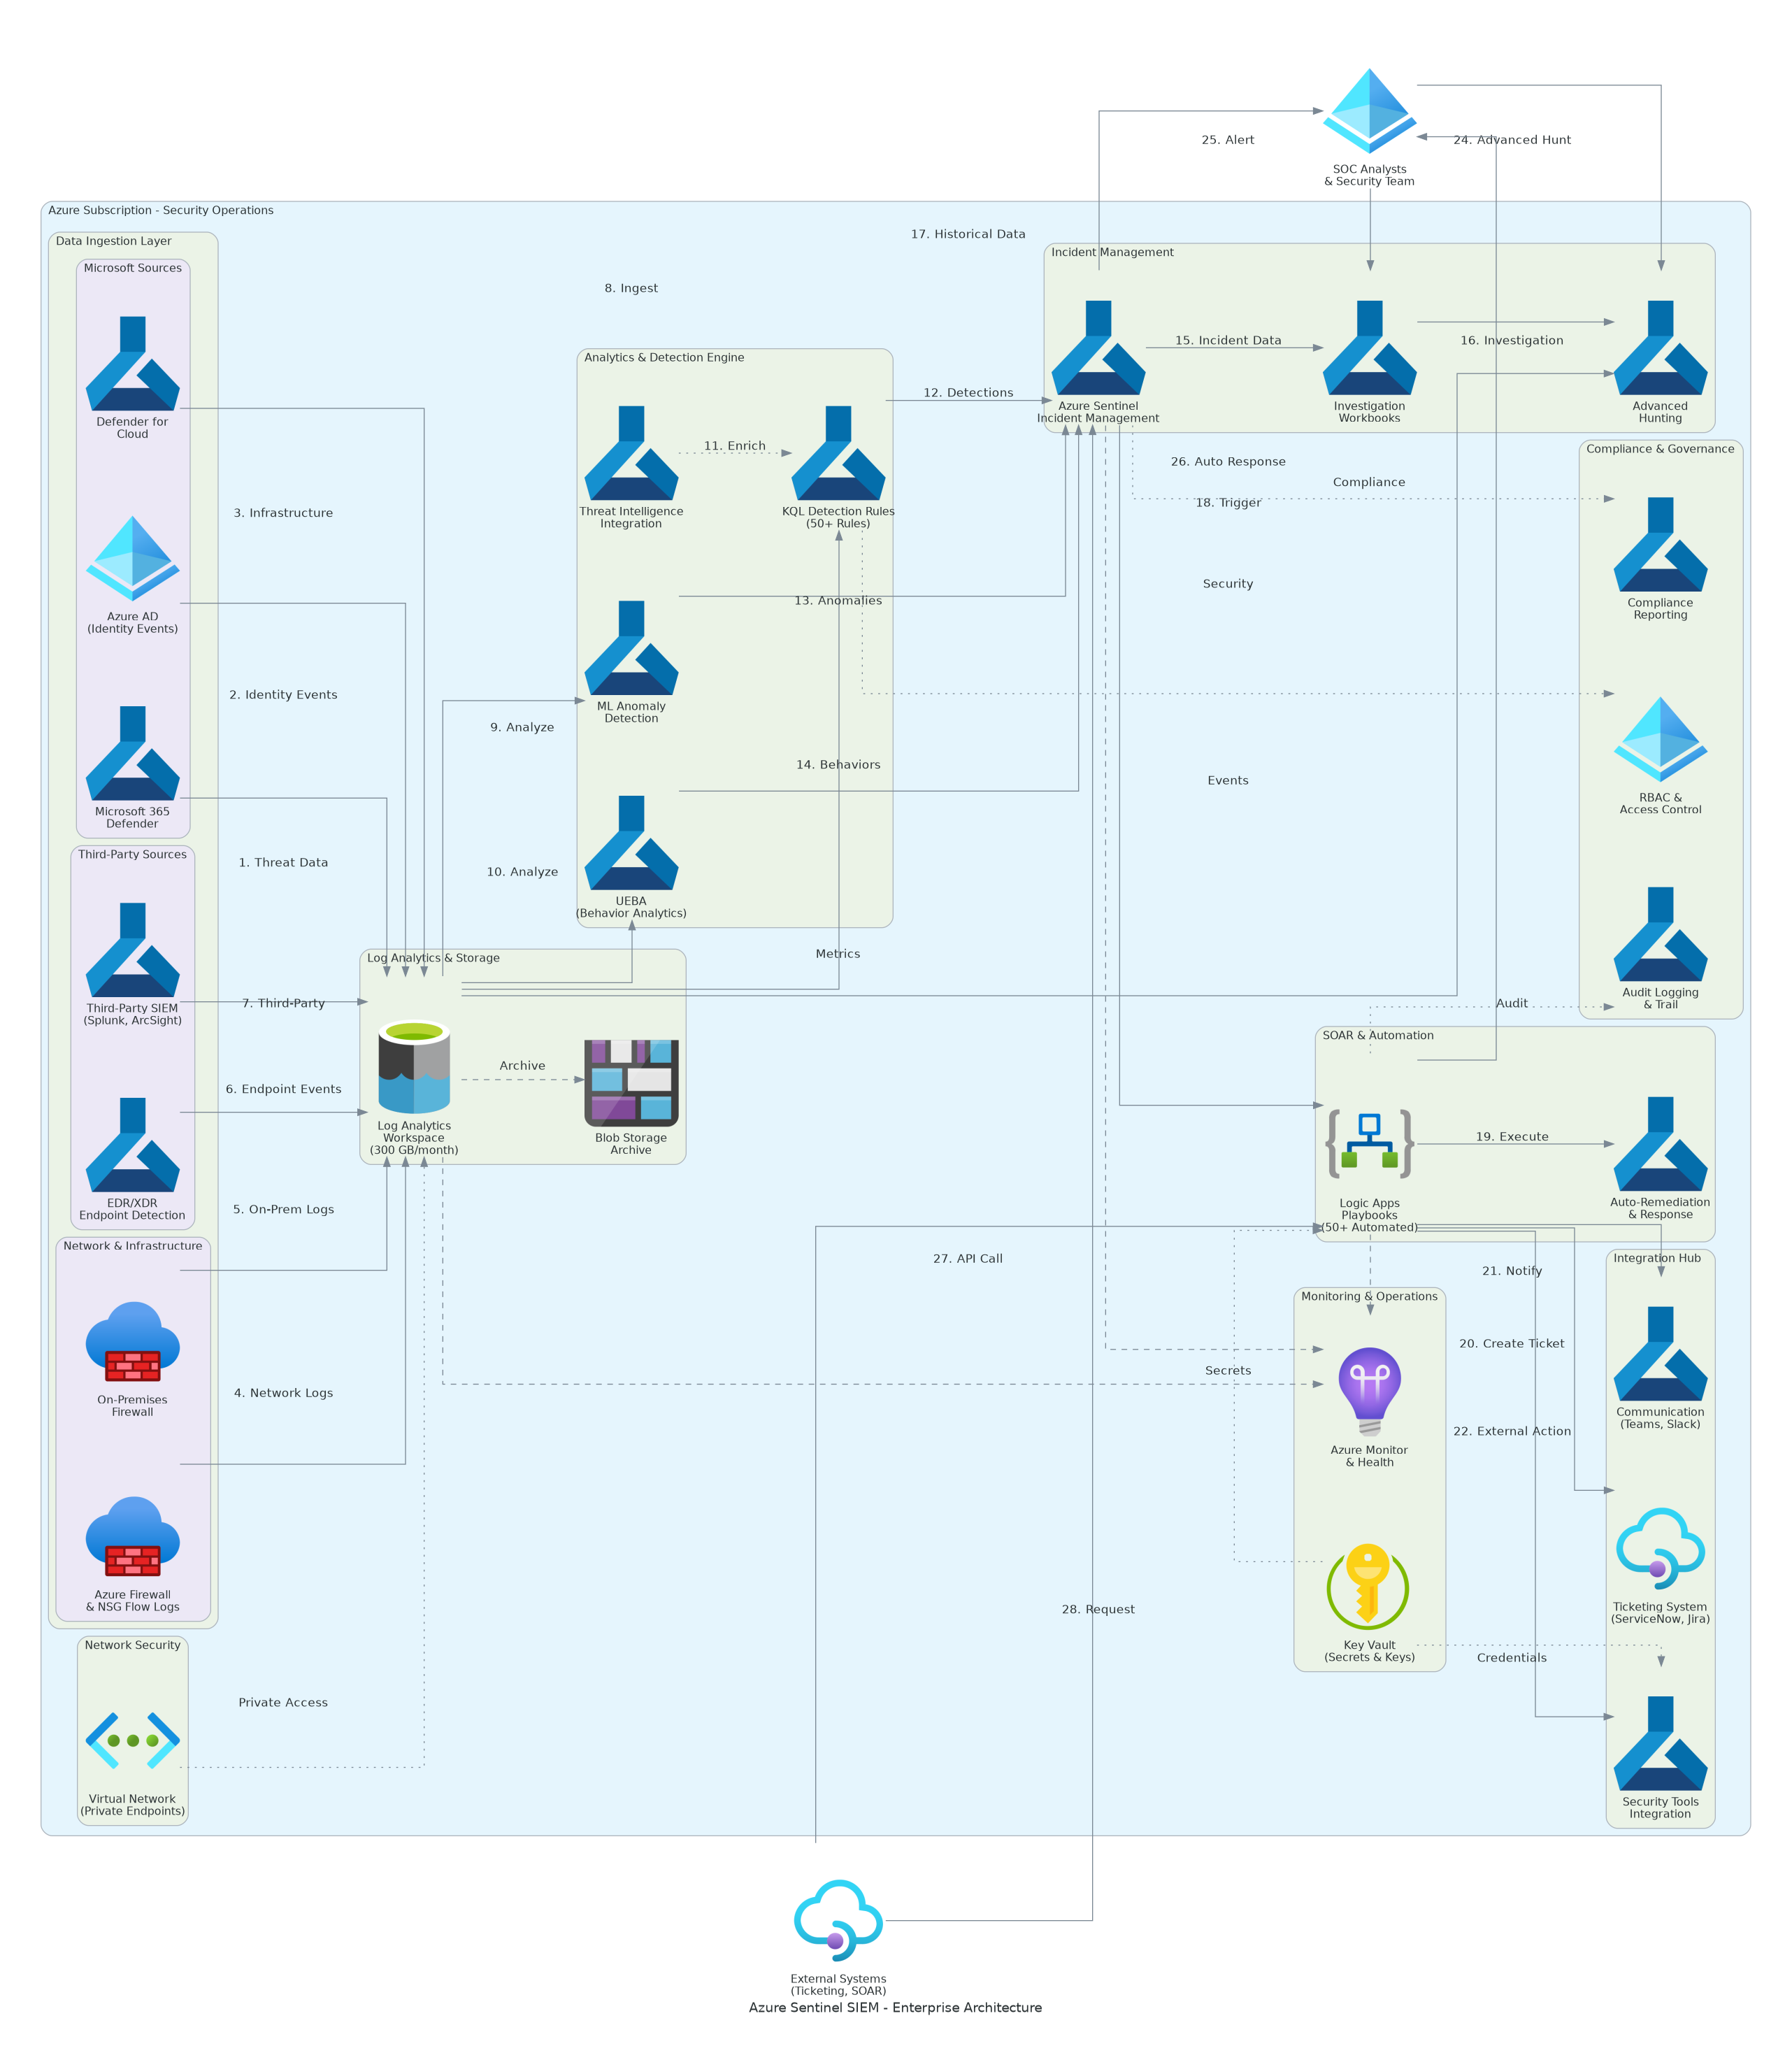
Solution Overview
Key Components
  Data Collection Layer: Log connectors from servers, applications, firewalls, and cloud services
  Analytics Engine: Sentinel workspace with KQL queries analyzing events in real-time
  Response Layer: Automated playbooks and incident management with investigation tools
Technology Stack
  Platform: Microsoft Azure with Sentinel (SIEM/SOAR)
  Data & Analytics: Log Analytics Workspace with KQL queries
  Integration: Microsoft Defender, Azure Monitor, third-party tools
Microsoft Sentinel SIEM Implementation

Slide 5
Implementation Approach
Phase 1: Foundation & Planning (Months 1-2)
  Log Analytics Workspace setup and Sentinel deployment
  Data connector configuration for critical systems (Azure AD, firewalls, endpoints)
  Initial detection rules and alert tuning
Phase 2: Core Implementation (Months 3-4)
  Advanced threat detection rules using KQL queries
  Automated incident response playbooks for common scenarios
  Security dashboard and reporting configuration
Phase 3: Deployment & Optimization (Months 5-6)
  User acceptance testing and security team training
  Detection rule optimization based on false positive analysis
  Continuous monitoring and threat hunting procedures
Microsoft Sentinel SIEM Implementation

Slide 6
Timeline & Milestones
Phase No | Phase Description | Timeline | Key Deliverables
Phase 1 | Foundation & Planning | Months 1-2 | Sentinel workspace live, Critical data sources connected, Initial detection rules active
Phase 2 | Core Implementation | Months 3-4 | Advanced detection rules deployed, Automated playbooks operational, Security dashboards available
Phase 3 | Deployment & Optimization | Months 5-6 | Security team trained, Detection rules tuned, Threat hunting procedures documented
Microsoft Sentinel SIEM Implementation

Slide 7
Success Stories
Client Success: Regional Healthcare Network
  Client: Healthcare organization with 5,000+ employees across 12 facilities
  Challenge: Security team overwhelmed by 10,000+ daily alerts from disconnected tools, 48-hour average threat detection time, compliance gaps with HIPAA requirements
  Solution: Deployed Microsoft Sentinel with unified log collection, AI-powered threat detection, and automated incident response playbooks
  Results: 90% reduction in alert noise, threat detection time reduced from 48 hours to 15 minutes, full HIPAA compliance automated, security team productivity increased 3x
  Testimonial: "Microsoft Sentinel transformed our security operations. We went from drowning in alerts to proactively hunting threats. The automated playbooks freed our team to focus on advanced threats." — Sarah Martinez, CISO, Regional Healthcare Network
Microsoft Sentinel SIEM Implementation

Slide 8
Our Partnership Advantage
What We Bring
  10+ years delivering enterprise security solutions
  150+ successful Microsoft Sentinel implementations
  Microsoft Solutions Partner for Security designation
  Certified security architects with Azure Security Engineer certifications
Value to You
  Proven methodology reduces implementation risk by 60%
  Pre-built detection rules and playbooks fast-track your deployment
  Comprehensive skills transfer for security team self-sufficiency
  Best practices from 150+ security implementations
Microsoft Sentinel SIEM Implementation

Slide 9
Investment Summary
Cost Category | Year 1 List | Year 1 Credits | Year 1 Net | Year 2 | Year 3 | 3-Year Total
Professional Services | $137,000 | $0 | $137,000 | $0 | $0 | $137,000
Cloud Infrastructure | $191,140 | ($9,000) | $182,140 | $191,140 | $191,140 | $564,420
Software Licenses | $7,400 | $0 | $7,400 | $7,400 | $7,400 | $22,200
Support & Maintenance | $19,428 | ($12,000) | $7,428 | $19,428 | $19,428 | $46,284
TOTAL | $354,968 | ($21,000) | $333,968 | $217,968 | $217,968 | $769,904
Microsoft Sentinel SIEM Implementation

Slide 10
Next Steps
Decision: Security team approval and executive sign-off by [Target Date]
Kickoff: Project start scheduled for [Start Date] with security and IT teams engaged
Team Formation: Security operations lead, IT infrastructure SMEs, and compliance officer designated
Week 1-2: Contract finalization, Azure environment access setup, and discovery workshops
Week 3-4: Log Analytics Workspace deployment and first critical systems generating alerts
Microsoft Sentinel SIEM Implementation

Slide 11
Thank You

