Slide 1



Solution Briefing
Test Solution
Alison Smith | November 11, 2025

Slide 2
Business Opportunity
Opportunity
  Accelerate digital transformation and modernize legacy systems to unlock new revenue streams
  Gain competitive advantage through data-driven insights and faster time-to-market
  Enable scalability and innovation while reducing operational costs by 30-40%
Success Criteria
  Achieve measurable ROI within 12 months with quantified business value metrics
  Complete deployment across all business units with 95% user adoption rate
  Establish foundation for continuous innovation and future capability expansion

Slide 3
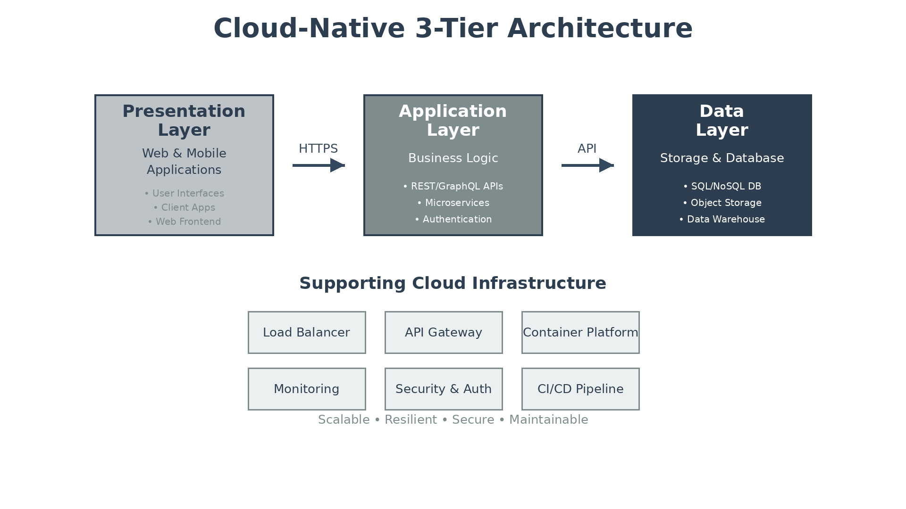
Solution Overview
Key Components
  Presentation Layer: Modern web and mobile interfaces with responsive design and real-time updates
  Application Layer: API services handling business logic, authentication, and data orchestration
  Data Layer: Scalable database infrastructure with caching, backup, and disaster recovery
Technology Stack
  Cloud Platform: AWS, Azure, or GCP
  Containerization: Docker with Kubernetes
  API Framework: REST/GraphQL APIs
  Monitoring: Logging and observability

Slide 4
Implementation Approach
Phase 1: Foundation & Planning *(Months 1-2)*
  Cloud environment setup and infrastructure provisioning
  Security baseline and CI/CD pipeline establishment
  Architecture validation and technical design review
Phase 2: Core Implementation *(Months 3-4)*
  Database layer deployment with backup and replication
  Application and presentation tier development
  Integration testing and performance optimization
Phase 3: Deployment & Optimization *(Months 5-6)*
  User acceptance testing and production deployment
  Monitoring and observability implementation
  Performance tuning and continuous optimization

Slide 5
Timeline & Milestones
Phase No | Phase Description | Timeline | Key Deliverables
Phase 1 | Foundation & Planning | Months 1-2 | Cloud environment live, Security baseline configured, CI/CD pipeline operational
Phase 2 | Core Implementation | Months 3-4 | Database layer deployed, Application tier functional, Integration testing complete
Phase 3 | Deployment & Optimization | Months 5-6 | UAT completed, Production deployment successful, Monitoring and optimization active

Slide 6
Success Stories
Client Success: Global Manufacturing Leader
  Client: Fortune 500 Manufacturing Company with 15,000+ employees across 30 countries
  Challenge: Legacy systems causing 40% operational inefficiency, $12M annual waste from manual processes, and inability to scale for market expansion
  Solution: Deployed cloud-native platform with automated workflows, real-time analytics, and integrated supply chain visibility across all manufacturing sites
  Results: 45% reduction in operational costs ($5.4M annual savings), 60% faster order-to-delivery cycle, 99.7% system uptime, full ROI achieved in 14 months
  Testimonial: "This transformation exceeded our expectations. We've not only modernized our operations but created a competitive advantage that positions us for the next decade of growth. The implementation was seamless and the results were measurable from day one." — Michael Chen, Chief Operations Officer, Global Manufacturing Corp

Slide 7
Our Partnership Advantage
What We Bring
  15+ years delivering enterprise technology solutions
  200+ successful implementations for Fortune 500 companies
  Premier partnerships with AWS, Azure, Google Cloud
  Certified solution architects with 10+ years expertise
  24/7 support with 99.5% SLA guarantee
Value to You
  Proven methodology reduces implementation risk by 60%
  Pre-built accelerators fast-track your deployment
  Direct vendor escalation and early-access programs
  Comprehensive skills transfer for team self-sufficiency
  Best practices from 200+ implementations

Slide 8
Investment Summary

Slide 9
Thank You & Next Steps
Decision: [Specific decision needed by when]
Kickoff: [Target start date]
Team Formation: [Key team members required]
Week 1: Contract finalization
Week 2: Project initiation & planning
Week 3: Environment setup
Week 4: Initial implementation begins
Project Lead: [Name, Title] | [Email] | [Phone]
Technical Lead: [Name, Title] | [Email] | [Phone]
Account Manager: [Name, Title] | [Email] | [Phone]

