Slide 1



Solution Briefing
Dell Precision AI Workstation Infrastructure
['Presenter Name'] | November 22, 2025

Slide 2
Business Opportunity
Opportunity
  Reduce cloud GPU costs by 60-70% with on-premises Dell Precision workstations optimized for AI/ML
  Enable data scientists to train large language models and computer vision models locally with NVIDIA RTX A6000 GPUs
  Achieve data sovereignty and eliminate multi-terabyte dataset transfer bottlenecks costing hours of productivity
Success Criteria
  ROI realization within 3-6 months through cloud cost avoidance and productivity gains
  Model training time reduced from days to hours with 48GB GPU memory and 7000MB/s NVMe storage
  10 data scientists fully equipped with dedicated workstations achieving 95%+ GPU utilization
Dell Precision AI Workstation Infrastructure

Slide 3
Engagement Scope
Parameter | Scope |  | Parameter | Scope
Number of Workstations | 10 Dell Precision 7960 units |  | Workstation Performance | Dell Precision 7960 dual Xeon Gold
GPU Configuration | NVIDIA RTX A6000 48GB |  | Operating System | Ubuntu 22.04 LTS with CUDA
Data Science Tools | Standard stack (PyTorch TensorFlow) |  | Access Control | Standard file permissions and SSH
Shared Storage | Dell PowerScale F600 100TB NAS |  | Data Classification | Unclassified research data
Data Scientists | 10 concurrent users |  | Training Performance | Target: 80% GPU utilization average
User Roles | 2 roles (data scientist admin) |  | Storage Performance | 7000 MB/s NVMe read per workstation
Dataset Size per Project | 5TB average dataset size |  | Deployment Environments | Production only
Model Checkpoint Storage | 2TB model storage requirements |  | Network Connectivity | 10GbE to shared storage
Dell Precision AI Workstation Infrastructure

Slide 4
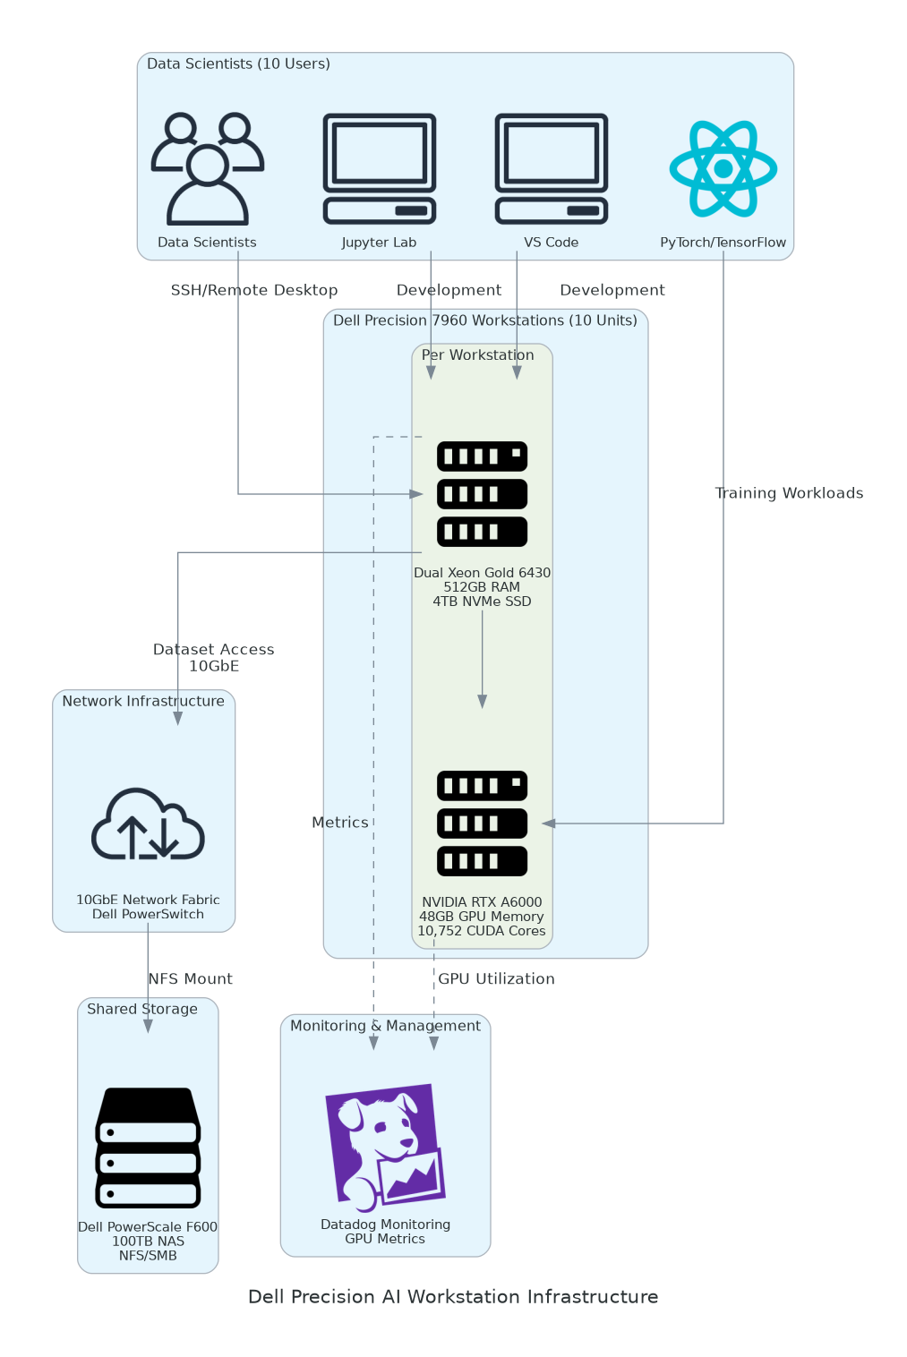
Solution Overview
Workstation Platform
  Dell Precision 7960 Tower with dual Intel Xeon Gold 6430 processors (64 cores total)
  512GB DDR5 RAM for large-scale data preprocessing and in-memory operations
  4TB NVMe SSD achieving 7000MB/s read speeds for training dataset I/O
GPU Acceleration
  NVIDIA RTX A6000 with 48GB GDDR6 memory and 10752 CUDA cores for parallel computing
  336 Tensor cores for mixed-precision training acceleration (FP16/TF32)
  NVIDIA AI Enterprise software suite with TensorRT and NGC catalog access
Shared Infrastructure
  Dell PowerScale F600 NAS with 100TB usable capacity for team dataset repository
  10GbE network fabric for high-speed data transfer between workstations and storage
  Centralized monitoring with Datadog for GPU utilization and infrastructure metrics
Dell Precision AI Workstation Infrastructure

Slide 5
Implementation Approach
Phase 1: Planning & Procurement (Weeks 1-2)
  Finalize hardware specifications and validate power/cooling requirements
  Submit Dell hardware order and coordinate delivery logistics
  Prepare data center space including rack installation and network cabling
Phase 2: Deployment & Configuration (Weeks 3-4)
  Dell ProDeploy rack installation and initial hardware setup
  Ubuntu 22.04 LTS installation with CUDA 12.2 and ML framework stack
  PowerScale NAS configuration with NFS shares and access permissions
Phase 3: Validation & Training (Weeks 5-6)
  GPU benchmark testing and ML framework validation with sample models
  Dataset migration from cloud storage to PowerScale shared repository
  2-day hands-on training and production go-live with real-world workloads
Dell Precision AI Workstation Infrastructure

Slide 6
Timeline & Milestones
Phase No | Phase Description | Timeline | Key Deliverables
Phase 1 | Planning & Procurement | Weeks 1-2 | Hardware ordered, Data center space prepared, Network infrastructure validated
Phase 2 | Deployment & Configuration | Weeks 3-4 | All 10 workstations installed, Ubuntu and CUDA configured, PowerScale NAS operational
Phase 3 | Validation & Training | Weeks 5-6 | Benchmark performance validated, Team training completed, First models trained successfully
Dell Precision AI Workstation Infrastructure

Slide 7
Success Stories
Client Success: Autonomous Vehicle Research Lab
  Client: University research lab training computer vision models for autonomous driving with 15 PhD students and post-docs
  Challenge: Spending $480K annually on AWS p4d instances with 8-hour daily usage. Dataset transfer from S3 taking 3-4 hours daily costing researcher productivity. Data sovereignty concerns with sensitive driving footage.
  Solution: Deployed 15 Dell Precision 7960 workstations with NVIDIA RTX A6000 48GB GPUs. Configured PowerScale F900 with 500TB for multi-terabyte video dataset repository. 10GbE network fabric for high-speed storage access.
  Results: $320K annual savings (67% cost reduction vs AWS p4d baseline). Model training time reduced from 36 hours to 14 hours with local NVMe storage eliminating S3 download latency. ROI achieved in 4.2 months. 100% data sovereignty with all datasets on-premises.
  Testimonial: "Switching to Dell Precision workstations transformed our research productivity. Our students can now iterate on models 3x faster, and we eliminated the frustration of waiting hours for datasets to download from S3. The cost savings funded two additional PhD positions." — Dr. Amanda Chen, Director of Autonomous Systems Lab
Dell Precision AI Workstation Infrastructure

Slide 8
Our Partnership Advantage
What We Bring
  8+ years deploying Dell AI infrastructure with 100+ GPU workstation implementations
  Deep expertise in CUDA optimization PyTorch/TensorFlow tuning and distributed training
  Dell Titanium Partner with AI/ML Center of Excellence designation
  Certified solutions architects with NVIDIA DLI Deep Learning certification
Value to You
  Pre-configured software stacks accelerate deployment (Ubuntu + CUDA + PyTorch/TensorFlow validated)
  GPU performance tuning methodology achieving 95%+ utilization vs 60-70% typical
  Direct Dell and NVIDIA technical support escalation through partner channels
  Best practices from 100+ deployments avoid common pitfalls (driver conflicts, memory bottlenecks, I/O tuning)
Dell Precision AI Workstation Infrastructure

Slide 9
Investment Summary
Cost Category | Year 1 List | Year 1 Credits | Year 1 Net | Year 2 | Year 3 | 3-Year Total
Professional Services | $38,000 | ($4,000) | $34,000 | $0 | $0 | $34,000
Hardware | $306,000 | ($59,175) | $246,825 | $0 | $0 | $246,825
Software | $45,260 | ($10,800) | $34,460 | $45,260 | $45,260 | $125,980
Support & Maintenance | $24,850 | $0 | $24,850 | $24,850 | $24,850 | $74,550
TOTAL | $414,110 | ($73,975) | $340,135 | $70,110 | $70,110 | $481,355
Dell Precision AI Workstation Infrastructure

Slide 10
Next Steps
Decision: Executive approval for AI workstation deployment by [specific date]
Kickoff: Submit Dell hardware purchase order within 1 week of approval
Preparation & Delivery: Validate data center space and Dell ships equipment (Weeks 1-3)
Deployment: Dell ProDeploy on-site installation and our team configures Ubuntu/CUDA stack (Weeks 3-4)
Training & Go-Live: 2-day hands-on workshop and first production models trained (Weeks 5-6)
Dell Precision AI Workstation Infrastructure

Slide 11
Thank You

