Slide 1



Solution Briefing
Azure Virtual WAN Global Network
Alison Smith | November 18, 2025

Slide 2
Business Opportunity
Opportunity
  Connect all branch offices to Azure and each other through a single managed network backbone
  Replace complex VPN configurations with automated routing that scales as you add locations
  Reduce network management overhead by 50-60% with centralized policy and monitoring
Success Criteria
  Connect all branch locations to Azure within 3 months with consistent security policies
  Achieve 40% reduction in network management costs compared to traditional hub-spoke VPN
  Deliver reliable connectivity with automatic failover and less than 100ms latency

Slide 3
Engagement Scope
Parameter | Scope |  | Parameter | Scope
Virtual WAN Hubs | 3 regional hubs |  | Deployment Regions | 3 Azure regions globally
Connected Sites | 10-15 branch locations |  | Availability Requirements | High availability (99.95%)
VPN Connections | Site-to-site IPsec VPN |  | Infrastructure Complexity | vWAN + Azure Firewall + routing
ExpressRoute Circuits | 2 circuits (primary backup) |  | Security Requirements | Azure Firewall DDoS protection
Total Users | 1000 users across sites |  | Compliance Frameworks | SOC2 ISO27001
User Roles | 3 roles (network ops security admin) |  | Latency Requirements | <50ms inter-region
Bandwidth Requirements | 1 Gbps aggregate |  | Routing Complexity | BGP route propagation
Traffic Volume | 10 TB/month |  | Deployment Environments | 2 environments (non-prod prod)

Slide 4
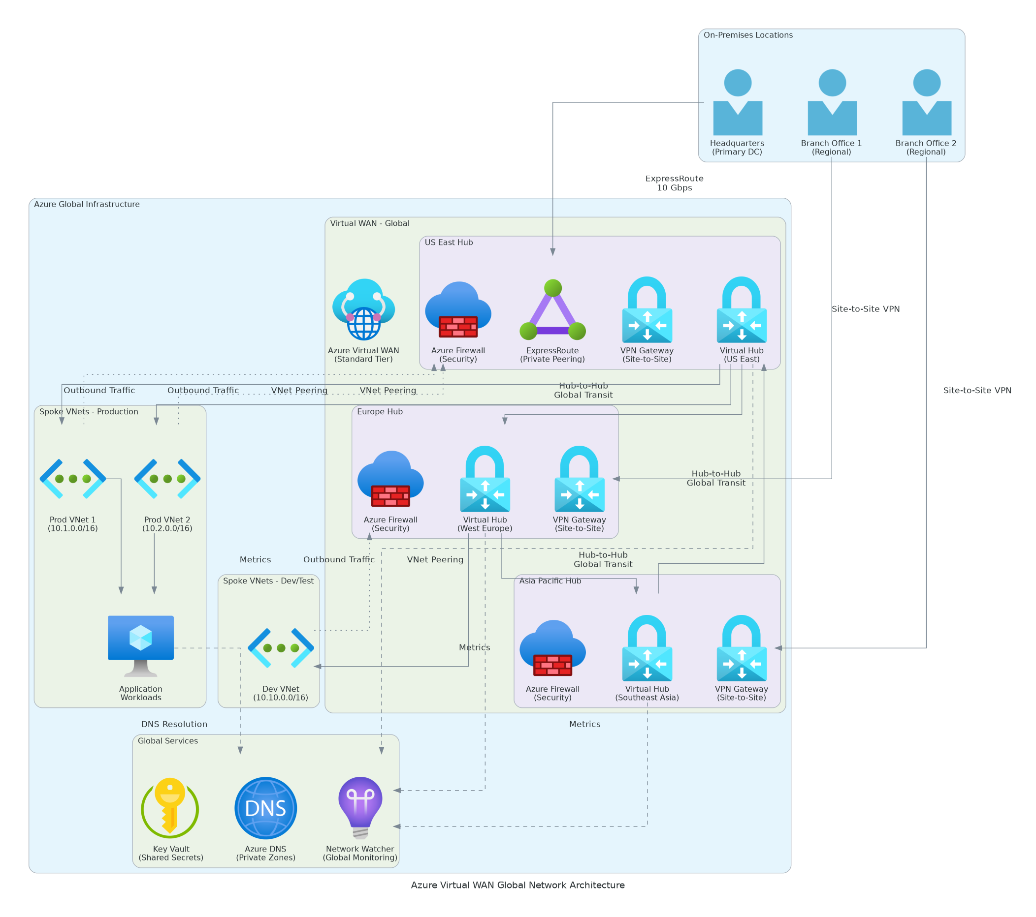
Solution Overview
Key Components
  Virtual WAN Hub: Microsoft-managed regional network hub that connects branches, VNets, and Azure services
  Branch Connectivity: SD-WAN integration, site-to-site VPN, or ExpressRoute for office connections
  Security Services: Azure Firewall and routing policies applied consistently across all traffic
Technology Stack
  Platform: Azure Virtual WAN with Standard tier
  Routing: Automated BGP routing and traffic optimization
  Security: Azure Firewall Manager with centralized policies
  Monitoring: Azure Network Watcher and traffic analytics

Slide 5
Implementation Approach
Phase 1: Network Assessment & Design (Months 1-2)
  Inventory all branch locations and current connectivity methods
  Design hub placement based on user geography and latency requirements
  Plan IP addressing, routing policies, and security rules
Phase 2: Hub Infrastructure Deployment (Months 3-4)
  Deploy Virtual WAN hubs in primary Azure regions
  Configure Azure Firewall and routing policies
  Connect Azure Virtual Networks to the WAN backbone
Phase 3: Branch Connectivity & Optimization (Months 5-6)
  Connect branch offices via SD-WAN, VPN, or ExpressRoute
  Validate end-to-end connectivity and security policies
  Optimize routing and monitor performance metrics

Slide 6
Timeline & Milestones
Phase No | Phase Description | Timeline | Key Deliverables
Phase 1 | Network Assessment & Design | Months 1-2 | Network inventory complete, Hub placement design approved, Routing policy documented
Phase 2 | Hub Infrastructure Deployment | Months 3-4 | Virtual WAN hubs operational, Azure Firewall configured, VNet connectivity verified
Phase 3 | Branch Connectivity & Optimization | Months 5-6 | All branches connected, Security policies enforced, Performance monitoring active

Slide 7
Success Stories
Client Success: International Logistics Company
  Client: Logistics provider with 45 warehouse locations across North America, Europe, and Asia
  Challenge: Managing 45 separate VPN tunnels to Azure, inconsistent security policies, 3-day average to add new locations, $180K annual network management costs
  Solution: Deployed Azure Virtual WAN with three regional hubs, SD-WAN integration at each warehouse, centralized Azure Firewall policies, and automated routing
  Results: 55% reduction in network management costs ($99K annual savings), new location connectivity reduced from 3 days to 4 hours, 99.95% network uptime, consistent security policies across all locations
  Testimonial: "Azure Virtual WAN simplified our entire network architecture. Adding a new warehouse used to take days of VPN configuration. Now our team connects a new site in hours with automatic routing and security policies already in place." — Robert Martinez, VP of IT Infrastructure, Global Logistics Inc

Slide 8
Our Partnership Advantage
What We Bring
  Azure Network Specialty certification with SD-WAN integration expertise
  75+ Azure Virtual WAN deployments for multi-national organizations
  Direct relationships with leading SD-WAN vendors (Cisco, VMware, Fortinet)
  Pre-built automation templates for hub deployment and branch connectivity
  24/7 network operations center support during migration phases
Value to You
  Proven methodology reduces deployment risk and accelerates time-to-value
  SD-WAN vendor partnerships ensure seamless branch integration
  Experience with complex routing scenarios prevents connectivity issues
  Post-deployment optimization identifies cost savings opportunities
  Knowledge transfer ensures your team manages the network confidently

Slide 9
Investment Summary
Cost Category | Year 1 List | Provider/Partner Credits | Year 1 Net | Year 2 | Year 3 | 3-Year Total
TOTAL INVESTMENT | $0 | $0 | $0 | $0 | $0 | $0

Slide 10
Next Steps
Network Inventory: Compile list of all branch locations with current connectivity
Decision: SOW approval and contract execution by [Target Date]
Kickoff: Project initiation scheduled for [Start Date]
Week 1: Network discovery and requirements workshop
Week 2: Hub placement design and IP addressing plan
Week 3: SD-WAN vendor coordination and compatibility verification
Week 4: Pilot branch selection and migration planning

Slide 11
Thank You
Your Account Manager: [Name, Title] | [Email] | [Phone]

