Slide 1



Solution Briefing
HashiCorp Multi-Cloud Platform
['Presenter Name'] | November 22, 2025

Slide 2
Business Opportunity
Opportunity
  Eliminate manual infrastructure provisioning and reduce deployment time from days to minutes
  Achieve consistent infrastructure across AWS Azure GCP and on-premises environments
  Scale infrastructure operations without adding headcount through self-service automation
Success Criteria
  80% reduction in infrastructure provisioning time with automated workflows
  95%+ policy compliance through automated governance and security controls
  ROI realization within 18-24 months through operational efficiency and cost optimization
HashiCorp Multi-Cloud Platform

Slide 3
Engagement Scope
Parameter | Scope |  | Parameter | Scope
Managed Cloud Providers | 3 clouds (AWS Azure GCP) |  | Deployment Regions | Multi-region (us-east-1 eu-west-1 ap-southeast-1)
Infrastructure Resources | 2500 total resources |  | Availability Requirements | High (99.9%)
Terraform Workspaces | 100 workspaces |  | Infrastructure Complexity | Multi-cloud with networking
External System Integrations | 4 integrations (GitHub Datadog Slack ServiceNow) |  | Security Requirements | Enterprise (Vault SSO RBAC)
VCS Platform | GitHub |  | Compliance Frameworks | SOC2 ISO27001
Total Platform Users | 50 users |  | Policy Governance | 50 Sentinel policies
User Roles | 5 roles (viewer operator admin security auditor) |  | Processing Mode | Self-service with approvals
Concurrent Infrastructure Runs | 15 concurrent runs |  | Deployment Environments | 3 environments (dev staging prod)
HashiCorp Multi-Cloud Platform
Notes:
Additional Scope Parameters (not displayed on slide):
• State Storage Volume: 2 TB

Slide 4
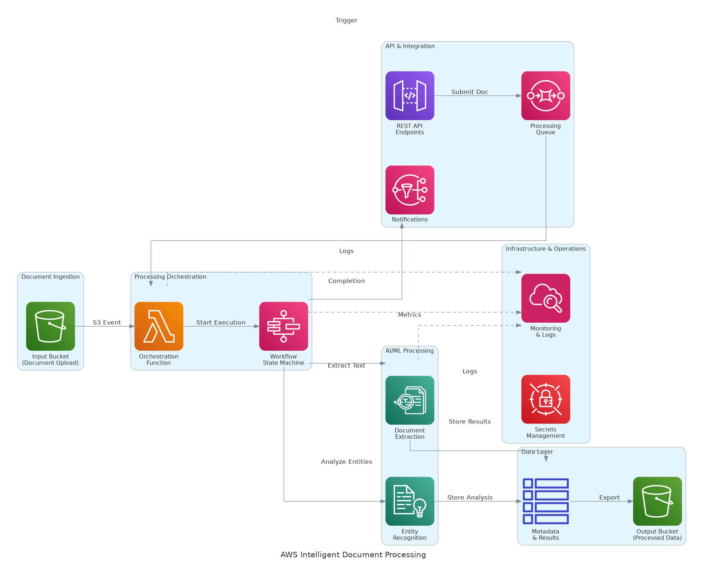
Solution Overview
HashiCorp Stack
  Terraform Cloud for infrastructure as code with workspaces and policy enforcement
  HashiCorp Vault for centralized secrets management and dynamic credentials across clouds
  HashiCorp Consul for service mesh and multi-cloud service discovery
Platform Architecture
  Multi-cloud provisioning across AWS Azure GCP with unified workflows
  Policy as code with Sentinel for governance security and cost controls
  VCS integration with GitHub for GitOps workflows and collaboration
HashiCorp Multi-Cloud Platform

Slide 5
Implementation Approach
Phase 1: Foundation (Months 1-3)
  Deploy Terraform Cloud with initial workspaces and VCS integration
  Migrate existing Terraform state from local/S3 to centralized platform
  Implement Vault for secrets management and establish RBAC model
Phase 2: Expansion (Months 4-6)
  Onboard additional cloud environments and expand to 50+ workspaces
  Deploy Sentinel policies for security cost and compliance governance
  Integrate with CI/CD pipelines and enable self-service provisioning
Phase 3: Optimization (Months 7-9)
  Implement Consul service mesh for cross-cloud connectivity
  Deploy advanced automation including drift detection and remediation
  Complete training transition to operations and enable full self-service
HashiCorp Multi-Cloud Platform

Slide 6
Timeline & Milestones
Phase No | Phase Description | Timeline | Key Deliverables
Phase 1 | Foundation & Migration | Months 1-3 | Terraform Cloud operational 25 workspaces migrated Vault secrets management deployed RBAC implemented
Phase 2 | Expansion & Governance | Months 4-6 | 100 workspaces across all clouds Sentinel policies enforcing governance CI/CD integration complete Self-service enabled
Phase 3 | Optimization & Scale | Months 7-9 | Consul service mesh deployed Advanced automation active Full team enablement complete
HashiCorp Multi-Cloud Platform

Slide 7
Success Stories
Client Success: Global Financial Services Firm
  Client: Fortune 500 financial institution with 2500+ multi-cloud resources
  Challenge: Inconsistent Terraform usage creating compliance gaps and infrastructure drift. Manual provisioning taking 5-7 days per environment. No policy enforcement enabling security misconfigurations costing $180K annually in incidents.
  Solution: Deployed HashiCorp multi-cloud platform with Terraform Cloud, Vault, and 50+ Sentinel policies. Implemented GitOps workflows and self-service provisioning.
  Results: 75% reduction in provisioning time (7 days to 1.5 days) and 99% policy compliance rate with zero security incidents. $450K annual savings through cost optimization policies. Full ROI achieved in 16 months.
  Testimonial: "The HashiCorp platform transformed our infrastructure chaos into a governed, compliant multi-cloud operation. Sentinel policies prevent misconfigurations before they reach production." — James Chen, VP of Cloud Engineering
HashiCorp Multi-Cloud Platform

Slide 8
Our Partnership Advantage
What We Bring
  8+ years implementing HashiCorp solutions with proven multi-cloud expertise
  30+ successful Terraform Enterprise deployments across enterprises
  HashiCorp Implementation Partner with certified platform engineers
  Deep expertise in Sentinel policy development and multi-cloud architecture
Value to You
  Pre-built Terraform modules and policy libraries accelerate deployment
  Proven workspace organization patterns from 30+ implementations
  Direct HashiCorp engineering support through partner network
  Best practices from real-world multi-cloud migrations avoid common pitfalls
HashiCorp Multi-Cloud Platform

Slide 9
Investment Summary
Cost Category | Year 1 List | Year 1 Credits | Year 1 Net | Year 2 | Year 3 | 3-Year Total
Professional Services | $165,000 | $0 | $165,000 | $0 | $0 | $165,000
Cloud Infrastructure | $47,918 | ($12,700) | $35,218 | $47,918 | $47,918 | $131,054
HashiCorp Licenses | $71,250 | ($15,000) | $56,250 | $71,250 | $71,250 | $198,750
Software Licenses | $18,360 | $0 | $18,360 | $18,360 | $18,360 | $55,080
Support & Maintenance | $84,900 | $0 | $84,900 | $84,900 | $84,900 | $254,700
TOTAL | $387,428 | ($27,700) | $359,728 | $222,428 | $222,428 | $804,584
HashiCorp Multi-Cloud Platform

Slide 10
Next Steps
Decision: Executive approval for platform implementation by [specific date]
Kickoff: Target implementation start date within 30 days of approval
Team Formation: Identify infrastructure leads, provide existing Terraform code samples
Week 1-2: Contract finalization workspace migration planning and cloud access setup
Week 3-4: Initial workspace migration and platform configuration, first automated runs via VCS
HashiCorp Multi-Cloud Platform

Slide 11
Thank You

