Slide 1
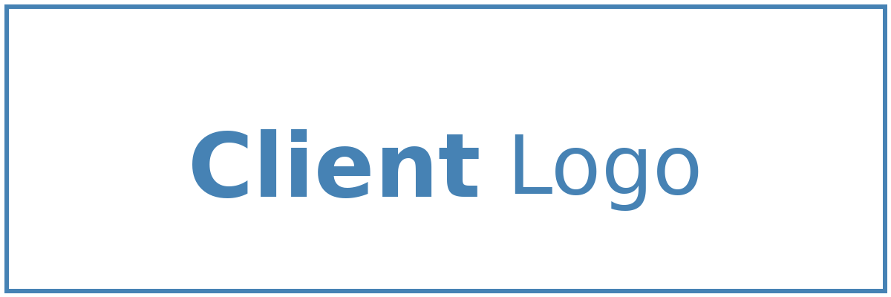
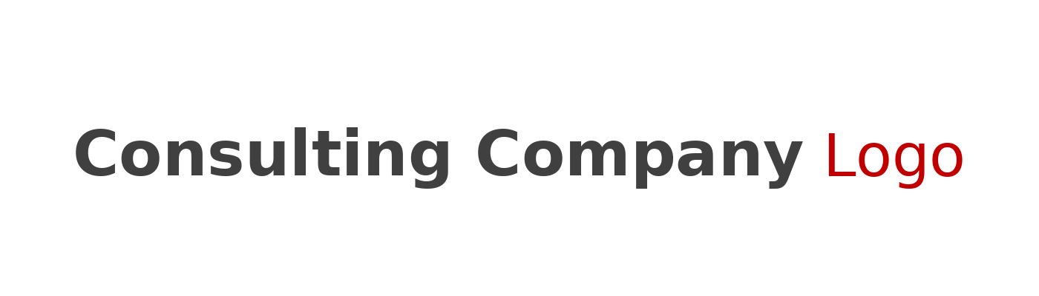

Solution Briefing
Azure Virtual Desktop
Enterprise Solutions Architect | November 16, 2025

Slide 2
Business Opportunity
Opportunity
  Modernize desktop infrastructure to support secure remote work and flexible workplace models
  Reduce IT operational overhead by 40-50% through centralized cloud-based desktop management
  Enable employees to access corporate desktops from any device, location, or network connection
  Implement enterprise-grade security and compliance controls with multi-session efficiency
Success Criteria
  Deploy pooled and/or personal desktops with 99.9% availability within 8-10 weeks
  Achieve 70%+ reduction in remote access VPN complexity and security incidents
  Reduce per-user infrastructure costs by 35-45% compared to traditional VDI solutions
  Enable seamless user experience with sub-200ms latency across geographies

Slide 3
Engagement Scope
Category | Parameter | Scope
Solution Scope | Host Pools | 3 host pools
Solution Scope | Application Groups | 5-10 app groups
Integration | Identity Integration | Azure AD hybrid join
Integration | Profile Management | FSLogix profile containers
User Base | Total Users | 200 concurrent users
User Base | User Roles | 3 roles (standard power admin)
Data Volume | User Profiles | 10 GB per user
Data Volume | Application Data | 500 GB shared storage
Technical Environment | Deployment Regions | Single Azure region (East US)
Technical Environment | Availability Requirements | Standard (99.9%)
Technical Environment | Infrastructure Complexity | Multi-session Windows 11 hosts
Security & Compliance | Security Requirements | Conditional Access MFA Intune
Security & Compliance | Compliance Frameworks | SOC2
Performance | User Experience | Standard latency requirements
Performance | Graphics Requirements | Standard office workloads
Environment | Deployment Environments | 2 environments (pilot prod)

Slide 4
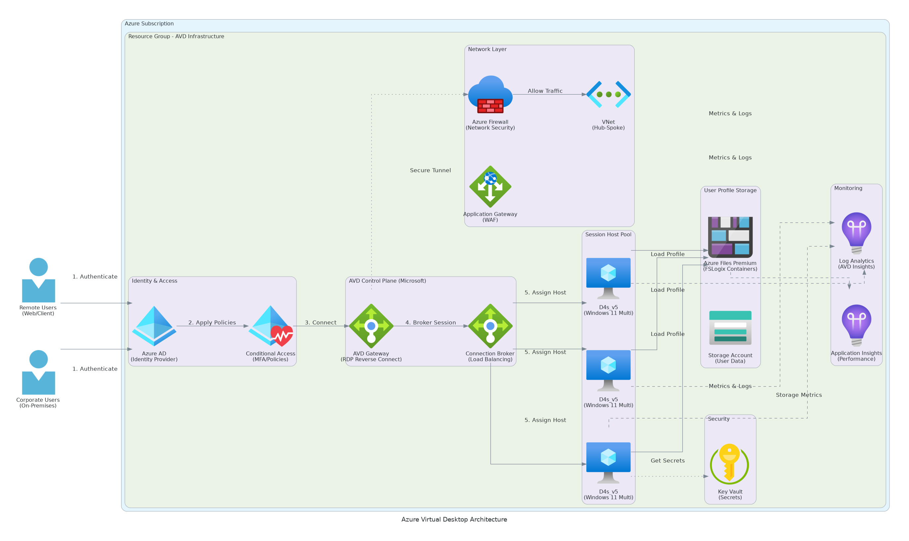
Solution Overview
Key Components
  Host Pools: Pooled (multi-session Windows 10/11) or personal (dedicated per-user) configurations
  Session Hosts: Azure VMs (D4s_v5 series) running Windows 10/11 Multi-session with load balancing
  FSLogix Profile Management: Unified profile containers and Office containers for persistent user data
  Azure Files: SMB-based storage for profile and user-specific data with fast access
  Azure AD & Conditional Access: Enterprise identity management with policy-driven access control
  Azure Monitor: Real-time diagnostics, performance monitoring, and health alerts
Technology Stack
  Platform: Azure Virtual Desktop (AVD)
  Session Hosts: Windows 10/11 Multi-session (D4s_v5 VMs)
  Storage: Azure Files + FSLogix
  Identity: Azure AD / Microsoft Entra ID
  Security: Network Security Groups, Private Endpoints
  Monitoring: Azure Monitor, Diagnostics Services

Slide 5
Implementation Approach
Phase 1: Assessment & Design *(Weeks 1-3)*
  Current desktop environment discovery and user requirements
  AVD architecture design (pooled vs. personal selection)
  Golden image strategy and application packaging
  Network and security design with NSG and Private Endpoints
Phase 2: Infrastructure & Golden Image *(Weeks 4-6)*
  Azure infrastructure provisioning (host pools, Azure Files, networking)
  Golden image creation and application deployment
  FSLogix profile configuration and testing
  Azure Monitor setup and baseline metrics
Phase 3: Deployment & Validation *(Weeks 7-10)*
  User and group assignment to host pools
  Pilot deployment with business users (10-15 users)
  Performance validation and optimization
  Training and handover to support team

Slide 6
Timeline & Milestones
Phase No | Phase Description | Timeline | Key Deliverables
Phase 1 | Assessment & Design | Weeks 1-3 | Environment analysis, AVD architecture, golden image strategy, security design
Phase 2 | Infrastructure & Golden Image | Weeks 4-6 | Host pools configured, Azure Files deployed, golden image created, FSLogix ready
Phase 3 | Deployment & Validation | Weeks 7-10 | Pilot users onboarded, performance validated, training complete, support ready

Slide 7
Success Stories
Client Success: Global Financial Services Organization
  Client: Fortune 500 Financial Services company with 8,000+ employees in 45 countries
  Challenge: Legacy desktop infrastructure unable to support remote work; expensive VPN with poor user experience; security gaps with unsecured bring-your-own-device access; IT helpdesk overwhelmed with remote access issues
  Solution: Deployed Azure Virtual Desktop with pooled desktops for 70% of workforce and personal desktops for executives; integrated FSLogix for seamless profile access across any device; implemented conditional access policies; centralized monitoring and management
  Results: 100% remote work capability within 10 weeks, 60% reduction in IT helpdesk tickets, 85% user satisfaction (NPS 72), 45% reduction in VPN-related security incidents, achieved SOC2 compliance with unified audit logging
  Testimonial: "Azure Virtual Desktop enabled us to embrace distributed work while actually improving security and reducing costs. Our users love the seamless experience, and our IT team finally has visibility and control. This was a game-changer for our business continuity." — Patricia Wong, Chief Information Officer, Global Financial Services

Slide 8
Our Partnership Advantage
What We Bring
  12+ years delivering virtual desktop and workspace solutions
  150+ successful Azure Virtual Desktop deployments
  Certified Microsoft Azure Solutions Architects
  Deep expertise in FSLogix, golden image optimization, and performance tuning
  24/7 support with guaranteed response times
  Pre-built AVD accelerators for faster deployment
Value to You
  Proven methodology reduces implementation risk by 70%
  Pre-optimized golden images for common applications
  Network design expertise ensures optimal user experience
  Training ensures your team becomes self-sufficient
  Ongoing optimization recommendations for cost and performance
  Access to Microsoft AVD partner ecosystem and best practices

Slide 9
Investment Summary
Cost Category | Year 1 List | Provider/Partner Credits | Year 1 Net | Year 2 | Year 3 | 3-Year Total
Cloud Infrastructure | $28,000 | ($4,000) | $24,000 | $28,000 | $28,000 | $80,000
Professional Services | $55,000 | ($2,000) | $53,000 | $0 | $0 | $53,000
Software Licenses & Subscriptions | $12,000 | $0 | $12,000 | $12,000 | $12,000 | $36,000
Support & Maintenance | $3,500 | $0 | $3,500 | $3,500 | $3,500 | $10,500
TOTAL INVESTMENT | $98,500 | ($6,000) | $92,500 | $43,500 | $43,500 | $179,500

Slide 10
Next Steps
Decision: Board approval for AVD initiative by [specific date]
Kickoff: Project start date of [target start date]
Team Formation: Designate IT lead, network architect, and user champions
Week 1: Contract finalization and project initiation
Week 2: Discovery sessions and requirements gathering
Week 3: Architecture design and golden image planning
Week 4: Environment setup and pilot user selection

Slide 11
Thank You
Your Account Manager: [Name, Title] | [Email] | [Phone]

