Slide 1
Solution Briefing
IBM Red Hat OpenShift Container Platform
['Presenter Name'] | November 22, 2025

Slide 2
Business Opportunity
Opportunity
  Deploy containerized applications in minutes instead of days
  Reduce infrastructure costs by 30-50% through improved utilization
  Enable developer self-service reducing ticket queues by 80%
Success Criteria
  10x improvement in deployment frequency from weekly to daily
  50% reduction in operational overhead through automation
  Support 50 developers deploying 500 containerized applications
IBM Red Hat OpenShift Container Platform

Slide 3
Engagement Scope
Parameter | Scope |  | Parameter | Scope
Cluster Size | 6-node cluster (3 control + 3 workers) |  | Availability Requirements | Multi-AZ HA
Container Capacity | 500-1000 containers |  | Infrastructure Complexity | Standard 6-node cluster
CI/CD Integrations | OpenShift Pipelines + GitOps |  | Security Requirements | RBAC + pod security policies
External Systems | LDAP/AD + monitoring |  | Compliance Frameworks | SOC2 ISO 27001
Developer Count | 50 developers |  | Service Mesh | Istio for microservices
User Roles | 5 roles |  | Monitoring Stack | Prometheus + Grafana
Application Count | 10 initial applications |  | Deployment Environments | 3 environments (dev staging prod)
Persistent Storage | 20 TB |  | Deployment Platform | VMware vSphere
IBM Red Hat OpenShift Container Platform

Slide 4
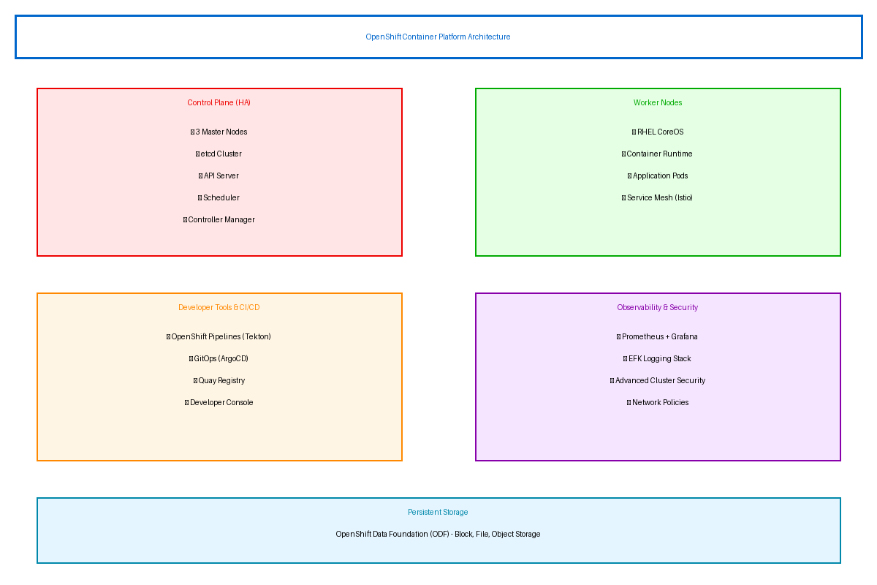
Solution Overview
Container Platform
  OpenShift with integrated Kubernetes orchestration and automated operations
  Multi-master control plane with etcd cluster for high availability
  Worker nodes running RHEL CoreOS for immutable infrastructure
Developer Tools & CI/CD
  OpenShift Pipelines (Tekton) for cloud-native CI/CD workflows
  GitOps with ArgoCD for declarative application deployment
  Integrated Quay registry with vulnerability scanning
Observability & Security
  Prometheus and Grafana for metrics and dashboarding
  OpenShift Logging (EFK stack) for centralized logs
  Advanced Cluster Security for vulnerability management
IBM Red Hat OpenShift Container Platform

Slide 5
Implementation Approach
Phase 1: Foundation (Months 1-2)
  Deploy 6-node OpenShift cluster with high availability
  Configure storage integration and establish RBAC with AD/LDAP
  Deploy monitoring and logging infrastructure
Phase 2: Application Migration (Months 3-4)
  Containerize initial 5-10 applications using best practices
  Configure OpenShift Pipelines for automated CI/CD
  Implement GitOps deployment with ArgoCD
Phase 3: Production & Scale (Months 5-6)
  Production deployment with automated health checks
  Enable developer self-service with templates and quotas
  Knowledge transfer training and documentation
IBM Red Hat OpenShift Container Platform

Slide 6
Timeline & Milestones
Phase No | Phase Description | Timeline | Key Deliverables
Phase 1 | Foundation & Setup | Months 1-2 | 6-node cluster deployed, RBAC configured, Monitoring and logging operational
Phase 2 | Application Migration | Months 3-4 | 10 apps containerized, CI/CD pipelines active, GitOps deployment established
Phase 3 | Production & Enablement | Months 5-6 | Developer self-service enabled, Service mesh deployed, Operations team trained
IBM Red Hat OpenShift Container Platform

Slide 7
Success Stories
Client Success: Financial Services Company
  Client: Global bank with 200 developers across 15 countries
  Challenge: VM-based deployments taking 2 weeks with 15% resource utilization. Application teams blocked waiting for infrastructure provisioning. Inconsistent environments causing production failures.
  Solution: Deployed OpenShift on VMware with GitOps workflows and developer self-service portal. Migrated 50 applications to containers.
  Results: 95% reduction in deployment time (2 weeks to 4 hours) and 5x resource utilization improvement. Developer productivity increased 40% with self-service capabilities. Infrastructure costs reduced 35% through consolidation.
  Testimonial: "OpenShift transformed our application delivery from a bottleneck into a competitive advantage. Developers love the self-service capabilities, and our operations team manages 3x more applications with the same headcount." — Michael Chen, VP of Infrastructure
IBM Red Hat OpenShift Container Platform

Slide 8
Our Partnership Advantage
What We Bring
  8+ years delivering Red Hat OpenShift solutions
  30+ successful OpenShift deployments across industries
  Red Hat Advanced Consulting Partner certification
  Kubernetes and container platform expertise
Value to You
  Pre-built application templates accelerate migration
  Proven containerization methodology reduces risk
  Direct Red Hat specialist support through partnership
  Best practices from 30+ implementations
IBM Red Hat OpenShift Container Platform

Slide 9
Investment Summary
Cost Category | Year 1 List | Year 1 Credits | Year 1 Net | Year 2 | Year 3 | 3-Year Total
Professional Services | $90,000 | ($5,000) | $85,000 | $0 | $0 | $85,000
Cloud Infrastructure | $9,876 | $0 | $9,876 | $9,876 | $9,876 | $29,628
Hardware/Equipment | $174,000 | ($15,000) | $159,000 | $8,000 | $8,000 | $175,000
Software Licenses | $136,800 | ($20,000) | $116,800 | $136,800 | $136,800 | $390,400
Support & Maintenance | $52,900 | $0 | $52,900 | $52,900 | $52,900 | $158,700
TOTAL | $463,576 | ($40,000) | $423,576 | $207,576 | $207,576 | $838,728
IBM Red Hat OpenShift Container Platform

Slide 10
Next Steps
Decision: Executive approval for OpenShift implementation by [specific date]
Kickoff: Target cluster deployment within 30 days of approval
Team Formation: Identify platform team infrastructure contacts and pilot applications
Week 1-2: Infrastructure readiness assessment and OpenShift deployment planning
Week 3-4: Cluster deployment monitoring setup and first pilot application containerized
IBM Red Hat OpenShift Container Platform

Slide 11
Thank You

