Slide 1



Solution Briefing
AWS Cloud Migration - On-Premise to Cloud
[Presenter Name] | November 15, 2025

Slide 2
Business Opportunity
Opportunity
  Eliminate data center costs and redirect capital to business innovation and growth
  Achieve operational agility with cloud-native scalability and global infrastructure
  Modernize legacy applications while reducing technical debt and maintenance burden
Success Criteria
  Complete migration of production workloads within 6-9 months with zero data loss
  Achieve 30-40% infrastructure cost reduction through right-sizing and optimization
  Establish AWS landing zone foundation for future cloud-native development

Slide 3
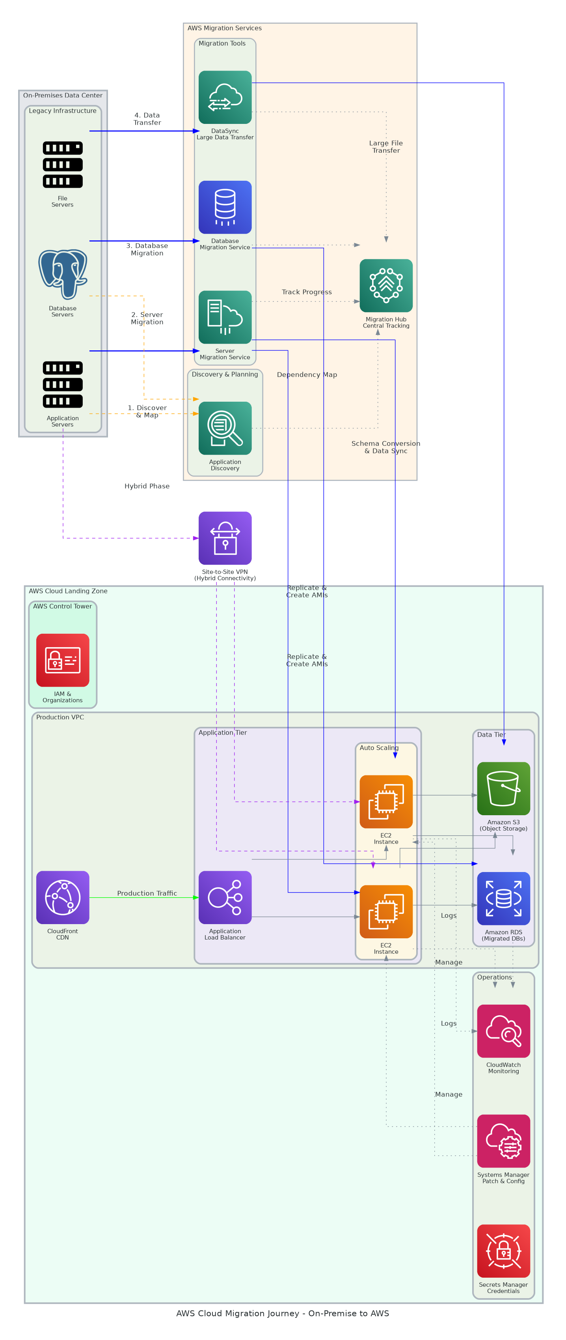
Solution Overview
Migration Approach
  Discovery with Application Discovery Service maps dependencies and complexity
  Migration tools: DMS for databases, SMS for servers, DataSync for data transfer
  Migration Hub provides centralized tracking across all migration waves
AWS Landing Zone
  Multi-account structure with Control Tower and Organizations for governance
  Production infrastructure: Auto Scaling EC2, RDS, S3, CloudFront, VPC networking
  Site-to-Site VPN enables secure hybrid connectivity during phased migration

Slide 4
Implementation Approach
Phase 1: Discovery & Assessment (Months 1-2)
  Application discovery and dependency mapping with AWS tools
  Migration readiness assessment and wave planning (lift-shift vs replatform)
  AWS landing zone design and account structure setup
Phase 2: Migration Execution (Months 3-6)
  Wave 1: Non-critical applications for validation and learning
  Wave 2: Business-critical applications with tested migration patterns
  Wave 3: Complex/legacy applications requiring refactoring
Phase 3: Optimization (Months 7-9)
  Right-sizing based on CloudWatch metrics and usage patterns
  Cost optimization through Reserved Instances and Savings Plans
  Security hardening and compliance validation

Slide 5
Timeline & Milestones
Phase No | Phase Description | Timeline | Key Deliverables
Phase 1 | Discovery & Assessment | Months 1-2 | Application inventory completed, Migration waves defined, AWS landing zone operational
Phase 2 | Migration Execution | Months 3-6 | Wave 1-3 migrated to AWS, Applications validated in cloud, Hybrid connectivity established
Phase 3 | Optimization & Closure | Months 7-9 | Infrastructure right-sized, Costs optimized, On-premises decommissioned

Slide 6
Success Stories
Client Success: Global Manufacturing Company
  Client: Mid-market manufacturer with 5,000 employees across 12 global facilities
  Challenge: Aging data centers requiring $3M upgrade, 72-hour lead time for new environments
  Solution: AWS migration of 150 servers, 20 databases, and 50TB data using DMS/SMS/DataSync
  Results: 42% cost reduction ($1.8M annual savings), 95% faster provisioning, zero downtime, DC terminated
  Testimonial: "The migration delivered beyond cost savings - we've fundamentally changed how we operate. New capabilities that took months now take hours, enabling business agility we never had before." — Jennifer Wu, CIO, GlobalManufacture Corp

Slide 7
Our Partnership Advantage
What We Bring
  12+ years delivering AWS migrations with 100% success rate
  150+ successful migrations totaling 10,000+ servers to AWS
  AWS Migration Competency and Premier Consulting Partner status
  Certified migration specialists and AWS-authorized instructors
  Pre-built migration accelerators and automation tools
Value to You
  Proven migration methodology reduces risk and accelerates timeline
  AWS Migration credits (10-25% of spend) offset migration costs
  Direct AWS TAM and migration specialist support
  Best practices from 150+ migrations avoid common pitfalls
  Comprehensive training for cloud operations team

Slide 8
Investment Summary
Cost Category | Year 1 | Year 2 | Year 3 | 3-Year Total
Professional Services | $514,000 | $0 | $0 | $514,000
Cloud Infrastructure | $200,532 | $25,282 | $25,282 | $251,096
Software Licenses & Subscriptions | $25,000 | $0 | $0 | $25,000
TOTAL SOLUTION INVESTMENT | $739,532 | $25,282 | $25,282 | $790,096

Slide 9
Next Steps
Decision: Executive approval for discovery and migration planning by [specific date]
Kickoff: Discovery phase start date [30 days from approval]
Team Formation: Application owners, infrastructure team, migration project manager
Week 1: Contract finalization and AWS account setup
Week 2: Application Discovery Service deployment and data collection
Week 3: Dependency mapping and migration complexity assessment
Week 4: Migration wave planning and AWS landing zone design

Slide 10
Thank You
Your Account Manager: [Name, Title] | [Email] | [Phone]

