Slide 1



Solution Briefing
HashiCorp Terraform Enterprise
['Presenter Name'] | November 22, 2025

Slide 2
Business Opportunity
Opportunity
  Eliminate infrastructure provisioning bottlenecks and reduce deployment time from days to hours
  Achieve consistent infrastructure configurations across all environments through centralized state management
  Scale infrastructure operations without adding headcount through policy-driven automation
Success Criteria
  75% reduction in infrastructure provisioning time with self-service capabilities
  100% policy compliance through automated Sentinel enforcement
  ROI realization within 12-18 months through operational efficiency and reduced errors
HashiCorp Terraform Enterprise

Slide 3
Engagement Scope
Parameter | Scope |  | Parameter | Scope
HashiCorp Terraform Enterprise

Slide 4
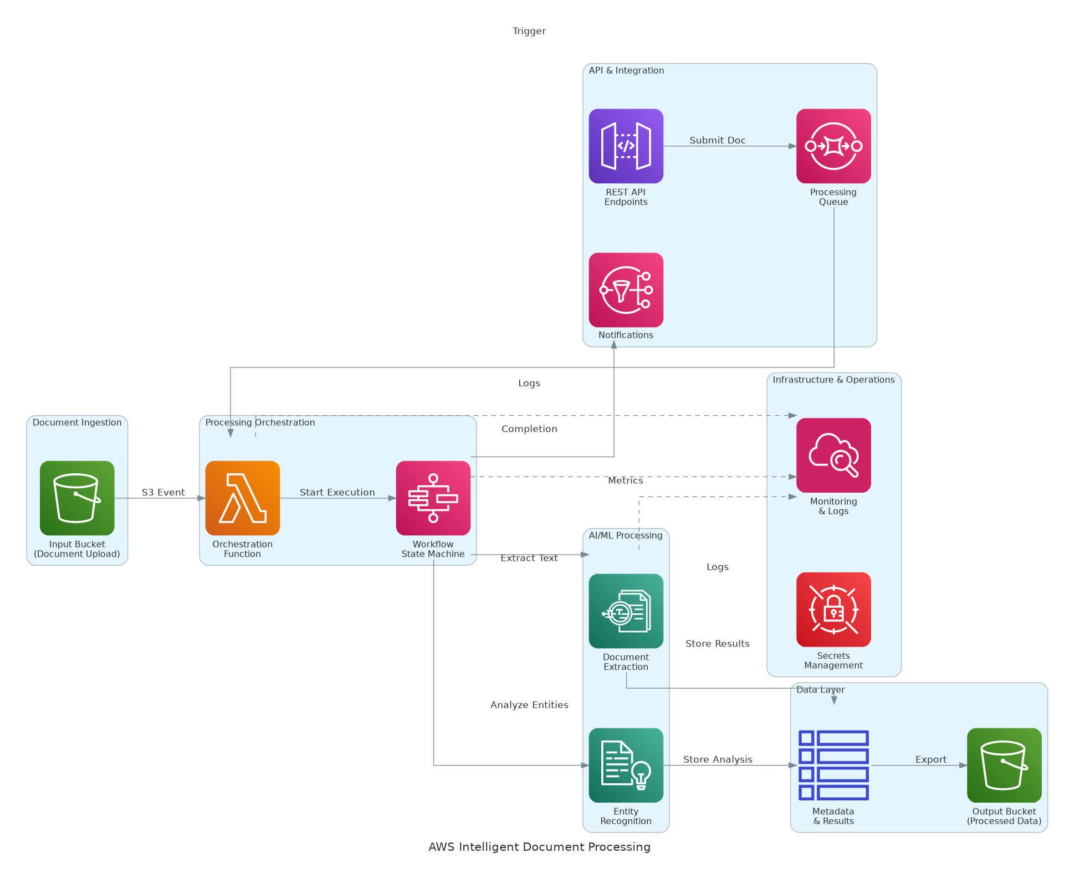
Solution Overview
Terraform Enterprise Core
  Centralized workspace management with VCS-driven workflows and remote state storage
  Sentinel policy as code for security cost and compliance governance
  Private module registry for infrastructure code reusability and versioning
Platform Architecture
  Kubernetes-based deployment on AWS EKS with PostgreSQL state database
  GitHub integration for GitOps workflows and automated runs
  HashiCorp Vault integration for dynamic cloud credentials and secrets management
HashiCorp Terraform Enterprise

Slide 5
Implementation Approach
Phase 1: Foundation (Months 1-2)
  Deploy Terraform Enterprise on Kubernetes with high availability configuration
  Migrate initial workspaces from Terraform OSS to centralized platform
  Implement VCS integration with GitHub and establish GitOps workflows
Phase 2: Expansion (Months 3-4)
  Onboard additional teams and migrate 100+ workspaces to platform
  Deploy Sentinel policies for security compliance and cost governance
  Integrate with Vault for secrets management and CI/CD pipelines
Phase 3: Optimization (Months 5-6)
  Enable self-service infrastructure provisioning with approval workflows
  Implement advanced automation including drift detection and scheduled runs
  Complete training knowledge transfer and transition to operations
HashiCorp Terraform Enterprise

Slide 6
Timeline & Milestones
Phase No | Phase Description | Timeline | Key Deliverables
Phase 1 | Foundation & Migration | Months 1-2 | Terraform Enterprise operational 50 workspaces migrated VCS integration complete RBAC implemented
Phase 2 | Expansion & Governance | Months 3-4 | 250 workspaces onboarded Sentinel policies enforcing governance Vault integration complete CI/CD pipelines integrated
Phase 3 | Optimization & Enablement | Months 5-6 | Self-service provisioning enabled Advanced automation deployed Full team training complete
HashiCorp Terraform Enterprise

Slide 7
Success Stories
Client Success: Global Investment Bank
  Client: Top 10 investment bank with 200+ AWS accounts
  Challenge: Inconsistent Terraform OSS usage creating configuration drift and compliance gaps. Manual infrastructure approvals taking 3-5 days. Security incidents from misconfigured infrastructure costing $250K annually.
  Solution: Deployed Terraform Enterprise with centralized workspace management, VCS workflows, and 40+ Sentinel policies for governance.
  Results: 80% reduction in provisioning time (5 days to 1 day) and 100% policy compliance with zero production incidents from drift. $380K annual savings through cost governance. Full ROI achieved in 14 months.
  Testimonial: "Terraform Enterprise gave us the governance we needed without sacrificing velocity. Sentinel policies catch security issues before they reach production, and our teams love the self-service capability." — Michael Rodriguez, Director of Infrastructure
HashiCorp Terraform Enterprise

Slide 8
Our Partnership Advantage
What We Bring
  6+ years implementing Terraform Enterprise platforms with proven results
  25+ successful TFE deployments across financial services healthcare and technology
  HashiCorp Implementation Partner with certified Terraform engineers
  Deep expertise in Sentinel policy development and GitOps workflows
Value to You
  Pre-built Terraform module libraries and policy templates accelerate deployment
  Proven workspace organization patterns from 25+ implementations
  Direct HashiCorp engineering support through partner network
  Best practices from real-world state migrations avoid data loss and downtime
HashiCorp Terraform Enterprise

Slide 9
Investment Summary
Cost Category | Year 1 List | Year 1 Credits | Year 1 Net | Year 2 | Year 3 | 3-Year Total
Professional Services | $125,000 | $0 | $125,000 | $0 | $0 | $125,000
Cloud Infrastructure | $35,916 | ($12,000) | $23,916 | $35,916 | $35,916 | $95,748
HashiCorp Licenses | $29,500 | ($10,000) | $19,500 | $29,500 | $29,500 | $78,500
Software Licenses | $34,260 | $0 | $34,260 | $34,260 | $34,260 | $102,780
Support & Maintenance | $58,400 | $0 | $58,400 | $58,400 | $58,400 | $175,200
TOTAL | $283,076 | ($22,000) | $261,076 | $158,076 | $158,076 | $577,228
HashiCorp Terraform Enterprise

Slide 10
Next Steps
Decision: Executive approval for Terraform Enterprise implementation by [specific date]
Kickoff: Target implementation start date within 30 days of approval
Team Formation: Identify Terraform users, provide existing code and state files
Week 1-2: Contract finalization state migration planning and platform access setup
Week 3-4: Initial workspace migration and VCS integration, first automated runs
HashiCorp Terraform Enterprise

Slide 11
Thank You

