Slide 1



Solution Briefing
Cisco DNA Center Network Analytics
['Presenter Name'] | November 22, 2025

Slide 2
Business Opportunity
Opportunity
  Eliminate reactive troubleshooting reducing MTTR from 4-6 hours to under 1 hour with AI-powered root cause analysis
  Achieve 99.9% network uptime with predictive insights that detect device failures 14 days in advance
  Automate network provisioning reducing switch deployment time from 4 hours to 15 minutes
Success Criteria
  75% reduction in network troubleshooting time with measurable MTTR improvements
  Zero-touch provisioning for new sites deployed in hours versus weeks
  ROI realization within 18 months through operational efficiency and reduced downtime
Cisco DNA Center Network Analytics

Slide 3
Engagement Scope
Parameter | Scope |  | Parameter | Scope
Primary Features/Capabilities | DNA Center for 200 devices |  | Availability Requirements | Standard (99.5%)
Customization Level | Standard DNA Center deployment |  | Infrastructure Complexity | Basic campus network
External System Integrations | 2 systems (AD + ITSM) |  | Security Requirements | Basic 802.1X and encryption
Data Sources | Network devices only |  | Compliance Frameworks | Basic logging
Total Users | 10 network administrators |  | Performance Requirements | Standard telemetry
User Roles | 2 roles (admin + viewer) |  | Deployment Environments | Production only
Data Processing Volume | 200 devices telemetry |  | Data Storage Requirements | 500 GB (90-day retention)
Deployment Regions | Single data center
Cisco DNA Center Network Analytics

Slide 4
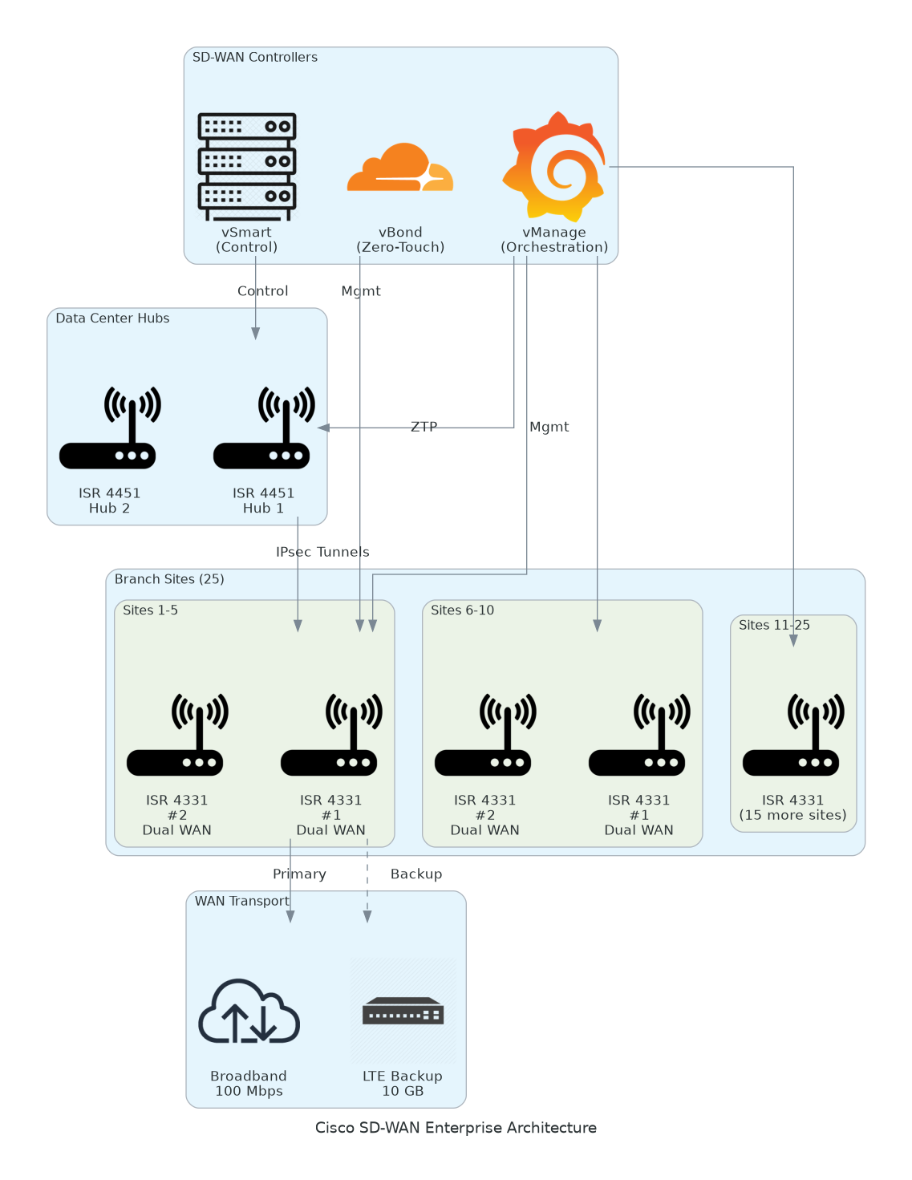
Solution Overview
Key Components
  Cisco DNA Center appliances with primary and secondary HA for 99.9% uptime
  AI Network Analytics with predictive failure detection and automated remediation
  Application Experience monitoring for Office 365, Webex, and SAP
Technology Stack
  Platform: Cisco DNA Center with zero-touch provisioning and policy automation
  Integration: Active Directory, ServiceNow ITSM, and NetBox IPAM
  Security: TrustSec micro-segmentation with policy-based access control
Cisco DNA Center Network Analytics

Slide 5
Implementation Approach
Phase 1: Foundation & Deployment (Weeks 1-6)
  Network assessment and DNA Center HA deployment
  Initial device onboarding for 50 pilot devices with policy framework design
  Remaining 150 devices onboarded with AI analytics and automation workflows
Phase 2: Advanced Features & Integration (Weeks 7-12)
  Application experience monitoring for Office 365, Webex, and SAP
  ServiceNow and NetBox integration with automated ticket workflows
  Policy automation for VLAN, ACL, and compliance configuration
Phase 3: Optimization & Training (Weeks 13-16)
  Validation testing and policy fine-tuning based on feedback
  Team training (32 hours) with hands-on labs and knowledge transfer
  Operational handoff with runbooks and hypercare support
Cisco DNA Center Network Analytics

Slide 6
Timeline & Milestones
Phase No | Phase Description | Timeline | Key Deliverables
Phase 1 | Foundation | Weeks 1-4 | DNA Center HA deployed, 50 pilot devices onboarded, Policy framework designed
Phase 2 | Automation & Analytics | Weeks 5-8 | 200 devices managed, AI analytics operational, Network policies automated
Phase 3 | Advanced Features | Weeks 9-12 | Application monitoring live, ITSM/IPAM integrated, SD-Access deployed (100 devices)
Phase 4 | Optimization | Weeks 13-16 | Validation complete, Team trained (32 hours), Full operational handoff
Cisco DNA Center Network Analytics

Slide 7
Success Stories
Client Success: Regional Healthcare System
  Client: Multi-hospital healthcare system with 180 devices across 8 locations
  Challenge: 4-6 hour outages impacting patient care. Manual provisioning taking 4 hours per device. No application performance visibility for critical healthcare apps.
  Solution: Deployed DNA Center with AI analytics, zero-touch provisioning, and Epic EMR monitoring.
  Results: 78% MTTR reduction and 99.8% uptime achieved. Device deployment reduced to 12 minutes. $135K annual savings with 14-month ROI.
  Testimonial: "DNA Center transformed our network from reactive firefighting to proactive management. We detected device failures before impacting patient care." — Michael Chen, Director of IT Infrastructure
Cisco DNA Center Network Analytics

Slide 8
Our Partnership Advantage
What We Bring
  12+ years delivering Cisco network automation solutions with proven enterprise deployments
  40+ successful DNA Center implementations across healthcare, finance, manufacturing
  Cisco Gold Partner with Advanced Enterprise Networks Architecture Specialization
  Certified DNA Center specialists and network automation experts on staff
Value to You
  Pre-built policy templates and automation workflows accelerate deployment by 40%
  Proven integration patterns for ServiceNow, NetBox, and SIEM platforms
  Direct Cisco TAC escalation and engineering support through partner network
  Best practices from 40+ implementations avoiding common deployment pitfalls
Cisco DNA Center Network Analytics

Slide 9
Investment Summary
Cost Category | Year 1 List | Year 1 Credits | Year 1 Net | Year 2 | Year 3 | 3-Year Total
Professional Services | $85,100 | $0 | $85,100 | $0 | $0 | $85,100
Hardware | $120,000 | $0 | $120,000 | $0 | $0 | $120,000
Software | $110,000 | ($20,000) | $90,000 | $110,000 | $110,000 | $310,000
Support | $18,000 | $0 | $18,000 | $18,000 | $18,000 | $54,000
TOTAL | $333,100 | ($20,000) | $313,100 | $128,000 | $128,000 | $569,100
Cisco DNA Center Network Analytics

Slide 10
Next Steps
Decision: Executive approval for $313K Year 1 investment by [specific date]
Hardware Procurement: Order DNA Center appliances (4-6 week lead time) with data center preparation
Team Formation: Assign technical lead, project team, and secure implementation resources
Week 1-4: Discovery phase with network assessment, policy design, and stakeholder workshops
Week 5-16: Full deployment with pilot validation, enterprise rollout, training, and operational handoff
Cisco DNA Center Network Analytics

Slide 11
Thank You

