Slide 1



Solution Briefing
AWS Intelligent Document Processing
['Presenter Name'] | November 20, 2025

Slide 2
Business Opportunity
Opportunity
  Eliminate manual data entry bottlenecks and reduce processing time from hours to minutes
  Achieve 99%+ accuracy with AI-powered extraction replacing error-prone manual processes
  Scale effortlessly to handle volume fluctuations without adding headcount
Success Criteria
  90% reduction in document processing time with measurable productivity gains
  95%+ data extraction accuracy validated against business requirements
  ROI realization within 12-18 months through labor cost savings and efficiency gains
AWS Intelligent Document Processing

Slide 3
Engagement Scope
Parameter | Scope |  | Parameter | Scope
Document Types | 2-3 document types |  | Availability Requirements | Standard (99.5%)
AI/ML Complexity | AWS Textract/Comprehend only |  | Infrastructure Complexity | Serverless (Lambda S3 Textract)
External System Integrations | 2 REST APIs |  | Security Requirements | Basic encryption IAM SSE-S3
Data Sources | S3 and email ingestion |  | Compliance Frameworks | SOC2
Total Users | 50 users |  | Accuracy Requirements | 95%+ extraction accuracy
User Roles | 3 roles (submitter reviewer admin) |  | Processing Speed | Standard batch processing
Document Processing Volume | 1000-5000 docs/month |  | Deployment Environments | 2 environments (dev prod)
Data Storage Requirements | 500 GB |  | Deployment Regions | Single AWS region (us-east-1)
AWS Intelligent Document Processing

Slide 4
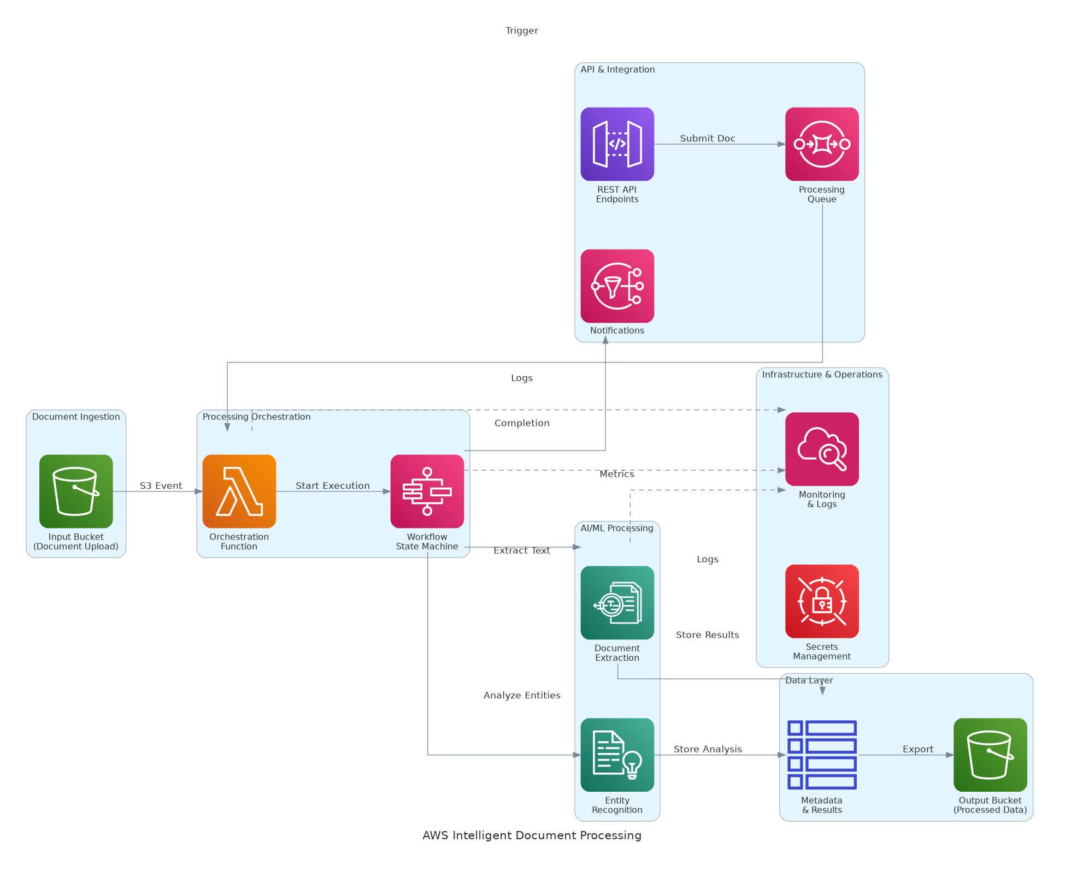
Solution Overview
AI/ML Services
  Amazon Textract for OCR and intelligent form/table extraction from documents
  Amazon Comprehend for NLP entity recognition and document classification
  Amazon A2I for human review and quality assurance on low-confidence results
Platform Architecture
  Serverless processing with Lambda and Step Functions for scalable workflows
  S3 storage, DynamoDB metadata, and API Gateway for integration
  CloudWatch monitoring and CloudTrail for compliance and audit logging
AWS Intelligent Document Processing

Slide 5
Implementation Approach
Phase 1: Pilot (Months 1-2)
  Deploy single document type to validate AI accuracy and business value
  Configure Textract/Comprehend models with sample documents
  Establish human review workflow and quality benchmarks
Phase 2: Expansion (Months 3-4)
  Extend to additional document types and higher volumes
  Implement API integrations with downstream business systems
  Configure automated routing and exception handling
Phase 3: Optimization (Months 5-6)
  Fine-tune AI models based on production data and feedback
  Implement advanced features like multi-language support
  Complete training and transition to operations team
AWS Intelligent Document Processing

Slide 6
Timeline & Milestones
Phase No | Phase Description | Timeline | Key Deliverables
Phase 1 | Pilot & Validation | Months 1-2 | Single document type automated, 95%+ accuracy validated, Human review workflow operational
Phase 2 | Expansion & Integration | Months 3-4 | Multiple document types supported, API integrations live, Volume processing at scale
Phase 3 | Optimization & Handoff | Months 5-6 | AI models fine-tuned, Advanced features deployed, Operations team trained
AWS Intelligent Document Processing

Slide 7
Success Stories
Client Success: Healthcare Insurance Provider
  Client: Regional health insurer processing 50,000+ claims monthly across 12 states
  Challenge: Manual processing taking 24-48 hours per claim with 8% error rate costing $3.2M annually. High labor costs limiting scalability and declining customer satisfaction.
  Solution: Deployed AWS Intelligent Document Processing with Textract for OCR and Comprehend for entity extraction. Implemented A2I for human-in-the-loop validation on low-confidence results.
  Results: 92% reduction in processing time (24 hours to 2 hours) and 99.2% accuracy rate with $2.8M annual savings. 40% improvement in customer satisfaction, full ROI achieved in 11 months.
  Testimonial: "AWS IDP transformed our claims processing from a bottleneck into a competitive advantage. The accuracy is phenomenal, and our team can now focus on complex cases that truly need human expertise." — Sarah Martinez, VP of Operations
AWS Intelligent Document Processing

Slide 8
Our Partnership Advantage
What We Bring
  10+ years delivering AWS AI/ML solutions with proven results
  50+ successful IDP implementations across healthcare, finance, government
  AWS Advanced Consulting Partner with Machine Learning Competency
  Certified solutions architects with Textract/Comprehend expertise
Value to You
  Pre-built document processing templates accelerate deployment
  Proven AI model training methodology reduces time to accuracy
  Direct AWS ML specialist support through partner network
  Best practices from 50+ implementations avoid common pitfalls
AWS Intelligent Document Processing

Slide 9
Investment Summary
Cost Category | Year 1 List | Year 1 Credits | Year 1 Net | Year 2 | Year 3 | 3-Year Total
Professional Services | $82,250 | $0 | $82,250 | $0 | $0 | $82,250
Cloud Infrastructure | $26,830 | ($(5,000) | $21,830 | $26,830 | $26,830 | $75,490
Software Licenses | $2,784 | $0 | $2,784 | $2,784 | $2,784 | $8,352
Support & Maintenance | $4,087 | $0 | $4,087 | $4,087 | $4,087 | $12,261
TOTAL | $115,951 | ($(5,000) | $110,951 | $33,701 | $33,701 | $178,353
AWS Intelligent Document Processing

Slide 10
Next Steps
Decision: Executive approval for pilot phase by [specific date]
Kickoff: Target pilot start date within 30 days of approval
Team Formation: Identify business SME, IT contact, and provide document samples
Week 1-2: Contract finalization and AWS account setup
Week 3-4: Document sample collection and AI model configuration, first production documents processed
AWS Intelligent Document Processing

Slide 11
Thank You

