Slide 1



Solution Briefing
NVIDIA DGX SuperPOD AI Infrastructure
['Presenter Name'] | November 22, 2025

Slide 2
Business Opportunity
Opportunity
  Train foundation models and LLMs at unprecedented scale with 64 H100 GPUs delivering 32 petaFLOPS
  Eliminate cloud compute bottlenecks and reduce AI training costs by 70% vs AWS p4d instances
  Accelerate time-to-market for AI products from months to weeks with dedicated infrastructure
Success Criteria
  Support 50+ data scientists with concurrent access to enterprise GPU resources
  Achieve 10x faster training times for large models (100B+ parameters) vs existing infrastructure
  ROI realization within 24-30 months through cloud cost avoidance and research acceleration
NVIDIA DGX SuperPOD AI Infrastructure

Slide 3
Engagement Scope
Parameter | Scope |  | Parameter | Scope
DGX Systems | 8x DGX H100 systems |  | Data Classification | Proprietary AI models
AI Workload Type | LLM training and inference |  | Compliance Requirements | Standard security
Research Team Size | 50-75 data scientists |  | GPU Utilization Target | 70-80% utilization
Storage Infrastructure | 1 PB NVMe storage |  | Training Time Requirements | Weeks to train large models
Training Datasets | Multi-TB datasets |  | Software Stack | NVIDIA AI Enterprise + NGC
Model Checkpointing | Frequent checkpointing |  | Management Platform | Base Command Manager
Network Fabric | InfiniBand 400 Gbps |  | Datacenter Readiness | Facility upgrades required
Deployment Model | On-premises datacenter
NVIDIA DGX SuperPOD AI Infrastructure

Slide 4
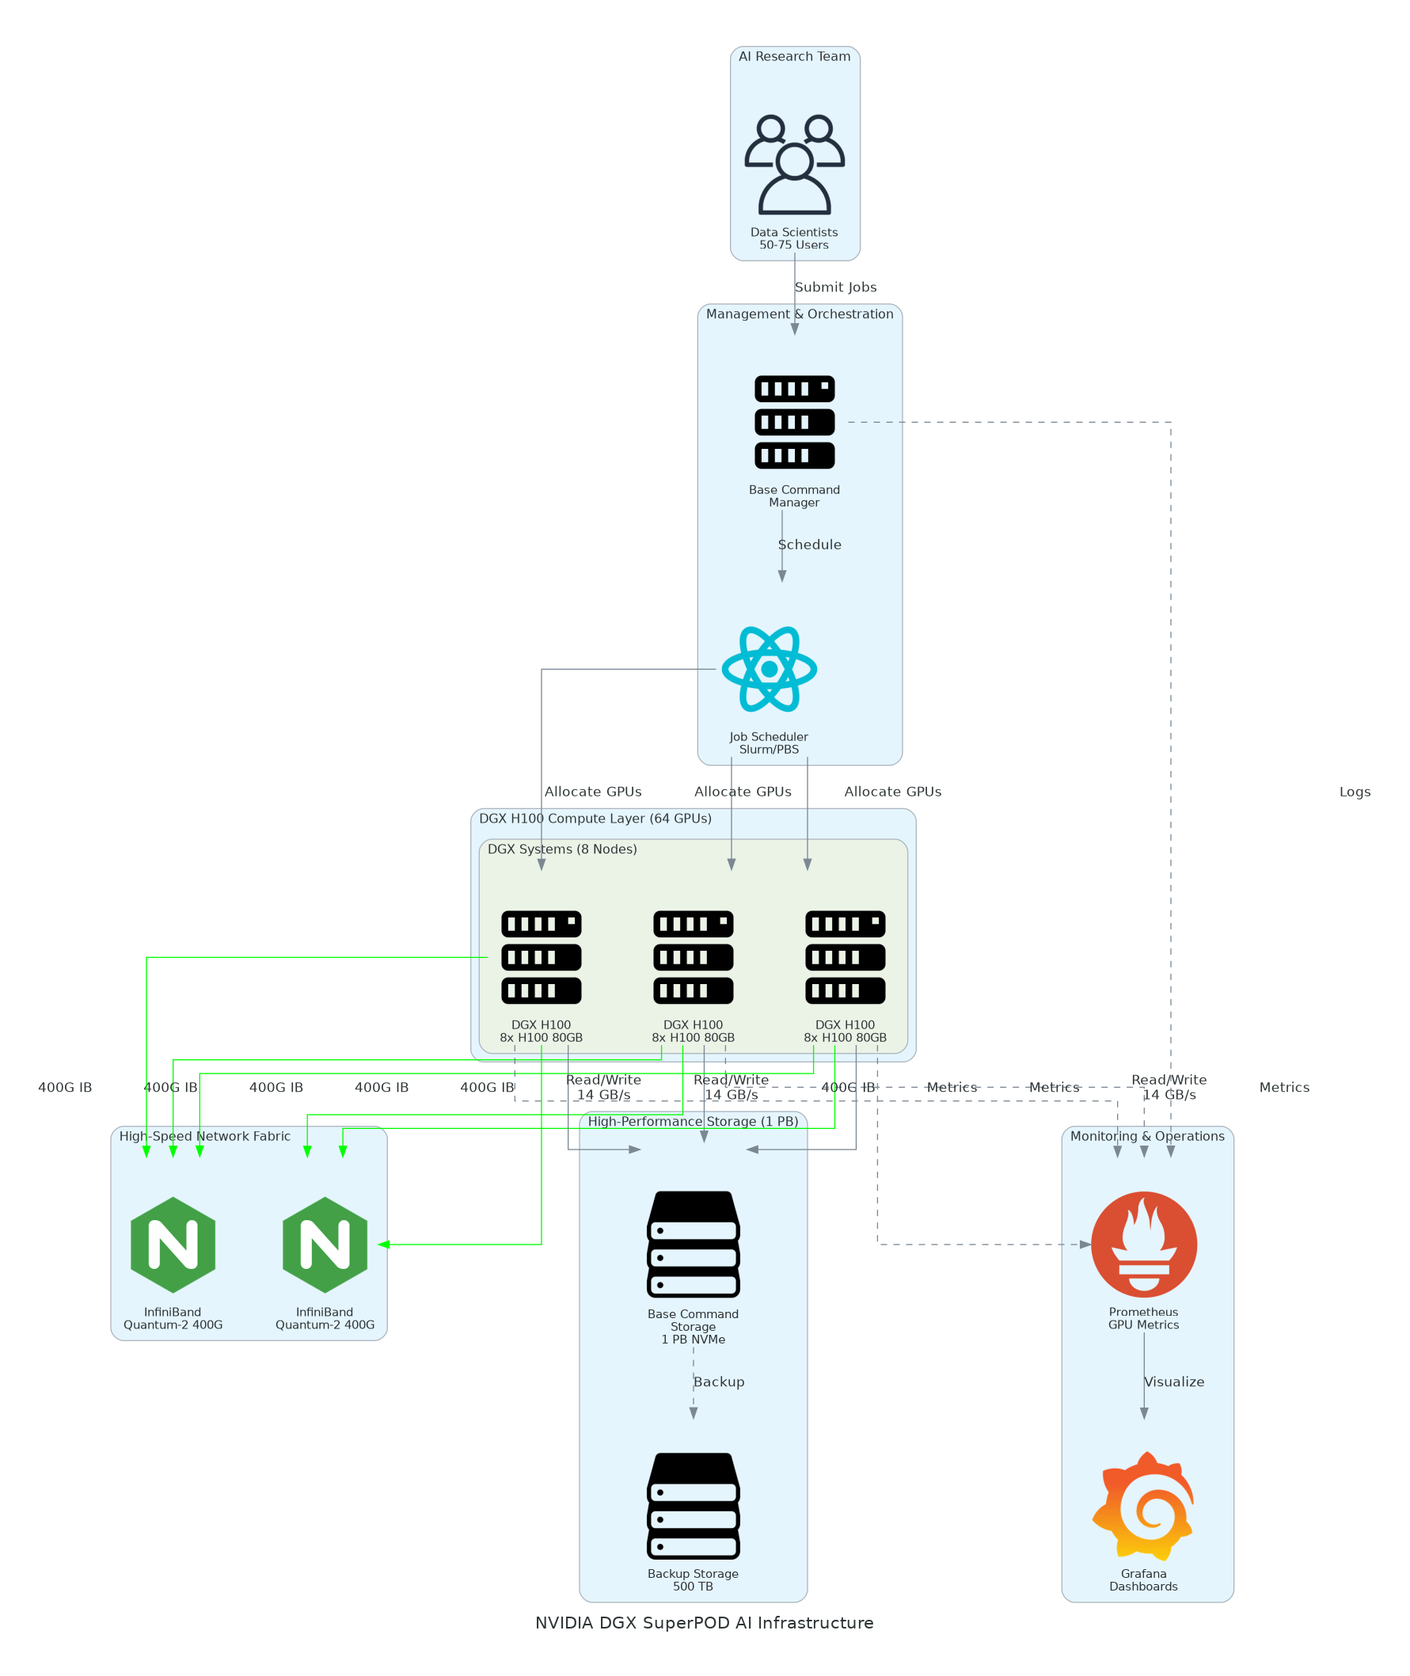
Solution Overview
Compute Infrastructure
  8x NVIDIA DGX H100 systems with 8x H100 80GB GPUs (64 total)
  32 petaFLOPS FP8 AI performance and 5.12 TB GPU memory
  DGX OS with optimized CUDA stack and NGC GPU-accelerated container catalog
High-Performance Architecture
  NVIDIA Quantum-2 400 Gbps InfiniBand fabric for multi-node distributed training
  1 PB NVMe storage with 14 GB/s throughput
  Base Command Manager with enterprise 24x7 support and 4-hour SLA
NVIDIA DGX SuperPOD AI Infrastructure

Slide 5
Implementation Approach
Phase 1: Facilities & Installation (Months 1-2)
  Datacenter assessment and power/cooling infrastructure upgrades (500 kW capacity)
  DGX system delivery installation and InfiniBand fabric configuration
  Storage cluster deployment and network integration with existing infrastructure
Phase 2: Software & Integration (Months 3-4)
  Base Command Manager setup for multi-user job scheduling and resource management
  NGC container deployment for PyTorch TensorFlow and AI framework stack
  LDAP/AD integration monitoring setup and storage mount point configuration
Phase 3: Optimization & Training (Months 5-6)
  Benchmark workloads and performance tuning for distributed training
  User onboarding training programs and best practices documentation
  Production workload migration and transition to research team operations
NVIDIA DGX SuperPOD AI Infrastructure

Slide 6
Timeline & Milestones
Phase No | Phase Description | Timeline | Key Deliverables
Phase 1 | Facilities & Installation | Months 1-2 | Power/cooling upgrades complete, DGX systems installed, InfiniBand fabric operational, Storage cluster deployed
Phase 2 | Software & Integration | Months 3-4 | Base Command configured, NGC containers deployed, User authentication integrated, Monitoring dashboards live
Phase 3 | Optimization & Training | Months 5-6 | Benchmarks validated, Research team trained, Production workloads migrated, Operations handoff complete
NVIDIA DGX SuperPOD AI Infrastructure

Slide 7
Success Stories
Client Success: Pharmaceutical Research Company
  Client: Global pharmaceutical company with 200+ researchers across drug discovery
  Challenge: Training molecular dynamics and protein folding models taking 8-12 weeks on cloud infrastructure costing $4M annually. Limited GPU availability creating research bottlenecks and delaying drug development programs.
  Solution: Deployed DGX SuperPOD with 128 GPUs, InfiniBand fabric, 2 PB storage, and Base Command orchestration.
  Results: 12x faster training times for AlphaFold2 models (1 week vs 12 weeks) and $3.2M annual cloud cost savings. Enabled 5 new drug discovery programs previously infeasible due to compute constraints. Full ROI achieved in 18 months.
  Testimonial: "DGX SuperPOD transformed our computational drug discovery capabilities. We can now run experiments that were previously impossible and our time-to-candidate has been cut in half. The investment paid for itself faster than we projected." — Dr. James Chen, VP of Computational Sciences
NVIDIA DGX SuperPOD AI Infrastructure

Slide 8
Our Partnership Advantage
What We Bring
  8+ years deploying NVIDIA GPU infrastructure with 25+ DGX implementations
  NVIDIA Partner Network Elite tier with DGX-Ready datacenter expertise
  Certified solutions architects with deep NVIDIA AI Enterprise and Base Command experience
  End-to-end capabilities: facilities assessment to AI workload optimization
Value to You
  Pre-deployment site assessments identify facilities gaps and prevent costly delays
  Proven deployment playbooks reduce implementation risk and timeline
  Direct NVIDIA technical support escalation through partner channels
  Post-deployment optimization services maximize GPU utilization and ROI
NVIDIA DGX SuperPOD AI Infrastructure

Slide 9
Investment Summary
Cost Category | Year 1 List | Year 1 Credits | Year 1 Net | Year 2 | Year 3 | 3-Year Total
Professional Services | $175,800 | $0 | $175,800 | $0 | $0 | $175,800
Facilities | $350,000 | $0 | $350,000 | $0 | $0 | $350,000
Hardware | $4,550,000 | ($180,000) | $4,370,000 | $0 | $0 | $4,370,000
Software Licenses | $211,200 | ($15,000) | $196,200 | $76,640 | $76,640 | $349,480
Support & Maintenance | $320,000 | $0 | $320,000 | $320,000 | $320,000 | $960,000
TOTAL | $5,607,000 | ($195,000) | $5,412,000 | $396,640 | $396,640 | $6,205,280
NVIDIA DGX SuperPOD AI Infrastructure

Slide 10
Next Steps
Decision: Executive approval and budget allocation by [specific date]
Site Assessment: Schedule facilities evaluation within 2 weeks of approval
Procurement: DGX order placement (12-16 week delivery lead time)
Facilities Prep: Parallel track power and cooling upgrades during DGX manufacturing
Delivery & Install: NVIDIA DGX delivery installation and initial configuration
NVIDIA DGX SuperPOD AI Infrastructure

Slide 11
Thank You

