Slide 1



Solution Briefing
NVIDIA GPU Compute Cluster
['Presenter Name'] | November 22, 2025

Slide 2
Business Opportunity
Opportunity
  Eliminate GPU access bottlenecks and enable 20-30 data scientists to train models in parallel
  Reduce training time by 10x vs CPU-only infrastructure (BERT training: 3 days to 7 hours)
  Replace cloud GPU spending and save $180K annually vs AWS p3.8xlarge baseline
Success Criteria
  Achieve 80%+ GPU utilization through intelligent Kubernetes scheduling vs 30% manual allocation
  Support both training and production inference workloads on unified platform
  ROI realization within 18-24 months through cloud cost avoidance and productivity gains
NVIDIA GPU Compute Cluster

Slide 3
Engagement Scope
Parameter | Scope |  | Parameter | Scope
GPU Servers | 8x Dell R750xa servers |  | Data Classification | Proprietary models
AI Workload Type | Distributed training |  | Compliance Requirements | Standard security
Data Science Team Size | 20 data scientists |  | GPU Utilization Target | 80% utilization
Storage Infrastructure | 200 TB NetApp storage |  | Training Time Requirements | Hours to days
Training Datasets | Multi-TB datasets |  | Software Stack | NVIDIA AI Enterprise
Model Checkpointing | Regular checkpointing |  | Management Platform | Kubernetes with GPU Operator
Network Fabric | 100 GbE Ethernet |  | Datacenter Readiness | Standard datacenter
Deployment Model | On-premises datacenter
NVIDIA GPU Compute Cluster

Slide 4
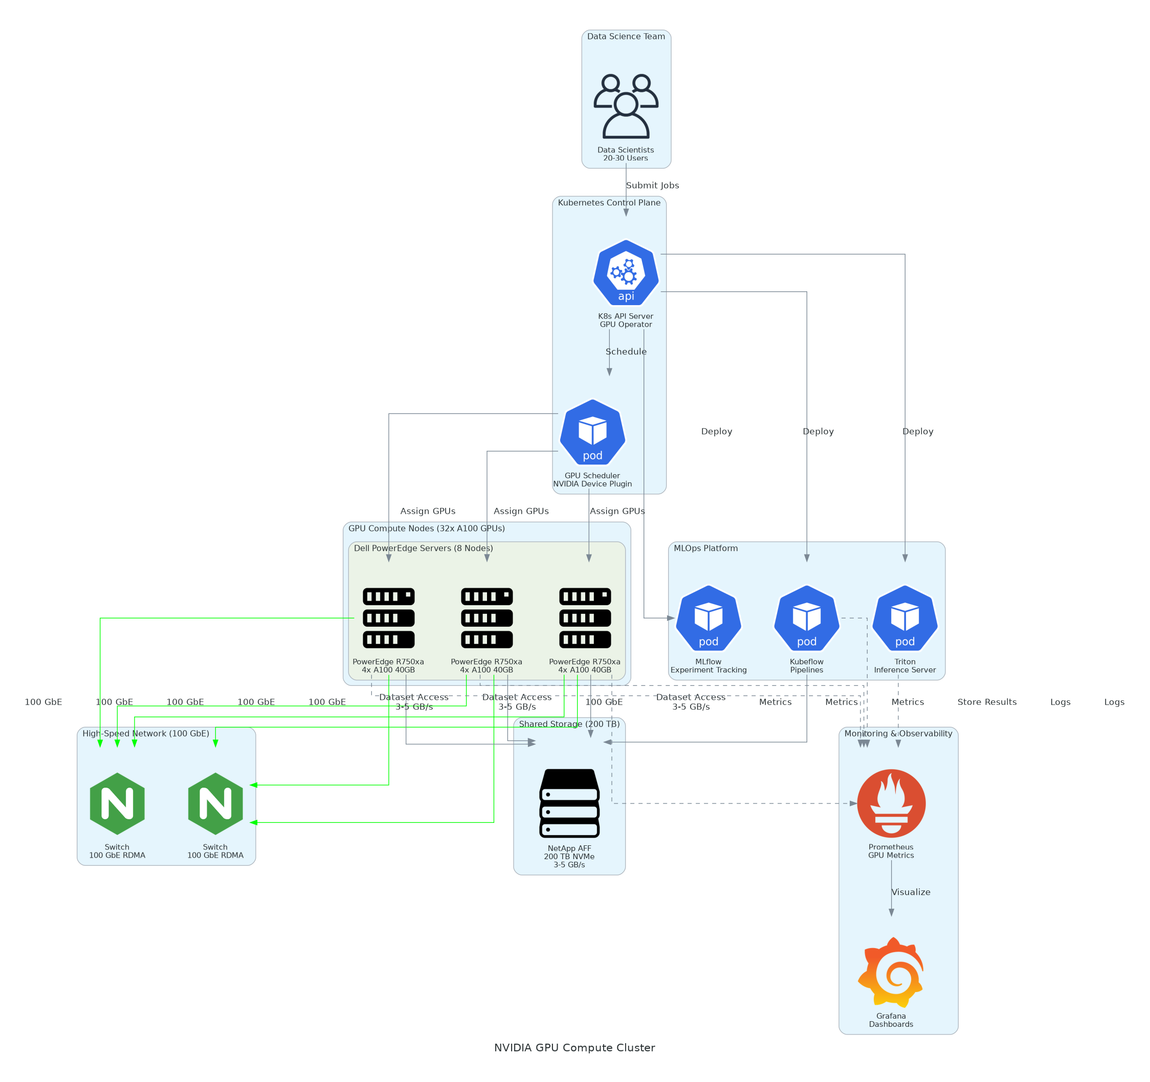
Solution Overview
Compute Infrastructure
  8x Dell PowerEdge R750xa servers with 4x NVIDIA A100 40GB (32 total)
  Dual AMD EPYC 7763 processors (128 cores) with 1 TB RAM
  NVIDIA AI Enterprise software suite with NGC container catalog access
Platform Architecture
  Kubernetes 1.28+ with NVIDIA GPU Operator for GPU scheduling and time-slicing
  100 GbE RDMA network with NCCL for distributed training communication
  NetApp AFF 200 TB storage (3-5 GB/s) with Kubeflow and Triton
NVIDIA GPU Compute Cluster

Slide 5
Implementation Approach
Phase 1: Infrastructure & Installation (Months 1-2)
  Hardware procurement and datacenter preparation (power cooling rack space)
  GPU server installation network fabric setup and storage system deployment
  Base OS installation GPU drivers and NVIDIA Container Toolkit configuration
Phase 2: Platform & Integration (Months 2-3)
  Kubernetes cluster deployment with NVIDIA GPU Operator and scheduling plugins
  Kubeflow platform setup for ML pipelines experiment tracking and model registry
  LDAP/AD integration shared storage mounts and monitoring dashboard configuration
Phase 3: Optimization & Training (Months 3-4)
  Benchmark testing with representative workloads and performance validation
  User training programs covering job submission GPU scheduling and best practices
  Production workload migration and transition to data science team operations
NVIDIA GPU Compute Cluster

Slide 6
Timeline & Milestones
Phase No | Phase Description | Timeline | Key Deliverables
Phase 1 | Infrastructure & Installation | Months 1-2 | Servers installed and configured, Network fabric operational, Storage system deployed, GPU drivers validated
Phase 2 | Platform & Integration | Months 2-3 | Kubernetes cluster live, Kubeflow platform configured, User authentication integrated, Monitoring dashboards active
Phase 3 | Optimization & Training | Months 3-4 | Benchmarks completed, Team trained on platform, Production workloads migrated, Operations handoff complete
NVIDIA GPU Compute Cluster

Slide 7
Success Stories
Client Success: Financial Services AI Team
  Client: Mid-size investment firm with 25-person data science team
  Challenge: Cloud GPU costs exceeding $350K annually with frequent quota limitations blocking research. Training times of 2-3 days per experiment limiting iteration speed and model quality. No infrastructure for production model deployment.
  Solution: Deployed 32x A100 GPU cluster with Kubernetes, Kubeflow, and Triton Inference Server integration.
  Results: 85% reduction in GPU costs ($350K to $50K annually cloud supplemental usage). 12x faster training for trading models (2 days to 4 hours). 40% increase in research throughput enabling 60% more model experiments. Full ROI achieved in 16 months.
  Testimonial: "The GPU cluster transformed our AI capabilities from constrained cloud bursting to a true research platform. Our team can now experiment freely and deploy models to production in hours instead of weeks. The ROI was immediate and substantial." — Michael Torres, Head of Quantitative Research
NVIDIA GPU Compute Cluster

Slide 8
Our Partnership Advantage
What We Bring
  10+ years deploying GPU clusters with 40+ successful implementations
  Deep expertise in Kubernetes NVIDIA GPU Operator and MLOps platforms
  NVIDIA Partner Network certification with AI Enterprise specialization
  End-to-end capabilities from infrastructure to ML workflow optimization
Value to You
  Pre-built Kubernetes configurations and GPU scheduling policies accelerate deployment
  Proven MLOps platform integration (Kubeflow MLflow Weights & Biases)
  Best practices for GPU utilization optimization based on 40+ deployments
  Post-deployment support and performance tuning services
NVIDIA GPU Compute Cluster

Slide 9
Investment Summary
Cost Category | Year 1 List | Year 1 Credits | Year 1 Net | Year 2 | Year 3 | 3-Year Total
Professional Services | $141,700 | $0 | $141,700 | $0 | $0 | $141,700
Hardware | $896,000 | ($32,000) | $864,000 | $0 | $0 | $864,000
Software Licenses | $160,520 | ($12,000) | $148,520 | $166,120 | $166,120 | $480,760
Support & Maintenance | $122,000 | $0 | $122,000 | $122,000 | $122,000 | $366,000
TOTAL | $1,320,220 | ($44,000) | $1,276,220 | $288,120 | $288,120 | $1,852,460
NVIDIA GPU Compute Cluster

Slide 10
Next Steps
Decision: Executive approval and budget allocation by [specific date]
Infrastructure Assessment: Validate datacenter readiness (power cooling network)
Procurement: GPU server order placement (4-8 week delivery lead time)
Preparation: Parallel track infrastructure prep during hardware manufacturing
Deployment: Server installation Kubernetes setup and user onboarding
NVIDIA GPU Compute Cluster

Slide 11
Thank You

