Slide 1



Solution Briefing
NVIDIA Omniverse Enterprise Collaboration Platform
['Presenter Name'] | November 22, 2025

Slide 2
Business Opportunity
Opportunity
  Enable 50 designers to collaborate in real-time on the same 3D scene simultaneously eliminating file conversion bottlenecks
  Reduce rendering time by 90% with RTX ray tracing vs CPU rendering (8 hours to 45 minutes)
  Connect native CAD tools directly to Omniverse via Universal Scene Description with zero file conversion
Success Criteria
  Achieve 10x faster design iteration with real-time collaboration and instant updates
  Create photorealistic product visualizations for marketing before manufacturing
  ROI realization within 24-36 months through productivity gains and rendering cost reduction
NVIDIA Omniverse Enterprise Collaboration Platform

Slide 3
Engagement Scope
Parameter | Scope |  | Parameter | Scope
GPU Workstations | 50x RTX A6000 workstations |  | Data Classification | Proprietary 3D designs
Nucleus Servers | 2x Nucleus servers (HA) |  | Compliance Requirements | Standard security
Design Team Size | 50 designers and engineers |  | Real-Time Collaboration | 50 concurrent users
Storage Infrastructure | 100 TB USD scene storage |  | Rendering Performance | RTX ray tracing
3D Scene Data | Multi-TB project files |  | CAD Tool Connectors | 5 primary connectors
Rendering Workloads | Interactive + batch rendering |  | Rendering Farm | 10 GPU render nodes
Network Infrastructure | 100 GbE network |  | Datacenter Readiness | Standard IT infrastructure
Deployment Model | On-premises deployment
NVIDIA Omniverse Enterprise Collaboration Platform

Slide 4
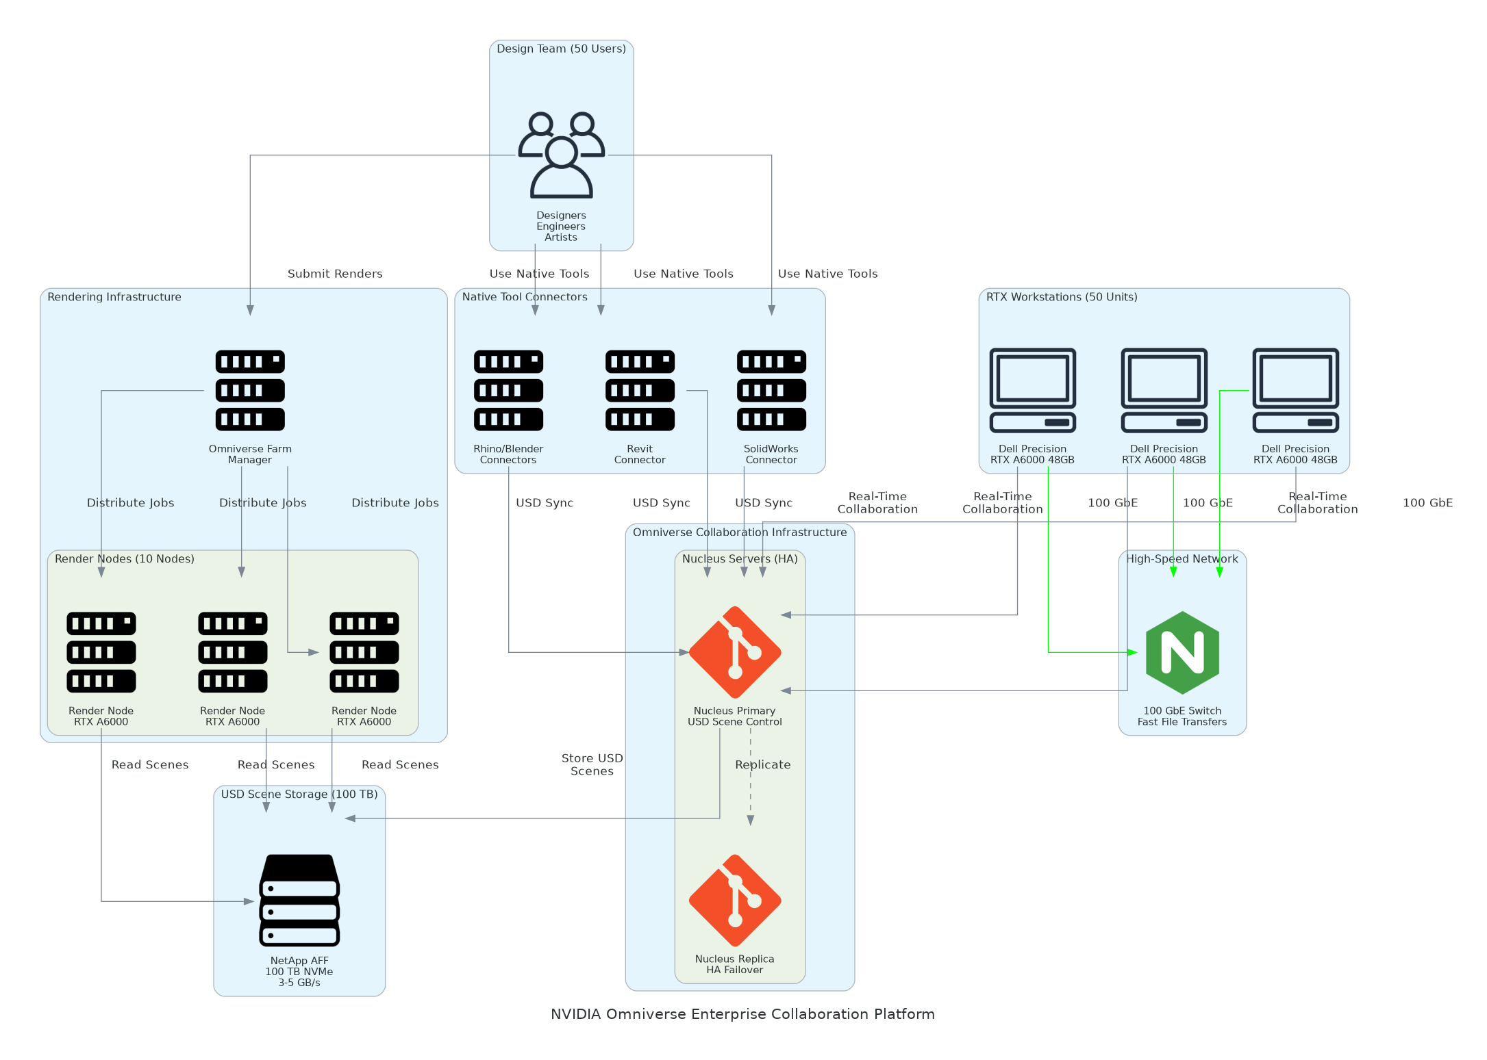
Solution Overview
Collaboration Infrastructure
  Omniverse Nucleus server cluster (2 servers HA) for USD scene storage
  50x Dell Precision 7960 workstations with NVIDIA RTX A6000 48GB GPUs
  Native connectors for Revit SolidWorks Rhino Blender Maya and Unreal Engine
Platform Capabilities
  Real-time collaboration with Git-like branching merging and live sync across tools
  RTX-accelerated ray tracing for photorealistic rendering and interactive performance
  Omniverse Farm (10 nodes) with 100 TB storage (3-5 GB/s)
NVIDIA Omniverse Enterprise Collaboration Platform

Slide 5
Implementation Approach
Phase 1: Infrastructure & Installation (Months 1-2)
  Nucleus server deployment storage setup and network infrastructure configuration
  RTX workstation deployment imaging GPU driver installation and performance validation
  Omniverse connector installation for all CAD/DCC tools and USD pipeline testing
Phase 2: Integration & Pilot (Months 2-3)
  Pilot project selection with 10-15 users from single department or project team
  Workflow customization USD pipeline development and rendering farm configuration
  Real-time collaboration testing with multi-tool workflows and scene sync validation
Phase 3: Rollout & Training (Months 3-4)
  Full team rollout with department-by-department onboarding and support
  Comprehensive training covering connector workflows rendering and collaboration best practices
  Production workload migration and transition to design team operations
NVIDIA Omniverse Enterprise Collaboration Platform

Slide 6
Timeline & Milestones
Phase No | Phase Description | Timeline | Key Deliverables
Phase 1 | Infrastructure & Installation | Months 1-2 | Nucleus servers deployed, Workstations configured, Connectors installed, Storage integrated
Phase 2 | Integration & Pilot | Months 2-3 | Pilot project launched, Custom workflows developed, Multi-tool collaboration validated, Rendering farm operational
Phase 3 | Rollout & Training | Months 3-4 | Full team onboarded, Training completed, Production projects migrated, Operations handoff complete
NVIDIA Omniverse Enterprise Collaboration Platform

Slide 7
Success Stories
Client Success: Automotive Design Studio
  Client: European automotive manufacturer with 75-person design studio
  Challenge: Design tools operated in silos requiring manual file exports and conversions causing 2-3 day delays between departments. CPU-based rendering taking 12-16 hours per frame limiting design iteration. Remote collaboration impossible during pandemic forcing expensive travel.
  Solution: Deployed Omniverse Enterprise with 75 RTX workstations, Nucleus cluster, and native CAD tool integrations.
  Results: 95% reduction in rendering time (12 hours to 35 minutes with RTX) and eliminated 2-3 day file conversion delays. Enabled real-time collaboration across 3 continents saving $240K in annual travel costs. Increased design iterations by 400% accelerating time-to-market by 6 months. Full ROI achieved in 22 months.
  Testimonial: "Omniverse transformed how our global design teams collaborate. Engineers in Germany see surface changes from designers in California instantly in their native tools. The rendering performance is jaw-dropping - what took overnight now happens in minutes." — Klaus Bergmann, Design Director
NVIDIA Omniverse Enterprise Collaboration Platform

Slide 8
Our Partnership Advantage
What We Bring
  5+ years NVIDIA Omniverse experience with 15+ enterprise deployments
  Deep USD expertise including Pixar-trained pipeline developers and technical artists
  Certified on Omniverse Enterprise platform with NVIDIA partner specialization
  End-to-end capabilities from infrastructure to custom workflow development
Value to You
  Pre-built USD pipelines for common CAD workflows accelerate deployment
  Proven connector integration experience across 20+ design tool combinations
  Custom workflow automation and PhysX simulation development capabilities
  Post-deployment optimization services and ongoing user enablement programs
NVIDIA Omniverse Enterprise Collaboration Platform

Slide 9
Investment Summary
Cost Category | Year 1 List | Year 1 Credits | Year 1 Net | Year 2 | Year 3 | 3-Year Total
Professional Services | $113,200 | $0 | $113,200 | $0 | $0 | $113,200
Hardware | $1,172,000 | ($37,500) | $1,134,500 | $0 | $0 | $1,134,500
Software Licenses | $99,000 | ($9,000) | $90,000 | $104,000 | $104,000 | $298,000
Support & Maintenance | $109,000 | $0 | $109,000 | $109,000 | $109,000 | $327,000
TOTAL | $1,493,200 | ($46,500) | $1,446,700 | $213,000 | $213,000 | $1,872,700
NVIDIA Omniverse Enterprise Collaboration Platform

Slide 10
Next Steps
Decision: Executive approval and budget allocation by [specific date]
Pilot Selection: Identify pilot project and 10-15 user team for Phase 1
Procurement: Workstation and server order placement (4-6 week lead time)
Infrastructure Prep: Network and storage preparation during hardware delivery
Deployment: Nucleus setup workstation deployment and connector integration
NVIDIA Omniverse Enterprise Collaboration Platform

Slide 11
Thank You

