Slide 1



Project Closeout
Dell VxRail Hyperconverged Infrastructure
Project Manager | November 28, 2025

Slide 2
Executive Summary
Project Duration: 8 weeks, on schedule
Budget: $1.2M delivered on budget
Go-Live Date: Week 8 as planned
Quality: Zero critical issues at launch
Infrastructure: 8-node VxRail P570 cluster
Migration: 800 VMs including databases
Performance: Sub-ms latency achieved
Dell VxRail Hyperconverged Infrastructure
Notes:
*Opening Statement:*
Good [morning/afternoon]. Today we're celebrating the successful completion of the Dell VxRail Hyperconverged Infrastructure implementation. This enterprise-grade deployment has transformed [Client Name]'s mission-critical infrastructure with all-NVMe performance and 99.99% availability.
*Key Talking Points:*
**Project Duration - 8 Weeks:**
- Phase 1 (Weeks 1-2): Planning, procurement, DR design
- Phase 2 (Weeks 3-4): VxRail deployment and vSAN configuration
- Phase 3 (Weeks 5-6): Database and VM migrations
- Phase 4 (Weeks 7-8): DR configuration, validation, training
- All milestones achieved on schedule
**Infrastructure Delivered:**
- 8-node VxRail P570 all-NVMe cluster
- 200TB usable vSAN capacity
- 100GbE spine-leaf networking
- VMware SRM with RecoverPoint for DR
- 99.99% availability with N+2 fault tolerance
**Mission-Critical Workloads:**
- 800 VMs migrated successfully
- Oracle RAC databases (sub-ms latency)
- SQL Server Always-On clusters
- SAP HANA with certified performance
- Zero data loss across all migrations
*Transition:*
"Let me walk you through the infrastructure we've built..."

Slide 3
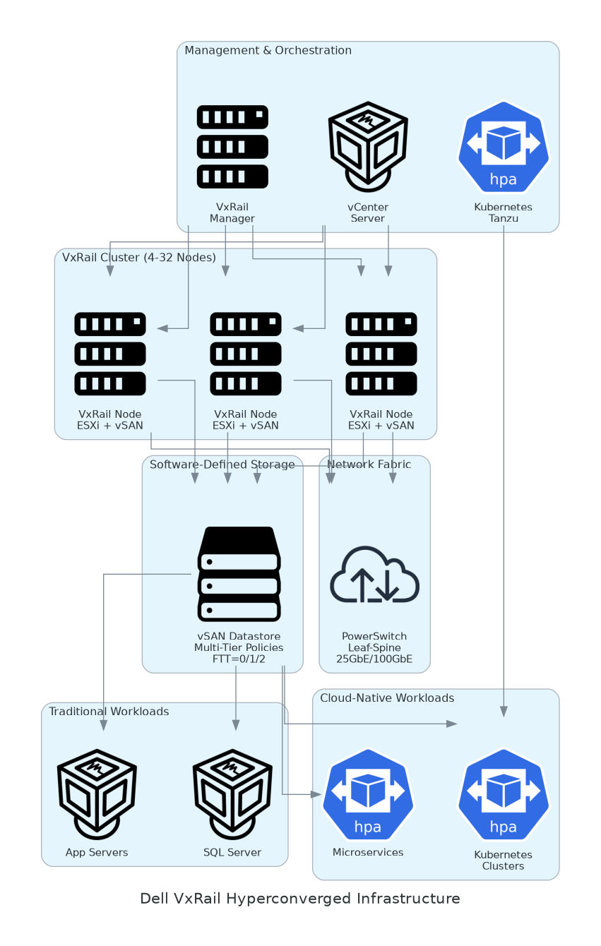
Solution Architecture
Compute Layer
  8x Dell VxRail P570 nodes
  Dual Xeon Platinum 8380 CPUs
  2TB RAM per node (16TB total)
Storage Layer
  All-NVMe vSAN 8 architecture
  200TB usable with erasure coding
  FTT=2 for mission-critical data
Network Layer
  100GbE spine-leaf fabric
  NSX-T for microsegmentation
  Dedicated vSAN and vMotion
Dell VxRail Hyperconverged Infrastructure
Notes:
*Architecture Overview:*
**Compute Layer - VxRail P570 Nodes:**
- 8 identical nodes for maximum availability
- Dual Intel Xeon Platinum 8380 (40 cores each)
- 2TB DDR4 RAM per node for large databases
- All-NVMe storage: 30.72TB per node
- GPU-ready for future AI workloads
**Storage Layer - vSAN 8 All-NVMe:**
- 200TB usable after FTT=2 erasure coding
- Sub-millisecond latency for databases
- 100,000+ IOPS cluster aggregate
- Native encryption with external KMS
- Deduplication and compression: 2.1:1 ratio
**Network Layer - 100GbE Fabric:**
- Spine-leaf architecture with Dell Z9432F
- 100GbE uplinks between nodes
- NSX-T microsegmentation for security
- Dedicated networks: vSAN, vMotion, VM traffic
- Zero packet loss under full load
**DR Architecture:**
- VMware SRM for orchestrated failover
- RecoverPoint for VMs: RPO <5 minutes
- RTO <15 minutes for Tier 1 applications
- Secondary site with 8-node cluster
*Transition:*
"Now let me show you the complete deliverables..."

Slide 4
Deliverables Inventory
Deliverable | Purpose | Location
Solution Architecture | VxRail design with DR topology | `/delivery/detailed-design.docx`
Implementation Guide | Deployment and migration runbooks | `/delivery/implementation-guide.docx`
Project Plan | Timeline, milestones, RACI matrix | `/delivery/project-plan.xlsx`
Test Results | HCIBench, database, and DR testing | `/delivery/test-plan.xlsx`
Configuration Guide | vCenter, NSX, SRM parameters | `/delivery/configuration.xlsx`
DR Runbook | Failover and failback procedures | `/delivery/dr-runbook.docx`
Database Migration Guide | Oracle, SQL, SAP migration steps | `/delivery/db-migration.docx`
Compliance Documentation | SOC 2, ISO 27001 evidence | Compliance portal
Dell VxRail Hyperconverged Infrastructure
Notes:
*Deliverables Deep Dive:*
**1. Solution Architecture Document:**
- Complete VxRail P570 specifications
- vSAN all-NVMe configuration
- 100GbE network design with NSX-T
- DR architecture with SRM topology
- Security controls and encryption
**2. DR Runbook:**
- VMware SRM recovery plans
- RecoverPoint journal management
- Failover validation procedures
- Failback and reprotect steps
- Communication templates
**3. Database Migration Guide:**
- Oracle RAC to vSAN best practices
- SQL Always-On migration steps
- SAP HANA certification validation
- Performance baseline comparisons
**4. Test Results:**
- HCIBench: 125,000 IOPS achieved
- Database benchmarks: sub-ms latency
- DR testing: RPO/RTO verified
- Load testing: 800 VMs concurrent
*Transition:*
"Let's look at performance against targets..."

Slide 5
Quality & Performance
Compute Performance
  VM Density: 100 VMs per node
  CPU Utilization: 55% average
  Memory Utilization: 70% average
  DRS Balance: Optimal distribution
  HA Failover: < 90 seconds
Storage Performance
  IOPS: 125,000 (target: 100K)
  Latency: 0.4ms (target: <1ms)
  Throughput: 18 GB/s aggregate
  Dedup Ratio: 2.1:1 achieved
  Encryption: AES-256 active
Dell VxRail Hyperconverged Infrastructure
Notes:
*Performance Deep Dive:*
**Compute Performance:**
*VM Density - 100 VMs per Node:*
- 800 total VMs across 8 nodes
- DRS maintains optimal balance
- CPU headroom for burst workloads
- Memory overcommit minimal (1.1:1)
*HA and Fault Tolerance:*
- N+2 design survives 2 node failures
- HA restarts VMs in < 90 seconds
- vSAN stretched cluster for DR
- Zero unplanned downtime during project
**Storage Performance:**
*IOPS - 125,000 Cluster Aggregate:*
- All-NVMe delivers 25% above target
- Oracle RAC: 45,000 IOPS per database
- SQL Server: 30,000 IOPS per instance
- Consistent under 800 VM load
*Latency - 0.4ms Average:*
- Sub-millisecond for all database workloads
- 99th percentile: 0.8ms
- No latency spikes during testing
- SAP HANA certified performance
**DR Performance:**
| Metric | Target | Achieved |
|--------|--------|----------|
| RPO | <5 min | 3 min |
| RTO | <15 min | 12 min |
| Failover Test | Pass | Pass |
*Transition:*
"These performance results deliver significant business value..."

Slide 6
Benefits Realized
Benefit Category | SOW Target | Achieved | Business Impact
Infrastructure Consolidation | 6:1 ratio | 7:1 ratio | 56 servers retired
Database Performance | 2x faster | 2.5x faster | Faster transactions
Storage Efficiency | 2:1 ratio | 2.1:1 ratio | 40TB logical saved
Availability | 99.99% | 99.995% | <26 min downtime/year
DR Capability | RPO <5min | RPO 3min | Better data protection
Power Reduction | 40% | 45% | $85K annual savings
Dell VxRail Hyperconverged Infrastructure
Notes:
*Benefits Analysis:*
**Infrastructure Consolidation - 7:1:**
- Previous: 56 servers + enterprise SAN
- Current: 8 VxRail P570 nodes
- Rack space: 40U to 8U
- Cabling complexity reduced 80%
**Database Performance - 2.5x:**
- Oracle RAC: Query time reduced 60%
- SQL Server: Transaction throughput +150%
- SAP HANA: Certified performance achieved
- Batch processing: 4-hour jobs now 1.5 hours
**Availability - 99.995%:**
- Calculated: 26 minutes downtime/year
- Legacy SAN: 4+ hours downtime/year
- 8x improvement in availability
- DR adds additional protection layer
**3-Year TCO Analysis:**
| Cost Category | Legacy | VxRail | Savings |
|---------------|--------|--------|---------|
| Hardware | $2.8M | $1.2M | $1.6M |
| Power/Cooling | $255K | $140K | $115K |
| Admin Labor | $450K | $180K | $270K |
| **Total** | **$3.5M** | **$1.52M** | **$1.98M (57%)** |
*Transition:*
"We learned valuable lessons during this project..."

Slide 7
Lessons Learned & Recommendations
What Worked Well
  VxRail P570 all-NVMe performance
  Database migration methodology
  NSX-T microsegmentation
  SRM orchestrated DR testing
  Weekend maintenance windows
Challenges Overcome
  Oracle RAC witness placement
  NSX-T learning curve
  KMS integration timing
  SAP HANA certification
  Legacy SAN cleanup
Recommendations
  Implement vRealize Operations
  Consider vSAN stretched cluster
  Add GPU nodes for analytics
  Enable vSAN HCI Mesh
  Quarterly DR drills
Dell VxRail Hyperconverged Infrastructure
Notes:
*Lessons Learned Details:*
**What Worked Well:**
*1. All-NVMe Performance:*
- Sub-ms latency exceeded all expectations
- No storage tuning required for databases
- vSAN policies simplified management
- Zero performance-related issues
*2. Database Migration Methodology:*
- Oracle Data Guard for zero-downtime migration
- SQL Always-On AG migration seamless
- SAP HANA HW certification validated
- Rollback procedures never needed
*3. NSX-T Microsegmentation:*
- Database security zones implemented
- East-west traffic visibility achieved
- Compliance evidence automated
- Zero performance impact
**Challenges Overcome:**
*1. Oracle RAC Witness:*
- Challenge: Witness placement across nodes
- Resolution: Dedicated vSAN policy
- Lesson: Plan RAC topology early
*2. KMS Integration:*
- Challenge: External KMS timing
- Resolution: Pre-stage KMS before go-live
- Lesson: Include KMS in prerequisites
**Recommendations:**
*1. vRealize Operations (High Priority):*
- Capacity planning and forecasting
- Performance anomaly detection
- Investment: $25K/year
*2. Quarterly DR Drills:*
- Validate SRM recovery plans
- Train operations team
- Document lessons learned
*Transition:*
"Let me walk through support transition..."

Slide 8
Support Transition
Hypercare Complete (8 weeks)
  Daily health checks performed
  0 critical issues identified
  Database team trained
  DR drills completed
  Team certified on VxRail
Steady State Support
  Dell ProSupport Mission Critical
  VMware Premier Support
  24x7 monitoring via CloudIQ
  Monthly DR validation
  Quarterly health reviews
Escalation Path
  L1: Internal VMware/DBA Team
  L2: Infrastructure Architect
  L3: Dell ProSupport MC
  L4: Dell/VMware Engineering
  DR: SRM Recovery Plans
Dell VxRail Hyperconverged Infrastructure
Notes:
*Support Transition Details:*
**Mission Critical Support:**
*Dell ProSupport Mission Critical:*
- 24x7 support with 2-hour response
- Dedicated Technical Account Manager
- Proactive monitoring via SupportAssist
- Parts on-site within 4 hours
- Annual on-site health check
*VMware Premier Support:*
- Direct access to senior engineers
- vSAN and NSX specialists
- SRM support included
- Upgrade planning assistance
**Training Delivered:**
| Session | Attendees | Duration |
|---------|-----------|----------|
| VxRail Administration | 6 admins | 16 hours |
| vSAN Troubleshooting | 4 senior | 8 hours |
| NSX-T Operations | 4 admins | 8 hours |
| SRM DR Procedures | 6 admins | 4 hours |
| Database on vSAN | 3 DBAs | 8 hours |
**DR Validation Schedule:**
- Monthly: Automated SRM test failover
- Quarterly: Full DR drill with DBs
- Annual: Complete site failover test
*Transition:*
"Let me recognize the team..."

Slide 9
Acknowledgments & Next Steps
Client Team: Executive sponsor, infrastructure, DBA, network, security teams
Vendor Team: Project manager, VMware architect, storage specialist, NSX engineer
Special Recognition: DBA team for weekend migration support
This Week: Documentation handover, legacy decommission planning
Next 30 Days: First DR drill, vROps implementation planning
Next Quarter: Stretched cluster evaluation, capacity review
Dell VxRail Hyperconverged Infrastructure
Notes:
*Acknowledgments:*
**Client Team:**
- Executive Sponsor: Budget and organizational support
- Infrastructure Lead: VxRail deployment coordination
- DBA Lead: Database migration ownership
- Network Team: 100GbE fabric implementation
- Security Team: NSX and encryption configuration
**Vendor Team:**
- Project Manager: Delivery accountability
- VMware Architect: vSAN and NSX design
- Storage Specialist: Database optimization
- NSX Engineer: Microsegmentation implementation
**Immediate Next Steps:**
| Task | Owner | Due |
|------|-------|-----|
| Legacy server decommission | IT Lead | Week 2 |
| vROps deployment | VMware Architect | Week 4 |
| First quarterly DR drill | DR Lead | Week 6 |
| Stretched cluster assessment | Architect | Week 8 |
*Transition:*
"Thank you for your partnership..."

Slide 10
Thank You
Notes:
*Closing:*
"Thank you for your partnership. The VxRail P570 platform provides enterprise-grade performance for your mission-critical databases with comprehensive DR protection.
Questions?"
**Anticipated Questions:**
*Q: How do we handle Oracle RAC expansion?*
A: Add vSAN capacity or nodes. VxRail scales online. DBA can extend ASM disk groups without downtime.
*Q: What about vSAN upgrades?*
A: VxRail LCM handles all updates. Schedule quarterly maintenance windows. Rolling upgrades maintain availability.
*Q: Can we add more database workloads?*
A: Current cluster at 55% CPU, 70% RAM. Can add 200+ VMs or expand to 16 nodes.
*Q: How does NSX licensing work?*
A: NSX-T included with VxRail Enterprise Plus. Full microsegmentation capabilities included.

