Slide 1



Solution Briefing
AWS Disaster Recovery for Web Applications
[Presenter Name] | November 15, 2025

Slide 2
Business Opportunity
Opportunity
  Eliminate business risk from single-region failures and achieve enterprise-grade resilience
  Meet compliance requirements for RTO (15 min) and RPO (5 min) with proven architecture
  Transform DR from costly insurance to strategic competitive advantage
Success Criteria
  Achieve 99.99% application uptime with automated failover capabilities
  Validate RTO/RPO targets through quarterly DR testing and documentation
  Demonstrate measurable ROI through risk reduction and business continuity assurance

Slide 3
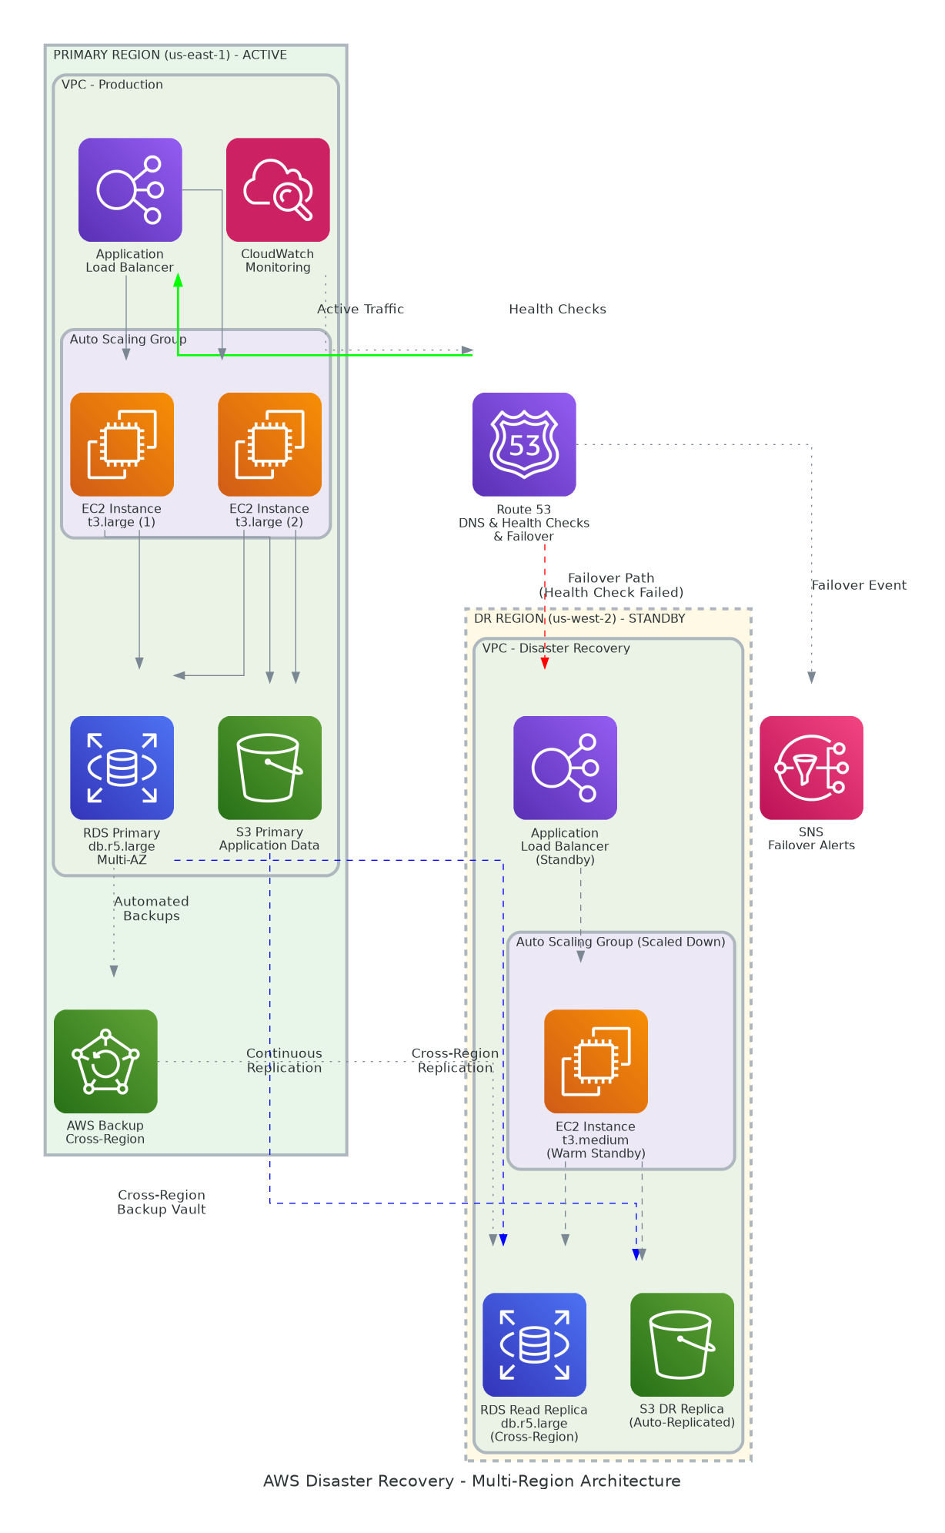
Solution Overview
Multi-Region Infrastructure
  Primary Region: ALB, Auto Scaling EC2, Multi-AZ RDS, S3 with versioning
  DR Region: Warm standby EC2, cross-region RDS replica, S3 replication
  Route 53 health-based failover with automated DNS switching
Disaster Recovery Capabilities
  Continuous data replication ensures 5-minute RPO target
  Warm standby enables 15-minute RTO for rapid failover
  Automated runbooks and AWS Backup for cross-region vault redundancy

Slide 4
Implementation Approach
Phase 1: Assessment & Design *(Months 1-2)*
  Business Impact Analysis (BIA) to determine RTO/RPO requirements
  Current-state architecture assessment and dependency mapping
  DR architecture design and AWS landing zone setup
Phase 2: Implementation *(Months 3-4)*
  Primary and DR region infrastructure deployment
  RDS replication, S3 sync, and backup configuration
  Route 53 failover policies and health check setup
Phase 3: Testing & Validation *(Month 5-6)*
  DR failover testing and RTO/RPO validation
  Runbook development and team training
  Production cutover and ongoing monitoring

Slide 5
Timeline & Milestones
Phase No | Phase Description | Timeline | Key Deliverables
Phase 1 | Assessment & Design | Months 1-2 | BIA completed, DR architecture approved, AWS environments provisioned
Phase 2 | DR Implementation | Months 3-4 | Multi-region infrastructure deployed, Replication configured, Monitoring operational
Phase 3 | Testing & Validation | Months 5-6 | DR testing passed, RTO/RPO validated, Runbooks completed, Team trained

Slide 6
Success Stories
Client Success: Financial Services SaaS Provider
  Client: FinTech company serving 200,000+ users with strict uptime SLA requirements
  Challenge: Single-region architecture posed business risk, 99.99% SLA required, compliance mandated DR
  Solution: AWS multi-region DR with Route 53 failover, RDS replication, automated backup
  Results: 99.995% uptime achieved (exceeded SLA), 12-min RTO, zero data loss, passed compliance audit
  Testimonial: "Our DR solution has become a competitive differentiator. We've won deals specifically because we can demonstrate business continuity capabilities our competitors can't match." — David Thompson, CTO, SecureFinance Platform

Slide 7
Our Partnership Advantage
What We Bring
  15+ years designing and implementing AWS DR solutions
  75+ successful DR implementations across industries
  AWS Advanced Consulting Partner with Migration Competency
  Certified solutions architects with DR expertise and AWS Well-Architected reviews
  24/7 support with documented escalation procedures
Value to You
  Proven DR design patterns reduce implementation risk
  Pre-built runbooks and automation accelerate deployment
  Quarterly DR testing included to maintain readiness
  Direct AWS TAM engagement for critical DR scenarios
  Best practices from 75+ implementations

Slide 8
Investment Summary
Cost Category | Year 1 | Year 2 | Year 3 | 3-Year Total
Professional Services | $364,000 | $0 | $0 | $364,000
Infrastructure & Materials | $228,277 | $23,777 | $23,777 | $275,832
TOTAL SOLUTION INVESTMENT | $592,277 | $23,777 | $23,777 | $639,832

Slide 9
Next Steps
Decision: Executive approval and budget allocation by [specific date]
Kickoff: BIA and DR assessment start date [30 days from approval]
Team Formation: Identify application owners, infrastructure team, business stakeholders
Week 1: Contract finalization and project kickoff
Week 2: Business Impact Analysis (BIA) workshops with stakeholders
Week 3: Current-state architecture assessment and dependency mapping
Week 4: DR architecture design review and AWS environment setup

Slide 10
Thank You
Your Account Manager: [Name, Title] | [Email] | [Phone]

