Slide 1



Solution Briefing
Dell VxRail Hyperconverged Infrastructure
['Presenter Name'] | November 22, 2025

Slide 2
Business Opportunity
Opportunity
  Eliminate infrastructure complexity by consolidating servers and storage into single VMware-powered platform
  Reduce data center footprint by 70% and lower power consumption through hyperconverged architecture
  Accelerate VM provisioning from days to minutes with software-defined storage and automated lifecycle management
Success Criteria
  Reduce infrastructure TCO by 40-50% over 3 years through operational simplification and cost avoidance
  Achieve 99.9%+ uptime with automated failover and integrated Dell/VMware support eliminating vendor finger-pointing
  Deploy new applications 10x faster with self-service VM provisioning and simplified management
Dell VxRail Hyperconverged Infrastructure

Slide 3
Engagement Scope
Parameter | Scope |  | Parameter | Scope
Cluster Size | 4-node VxRail E560 cluster |  | Legacy Infrastructure | EMC Unity or NetApp SAN
Storage Capacity | 40TB usable all-flash SSD |  | Network Fabric | 25GbE ToR switches for vSAN
vSphere Version | vSphere 8 Enterprise Plus |  | Data Sensitivity | Internal business data
Backup Integration | Veeam Backup & Replication |  | Encryption | vSAN encryption at rest
VM Count | 250 virtual machines |  | VM Density | 60 VMs per node average
Admin Team | 3-5 virtualization administrators |  | vSAN Performance | Mixed workload 10K IOPS per VM
Storage Type | All-flash SSD vSAN |  | Migration Approach | Phased vMotion migration
VM Size | Average 500GB per VM |  | Current Virtualization | VMware vSphere 7.0 on traditional SAN
Dell VxRail Hyperconverged Infrastructure

Slide 4
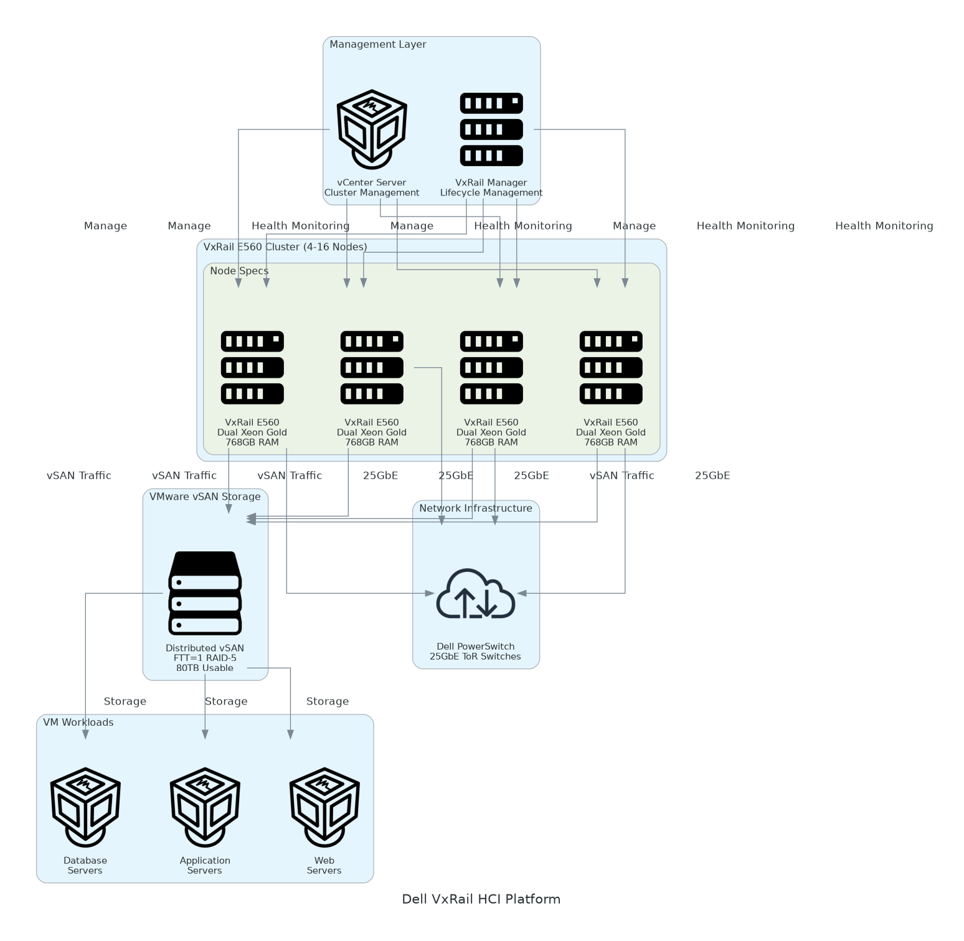
Solution Overview
VxRail Platform & Software Stack
  4-node VxRail E560 cluster with dual Xeon processors (256 vCPUs)
  VMware vSphere 8 with vSAN 8 for deduplication and encryption
  768GB RAM per node and vCenter with vRealize Operations monitoring
Integrated Architecture
  All-flash vSAN with 15.36TB NVMe per node (40TB usable)
  25GbE network fabric with redundant ToR switches for vSAN
  VxRail Manager for automated lifecycle management and firmware updates
Dell VxRail Hyperconverged Infrastructure

Slide 5
Implementation Approach
Phase 1: Planning & Preparation (Weeks 1-2)
  Conduct infrastructure assessment and VM inventory analysis
  Design VxRail cluster configuration and validate network requirements
  Order hardware and coordinate data center rack space and power provisioning
Phase 2: Deployment & Configuration (Weeks 3-4)
  Dell ProDeploy on-site installation of VxRail nodes and network switches
  Configure vSphere cluster, vSAN storage policies, and distributed switching
  Deploy vCenter Server, vRealize Operations, and backup infrastructure integration
Phase 3: Migration & Validation (Weeks 5-6)
  Migrate pilot workloads and execute phased migration of production VMs by application tier
  Validate backup/restore procedures and conduct failover testing
  Complete IT team training on vSphere/vSAN and production go-live with legacy infrastructure decommissioned
Dell VxRail Hyperconverged Infrastructure

Slide 6
Timeline & Milestones
Phase No | Phase Description | Timeline | Key Deliverables
Phase 1 | Planning & Preparation | Weeks 1-2 | Infrastructure assessment completed, VxRail ordered, Network design validated
Phase 2 | Deployment & Configuration | Weeks 3-4 | VxRail cluster installed, vSphere configured, Monitoring and backup operational
Phase 3 | Migration & Validation | Weeks 5-6 | VMs migrated via vMotion, IT team trained, Legacy infrastructure decommissioned
Dell VxRail Hyperconverged Infrastructure

Slide 7
Success Stories
Client Success: Regional Healthcare Provider
  Client: 500-bed hospital system running 450 VMs across 3 data centers
  Challenge: Aging SAN with $180K annual support costs. Complex management across compute/storage silos. Slow VM provisioning (5-7 days) blocking deployments. 8-rack footprint.
  Solution: Deployed 3 VxRail clusters with 6 nodes each. Migrated 450 VMs via vMotion with zero downtime.
  Results: 65% cost reduction ($720K vs $2.1M). Footprint reduced to 3 racks. VM provisioning from 7 days to 15 minutes. 99.98% uptime.
  Testimonial: "VxRail transformed our infrastructure from constant firefighting to strategic enabler. We decommissioned our aging SAN, eliminated vendor finger-pointing, and now focus on innovation." — Michael Torres, VP of IT Infrastructure
Dell VxRail Hyperconverged Infrastructure

Slide 8
Our Partnership Advantage
What We Bring
  12+ years deploying VMware and Dell infrastructure with 200+ VxRail implementations
  Deep expertise in vSAN architecture, vSphere optimization, and HCI migrations
  Dell Titanium Partner with VMware Principal Partner status
  Certified VxRail Deploy and VCP-DCV credentialed solutions architects
Value to You
  Pre-validated VxRail reference architectures accelerate design phase
  Migration runbooks and automation scripts reduce risk and timeline
  Direct Dell and VMware technical support escalation through partner channels
  Best practices from 200+ deployments avoid common pitfalls (network bottlenecks, capacity planning, vSAN tuning)
Dell VxRail Hyperconverged Infrastructure

Slide 9
Investment Summary
Cost Category | Year 1 List | Year 1 Credits | Year 1 Net | Year 2 | Year 3 | 3-Year Total
Professional Services | $42,000 | $0 | $42,000 | $0 | $0 | $42,000
Hardware | $219,640 | $0 | $219,640 | $0 | $0 | $219,640
Networking | $38,240 | $0 | $38,240 | $0 | $0 | $38,240
Software | $109,000 | $0 | $109,000 | $27,000 | $27,000 | $163,000
Support & Maintenance | $29,400 | $0 | $29,400 | $29,400 | $29,400 | $88,200
TOTAL | $876,560 | ($378,000) | $498,560 | ($265,200) | ($265,200) | ($31,840)
Dell VxRail Hyperconverged Infrastructure

Slide 10
Next Steps
Decision: Executive approval for VxRail HCI deployment by [specific date]
Kickoff: Submit Dell hardware purchase order within 1 week of approval
Infrastructure Preparation: Validate rack space, power circuits (3.2kW for 4 nodes), and network 25GbE readiness (Weeks 1-2)
Hardware Delivery: Dell ships VxRail nodes and network switches (2-3 week lead time)
Deployment & Migration: Dell ProDeploy installation (Weeks 3-4) and phased VM migration using vMotion (Weeks 5-6)
Dell VxRail Hyperconverged Infrastructure

Slide 11
Thank You

