Slide 1



Solution Briefing
Dell VxRail Enterprise Hyperconverged Infrastructure
['Presenter Name'] | November 22, 2025

Slide 2
Business Opportunity
Opportunity
  Modernize aging enterprise SAN infrastructure with all-NVMe hyperconverged platform delivering 100,000+ IOPS
  Achieve 99.99% uptime SLA for Oracle RAC, SQL Always-On, and SAP HANA with FTT=2 fault tolerance
  Reduce disaster recovery RTO from hours to minutes with VMware SRM and automated failover orchestration
Success Criteria
  Meet strict Tier 1 application SLAs with <1ms storage latency and automated infrastructure failover
  Reduce TCO by 40-50% over 3 years through operational simplification and legacy SAN decommissioning
  Achieve RPO <5 minutes and RTO <15 minutes for mission-critical database disaster recovery
Dell VxRail Enterprise Hyperconverged Infrastructure

Slide 3
Engagement Scope
Parameter | Scope |  | Parameter | Scope
Cluster Size | 8-node VxRail P570 all-NVMe cluster |  | Network Fabric | 100GbE spine-leaf network
Storage Capacity | 200TB usable all-NVMe |  | vSAN Features | FTT=2 RAID-6 erasure coding
vSphere Stack | vSphere 8 Enterprise Plus with NSX |  | Compliance | Mission-critical with SOC 2 ISO 27001
DR Solution | VMware SRM with RecoverPoint for VMs |  | Encryption | vSAN and VM encryption with KMS
VM Count | 800 VMs including mission-critical databases |  | Latency SLA | <1ms storage latency for databases
Database Workloads | Oracle RAC SQL Always-On SAP HANA |  | Availability | 99.99% uptime with N+2 fault tolerance
Storage Type | All-NVMe 30.72TB per node |  | DR Requirements | RPO <5 min RTO <15 min with SRM
IOPS Requirements | 100000+ IOPS cluster aggregate |  | Current Infrastructure | EMC VMAX or NetApp enterprise SAN
Dell VxRail Enterprise Hyperconverged Infrastructure

Slide 4
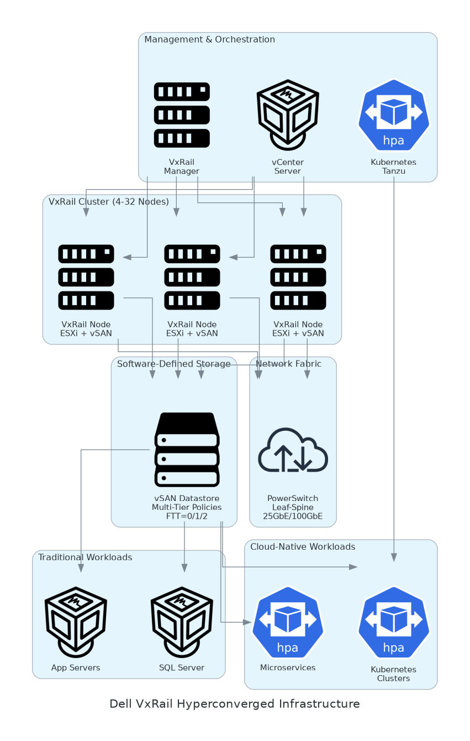
Solution Overview
VxRail Enterprise Platform & VMware Stack
  8-node VxRail P570 cluster with dual Xeon Platinum (512 vCPUs)
  VMware vSphere 8 with vSAN 8 all-NVMe and FTT=2 RAID-6
  VMware NSX for micro-segmentation and vRealize Suite for predictive analytics
Disaster Recovery Architecture
  Dell RecoverPoint for VMs with multi-site replication (RPO <5 minutes)
  VMware Site Recovery Manager for automated failover orchestration (RTO <15 minutes)
  Veeam Enterprise Plus for application-aware backup and instant recovery
Dell VxRail Enterprise Hyperconverged Infrastructure

Slide 5
Implementation Approach
Phase 1: Architecture & Planning (Weeks 1-2)
  Conduct infrastructure assessment database workload profiling and VxRail enterprise cluster design
  Design NSX micro-segmentation architecture and validate 100GbE spine-leaf network requirements
  Order hardware and coordinate data center rack space power and cooling
Phase 2: Infrastructure Deployment (Weeks 3-5)
  Dell ProDeploy Enterprise installation of VxRail nodes and configure vSphere with FTT=2 NSX and RecoverPoint
  Deploy vCenter vRealize Operations and integrate with Veeam backup infrastructure
  Validate backup/restore procedures and DR site connectivity
Phase 3: Workload Migration & Validation (Weeks 6-8)
  Migrate pilot databases and execute phased migration of Tier 1 applications (Oracle RAC SQL SAP HANA)
  Conduct performance benchmark testing and disaster recovery failover testing with SRM
  Complete IT team training on enterprise operations and production go-live with legacy SAN decommissioned
Dell VxRail Enterprise Hyperconverged Infrastructure

Slide 6
Timeline & Milestones
Phase No | Phase Description | Timeline | Key Deliverables
Phase 1 | Architecture & Planning | Weeks 1-2 | Database workload assessment, VxRail enterprise design, NSX architecture, Hardware ordered
Phase 2 | Infrastructure Deployment | Weeks 3-5 | VxRail cluster installed, vSphere/vSAN/NSX configured, Backup and DR operational
Phase 3 | Workload Migration & Validation | Weeks 6-8 | Databases migrated, Performance validated, DR tested, Legacy SAN decommissioned
Dell VxRail Enterprise Hyperconverged Infrastructure

Slide 7
Success Stories
Client Success: Global Financial Services Firm
  Client: Investment bank running mission-critical trading platforms on 800 VMs
  Challenge: Aging VMAX SAN with $380K annual support costs and 99.5% uptime SLA failures. DR RTO of 4 hours failing continuity requirements. Multi-vendor finger-pointing.
  Solution: Deployed 2 VxRail clusters with all-NVMe for primary and DR sites. NSX micro-segmentation. RecoverPoint and SRM for automated failover.
  Results: 99.995% uptime eliminating SLA penalties. DR RTO reduced from 4 hours to 12 minutes. $1.8M TCO savings. Latency improved from 5ms to <1ms.
  Testimonial: "VxRail transformed our infrastructure from liability to competitive advantage. Our trading latency dropped to sub-millisecond and we achieved six-nines uptime. Automated DR gives us confidence." — James Patterson, CTO Infrastructure
Dell VxRail Enterprise Hyperconverged Infrastructure

Slide 8
Our Partnership Advantage
What We Bring
  15+ years deploying VMware enterprise infrastructure with 75+ VxRail enterprise implementations
  Deep expertise in Oracle RAC, SQL Always-On, SAP HANA on vSAN with database-specific tuning
  Dell Titanium Partner with VMware Principal Partner and NSX Advanced certification
  Certified VCDX architects and VxRail Deploy specialists with mission-critical experience
Value to You
  Pre-validated VxRail reference architectures for Oracle RAC and SQL Always-On workloads
  Database migration runbooks with proven zero-downtime cutover procedures
  Direct Dell and VMware escalation channels through enterprise partnership
  Best practices from 75+ enterprise deployments avoid common pitfalls (vSAN tuning, NSX performance, DR orchestration)
Dell VxRail Enterprise Hyperconverged Infrastructure

Slide 9
Investment Summary
Cost Category | Year 1 List | Year 1 Credits | Year 1 Net | Year 2 | Year 3 | 3-Year Total
Professional Services | $159,000 | $0 | $159,000 | $0 | $0 | $159,000
Hardware | $996,560 | $0 | $996,560 | $0 | $0 | $996,560
Net Investment After Savings | $2,081,540 | ($471,000) | $1,610,540 | ($176,700) | ($176,700) | $1,257,140
Networking | $393,760 | $0 | $393,760 | $0 | $0 | $393,760
Software | $421,820 | $0 | $421,820 | $183,900 | $183,900 | $789,620
Support & Maintenance | $110,400 | $0 | $110,400 | $110,400 | $110,400 | $331,200
TOTAL | $4,163,080 | ($942,000) | $3,221,080 | ($353,400) | ($353,400) | $2,514,280
Dell VxRail Enterprise Hyperconverged Infrastructure

Slide 10
Next Steps
Decision: Executive approval for VxRail enterprise HCI deployment by [specific date]
Kickoff: Submit Dell hardware purchase order and engage Dell ProDeploy Enterprise (Week 1)
Infrastructure Preparation: Validate rack space, power (6.4kW for 8 nodes), network fabric readiness, DR site connectivity (Weeks 1-2)
Hardware Delivery: Dell ships VxRail P570 nodes and PowerSwitch spine-leaf fabric (3-4 week lead time)
Deployment & Migration: ProDeploy installation and configuration (Weeks 3-5), pilot databases (Weeks 5-6), Tier 1 migration (Weeks 6-8)
Dell VxRail Enterprise Hyperconverged Infrastructure

Slide 11
Thank You

