Slide 1



Solution Briefing
Dell PowerEdge CI/CD Infrastructure
['Presenter Name'] | November 22, 2025

Slide 2
Business Opportunity
Opportunity
  Eliminate cloud CI/CD costs averaging $21/user/month (GitHub Actions) plus compute and egress fees
  Own build farm infrastructure providing consistent performance and <5 minute queue times
  Enable data sovereignty and air-gapped builds for regulated industries and classified workloads
Success Criteria
  Reduce 3-year TCO by 75% vs cloud baseline ($460K on-prem vs $448K cloud cost avoidance)
  Process 5,000 builds/day with <5 minute average queue time and 95%+ build success rate
  Achieve ROI payback within 18 months through cloud cost elimination and productivity gains
Dell PowerEdge CI/CD Infrastructure

Slide 3
Engagement Scope
Parameter | Scope |  | Parameter | Scope
Number of Developers | 50 developers with CI/CD access |  | Current CI/CD | GitHub Actions cloud runners
Build Agents | 8 Dell PowerEdge R650 build servers |  | Container Platform | Docker Enterprise with registry
CI/CD Platform | GitLab Premium self-hosted |  | Code Sensitivity | Proprietary source code
Artifact Repository | JFrog Artifactory Pro |  | Authentication | SSO with SAML integration
Build Volume | 5000 builds per day |  | Build Queue Time | <5 minute average queue time
Pipeline Complexity | Multi-stage pipelines with tests |  | Build Duration | 15 minute average build time
Artifact Storage | 20TB artifact capacity |  | Deployment Strategy | Phased migration by team
Build Artifacts | Maven npm Docker images |  | Build Agent OS | Ubuntu 22.04 LTS with Docker
Dell PowerEdge CI/CD Infrastructure

Slide 4
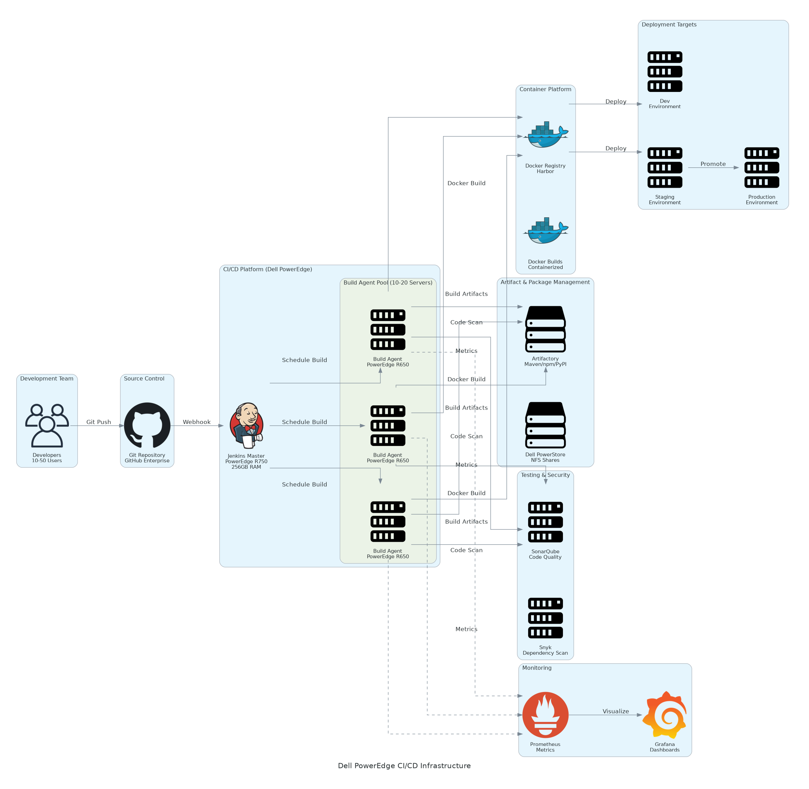
Solution Overview
Build Infrastructure & CI/CD Platform
  8 Dell PowerEdge R650 servers with 512GB RAM for parallel builds
  GitLab Premium and JFrog Artifactory for source control and artifacts
  SonarQube and HashiCorp Vault for quality scanning and secrets
Storage and Network
  Dell Unity XT 380 with 50TB all-flash SSD storage
  10GbE network fabric with redundant PowerSwitch for fast downloads
  Centralized monitoring and alerting for build queue health
Dell PowerEdge CI/CD Infrastructure

Slide 5
Implementation Approach
Phase 1: Infrastructure Deployment (Weeks 1-4)
  Order and install Dell PowerEdge build agents with Unity storage and networking
  Deploy GitLab Premium Artifactory Pro and SonarQube platforms on RHEL
  Configure Docker Enterprise and HashiCorp Vault for pipeline security
Phase 2: Pilot Migration (Weeks 5-7)
  Migrate 5-10 pilot projects from cloud CI/CD to on-premises GitLab
  Configure build pipelines with Artifactory integration and SonarQube scanning
  Validate build performance queue times and collect developer feedback
Phase 3: Production Rollout (Weeks 8-10)
  Phased migration of all 50 developers by team (10 developers every week)
  Decommission cloud CI/CD runners and redirect all builds to on-prem
  Train DevOps team on GitLab administration and establish monitoring dashboards
Dell PowerEdge CI/CD Infrastructure

Slide 6
Timeline & Milestones
Phase No | Phase Description | Timeline | Key Deliverables
Phase 1 | Infrastructure Deployment | Weeks 1-4 | PowerEdge build farm installed, GitLab and Artifactory deployed, Vault configured
Phase 2 | Pilot Migration | Weeks 5-7 | 5-10 pilot projects migrated, Build performance validated, Developer feedback collected
Phase 3 | Production Rollout | Weeks 8-10 | All 50 developers migrated, Cloud CI/CD decommissioned, DevOps team trained
Dell PowerEdge CI/CD Infrastructure

Slide 7
Success Stories
Client Success: Financial Services Fintech Startup (60 Developers)
  Client: Payment processing fintech with 60 developers running 8,000 builds/day
  Challenge: GitHub Actions costs $22K/month ($264K annually). Build queues 15-20 minutes blocking productivity. PCI DSS concerns with cloud-hosted code.
  Solution: Deployed PowerEdge build farm with GitLab and Artifactory. Migrated all pipelines from cloud to on-prem.
  Results: $264K annual cost elimination. Build queues reduced to <3 minutes improving velocity 30%. PCI compliance achieved. 18-month ROI payback.
  Testimonial: "Migrating to on-prem CI/CD with Dell PowerEdge was the best infrastructure decision we made. We cut our GitHub Actions bill from $18K/month to zero, builds are faster, and we achieved PCI compliance for our payment code. The investment paid for itself in 18 months." — David Kim, VP of Engineering
Dell PowerEdge CI/CD Infrastructure

Slide 8
Our Partnership Advantage
What We Bring
  10+ years deploying CI/CD infrastructure with 100+ GitLab and Jenkins implementations
  Deep expertise in build optimization artifact management and pipeline migration
  Dell Authorized Partner with DevOps and cloud-native specialization
  Certified GitLab and JFrog experts with CI/CD architecture credentials
Value to You
  Pre-built CI/CD migration playbooks for cloud-to-on-prem pipeline conversion
  Build agent sizing calculators and capacity planning tools
  Direct GitLab and JFrog engineering escalation through partner support
  Best practices from 100+ deployments avoid common pitfalls (build caching, artifact proxying, Docker layer optimization)
Dell PowerEdge CI/CD Infrastructure

Slide 9
Investment Summary
Cost Category | Year 1 List | Year 1 Credits | Year 1 Net | Year 2 | Year 3 | 3-Year Total
Professional Services | $61,500 | $0 | $61,500 | $0 | $0 | $61,500
Hardware | $190,320 | $0 | $190,320 | $0 | $0 | $190,320
Net Investment After Savings | $338,140 | ($149,400) | $188,740 | ($88,400) | ($88,400) | $11,940
Networking | $25,320 | $0 | $25,320 | $0 | $0 | $25,320
Software | $48,500 | $0 | $48,500 | $48,500 | $48,500 | $145,500
Support & Maintenance | $12,500 | $0 | $12,500 | $12,500 | $12,500 | $37,500
TOTAL | $676,280 | ($298,800) | $377,480 | ($176,800) | ($176,800) | $23,880
Dell PowerEdge CI/CD Infrastructure

Slide 10
Next Steps
Decision: Executive approval for on-prem CI/CD infrastructure by [specific date]
Kickoff: Submit Dell hardware purchase order for PowerEdge Unity and PowerSwitch (Week 1)
Infrastructure Deployment: Dell ProDeploy installation GitLab and Artifactory setup (Weeks 1-4)
Pilot Migration: Migrate 5-10 pilot projects validate build performance (Weeks 5-7)
Production Rollout: Phased migration by team decommission cloud CI/CD (Weeks 8-10) with immediate $12K+/month savings
Dell PowerEdge CI/CD Infrastructure

Slide 11
Thank You

