Slide 1



Solution Briefing
Dell PowerSwitch Data Center Network
['Presenter Name'] | November 22, 2025

Slide 2
Business Opportunity
Opportunity
  Replace aging Cisco infrastructure with modern spine-leaf architecture at 40% lower cost
  Support cloud-native workloads with 100GbE spine and 25GbE leaf fabric delivering 1.6Tbps bandwidth
  Enable network automation with OS10 Linux-based platform and SmartFabric zero-touch provisioning
Success Criteria
  Reduce 3-year TCO by $1M+ vs Cisco Nexus equivalent (Dell $2.3M vs Cisco $3.4M)
  Achieve <2 microsecond latency for east-west traffic supporting microservices and container platforms
  Deploy 40-rack data center network in 8-10 weeks with zero-touch provisioning and automated configuration
Dell PowerSwitch Data Center Network

Slide 3
Engagement Scope
Parameter | Scope |  | Parameter | Scope
Number of Racks | 40 racks with ToR switches |  | Legacy Infrastructure | Cisco Nexus 9K and Catalyst switches
Spine Switches | 4 Dell Z9432F-ON 100GbE |  | Operating System | Dell OS10 Enterprise with automation
Leaf Switches | 40 Dell S5248F-ON 25GbE ToR |  | Network Segmentation | VXLAN multi-tenancy
Network Fabric | BGP underlay with EVPN-VXLAN overlay |  | Access Control | TACACS+ centralized authentication
Network Engineers | 3-5 network administrators |  | Latency SLA | <2 microsecond east-west latency
Automation Maturity | Ansible playbooks and ZTP |  | Throughput | 7000 Mbps per server (25GbE NIC)
Server Ports | 1920 ports (40 racks × 48 ports) |  | Deployment Approach | Phased rack-by-rack migration
Fabric Bandwidth | 1.6Tbps aggregate throughput |  | Network Connectivity | 100GbE spine 25GbE leaf
Dell PowerSwitch Data Center Network

Slide 4
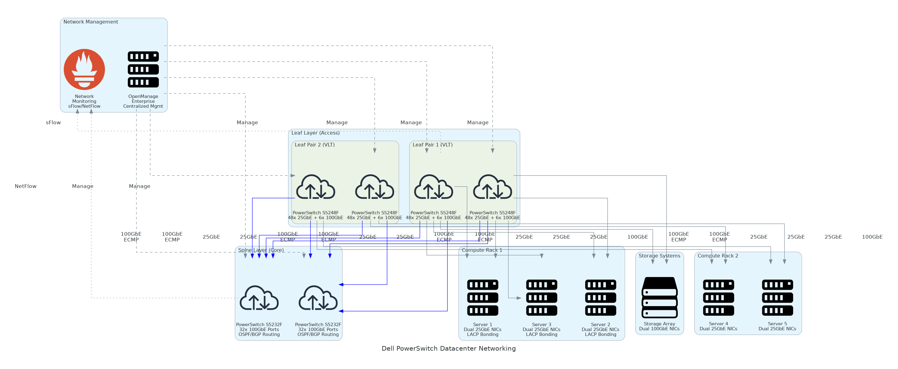
Solution Overview
Spine-Leaf Network Fabric
  4 Dell Z9432F-ON 100GbE spine switches with 1.6Tbps total bandwidth
  40 Dell S5248F-ON 25GbE leaf switches providing 1920 server ports
  Redundant dual-plane architecture with 3:1 oversubscription for resilience
Automation and Orchestration
  Dell OS10 Enterprise with Ansible and Python automation capabilities
  SmartFabric Services for zero-touch provisioning and lifecycle management
  BGP routing with EVPN-VXLAN for network virtualization
Dell PowerSwitch Data Center Network

Slide 5
Implementation Approach
Phase 1: Design & Procurement (Weeks 1-3)
  Complete network architecture design with IP addressing and BGP AS numbering
  Order Dell PowerSwitch spine leaf and aggregation switches with optics
  Prepare data center rack space and power infrastructure for switch installation
Phase 2: Infrastructure Deployment (Weeks 4-7)
  Install spine and leaf switches with 100GbE interconnects and cabling
  Deploy SmartFabric Services for zero-touch provisioning and automated configuration
  Configure BGP underlay and EVPN-VXLAN overlay for network virtualization
Phase 3: Migration & Validation (Weeks 8-10)
  Pilot rack migration validates fabric performance before full deployment
  Phased rack-by-rack migration from legacy Cisco to Dell PowerSwitch
  Network team training on OS10 administration BGP and production go-live
Dell PowerSwitch Data Center Network

Slide 6
Timeline & Milestones
Phase No | Phase Description | Timeline | Key Deliverables
Phase 1 | Design & Procurement | Weeks 1-3 | Network architecture designed, PowerSwitch ordered, Data center prepared
Phase 2 | Infrastructure Deployment | Weeks 4-7 | Spine-leaf installed, BGP and VXLAN configured, SmartFabric deployed
Phase 3 | Migration & Validation | Weeks 8-10 | Pilot rack validated, Phased migration completed, Legacy network decommissioned
Dell PowerSwitch Data Center Network

Slide 7
Success Stories
Client Success: E-Commerce Platform Provider (60 Racks)
  Client: SaaS e-commerce platform with 60-rack Kubernetes data center
  Challenge: Aging Cisco switches at end-of-life with $420K SmartNet renewal. Network bottlenecks causing latency and unable to support 25GbE upgrades or multi-tenancy.
  Solution: Deployed Dell PowerSwitch spine-leaf with BGP and EVPN-VXLAN. Migrated all workloads over 4-weekend phased cutover.
  Results: $1.2M savings vs Cisco Nexus refresh. Latency reduced from 15ms to <2ms improving performance 40%. Zero outages during migration or 12-month operation.
  Testimonial: "Migrating to Dell PowerSwitch was our best infrastructure decision. We saved $1.2M, achieved sub-2ms latency, and OS10 automation reduced provisioning from hours to minutes." — Rachel Thompson, VP of Infrastructure
Dell PowerSwitch Data Center Network

Slide 8
Our Partnership Advantage
What We Bring
  15+ years deploying data center networks with 100+ spine-leaf implementations
  Deep expertise in BGP VXLAN and network automation (Ansible, Python)
  Dell Titanium Partner with data center networking specialization
  Certified DECA (Dell EMC Certified Associate) architects and OS10 experts
Value to You
  Pre-validated spine-leaf reference architectures for various data center sizes
  BGP and VXLAN design templates and IP addressing calculators
  Direct Dell OS10 engineering escalation through partner support channels
  Best practices from 100+ deployments avoid common pitfalls (MTU, BGP timers, VXLAN multicast)
Dell PowerSwitch Data Center Network

Slide 9
Investment Summary
Cost Category | Year 1 List | Year 1 Credits | Year 1 Net | Year 2 | Year 3 | 3-Year Total
Professional Services | $87,000 | $0 | $87,000 | $0 | $0 | $87,000
Cisco Nexus Alternative | $3,383,600 | $0 | $3,383,600 | $0 | $0 | $3,383,600
Leaf Switches | $816,000 | $0 | $816,000 | $0 | $0 | $816,000
Optics & Cabling | $719,000 | $0 | $719,000 | $0 | $0 | $719,000
Software | $160,000 | $0 | $160,000 | $0 | $0 | $160,000
Spine Switches | $380,000 | $0 | $380,000 | $0 | $0 | $380,000
Support & Maintenance (3-Year) | $165,600 | $0 | $165,600 | $0 | $0 | $165,600
TOTAL | $4,655,200 | ($1,056,000) | $4,655,200 | ($1,056,000) | ($1,056,000) | $4,655,200
Dell PowerSwitch Data Center Network

Slide 10
Next Steps
Decision: Executive approval for PowerSwitch data center network by [specific date]
Kickoff: Submit Dell hardware purchase order for spine leaf and optics (Week 1)
Design: Complete architecture design with BGP AS numbering and VXLAN overlay (Weeks 1-3)
Deployment: Install spine-leaf fabric and configure BGP and VXLAN (Weeks 4-7)
Migration: Pilot rack Week 8, phased migration Weeks 8-10, Cisco decommission Week 10 with immediate $84K annual savings
Dell PowerSwitch Data Center Network

Slide 11
Thank You

